Slide 1
MTN-037 Screening and Enrollment

Slide 2
SSP Manual References
Protocol Sections 7.2 (Screening) and 7.3 (Enrollment) and Tables 11 (Screening Visit) and 12 (Enrollment Visit)
Section 4: Informed Consent
Section 5: Study Procedures
Section 7: Behavioral Measures
Section 11: Counseling Considerations

Slide 3
Screening Considerations
Conducted to determine participant eligibility
Administration of Informed Consent must be done before any other procedure
Screening process will be discontinued when ineligibility is determined
Participants may re-screen one time

Slide 4
Screening Procedures: Administrative
Collect Locator Information
Obtain Written Informed Consent
Assess Consent Form Comprehension
Assign PTID
Schedule Next Visit
Assess Eligibility
Provide Reimbursement
Collect Demographic Information
* If indicated

Slide 5
Screening: Behavioral/Counseling Procedures
HIV Pre-and Post Test
HIV/STI Risk Reduction (Including offering condoms)
Protocol Counseling

Slide 6
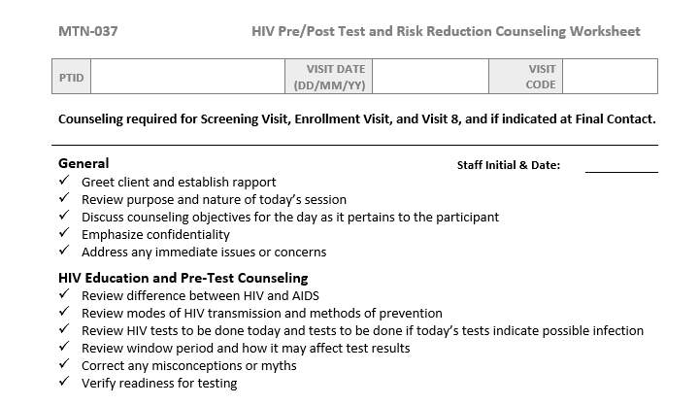
Pre/Post and Risk Reduction Counseling
Must occur any time HIV testing is being done (Screening, Enrollment, Visit 8, and if indicated)
Documented on HIV Pre/Post Test and Risk Reduction Counseling Worksheet or site-specific form

Slide 7
Protocol Counseling
Starts at screening
Three components:
Contraceptive counseling begins at screening (cis-females only)
Protocol Adherence counseling begins at enrollment (use Study Adherence Guidelines to guide conversation)
Product Use counseling provided at each Dosing Visit
Document on Protocol Counseling Worksheet

Slide 8
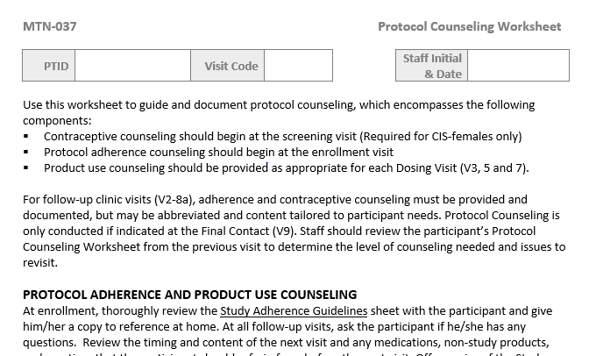
Protocol Counseling Worksheet

Slide 9
Screening Procedures: Clinical
Collect Medical History
Perform Physical Exam and Rectal Exam
Perform Male Genital Exam*
Perform Pelvic Exam*♀
Collect Concomitant Medications
Treat/Prescribe Treatment for RTI/UTI/STI*
Disclose Available Test Results

Slide 10
Screening Procedures: Lab
Pharyngeal
NAAT for GC/CT
Urine
NAAT for GC/CT
Blood
CBC with differential and platelets
Syphilis serology
Pelvic
Anorectal
Urine dipstick for culture*
Qualitative hCG ♀
Chemistries (AST/ALT/Creatinine)
HIV-1/2 test
Coagulation (PT/INR)
NAAT for GC/CT/TV ♀
NAAT for GC/CT
HSV ½ detection*

Slide 11
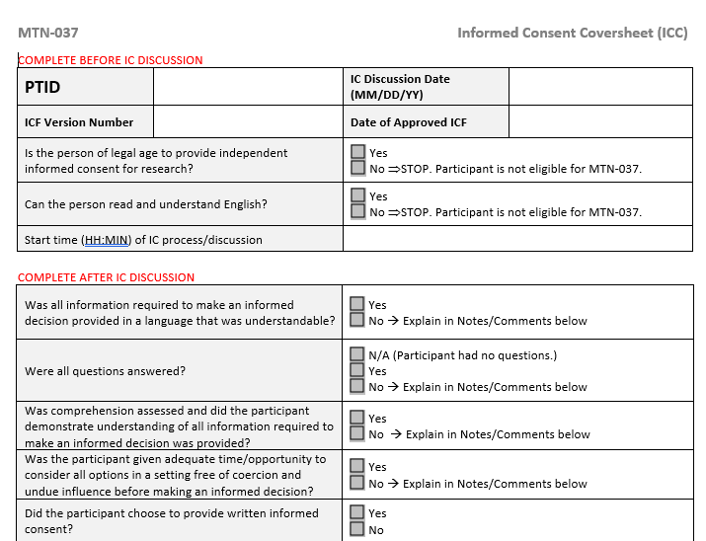
Screening Visit Tools: Informed Consent Coversheet
Notes:
The DAIDS policy on Requirements for Source Documentation in DAIDS Funded and/or Sponsored Clinical Trials lists detailed requirements and suggestions for documenting the informed consent process. All requirements listed in the DAIDS policy must be met. In order to also meet some of the suggestions listed in the DAIDS policy, site staff are strongly encouraged to use an Informed Consent Coversheet similar to the sample included on the study webpage under Study Implementation Materials.
Captures all required elements of IC documentation
Use of a coversheet strongly recommended to facilitate documentation of the informed consent process, in addition to the signed/dated informed consent form.
If coversheet is not used, IC review must be documented in a comprehensive progress note or the IC process must be described, in detail, in site SOP, with a chart note stating that the informed consent was obtained per SOP
The first half of the coversheet (items up to and including “Version number/date of informed consent form used during informed consent process/discussion”) should be completed at the start of the IC session.
The remainder should be completed at the end of the informed consent session.
If a site chooses not to utilize the Informed Consent Coversheet, all elements of each informed consent process must be documented in detail in a signed and dated chart note or process must be outlined in site SOP.

Slide 12
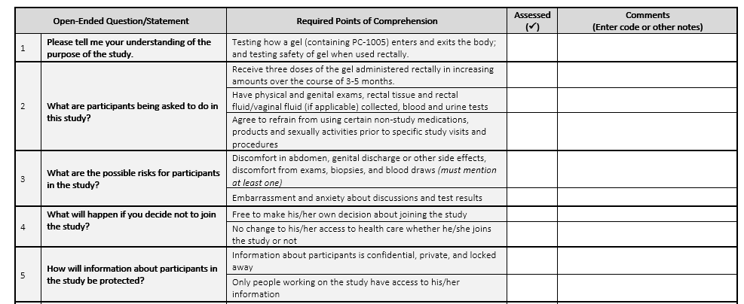
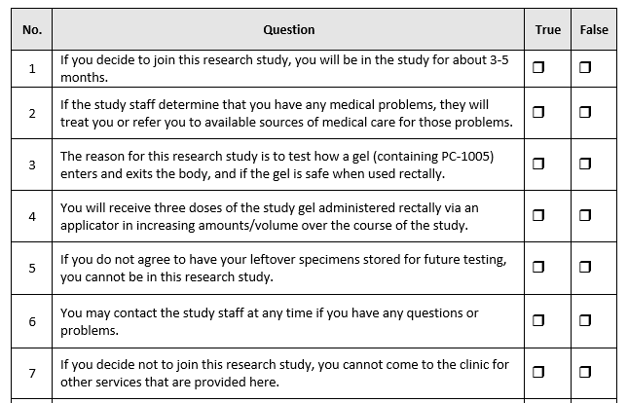
IC Comprehension Assessment
Notes:
Administered after IC discussion but before PPT signs the ICF
Assists staff in assessing PPT comprehension and ensures PPT understanding prior to providing consent for study participation
The participant must not be asked to agree to take part in the study, or to sign the informed consent form, until s/he fully understands the information contained in the informed consent, including visit procedures. Assists staff in assessing participant comprehension and ensures participant understanding prior to providing consent for study participation
Various methods (either oral or written) to assess comprehension may be utilized. One method is to use a written assessment tool that participants must complete prior to signing the informed consent form. Administered after the informed consent form (ICF) is reviewed with the participant but before the participant signs the ICF
Two templates were developed and are available on the study MTN webpage. Types: an open ended and a true/false. Sites can chose whichever version best fits the needs. Specifications on how each assessment is to be administered are included in the SSP section 4 (informed consent)

Slide 13
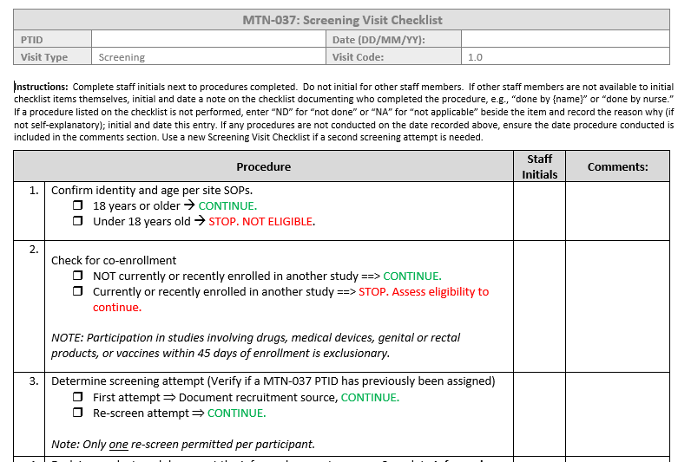
Screening Visit Checklist
Notes:
Sample visit checklists were created that detail all protocol-specified procedures that must be completed during a given visit. The checklists also specify the data collection forms that must be completed at each visit. Serves to guide study procedures as well as to serve as source documentation of procedures performed or omitted during a study visit; may be supplemented by chart notes. Site-specific templates should be modified to maximize the efficiency of site-specific study operations
The sequence of procedures presented on the visit checklists is a suggested ordering. In consultation with the MTN LOC (FHI 360), it is encouraged that site staff modify the checklists included in this section to maximize the efficiency of site-specific study operations. For screening, the only requirement is that IC be conducted before any per protocol procedures—other ordering is flexible.
This can be source for some procedures, but most procedures require additional documentation elsewhere. Refer to your source doc SOP document; this checklist is a tool for ensuring all the processes documented elsewhere are completed appropriately so staff has a snapshot of what needs to be done/resolved to complete eligibility assessments.

Slide 14
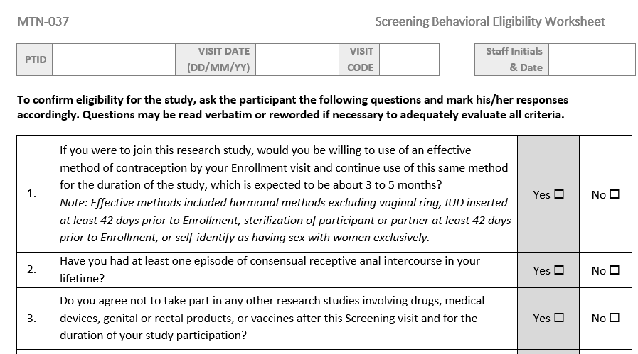
Screening Behavioral Eligibility Worksheet
Recommended source document for assessing eligibility criteria which are based on self-report
Notes:
Tip: Administer early in the visit, so that more time-consuming clinical and laboratory evaluations can be avoided if the participant is determined ineligible due to behavioral criteria.

Slide 15
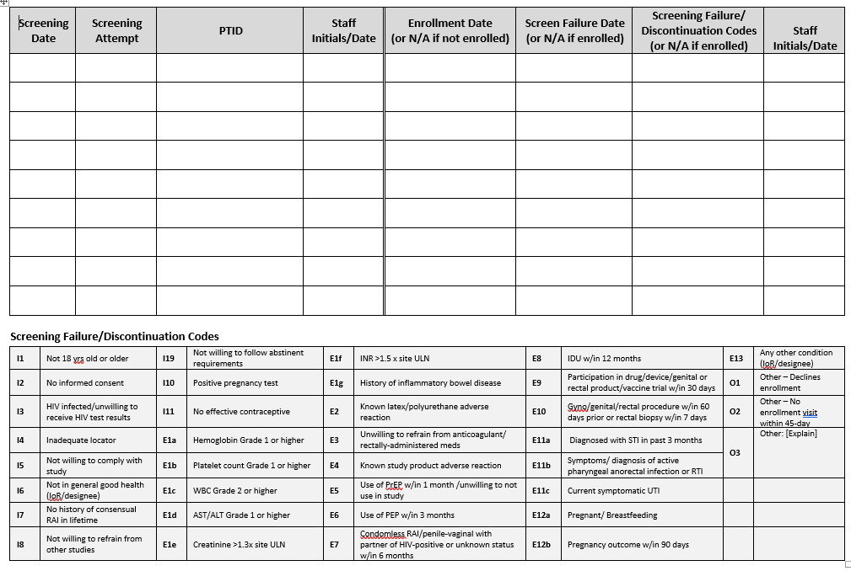
Screening and Enrollment Log
List ALL reasons the participant fails screening, especially if there is more than one reason. Codes on the lower part of the log will help abbreviate documentation.
Notes:
A sample screening and enrollment log suitable for use is available on the MTN website.
DAIDS policy requires logs be maintained for every prospective ppt screened. These need to be used in real time and completed as soon as a potential participant completes screening and signs the IC form. If the participant does not provide written IC, s/he should NOT be listed on this log.
Note on the log the column asking for Reason for screening failure/discontinuation- you’ll want to list ALL reasons s/he fails screening, if there is more than one reason. Codes on the lower part of the Log will help for ease of documentation.
If a participant rescreens, a new row on the log must be completed, using the SAME PTID number previously assigned.

Slide 16
Required Documentation for Screen Failures
Completed ICF
Chart notes (if screening visit) or eligibility checklist (if enrollment visit) indicating date of ineligibility determination and reason
Documentation that any clinically significant abnormalities were provided to the participant, as well as any appropriate referrals
All source documentation completed up until ineligibility determination
Chart notes
Visit checklist
Eligibility criteria CRF
Screening and Enrollment Log, updated with date and reason for screen failure

Slide 17
Enrollment Considerations
All procedures for this visit must be conducted on the same day and within 45 days of the screening visit.
The enrollment visit serves as the baseline visit for the study.
Final eligibility should be verified (by signing off on the Eligibility Checklist) prior to participant randomization.
Randomization to a post-dose sampling time and 48-hr sampling day is the act of enrollment into the study

Slide 18
Enrollment Procedures: Administrative
Review/Update Locator
Assess and Confirm Eligibility
Review IC/Confirm Willingness to Participate
Provide Reimbursement
Randomize to Rectal Tissue Sampling Schedule
Schedule Next Visit
Notes:
Note: Assess and confirm eligibility and randomization will happen at the end of the visit

Slide 19
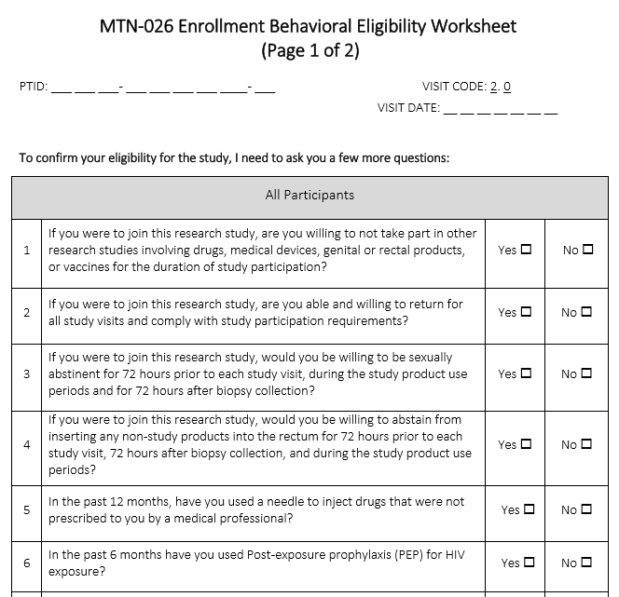
Enrollment Behavioral Eligibility Worksheet
Recommended source document for assessing eligibility criteria which are based on self-report
Notes:
Tip: Final assessment of eligibility done toward end of visit, but recommend administering this form early in the visit, so that more time-consuming clinical and laboratory evaluations can be avoided if the participant is determined ineligible due to behavioral criteria.

Slide 20
Enrollment: Behavioral/Counseling Procedures
HIV Pre-and Post Test
HIV/STI Risk Reduction (Including offering condoms)
Protocol Counseling (Protocol Adherence and Contraceptive Counseling components)
Behavioral Assessment (WSI/CASI)

Slide 21
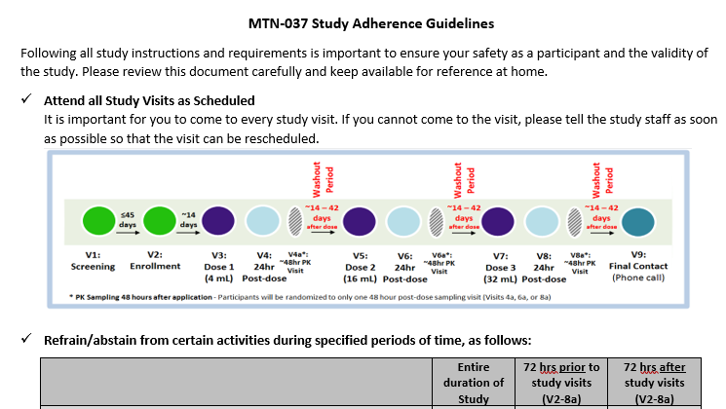
Study Adherence Guideline
Reviewed as part of protocol adherence counseling
Contains information on study visit scheduling, prohibited medications and practices, contraceptive requirements, and site contact information

Slide 22
WSI/CASI
Administered any time before randomization
Collects information on motivations for joining the study, rectal and menstrual practices, pregnancy history, contraception use, sexual behavior, substance use, product acceptability, concerns about the gel applicator
Detailed instructions available in SSP Section 7

Slide 23
Enrollment Procedures: Clinical
Review/update Medical History
Perform Physical Exam and Rectal Exam
Perform Male Genital Exam*
Perform Pelvic Exam*♀
Review/update Concomitant Medications
Treat/Prescribe Treatment for RTI/UTI/STI*
Disclose Available Test Results
Notes:
These are all the same as at screening (med hx, con meds only updated with new information since time of initial assessments at screening)

Slide 24
Enrollment Procedures: Lab
Pharyngeal
NAAT for GC/CT*
Urine
NAAT for GC/CT*
Blood
CBC with differential and platelets*
Syphilis serology*
Pelvic
Anorectal
Urine dipstick for culture*
Qualitative hCG ♀
Chemistries (AST/ALT/Creatinine)*
HIV-1/2 test
Plasma for archive
NAAT for GC/CT/TV *♀
NAAT for GC/CT*
HSV ½ detection*
Anal swab for HPV
Rectal fluid for PD/biomarker
Rectal enema effluent for PD
Rectal tissue for PD, histology, archive
Notes:
Same as at screening except
-all GC/CT testing is only if indicated
-CBC, chemistries, syphilis only if indicated
-No test for coagulation
-Collect plasma for archive
-Additional rectal samples

Slide 25
Eligibility Determination
Completed at the Enrollment Visit and documented on the Eligibility Checklist.
All inclusion criteria must be marked “yes” and all exclusion criteria must be marked “no.”
May require referencing information collected at both the enrollment and the screening visits. Note: The Eligibility Checklist is only completed at the Enrollment Visit
After evaluating eligibility, the IoR (or designee) and a second staff member must sign and date the Eligibility Checklist.

Slide 26
Randomization
Post-dose sampling time assignment (1:1:1:1)
Time-point assignment is maintained throughout study follow-up
.5-1 hour
1.5-3 hours
3.5-5 hours
24 hours
Notes:
Participants assigned to provide samples at the 24-hour time point will do so at the 24-hr Post-Dose visit instead of the Dosing visit

Slide 27
Randomization
48-hr sampling day assignment (1:1:1)
4a
6a
8a
1 48-hr visit per participant

Slide 28
Post-Randomization Procedures
Disclose/explain participant’s sample collection assignments
Provide any materials not already given to the participant (e.g. contact information, condoms, other study instructions)
Provide reimbursement
Update study visit calendar with 48-hr post-dose assignment and schedule next visit
Note: First study product administration happens at V3

Slide 29
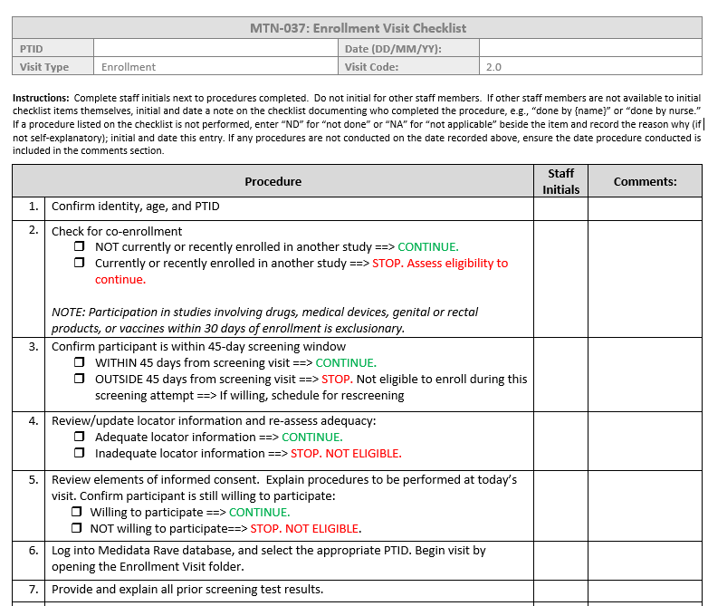
Enrollment Visit Checklist
Notes:
Sample visit checklists were created that detail all protocol-specified procedures that must be completed during a given visit. The checklists also specify the data collection forms that must be completed at each visit. Serves to guide study procedures as well as to serve as source documentation of procedures performed or omitted during a study visit; may be supplemented by chart notes. Site-specific templates should be modified to maximize the efficiency of site-specific study operations
The sequence of procedures presented on the visit checklists is a suggested ordering. In consultation with the MTN LOC (FHI 360), it is encouraged that site staff modify the checklists included in this section to maximize the efficiency of site-specific study operations. For screening, the only requirement is that IC be conducted before any per protocol procedures—other ordering is flexible.
This can be source for some procedures, but most procedures require additional documentation elsewhere. Refer to your source doc SOP document; this checklist is a tool for ensuring all the processes documented elsewhere are completed appropriately so staff has a snapshot of what needs to be done/resolved to complete eligibility assessments.

Slide 30
Screening and Enrollment Log
Notes:
A sample screening and enrollment log suitable for use is available on the MTN website.
DAIDS policy requires logs be maintained for every prospective ppt screened. These need to be used in real time and completed as soon as a potential participant completes screening and signs the IC form. If the participant does not provide written IC, s/he should NOT be listed on this log.
Note on the log the column asking for Reason for screening failure/discontinuation- you’ll want to list ALL reasons s/he fails screening, if there is more than one reason. Codes on the lower part of the Log will help for ease of documentation.
If a participant rescreens, a new row on the log must be completed, using the SAME PTID number previously assigned.

Slide 31
Questions? Comments?

