Slide 1
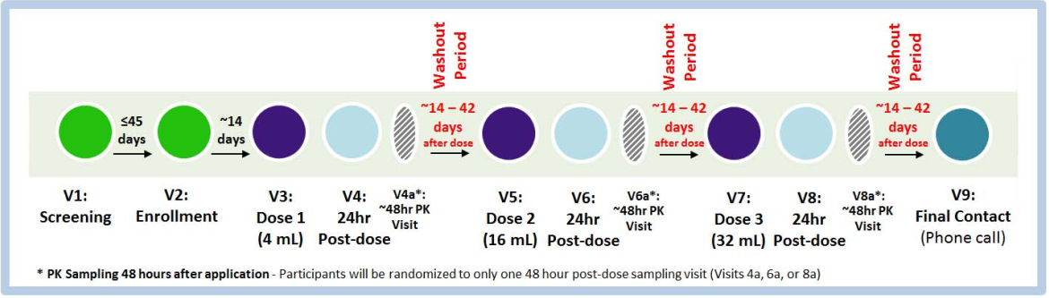
Follow-up Visit Considerations
MTN-037 Study-Specific Training
Notes:
Four types of follow-up visits
Dosing visits (V 3, 5, 7)
24 hr post-doing visit (V4, 6, 8)
48 hr Post-Dosing Visit (V4a, 6a or 8a) – ppt completed only one as per randomized assignment at Enrollment
Final Contact – phone call after washout period (> 2 weeks after final dose)
Washout period b/w each dose of 2-6 weeks after the date of each dose administration.

Slide 2

Protocal & SSP Manual References
Protocol Sections 7.4 (Follow-up) and 9.2-9.4 (Clinical Mangement)
SSP Section 5: Study Procedures
SSP Section 8: Clinical Considerations
SSP Section 9: AE and Safety Reporting
SSP Section 10: Laboratory Considerations
SSP Section 11: Counseling Considerations
SSP Section 12 Data Management

Slide 3
Scheduled and interim visits
Scheduled Visits:
Dosing Visits: V3, 5, AND 7
24 hr Post-Dosing Visits: V4, 6, AND 8
48 hr Post-Dosing Visits: V4a, 6a, OR 8a
Final Contact: V9
Split visits permitted but not encouraged due to the tight timing requirements of the dosing and post-dosing procedures requirements.
Interim visits: phone or clinic visits between scheduled visits
Procedures required will depend on the reason for the visit
Make-up missed visit
For administrative reasons
For product-related reasons
In response to AEs and/or SAEs.
For additional STI counseling and testing in response to STI symptoms.
For any needed HIV counseling and testing in response to participant report of symptoms consistent with acute infection or presumed exposure to HIV.
For other reasons at participant request
Early Termination:
Complete procedures per the 24 hr Post-Dosing/Early Termination Visit Checklist
Collecting the PK/PD blood, pelvic, and rectal specimens will be at management team discretion.
Notes:
These are the types of follow-up visits:
Scheduled visits, which can be split if necessary, but this is not encouraged due to the tight timing of requirement of the dose and post-dose procedures
Split visits: If study visits must be split, please ensure that:
HIV pre- and post-test counseling and HIV testing should occur on the same day (assuming use of rapid tests)
PK/PD specimens (blood, pelvic and rectal, as applicable) are collected per the time-point requirements to avoid complicating interpretability of the data.
Interim visits: can be phone or clinic visits and should be documented in study files and on applicable CRFs.
Early Termination: should a ppt terminate early from the study, have them complete an early termination visit per the procedures required of a 24 hr post-dose visit

Slide 4
Scheduling Considerations:
Schedule participant early in washout period (2-6 weeks) for each dose visit to minimize risk of a missed visit.
Schedule 24-hr and 48-hr Post-Dose Visits at a similar time of day to the Dosing Visit to ensure the PK/PD collections occur as close as possible to the target time (within +/- 4 hrs).
Time washout periods to coincide with female participant’s menses to avoid bleeding during Dosing and Post-Dosing Visits.
Washout period counts from the day of dose administration
Notes:
Schedule participant early in washout period (2-6 weeks) for each dose visit to minimize risk of a missed visit.
This will allow for multiple reschedules if necessary
Note: the washout period count starts the day of study gel dose administration. Visit 3 for the first dose should occure approx. 14 days after enrollment

Slide 5
Proceeding with Study Gel Dose Escalation
4ml
16ml
32ml
Visit 3
Visit 5
Visit 7
Safety Approval
to Proceed
Safety Approval
to Proceed
Immediately prior to dose administration at Visit 5 and 7, an authorized study clinician must complete a safety assessment and verify that the participant is eligible to receive the next scheduled dose. Document in chart notes.
A participant with any current AE Grade 2 or higher judged to be related to study product may not receive the next study gel dose; PSRT consultation is required.
Reminder: Initiate product hold for AE Grade 2 related or per IoR discretion for AE Grade 2 unrelated.
Permanantly discontinue participant for AE Grade 3 or 4.
Notes:
Before a participant may proceed to the next study gel dose in the escalating series (i.e. before V5 and 7), an authorized clinician at the site must complete a safety assessment and approve the participant to proceed
Clinician should review all previously identified ongoing AEs and evaluate and document its current status. This should be done within a few days before the next dosing visit to ensure the assessment is reflective of the participants medical status when receiving the next dose.
All AEs grade 2 or higher judged to be related to study product should be reduced to Grade 1 or resolved prior to administering the next study gel dose in the series (Visit 5 and 7). In the event an AE has not returned to Grade 1 or resolved at the time a dosing visit is scheduled to occur, the PSRT should be consulted prior to administering the next dose.
Document in chart notes

Slide 6
Scheduling Scenarios
What to do when a Participant….
Misses a Dosing Visit (V 3, 5, or 7)
  DO NOT MAKE-UP & TERMINATE: Participant will miss that dose and therefore cannot proceed for the next dose in the sequence → Terminate participant from Study
Completes a Dosing Visit, but misses the 24-hr Post-Dosing Visit (+20-28 hr window after Dosing Visit)
  MAKE-UP VISIT & RETAIN: Make every effort to make up the missed visit and required study procedures (as soon as possible and ideally within 48 hours) at an interim visit, and retain the participant for his/her remaining scheduled study follow-up visits. Safety evaluations are critical!
    If participant does not make up the missed visit with 48 hours of dose administration, no PK sampling will be done (i.e. exclude the 24-hr PK blood sample and, if assigned to the 24-hr post-dose sampling timepoint, the rectal/pelvic PK/PD samples).
Misses the assigned 48-hr Post-Dosing Visit (+44-52 hr window after Dosing Visit)
  DO NOT MAKE-UP, BUT RETAIN: Participant will miss the visit and not make it up. Retain the participant for his/her remaining scheduled study follow-up visits.
Notes:
Participant misses a Dose Visit: Highly unlikely given the wide wash-out period and if you schedule ppt early the window. If this occurs, a participant can’t make-up the dose with an interim visit; the dose will be missed. Because the participant will not receive the safety assessment of that missed study gel dose, s/he cannot proceed to the next dose. Therefore, there is no benefit to keep the participant in the study. They should be terminated and a replacement participant will be considered by the management team.
PPT Missed 24-hr post-dosing visit: Bring in ppt for interim visit ASAP (ideally within 48-hrs of dose). Visit must be done as the post-dose safety evaluation is critical (clinical exams, blood CBC & Chemistries) for the ppt to proceed to the next dose. If ppt cannot complete visit until after 48 hr post-dose, you do not need to complete the PK sampling (blood and if assigned to 24 hr point, the rectal/pelvic.) This is because the validity of the samples for the PK analysis diminish 48 hours after the dose.
Misses a 48-hr visit: do not make-up, per the same rationale just described. But assuming the ppt completed the 24-hr visit and the required safety evals, they can remain in the study as scheduled.

Slide 7
Dosing Visits (V 3, 5, and 7)
Administrative | Co-enrollment check, update locator, schedule next visit, provide reimbursement, offer condoms
Behavioral | WSI via CASI
Counseling | Protocol Counseling (Contraceptive ♂, Product Use, and Protocol Adherence)
Clinical | Review/update medical/menstrual♂/meds history Assess AEs Targeted Physical Exam Rectal Exam, Pelvic Exam♂ , Male Genital Evaluate/provide findings; RX/refer for RTI/UTI/STI
Laboratory | Pharyngeal – NAAT for GC/CT Blood – PK, Creatinine, CBC w/ platelets/diff., AST/ALT/ Syphilis Pelvic♂ – VF for PK, NAAT for GC/CT/TV Anorectal – rectal enema effluent for PD, rectal tissue for PK/PD/histology/archive, rectal fluid for PK/PD, NAAT for GC/CT, HSV 1/2 Urine – Qual hCG♂, NAAT for GC/CT, urine dipstick/culture
Study Product | Administer study gel dose (4ml, 16 ml, 32 ml)
*If indicated
♂ = female ppts only
If assigned to 0.5-1 hr, 1.5-3 hr, or 3.5-5 time point assignment
Notes:
Admin: standard procedures
Behavioral: done at each dose visit. These are the only times CASI is done during follow-up
Counseling:
Contraceptive counseling should be done at each follow-up visit for females, but can be tailored
No formal Product Use instructions since the gel is administered in clinic, but staff should explain each step (beginning with replacement of the cap of the Luer-Lok™ syringe with the rectal tip, to rectal insertion, and application). Staff should take as much time as needed to ensure the participant is comfortable and all questions or concerns have been addressed prior to and after insertion. Clinical:
Standard medical hx and AE review, eval/providing findings, and treating/referring for RTI/UIT/ STI;
targeted exam only if indicated at all follow-up visits
Rectal Exam always required, but pelvic for females and male genital exam only if indicated at all visits
Lab: Review required
Blood: PK per hourly time-point – will review more later in presentation, only creatinine
Rectal - enema effluent for PD, rectal tissue via biopsy for PD/PK/histology/archive; Pelvic – VF for PK (Note collected even if a pelvic exam is not done)
PK/PD samples only collected at this visit if ppt is assigned to the .5-1 hr, 1.5-3 hr, or 3.5-5 time point assignment
Urine: pregnancy test required at each dose visit for females
Study Product admiration: administer study gel in escalating doses

Slide 8
24-hr Post-Dosing Visits (V 4, 6 and 8)
Serves as Early Termination Visit: Complete all procedures and Study Discontinuation CRF
Administrative | Co-enrollment check, update locator, schedule next visit, provide reimbursement,
Behavioral | IDI (Visit 8 ONLY)
Counseling | Protocol Counseling (Contraceptive ♂ and Protocol Adherence) HIV Pre-/Post-Test/STI Risk Reduction (Visit 8 ONLY)
Clinical | Review/update medical/menstrual/meds history Assess AEs Targeted Physical Exam Rectal Exam, Pelvic Exam♂, Male Genital Evaluate/provide findings; RX/refer for RTI/UTI/STI
Laboratory | Pharyngeal – NAAT for GC/CT Blood – PK, Creatinine/AST/ALT, CBC w/ platelets/diff., HIV-1/2 (V8 ONLY), Syphilis Pelvic♂ – VF for PK, NAAT for GC/CT/TV Anorectal – Anal Swab for HPV, Rectal enema effluent for PD, Rectal tissue for PK/PD/histology/archive, Rectal fluid (PK/PD), NAAT for GC/CT, HSV 1/2 Urine –NAAT for GC/CT, Urine dipstick/culture
*If indicated
♂ = female ppts only
If assigned to 24-hr post-dose time-point
Notes:
Behavioral: IDI is done for all participants at Visit 8. The Behavioral Team will provide a separate training on the behavioral assessment in the coming weeks.
HIV testing and associated counseling done only at Visit 8
Clinical – same as the Dose Visit
Lab:
Blood: PK for the 24 hr time-point, also full chemistries and CBC
Rectal/pelvic: complete all of the Pk/PD related specimen collected only if ppt is assigned to the 24 hr post-dose time point; AND Anal swab for HPV

Slide 9
48-hr Post-Dosing Visits (V 4a, 6a OR 8a * per assignment)
Administrative | Co-enrollment check, update locator, schedule next visit, provide reimbursement, offer condoms
Behavioral | NONE
Counseling | Protocol Counseling (Contraceptive ♂ and Protocol Adherence)
Clinical | Review/update medical/menstrual/meds history Assess AEs Targeted Physical Exam Rectal Exam, Pelvic Exam♂, Male Genital Evaluate/provide findings; RX/refer for RTI/UTI/STI
Laboratory | Pharyngeal – NAAT for GC/CT Blood – PK, Creatinine/AST/ALT, CBC w/ platelets/diff., Syphilis Pelvic ♂ – VF for PK, NAAT for GC/CT/TV Anorectal –Rectal enema effluent for PD, Rectal tissue for PK/PD/histology/archive, Rectal fluid (PK/PD), NAAT for GC/CT, HSV 1/2 Urine – NAAT for GC/CT, urine dipstick/culture
*If indicated
♂ = female ppts only
Notes:
Admin, counseling, and clinical the same as the 24 hr Post-dose
NO behavioral assessments
Lab: same blood, rectal and pelvic specimens for PK/PD as 4824hr post-dose (No anal swab for HPV)

Slide 10
Final Contact/ Visit 9 (Study Exit Visit)
Administrative | Update locator, provide reimbursement, schedule next visit, offer condoms
Counseling | Protocol Counseling
Clinical | Review/update medical/menstrual/meds history Assess AEs Targeted Physical Exam Rectal Exam, Pelvic Exam♂, Male Genital Evaluate/provide findings; RX/refer for RTI/UTI/STI
Laboratory | Pharyngeal – NAAT for GC/CT Blood –Creatinine/AST/ALT, CBC w/ platelets/diff., Syphilis Pelvic ♂ –NAAT for GC/CT/TV Anorectal –NAAT for GC/CT, HSV 1/2 Urine – Qual hCG♂, NAAT for GC/CT, urine dipstick/culture
*If indicated
♂ = female ppts only
Either in-person or by phone
Approximately two to six weeks after the third dosing visit (Visit 7)
Notes:
Can be a phone contact unless there is a clinically indicated reason to bring in the ppt, or either the clinician or ppt prefers an in clinic visit
Schedule any time between 2-6 week after third dose – but try to schedule early in window. Menses will not be a factor if it is an phone contact
Complete any standard study exit procedures such as permission to contact log and Study Discontinuation CRF

Slide 11
PK/PD Specimen Collection Schedule (SSP Table 5-1)
Study Visit | Blood Samples (All time-points required for all participants) | Rectal/Pelvic Samples (per sample collection sequence assignment)
Enrollment | 1 time during visit (no specified time) | 1 time during visit (no specified time)
Dosing Visit (V3, 5, and 7) | 1 hours 2 hours 3 hours 4 hours (-/+ 15-minute window permitted for hourly times) 5-6 hours (Must occur within stated range) | 0.5-1 hours 1.5-3 hours 3.5-5 hours (Must occur within stated range)
24-Hr Post-Dose Visit (V4, 6, and 8) | 24 hours (-/+ 4 hours window permitted) | 24 hours (-/+ 4 hours window permitted)
48-Hr Post-Dose Visit (V4a, 6a, or 8a) | 48 hours (-/+ 4 hours window permitted) | 48 hours (-/+ 4 hours window permitted)
Notes:
This Table is from SSP Study Procedures 5.4.2 , Table 5-1
NOTE: three different guidelines for specimen collection windows
On the hour = +/- 15 minute window
Range = within range; no window permissible outside of range
24 hr and 48 hr post-dose = +/- 4 hours
Blood PK and rectal/pelvic PK sample times are independent to one another. Each singular time-point should be based on the study gel dose administration time. A sample collected late should not impac the timing of subsequent samples.

Slide 12

Dosing Visits: Specimen collection and Genital Exams
Rectal Naked Eye Exam
Male Genital/Pelvic,
if indicated*
Digital rectal exam
Perform Anoscopy
Administer Study Gel
Blood for Creatinine and pre-dose PK
Vaginal fluid NAAT*
Rectal fluid for NAAT*
With anoscope
Without speculum
Pelvic Exam,
if indicated (insert/ remove speculum)
Insert anoscope
Blood for PK (5x)
Vaginal fluid for PK
Rectal enema effluent for PD
Rectal Sponge for PD & biomarkers
Rectal biopsy for PK, PD, biomarker, archive
Rectal fluid for PK
w/ spigmoidoscope
Without speculum
With anoscope
Remove anoscope
Post-Dose
Specimen Collection
Prepare enema
Insert sigmoidoscope
*if indicated
Notes:
Flow diagram of specimen collection, rectal exam and study gel administration
Collect blood including pre-dose sample for PK first
Rectal exam (and female/male genital, if indicated) and any none PK related specimens collected prior to gel administration
If pelvic specimens should be collected w/o a speculum; if pelvic exam done insert/remove speculum before collecting samples (done this way for consistency)
Perform the digital exam before Inserting the anoscope for the anoscopy; collect rectal fluid for NAAT CG/CT if indicated and remove anoscope
Administer study gel - Start timer for collecting post-dose blood and rectal/pelvic specimens
Blood will be collected 5 times over the next 5-6 hours; rectal/pelvic is collected once per time-point assignment.
Reinsert the anoscope for rectal fluid and sponge collection; Remove before enema
Administer enema and collect effluent (MUST be done before biopsy as the effluent could dilute the biopsy tissue)
Make sure a sigmiodoscope is inserted for the biopsy

Slide 13
24-hr and 48-Hr Post Dosing Visits:
Specimen collection and Genital ExamS
Pelvic Exam,
if indicated (insert/ remove speculum)
Insert sigmoidoscope
Blood for PK
Vaginal fluid for PK & NAAT*
Anal Fluid for HPV
Prior to anoscopy
Rectal enema effluent for PD
Rectal Sponge for PD & Biomarkers
Rectal biopsy for PK, PD, biomarker, archive
Rectal fluid for PK & NAAT*
with anoscope
Without speculum
with spigmoidoscope
Naked Eye Exam (Rectal and Male Genital/Pelvic, if indicated)
Digital rectal exam → insert anoscope
Remove anoscope → Prepare enema
Remove
sigmoidoscope
Notes:
Done at one time-point
Same order as the 24 hr post-dose visit. Rectal exams including pelvic/male genital if performed, can be done as specimens are collected.

Slide 14
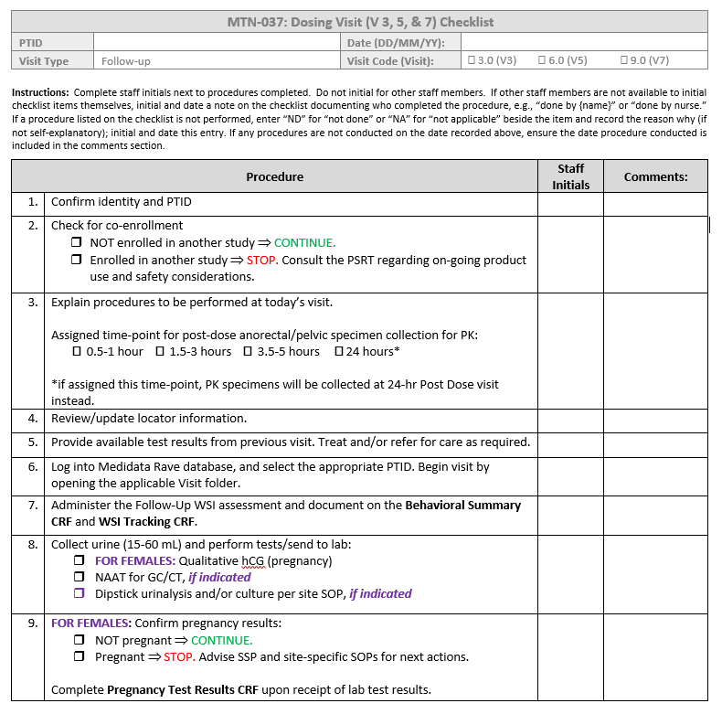
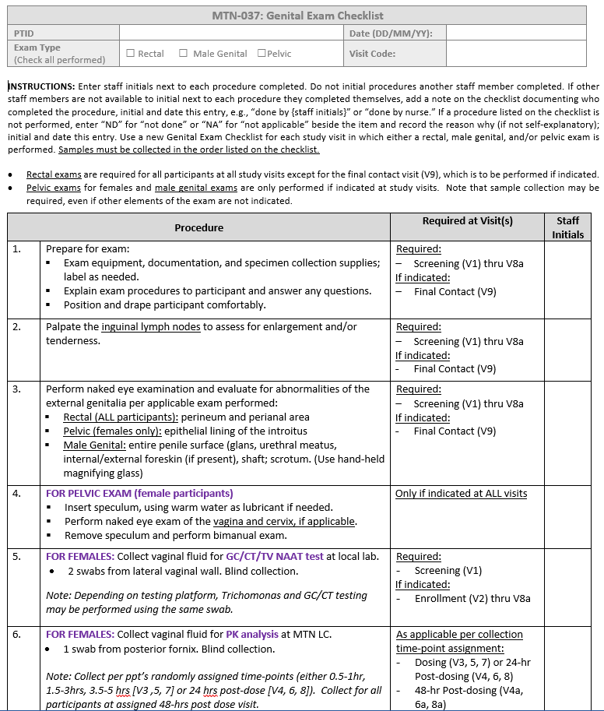
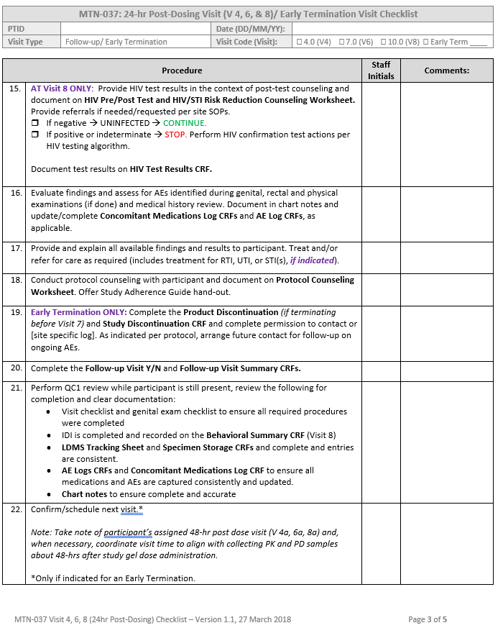
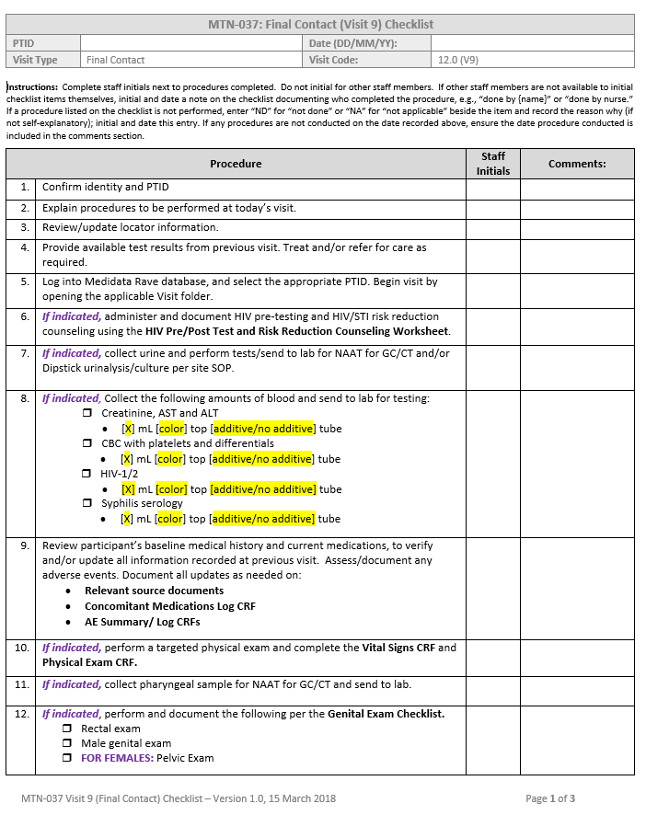
Study Visit
Checklists!
Notes:
Sample Visit Checklists and a Genital Exam Checklist is available on the MTN-037 website. Please use these samples to draft your site specific checklists.

Slide 15
Questions??

