Slide 1
MTN-037 Safety

Slide 2
Overview of Topics
Physical and Genital Exams
STI Management
Concomitant Medications
Medical and Menstrual History
Prohibited Medications and Practices

Slide 3
Physical Examination: Timing and Documentation
When:
Required at Screening and enrollment and, as indicated, at other times throughout study
Documentation:
Physical Exam CRF is recommended source document
Transcribe medically-relevant abnormal findings at Screening or Enrollment onto Baseline Medical History CRF
During follow-up, transcribe abnormalities onto AE CRF as needed
Cross-reference with Con Meds Log

Slide 4
Physical Examination Components
Temperature
Blood pressure
Pulse
Respirations
Weight
General Appearance
Height
Waist measurement
Abdomen
Lymph nodes
HEENT
Neck
Oral Mucosa
Heart
Lungs
Extremities
Neurological
Skin
Notes:
FULL exam – screening; targeted assessment at enrollment visit.

Slide 5
Pelvic Examination
If indicated
Including at screening and beyond
Genital bleeding
attempt to avoid pelvic during menses
Mild bleeding secondary to speculum insertion is not an AE

Slide 6
Pelvic Exam Terminology
Use terms from the Pelvic Exam CRF or FGGT
Use routine QC/QA opportunities to help ensure consistency of terminology across staff and exams
Common Pelvic Finding Terms:
Erythema, Edema, Petechiae, Ecchymosis, Peeling, Ulceration, Abrasion and Laceration

Slide 7
Pelvic Exam Technique
Naked eye examination – external genitalia
Palpate for inguinal lymphadenopathy
Do NOT insert the speculum before examining the external genitalia
Cervix and vagina – internal genitalia
Warm water speculum lubrication only
If cervix is poorly visualized, withdraw speculum conduct internal exam to establish position of the cervix and then re-insert the speculum

Slide 8
Pelvic Exam Technique
Remove visual obstruction (mucus, etc.)
Gentle dabbing saline-moistened swab
Avoid local trauma/bleeding
Bimanual exam – when clinically indicated
Vaginal fluid samples are blindly collected (despite if pelvic is performed)

Slide 9
Pelvic Exam Findings
NORMAL
Gland openings
Nabothian cysts
Mucus retention cysts
Gartner’s duct cysts
Blood vessel changes other than disruption
Skin tags
Scars
Cervical ectopy
IUCD strings
Some (scant) bleeding from speculum insertion/removal or biopsy

Slide 10
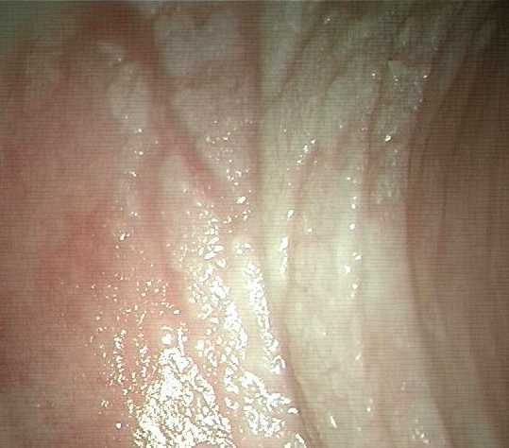
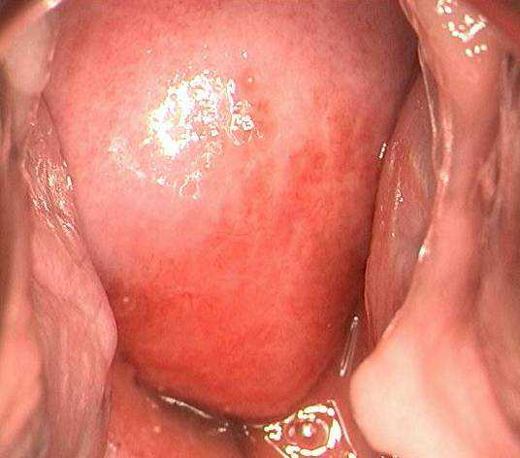
Pelvic Exam Findings
Epithelium
Superficial epithelial disruption (does not penetrate subepithelial tissue) OR localized erythema/edema
Deep epithelial disruption penetrates into and exposes the subeptheial tissue, including, sometimes vessels
Notes:
IF bleeding from the finding is present then the disruption is almost always DEEP. Defer towards DEEP.

Slide 11
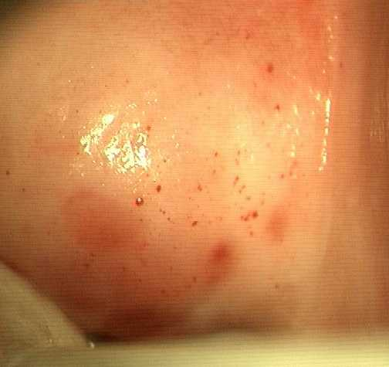
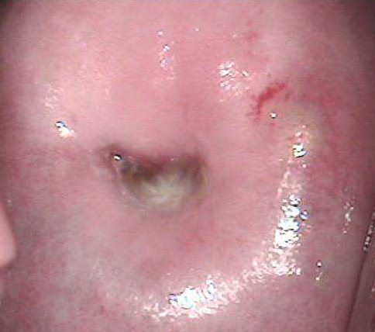
Pelvic Exam Findings
Blood vessels
Petechia
Ecchymosis

Slide 12
Male Genital Exam
External genital examination performed as clinically indicated (naked eye and hand held magnifying glass)
Entire penile surface
Internal and external foreskin (if present)
Shaft
Glans
Urethral meatus
Scrotum
Inguinal lymph nodes

Slide 13
Anorectal Exams
Required at all visits up until the final contact (when it is performed, if clinically indicated)
Anal exam for hemorrhoids, lesions, lumps, rash, ulcers
If perianal ulcers or vesicles are observed then pursue HSV 1/2 swabbing after visual examination and PRIOR to digital exam
Digital rectal exam – PRIOR to anoscope/sigmoidoscope
Rectal specimen collection – sparing lubrication of anoscope
A reminder of NO use of NSAIDs, aspirin PRIOR to rectal sample collections (PK, PD, mucosal safety biopsies)
Not allowed: non-study based enemas/douches or laxatives
Notes:
Abnormalities noted of the rectal mucosa (or concerning anorectal symptoms) that represent a contraindication to study participation are NOT eligible for the study. For those that have more mild abnormal anorectal findings (hemorrhoids), these are recorded as a baseline medical condition

Slide 14
Anorectal Biopsies
Anoscopy – sampling occurs 15 cm from the anal verge
Vitals signs obtained and documented following tissue collection
Small amount of bleeding from the rectum is normal (noticeable when wiping after a bowel movement) for 2-3 days after the procedure
Excessive bleeding (of fever, severe abdominal or anorectal pain, anal discharge) is not expected and is reportable and ought to prompt ER evaluation

Slide 15
Baseline Medical History
Past medical history
Past problems, including those where medication was taken for an extended period of time
Previous surgeries
Gynecologic history
Allergies (drugs, latex, seasonal)
Any current symptoms/conditions she is having

Slide 16
Baseline Medical History Guide
Baseline Medical History Questions
Notes:
RS: are we using this for 037?

Slide 17
Baseline Bleeding
Baseline Menstrual History
Collected at Screening
Documented in chart notes or site-specific form
Moving away from strict ranges for menses
Moving towards FGGT definitions of bleeding abnormalities
Changes in bleeding patterns will be assessed during follow-up
Notes:
Pause at 16 seconds and make correction –
NOTE: Counter the Devika’s recording, there is no Screening Menstrual History CRF in this study. First and last day of menses and menstrual bleeding pattern information should be recorded in chart notes or an a site-specific form. Any abnormal menstrual bleeding patterns should be entered on the BMH Log CRF.

Slide 19
Baseline Medical Conditions
Comprehensive Snap-Shot at Enrollment
Information obtained from history taking
Abnormal screening labs
Abnormal physical exam findings
Abnormal pelvic exam findings
Documented on Baseline Medical History CRF

Slide 20
Follow-up Medical History
Medical history must be updated at all follow-up visits
Are previously reports conditions ongoing?
Are there new or worsening symptoms?
Site clinicians can use their expertise to elicit complete and accurate information
How are you?
At your last visit, you reported X. Has this resolved?
Any current symptoms?
Any issues since your last visit?
Have you taken any medications since your last visit?

Slide 21
Follow-up Medical History Documentation
Review MUST be documented
Chart notes, or
Site specific tool
All newly-identified symptoms and conditions will be documented on the AE Log CRF
With exception of abnormal bleeding

Slide 22
Reporting GU AEs
Vaginal discharge per FGGT
Participant report
Observed by the clinician
If captured both by history and on examination, only report the one with the more severe grade
Vaginal bleeding
Record any genital bleeding that is different from baseline and NOT attributable to contraceptive use

Slide 23
STI Evaluations Performed
Chlamydia
Gonorrhea
Syphilis
HIV 1/2
HSV 1/2 detection (as clinically indicated)
Hepatitis B
Hepatitis C
Worthwhile to remember sites: rectal vs genito-urinary vs pharyngeal for gonorrhea and chlamydia

Slide 24
Female participants
Symptomatic BV
Symptomatic vulvovaginal candidiasis
In the absence of laboratory confirmed diagnosis, use the term “vulvovaginitis” if 2 or more are present:
Pain
Itching
Erythema
Edema
Rash
Tenderness
discharge

Slide 25
Female participants
Cervicitis – when 2 ore more are present in the absence of a laboratory-confirmed STI, report as “cervicitis” and follow the DAIDS FGGT
Dyspareunia
Erythema
Edema
Tenderness
Discharge

Slide 26
UTI
Suspected UTIs may be clinically managed based on the presence of symptoms consistent with a UTI
Urine dipstick may be performed per site standard of care but sites are expected to send a urine culture for definitive diagnosis/capture
Capture abnormalities from the dipstick (protein, glucose) in the Baseline Medical History Log CRF per DAIDS toxicity table

Slide 27
HIV testing
If at screening and/or enrollment a participant has signs/symptoms suggestive of acute HIV, the participant is NOT eligible for enrollment
Participants who fail screening due to concern for acute HIV should have repeat testing no sooner than two months following the prior negative HIV test. If the HIV antibody test is negative and the participant no longer has symptoms suggestive of acute viral infection, then the participant may undergo a second screening attempt for the study
Notes:
Fever, fatigue, headache, myalgia, weight loss, pharyngitis, lymphadenopathy, rash, diarrhea

Slide 28
HIV Reporting
HIV is NOT included in the DAIDS Toxicity Table and is NOT considered an AE for data collection/reporting
NO reporting of “HIV” or “HIV infection”
You MAY report “seroconversion illness” if a participant seroconverts and develops one or more signs of symptoms of acute HIV
Notes:
Use the comments section of the AE Log CRF to report specific symptoms: fatigue, pharyngitis, rash, etc.

Slide 29
Concomitant Medications
Concomitant Medications Log CRF
Prescription and OTC medications/preparations (including rectal lubricant)
Vaccinations
Vitamins and other nutritional supplements
Herbal, naturopathic, traditional preparations

Slide 30
Permanent Product Discontinuation
HIV acquisition
Pregnancy or breastfeeding
Anogenital STIs
Participant unwillingness or inability to comply/adhere to study procedures.
Reported use of PEP or PrEP
Anticoagulant use (warfarin, low molecular weight heparin, etc.)
Use of CYP3A inhibitors/inducers

Slide 31
Product Holds
Product hold parameters
Grade 1 and 2 not related: continue
Grade 2 related: product hold and consult with PSRT
Grade 3 and higher: permanent product discontinuation and PSRT notification

Slide 32
Prohibited Medications

Slide 33
Prohibited Practices
 | Entire duration of Study | 72 hrs prior to study visits (V2-8a) | 72 hrs after study visits (V2-8a)
Sexual Practices
Inserting any non-study products (including sex toys into the rectum) |  | x | x
Receptive anal intercourse (RAI) |  | x | x
Rectal stimulation via fingers |  | x | x
Receptive oral anogenital stimulation |  |  | x
FOR FEMALES: Receptive penile-vaginal intercourse or inserting anything in the vagina including: spermicides, vaginal medications (including hormones) vaginal douches, lubricants and moisturizers, sex toys (vibrators, dildos, etc.) |  | x
Notes:
RS: my guess is that these apply for MTN 037?

