Slide 2
MTN-037 Training
Julie Ngo
SCHARP
April 12, 2018

Slide 3
Presentation Overview
Key differences from previous studies
Study regimen and visit schedule
Visit calendar tool
Missed, Interim, and Split Visits
CRFs summary
Anorectal Specimen Storage, Dose Administration forms
Reports and Study Monitoring
Resources in Rave

Slide 4
Key Differences from previous studies
48 Hr Post-Dose sampling visit
  Participants only randomized to one
No dosing randomization
  New format for anorectal specimen storage forms

Slide 5
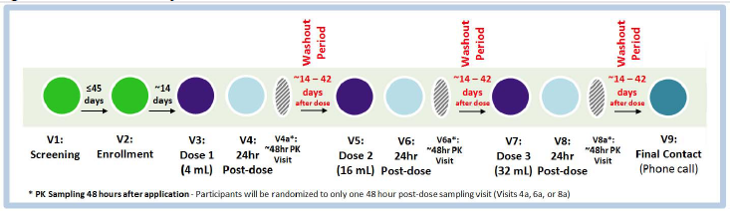
Study Product and Regimen
  4mL dose administered at Visit 3
  2-6 week washout period
  16mL dose administered at Visit 5
  2-6 week washout period
  32mL dose administered at Visit 7

Slide 6
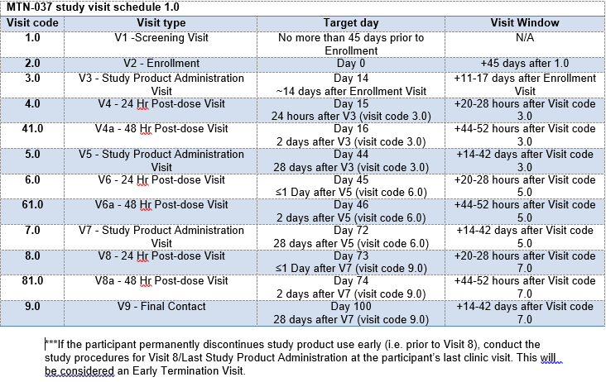
Visit Windows
Notes:
Enrollment may be scheduled within 45 days after initial Screening Visit.
Ideally, follow-up visits will occur on the target date. If visit cannot occur on target date, it should be completed within visit window. Some visits have visit windows while others do not. This is due to the timing of the visit (24 hour post dose visits)

Slide 7
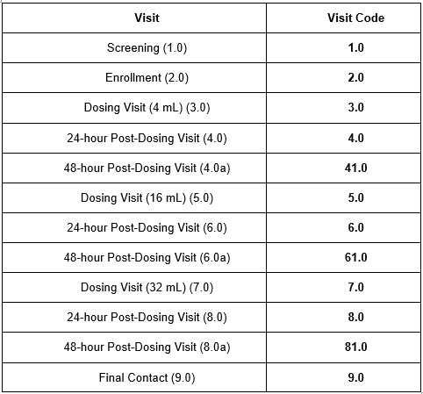
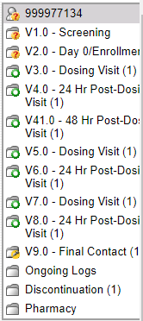
Visit Codes
Visit name and visit code automatically appear in Medidata Rave in pre-defined study visit folders
Notes:
Visit Codes are used to indicate at which point in a ppt’s trial participation an event occurred
Do not need to enter visit code on eCRFs as the forms for a given visit are within the pre-defined study visit folder.
If an early termination visit is conducted, the visit code of the early termination visit will depend on where the participant is at in her visit schedule at the time of early termination. For example, if a participant withdraws from the study at Visit 5, his or her early termination will be on that visit date and the visit code of the early termination visit will be 5.0.

Slide 8
Visit Calendar Tool
Excel tool provided by SCHARP to calculate the screening window and last day to Enroll
First tab creates the follow-up visit schedule/calendar for a ppt with actual dates
  Requires entry of PTID, full Enrollment Date, Visit 3 and 5 actual visit dates
  For each required follow-up visit, the target date, and allowable windows (if applicable) are generated
  Blank column provided for site to write-in actual visit dates
For easy reference, print and placed in the ppt’s study notebook once ppt has enrolled

Slide 9
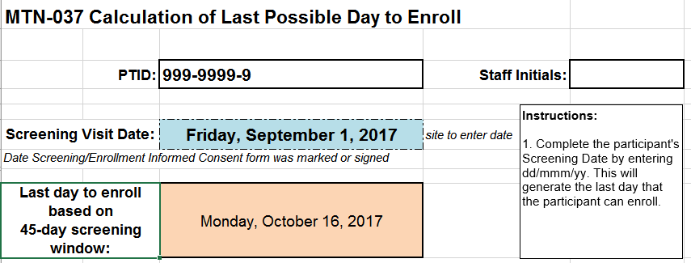
Last Day to Enroll Calculator
Notes:
This is available in the second tab of the visit window calendar tool. Tool is posted on MTN web site.
Allows sites to enter the Screening Visit Date and calculate last day to enroll based on the 45-day screening visit window.

Slide 10
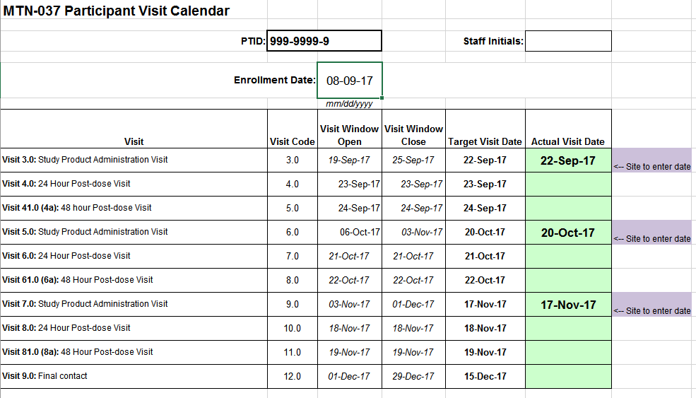
Visit Calendar Tool
Notes:
An actual visit date for Visit 3 and 5 must be entered to generate target dates/windows for remaining f/u visits.

Slide 11

Missed Visits
A follow-up visit is missed once allowable window closes if he/she has not completed any part of visit
If a visit does not have a window and the participant cannot come in on target day, the visit is considered missed.
    E.g., participant completes Enrollment and Visit 3 (Dosing visit), but is not able to come back into the clinic until Visit 5. The Visit 4 Sampling Visit is considered missed.
    E.g., The Visit 4, 6, and 8 have no visit windows (in Rave), thus are missed
If a participant misses Visit 3, Visit 5, or Visit 7 (the dosing visits), the management team should be notified as this participant might need to be replaced.
Missed visits are not made up. Rather, sites should make every attempt to retain participants at future visits.

Slide 12
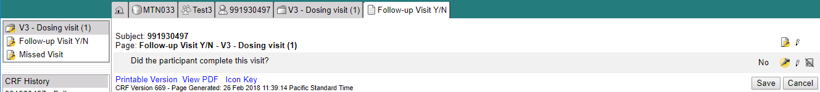
Missed Visits
Missed visits are documented in the study database using the Missed Visit CRF
The Missed Visit form will let SCHARP know not to expect any other forms for that participant at that study visit (with the exception of the Follow-up Yes/No CRF).
The Missed Visit CRF is completed in lieu of a Protocol Deviations Log CRF

Slide 13
Interim Visits
Visits that take place between scheduled visits
  Additional study procedures and/or data collection conducted outside of what is specified in protocol for required study visit (Example: Report of new AE, issue with study product, etc.)
  Required study visit procedures conducted outside visit window, either to make up certain procedures from missed visit or conduct Visit 8 Early Termination Visit procedures due to early product discontinuation
All interim contacts (e.g., phone calls and/or clinic visits) will be properly documented in study files and on applicable CRFs
Notes:
Required procedures: Procedures required during an interim visit will depend on the reason for the visit. For example, if a participant presents to the site to report an AE, all clinically-related procedures to assess the AE and required documentation would be the required procedures for that interim visit.

Slide 14
Interim Visit Codes
If the interim contact results in at least one newly-completed eCRF, the interim visit is assigned an interim visit code
Interim visit codes use the box to the right of the decimal point – assign starting with .1
For the numbers to the left of the decimal point, use the visit code of the most recently required visit, even if the interim visit date is in the next visit’s window or if the visit was missed
The interim visit code will be a number in-between the two visit codes when the interim visit occurred
  E.g., a ppt has an interim visit 2 days after his/her Visit 6 to follow-up on an AE; assign interim visit code = 6.1 (in between Visits 6.0 and 7.0)

Slide 15
Split Visits
A visit is a split visit when the required visit procedures are split (done) over 2 or more days
The days must all fall within allowable visit window; any required procedures not done within allowable window are missed
For split visits, only 1 Follow-up Visit Summary eCRF is completed, and the Visit Date on this CRF is the date of the first part of the split visit
  All CRFs completed for the split visit within the applicable study visit folder (e.g., CRFs completed for a split Visit 3 visit completed across Days 7 and 8 would all have visit code 3.0)
Note: All PK/PD/mucosal safety specimen collections must occur on the same day
Notes:
Split visits are not allowed for Enrollment. All lab specimens must be collected on the same day and they cannot be split.
Needed to correlate data points for analysis purposes

Slide 16
PTID Assignment
PTID generated in Medidata Rave
Unique 9 digit number – PTIDs are not reused across studies and HVTN, MTN, and HPTN
MTN-037 PTID assignment is defined as completion of entry on MTN-037 PTID-Name Linkage Log
Notes:
PTIDs will be generated in Medidata Rave
Each PTID is unique and assigned to single participant only at a given site (not assigned to any other participant at any site or in any study for which SCHARP is the SDMC. The first 3 digits will refer to the site ID.
PTID assignment is defined as completion of an entry on the MTN-033 PTID-Name Linkage Log for a given participant.

Slide 17
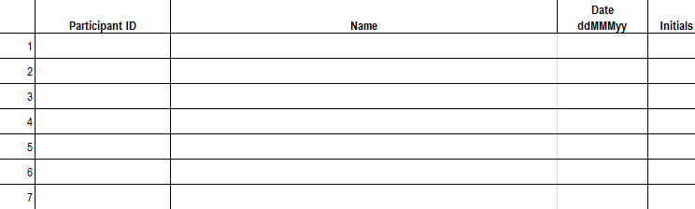
PTID/Name Linkage Log
Sample site-specific PTID/Name Linkage Log
Notes:
SCHARP will provide an electronic copy of a site-specific PTID Name Linkage Log to record each participant’s PTID and name.
Information on how to complete this log is specified in your site’s DM SOP. Again, PTIDs are assigned to a participant using the PTID Name Linkage Log only to those prospective ppts who complete IC, regardless of whether they enroll in the study. Ppts keep the same PTID even if complete multiple screening attempts. The PTID Name Linkage Log should always be stored in a double-locked area to protect ppt confidentiality and should be kept separate from ppt binders.

Slide 18
Screening CRFs
Screening Date of Visit
Demographics
Baseline Medical History Summary and Log
Concomitant Medications Summary and Log
Eligibility Criteria
Vital Signs
Physical Exam
Anorectal Exam
Pelvic Exam
Local Laboratory Results
Hematology
STI Tests
HIV Test Results

Slide 19

Enrollment CRFs
Randomization
Enrollment
Baseline Medical History Log
WSI Summary and Tracking
www.imedidata.com
Vital Signs
Physical Exam
Anorectal Exam
Pelvic Exam
Specimen Storage
Anorectal Specimen Storage Enr
HIV Test Results

Slide 20

Randomization CRF
The randomization CRF must be completed regardless if the participant screens out or enrolls.
  Located in the Enrollment folder
  “Is the participant ready to be randomized?”
    If participant screen fails, select “No”
    If enrolling, select “Yes”

Slide 21

Clinical Management
Vital Signs
Physical Exam
Anorectal Exam
Pelvic Exam
Product Discontinuation
Product Hold Summary
Product Hold Log
Adverse Event Summary
Adverse Event Log

Slide 22

Laboratory Related CRFs
Specimen Storage
Anorectal Specimen Storage Enr
Anorectal Specimen Storage
Pelvic Specimen Storage
Local Laboratory Results
Hematology
STI Test Results
HIV Test Results
HIV Confirmatory Results

Slide 23
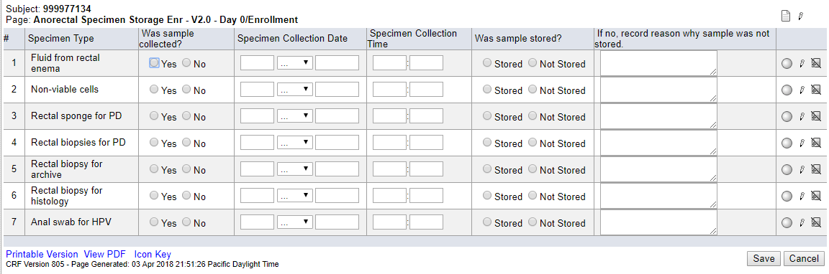
Anorectal Specimen Storage Enr Form

Slide 24
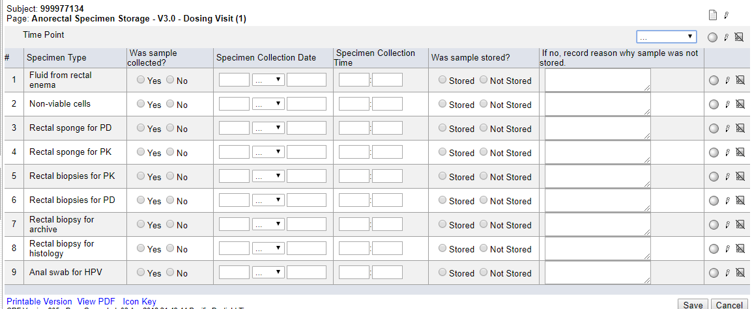
Anorectal Specimen Storage Form

Slide 25

Follow-up Visits – Key CRFs
Follow-up Visits – Key CRFs
Follow-up Visit Summary, including Follow-up Visit Yes/No
Additional Study Procedures
Dose Administration
Pharmacy Dispensation
Protocol Deviations Log
Product Discontinuation
Study Discontinuation
Participant Replacement

Slide 26
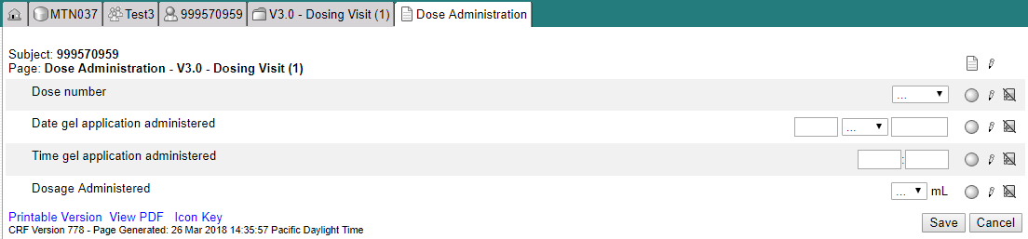
Dose Administration
Form appears in visit folders 3, 5, and 7

Slide 27

Case Report Forms
eCRF Rave output available as single PDF on MTN-037 ATLAS webpage
  https://atlas.scharp.org/cpas/project/MTN/037/begin.view
  To be used as back-up (contingency) in event database cannot be accessed (e.g. temporary internet or power outage)
Vision = EDC! (NO paper CRFs)

Slide 28
MTN-037
Reports and Other Resources

Slide 29
MTN-037 Routine Study Reports
Rave reports
  Query Detail
  Query Summary
  Page Status Comprehensive
  Productivity
Emailed Report
  LDMS Specimen Monitoring
ATLAS Reports
  Screen Out
  Enrollment
  Retention
  Visit Adherence (Procedures Completion)
  Missed Visit Summary Report
  Missed Visit Site Listings
  Data Management Quality (DMQ) Report
  Data Summary Report
Notes:
Transition to discussing reports and data quality.

Slide 30
Medidata Rave Reports
Designated site staff (Site IoR, Study Coordinator, and Data Manager) will have access to these reports
The Reporter eLearning module will automatically be added to your homepage to complete (no email is sent from iMedidata)
Should additional data team staff members need access to the these reports, please send this request to sc.medidata.acccess@scharp.org

Slide 31
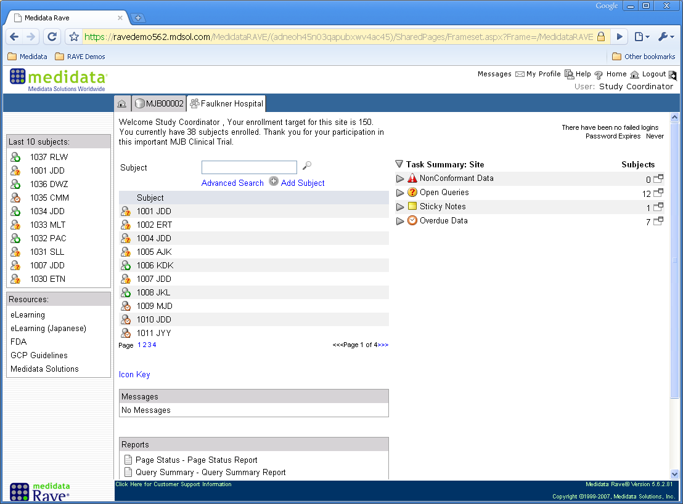
Rave Reports
Assigned Reports

Slide 32
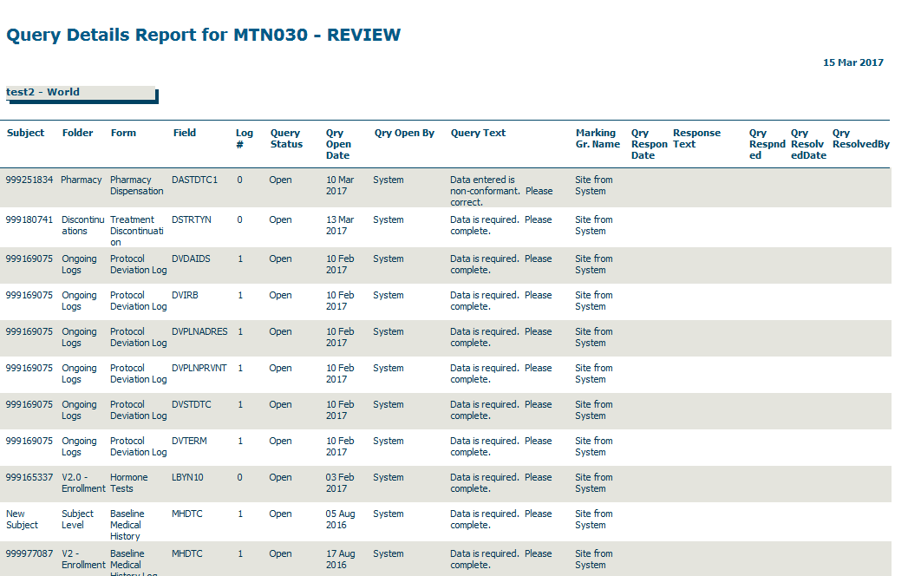
Data Metric Tools in Rave
Data queries report (by site)
Notes:
Data metrics (QC reports) can be generated with Rave and exported as PDF or excel files. QC reports can be run by site, by participant, by form, by study visit, or by a specific item on an eCRF. Reports for queries generated just by the study Clinical Data Manager or the study monitor can also be generated as well as reports by query status (open, answered, closed, cancelled) or between a specific time period.

Slide 33
SCHARP Data Reviews
SCHARP Data Managers:
Review protocol endpoint data
Review and resolve answered system queries
Place, review, and resolve manual queries based on ongoing data review (Site from DM)
SCHARP CSA:
Reviews clinical CRFs such as AE log CRFs on an ongoing basis
Places, reviews, and resolves manual queries based on ongoing clinical data review (Site from Safety)

Slide 34
PPD Monitoring - Targeted Source Data Verification (TSDV)
DAIDS, SCHARP, & PPD to determine on which CRFs and fields to place SDV boxes within Rave.
During site monitoring visits, PPD monitors use the Task Summary on the Rave homepage to identify forms required for review.
PPD monitors use TSDV boxes to document their reviews within the study database.
PPD monitors can place manual queries for the site to review and address (Site from monitor)
Notes:
PPD monitors can place manual queries for the site to review and address by updating the item in question and or providing a response to the query by providing additional information. SCHARP can also place queries within Rave as a communication tool between SCAHRP and PPD.
Typically fields that are reviewed by the PPD monitors include inclusion exclusion criteria and primary endpoint data.

Slide 35
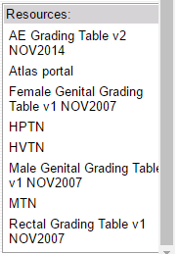
Resources Within Rave
Resource Pane: bottom left-side of home screen
  Displays a list of internet links that are standard across HVTN, HPTN, and MTN studies.
    AE Grading Table v2
    Atlas portal
    Female Genital Grading Table v1
    HPTN
    HVTN
    Male Genital Grading Table v1
    MTN
    Rectal Grading Table v1
Notes:
On the bottom left-side of your home page is a Resource Pane with links to relevant information, such as the AE Grading Table, Atlas portal, and MTN page. The Resource Pane is a core feature in Rave for SCHARP network studies. This means that some of the links will not be relevant to you. For example, if you are a MTN site, you will not use the HVTN link.

Slide 36
Resources Within Rave
iMedidata Portal: Help menu on upper right corner provides access to these functions:
  Help On This Page – Click to open Online Help for the current application page in a new tab.
  Knowledge Space Home – Click to open the top level Help page in a new tab.
  Show Me Videos – Click to open a new tab where you can view a short instructional video about iMedidata.
  Help center – Click to open a page that allows you to view documentation and helpful tips as well as to report a problem
Notes:
If you click on the Help button on the top right corner of the page, a drop down menu will appear with 4 different help topics to choose form: Help on this page, Knowledge Space Home, Show me videos, and Help Center.

Slide 37
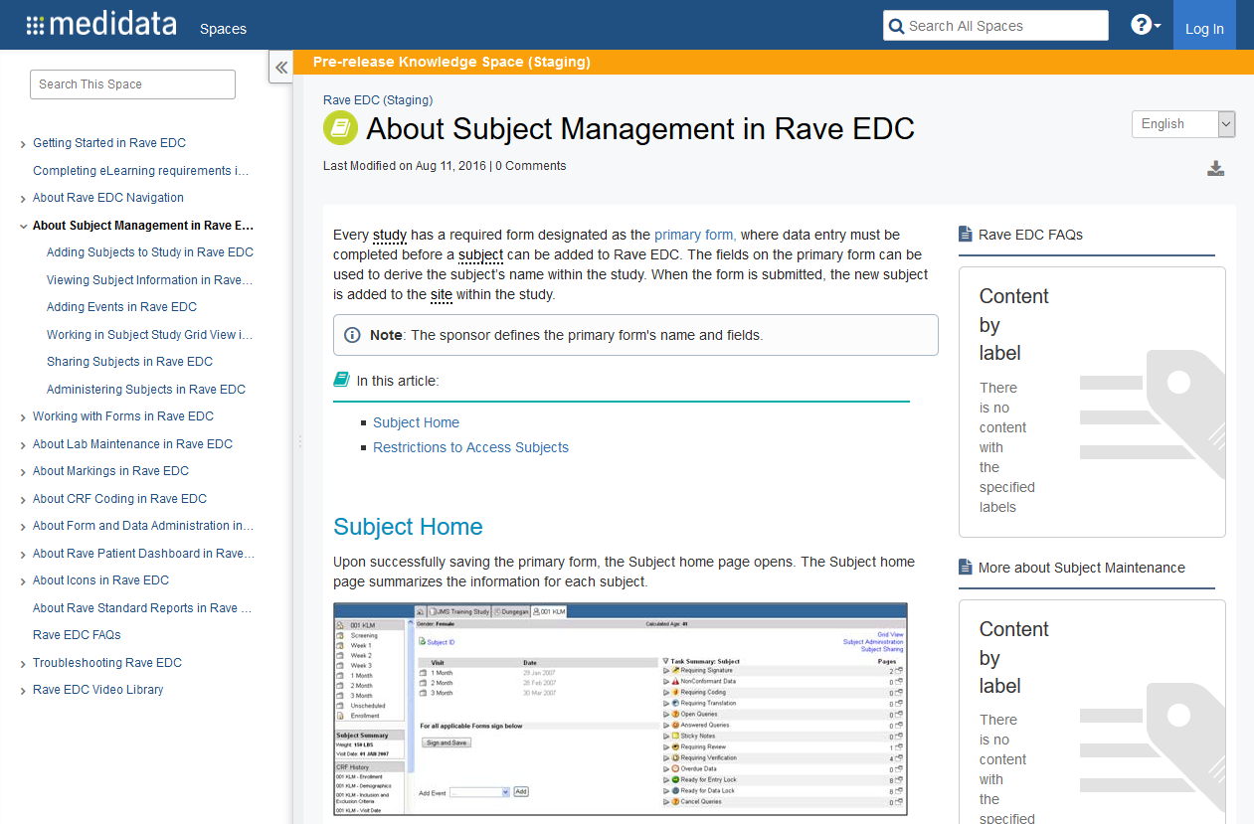
Resources: Within Rave
Once within a study, you can click on the “Help” button on any page to access information relevant to that page.
Notes:
Every page in Rave has a Help button on the top right corner. If you have a question about content on the page you are on, clicking on the help button will open a new window with help information. For example, if you click on the help button when on a participant page, the window on this slide will open. You can click on the links to the right to drill down for more information.

Slide 38
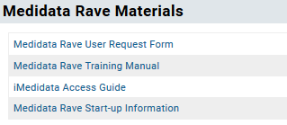
MTN-037 Resources
MTN website
  SSP
  Specimen Label Macro
  Visit Calendar Tool
MTN Atlas Portal (https://atlas.scharp.org/cpas/project/MTN/037/begin.view)
  eCRF Medidata Rave Output
  CRF Completion Guidelines (CCGs)
  Medidata Rave Materials
Notes:
Will post Medidata Rave training slides

Slide 39
MTN-037 Query Management
Management

Slide 40
Query Management within Rave
Data, clinical and coding queries are applied, reviewed, answered, and resolved within the Rave database.
There are two main types of queries applied to eCRFs within Rave:
    System Queries
      Automatically generated by Rave EDC when a page is saved with data that is missing (left blank) or when a data point does not conform to a pre-specific edit check.
    Manual Queries
      Opened by a SCHARP Data Manager, Clinical Coder, or PPD Monitor upon manual review of the data for clarification on or correction to a specific item
Notes:
There are two main query types that you will see within Medidata Rave:
System Queries – Automatically generated by Rave EDC when there is an issue with submitted data, a required field is left blank, or when a data point does not conform to a pre-configured edit check . In addition to a correction to the form item itself, if needed, a generated query may also require a response within a text box in order to resolve the query.
Manual Queries – Opens on a specific form item by a SCHARP DM or site monitor, to site staff for clarification or correction on a submitted item or form.

Slide 41
Task Summary
Shows any pending tasks associated with the study based on user role
Pending tasks are items needing prompt attention:
  Requiring signatures
  Non-conformant data
  Open queries
  Overdue data
Site and Participant level
Notes:
The Task Summary shows any pending tasks (associated with the study) to which the logged-in user has access (based on role and user privileges). Pending tasks are items needing attention right now, such as, non-conformant data, open queries, those that require signature, and overdue data.
There is a task summary at the site level and participant level.

Slide 42
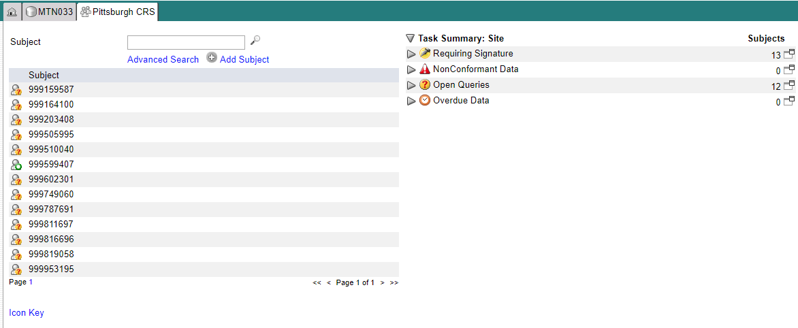
Task Summary: Site Level
Notes:
The Task Summary section on a site level displays the number of subjects within the site that contain the selected item (for example, 13 participants within the site have CRFs with nonconformant data and 12 ppts with open queries). The site level view provides a quick overview of what is happening at that moment at the site.

Slide 43
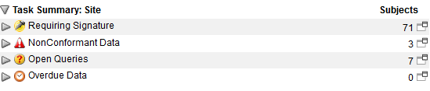
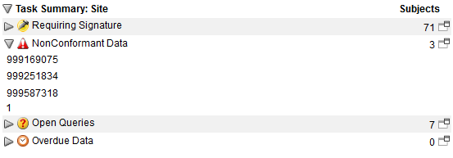

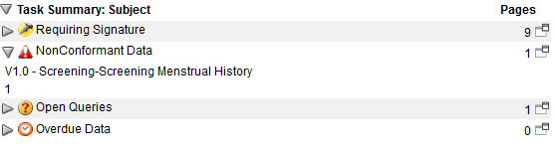
Task Summary: Site to Participant Level
Notes:
One can drill down from the Site level to the Participant level. For example, if you expand the nonconformant data task, a listing of participants with nonconformant data will display. When you click on one of the participants, the selected participant home page displays with the Task summary (participant level) opened to the CRF(s) with NonConformant Data.

Slide 44

Task Summary: Site to Participant Level
Notes:
Clicking on the CRF listed under NonConformant Data will take you to that CRF where you can address the issue.

Slide 45
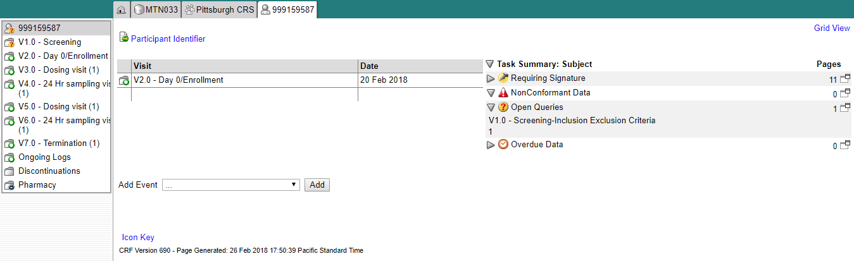
Task Summary: Participant Level
Notes:
From the Participant Level, you can also access forms with pending issues. In the expanded Task Summary view for Open Queries, for example, you can click on “V1.0 Screening – Inclusion Exclusion Criteria” and the selected form displays.

Slide 46
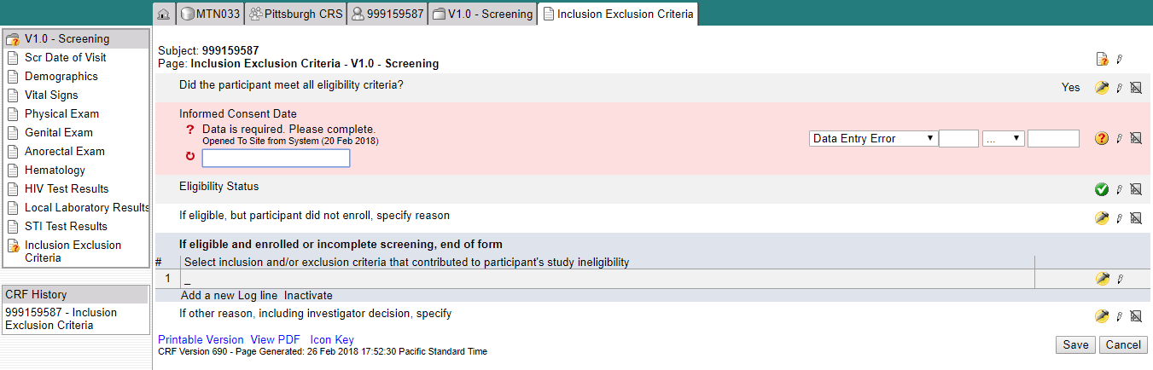
Task Summary: Participant Level
Notes:
You can enter the correct missing data, in this case, and click save to resolve the query.

Slide 47
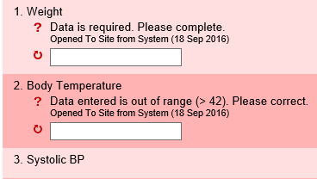
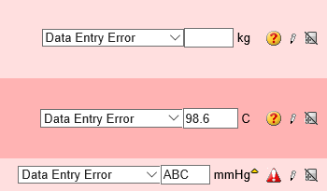
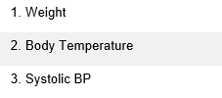
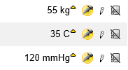
Resolving Queries within Rave
    Examples of System Queries:
Missing Data Query
Edit check Query
Non-Conformant Query
Query Text
A Delta symbol appears when an item have been updated and the page has been saved.
Once you make the correction and save the page the line is no longer pink and the query icon goes away.
Notes:
System and manual queries consist of a text box and the option to require an explanation regarding the queried data. A query displays on the form page and is highlighted in pink or red, with a query message and the data entry field open for editing. The question mark icon will appear as well if a outstanding query has been placed on an item. If the data entered in non-conformant (e.g., if the response is not in the correct format (missing digits, units, etc), a red triangle will appear as the icon for that item.
A system query typically will resolve automatically when the data value is corrected and the form is resaved. Some system queries allow for site staff to enter in a response when resolving a query as well. A yellow delta symbol will appear to indicate that the data point has been changed from the initial value entered.

Slide 48
Resolving Queries within Rave
Optional site response to query
Optional site response to query
NOTE: An OPTIONAL text field is provided beneath the system query text to document clarifying information regarding the data point or to request additional guidance from SCHARP on query resolution.
Notes:
System queries also allow for the option for site staff to enter in a response when resolving a query. If the site would like to include additional clarifying information for the data manager to review or if the Rave user would like additional guidance on how to resolve the query, a comment can entered into the text field provided for SCHARP to review. A query response is NOT required, however, when addressing system queries. For example, in the first example on this slide, the a response requiring the participant's weight is missing. This system query for missing data can be resolved by entering in the response for this item and re-saving the page. A response to the query is not required. Once the item has been updated with the participant’s weight, the query will be resolved by the system. Note however, that a Rave user opt to provide a response to the query, SCHARP will review the response and updated field before the query can be closed.

Slide 49
Resolving Queries within Rave
    Example of a Manual Query:
Notes:
If a manual query has been placed on an a specific form item by SCHARP or a PPD monitor for site staff to review, the query will be displayed on the form page and will be highlighted in pink or red, with a query message specifying the details of the QC. The existing data entry field automatically will be open for editing. To resolve manual queries, update the data entry field and re-save the page.
SCHARP will then review the updated item as well as the query response and close the query when the discrepancy is resolved. In cases where a query response is not required, an update to the data field will resolve the query without a manual review by SCHARP.
In this example, a manual query has been opened by the Data Manager to clarify whether an AE had been reported at the specified visit for this participant. The query was then resolved after the site confirmed that an AE was reported for this participant and completed the corresponding AE form on the AE log.

Slide 50
Field Audit Trail
All changes that have made to a specific item on an eCRF can be viewed via the audit trail
To access an item’s audit trail, navigate to the completed form and click the data status icon.
  Audit trail within Rave will show each user who enters data, responds to queries, etc.
Notes:
All changes made and queries applied and resolved to a data point are tracked in an audit trail. Any changes that all users at the site, at SCHARP, and by study monitors make to the form data and/or folders on the task list are tracked in an audit trail.
The audit trail includes information on:
Action performed on the field.
User First Name, Last Name, User System ID, and Login Name of the user that performed the action. The login and user system ID are unique identifiers for each user in Rave EDC.
The time and date of the action.
If your action results in more than one audit, each audit has its own distinct date time stamp. This is true even if your action generates two entries simultaneously.
Navigate to a Study > Site > Subject > a complete form.
Click Data Status for a data field to view the audit trail for the field.

Slide 51
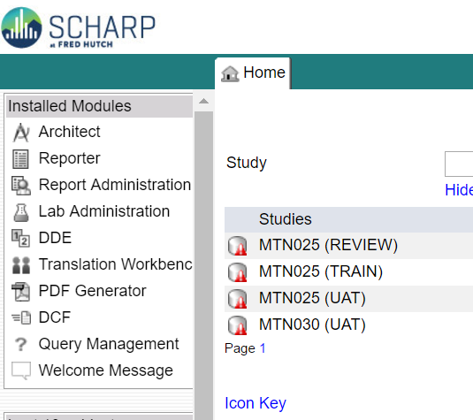
RAVE Query Management Module
The Query Management module is a tool that allows you to search, view, and answer queries that have been placed by SCHARP and the system for your site.
Access the RAVE Query Management module from the Installed Modules sidebar on your Medidata homepage
Notes:
If you do not see the Query Management link in the sidebar, please contact the SCHARP study CDM to request that this module be added to the applicable accounts. An eLearning is required in order to have access to this module.

Slide 52
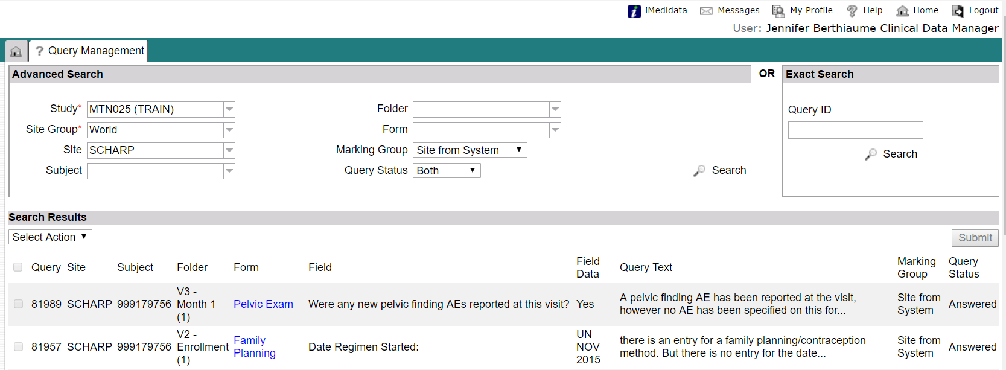
RAVE Query Management Module
The module screen is divided into three sections: the Advanced Search, Exact Search, and Search Results panels.
Notes:
Specify your search criteria in Advanced Search, using the dropdowns.
Study and Site group are required.
Click Search after criteria have been set.

Slide 53
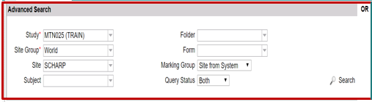
RAVE Query Management Module
The Advanced Search panel can be used to search for all queries by:
Study*
Site*
Specific form or folder
Marking Group (site from system, site from DM, etc.)
Query status (Answered, Open, or Both)
*Note that the study and the site group must be specified to perform a search.
Notes:
Specify your search criteria in Advanced Search, using the dropdowns.
Study and Site group are required.
Click Search after criteria have been set.

Slide 54
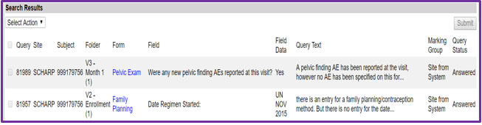
RAVE Query Management Module
The Search Results panel returns all queries that match the parameters specified in the Advanced Search panel.
Using this panel, one or more queries can be selected to perform certain actions.
The first column, “Query”, indicates the unique ID assigned to each query generated in the database
The “Field Data” provides the data value entered for that field or item

Slide 55
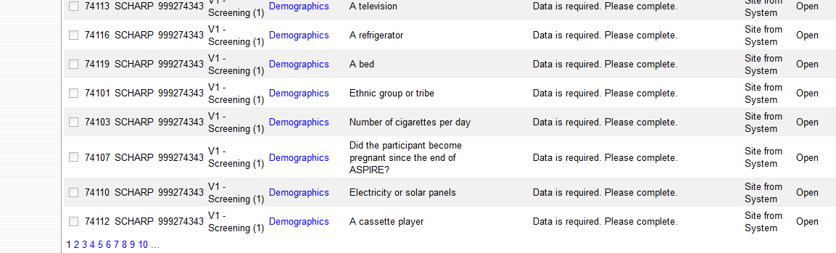
RAVE Query Management Module
If the search returns multiple pages of results, pagination links are located in the bottom-left corner of the search results. Click a page to go to that specific page.

Slide 56
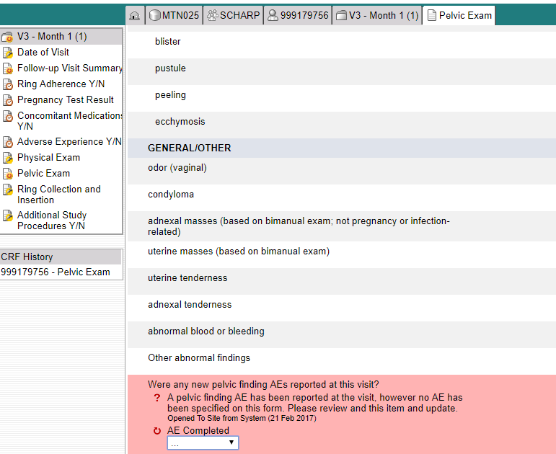
RAVE Query Management Module
To access an eCRF from the Search Results panel, select the form name hyperlink provided.
The system then will navigate you to the specific eCRF within RAVE
Notes:
Clicking on the specific form per row will navigate to the specific form for the query to be resolved.

Slide 57
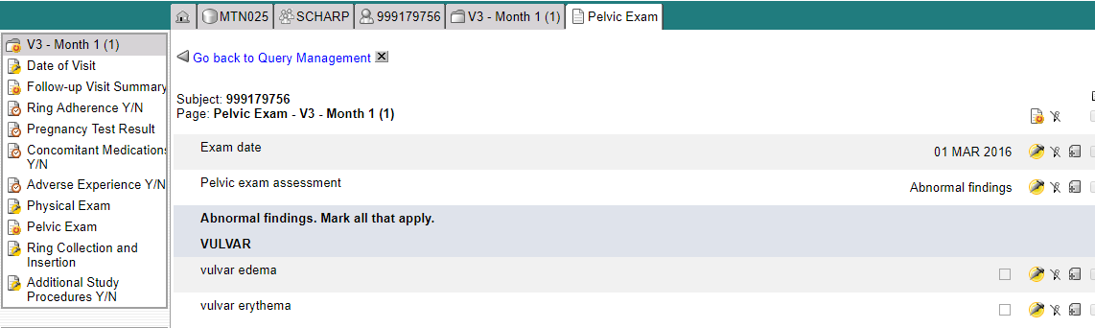
RAVE Query Management Module
Once a query has been addressed, you can return to the Query Management module by clicking the “Go back to Query Management” Link and continue addressing queries.
Notes:
After searching and locating the queries, you can manage queries by updating the data and answering them. Update the data on the form as applicable. For a manual query (i.e. placed by SCHARP or PPD), make sure to enter a query response in the text box that displays.
For system queries, a manual response is not required if the data conforms to what is expected.
After the data has been updated via the pencil icon, navigate back to Query Management.

Slide 58
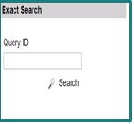
RAVE Query Management Module
The Exact Search panel allows users to search for a single, specific query using the query ID.
To conduct an exact search, you must enter the complete Query ID in order to return the query
The query matching the ID that you have search for is displayed in the Search Results panel

Slide 59

RAVE Query Management eLearning
Complete the RAVE Query Management eLearning assigned to you as this training will provide you with additional tips for resolving queries using this module
This eLearning should take approx. 25 minutes

Slide 60
Medidata Rave User Accounts
To update or remove existing user accounts, or to add new user accounts, complete Medidata Rave User Request Form with these details and email this form to sc.access.medidata@scharp.org.
Notes:
SCHARP ticketing system will track progress as we proceed with user access administration.

Slide 61
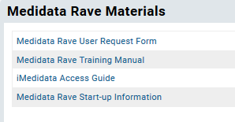
Medidata Rave User Accounts
The Medidata Rave User Request Form is available on the MTN-033 ATLAS portal under the “Medidata Rave Materials” section.
Your request typically will be completed within 3-5 business days, but please ensure that a request is submitted no later than 1 week prior to when site staff will need access to Rave to ensure ample time.

Slide 62
Participant Grid View
The Participant Grid View:
  Displays participant folders and forms in a grid format
  Provides the status of specific forms
  Allows authorized Rave users to quickly perform activities such a freeze, sign-off, verify, and sign-off on multiple forms
      E.g., Investigator role can quickly sign-off on multiple eCRFs for a given participant at the same time
Notes:
The Grid View provides an alternate display of a participant’s folders and forms in a grid format. The Grid View allows you to find and display participant visits and associated forms, including the status of specific forms. Forms without status icons have no saved data. The Grid View allows authorized Rave users such as site/PPD monitors, site investigators, and SCHARP data managers to quickly perform activities, such as, verify, freeze, sign-off, and lock on multiple forms at a time.

Slide 63
Participant Grid View
To access the participant grid view, click on “Grid View” located in the upper right corner of the participant’s main page.
Notes:
To access the participant grid view, navigate to the “Grid View” link located in the upper right hand side of each participant’s home (or calendar) page. This gives a good snapshot/overview of forms completed for ppt.

Slide 64
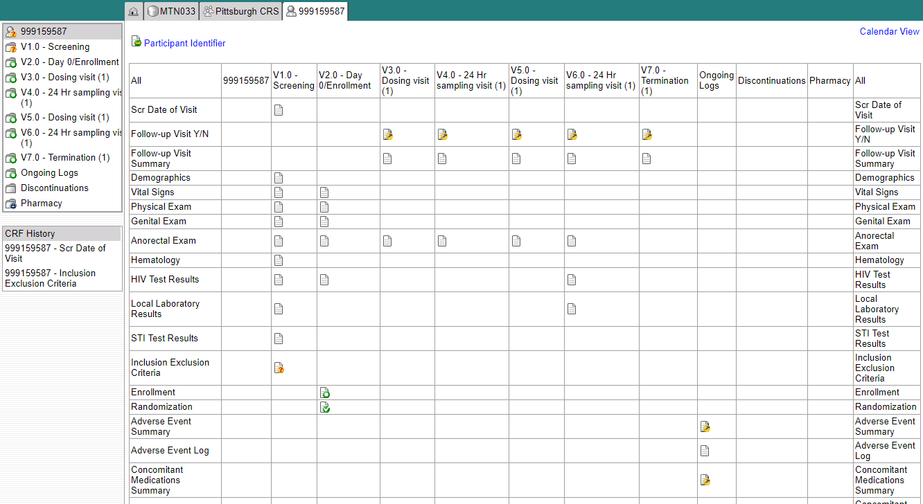
Participant Grid View
Notes:
Here you will see that the grid view allows for you to view all folders and forms for a participant. Forms that have been completed or are expected to be completed will appear with an icon. If a form or a folder is not in participant’s visit folder, the cell will appear empty. For example, forms not required at Screening are left blank.
The same status icons that we reviewed for each item within an eCRF appears within Grid View as well. These icons show whether the form is completed, is overdue, locked, has queries, and so on.
You can navigate to the page view of each form listed to view the data recorded on each form by clicking on the icon.

Slide 65
Participant Grid View – Investigator Role
Electronic form sign-off by the Site Investigator (IoR) to verify the completeness and accuracy of the study data should occur after all queries have been resolved on the form and prior to database lock as the study approaches close out and completion.
To maximize efficiency, please hold off on providing Investigator sign-off for a participant casebook until instructed by SCHARP CDM(s).
  Single sign-off per participant once participant terminates from study
  Site Investigator sign off of a form should not be completed until after data review by a PPD monitor or by a SCHARP Data Manager and all queries are resolved.
Notes:
Site Investigators of Record (IoR) will electronically sign a form within Rave to verify the completeness and accurateness of the study data once data has been entered for that form and all queries associated with the form have been resolved. Site investigators can use the participant grid view to sign-off on multiple forms at a time. Each completed form within Rave must be electronically signed by the site investigator verifying completeness and accurateness of the study data. While investigators have the option to sign off on eCRFs at any point during the study once all queries have been resolved and prior to database lock, we recommend that form sign off towards the end of the study and during the study close out period for greatest efficiency. If forms are updated after an initial sign-off by the IoR, the eSignature is broken and the investigator will need to complete a second sign off of the form. The study SCHARP Clinical Data Manager will provide instruction on the optimal time for IoRs to provide eSignatures during study close out to avoid the need for multiple sign-offs for a given CRF.

