Slide 1
Amawulire agakwata ku kwegattira emabega ewafulumirwa

Slide 2
Okwegattira emabega ewafulumirwa kitegeeza ki?
Okwegattira emabega ewafulumirwa tutegeeza ng’omusajja ateeka obusajja bwe mu muganziwe emabega gyafulumira obubi.
Notes:
Si kyekimu ng’okuteeka obusajja mu bukyaala “Okuva emabega ‘’ oba “okuvira mu mugongo.

Slide 3
Ani yegatta emabega ewafulumirwa?
Newankubadde abantu bangi baswala okukyogerako, abantu abebika bingi beegattira emabega ewafulumirwa.

Slide 4
Abaami n’abakyala bafuna okwegattira emabega ewafulumirwa obubi. Sinsonga oba yegase n’amusajja oba mukazi.
Ani yegatta emabega ewafulumirwa?

Slide 5
Lwaki abantu bayinza okufuna okwegattira emabega ewafulumirwa obubi?

Slide 6
Ensonga nyingi lwaki abantu bennyigira mu kwegattira emabega ewafulumirwa. Ezimu kwezo mulimu:
okwagala okumanya bwekuwulikika
essanyu
ekiwubaalo
okumala amangu
okuwulira nga bakumimye
okusanyusa omwagalwawo
sente
ngoli lubuto oba munsonga z’ekyikyala
nga enkola eyokwegema okuzaala
Okusigala nga oli mberera
okwongera mu mukwano era nensonga endala nyingi

Slide 7
Akawuka kamukenenya kasobola okusigibwa nga kayita mukwegatta emabega ewafulumirwa obubi?
Yee.
Mu butufu, okwegattira emabeega ewafulimirwa nga tolina akapiira ka kalimpitawa kiteka abantu mukatyabaga akawagulu ennyo okufuna akawuka kamukenenya okusinga engeri endala zona ez’okwegatta.
Okwegattira emabega ewafulimirwa ng’atolina kapiira ka kalimpitawa kyabulabe eri abakyala okusinga okwegattira mu bukyala nga tolina kapiira ka kalimpitawa bwekituka ku kufuna akawuka kamukenenya n’eddwadde eziyitira mukwegatta.

Slide 8
Lwaki okwegattira emabega ewafulumirwa nga tolina kapiira kyabulabe nnyo?
Akawuka kamukenya kasobola okusigibwa amangu nga kayita mu kwegattira emabega ewafulumirwa kubanga akabuubi k’omukyenda ekifulumya obubi (rectum) kawewevu nyo ate tekalina biseereza eby’obutonde.
Akabuubi ke kyenda ekifulumya obubi (rectum) kangu nnyo okukosebwa nga wegattira emabeega ewafulumirwa obubinga tewali kiseerezaayo, ekiwa akawuka ka mukenenya ekubo ely’okuyingira mu mubiri amangu.

Slide 9
Nsobola ntya okweziyiza okufuna akawuka kamukenya nga n’egattira emabega ewafulumirwa?

Slide 10
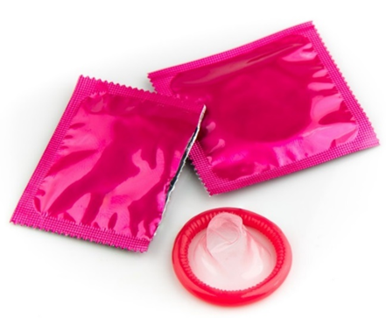
Nsobola ntya okweziyiza okufuna akawuka kamukenya nga n’egattira emabega ewafulumirwa?
Engeri esinga okweziyiza okufuna akawuka kamukenenya nga wegattira emabega ewafulumirwa kwe kukozesa akapiira kakalimpitawa n’e kisereza ekirimu amazzi (nga KY Jelly).
Ekisereza/ekigonza ekirimu ekizigo (nga Vasiline oba body lotion) kigya kuyuza condom era tekirina kukozesebwa.
Notes:
Engeri endala ez’okukeendeza obuzibu mulimu okukeendeza omuwendo gw’abantu bewegatta nabo era n’okulekerawo okwegattira emabega ewafulumirwa odde kungeri eddala ez’okwegata ezitali zabulabe nyo

Slide 11
Tekimanyiddwa obanga okukozesa akaweta ka dapivirine ak’omubukyala kiwa obukumi obutafuna akawuka kamukenenya nga kuyita mukwegattira emabega ewafulumirwa. Akaweta tekalina kusonsekebwa mabega mu kyenda ekifulumya obubi (rectum).
Nsobola ntya okweziyiza okufuna akawuka kamukenya nga n’egattira emabega ewafulumirwa?

Slide 12
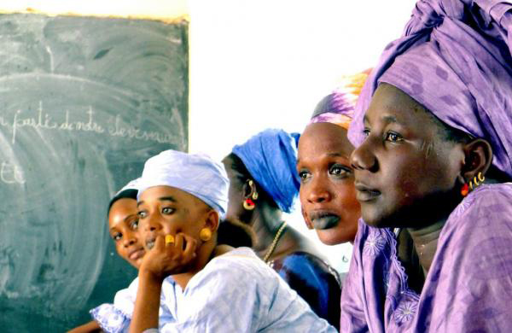
Lwaki mu HOPE, kyamugaso okwogera kukwegattira emabegga ewafulumirwa obubi?

Slide 13
Lwaki kyamugaso okwogera kukwegattira emabegga ewafulumirwa mu HOPE?
Abakyala n’abaami bangi tebamanyi nti okwegattira emabegga ewafulumirwa nga tokozeseza kapiira kakalimpitawa kibateeka mu katyabaga kamaanyi akokufuna akawuka kamukenenya n’edwadde endala eziyita mukwegatta.
Notes:
Omukozi mu kunoonyereza akusaba omubulire byonna ebikwata ku n’eyisa ez’okwegattira emabega ewafulumirwa okukakasa nti banakyewa bafuna amawulire gebetaaga okwekuma.
Akaweta tekakolebwa kuziyiza kawuka kamukenenya nga kayita mu kwegattira emabega ewafulumirwa obubi era tekalina kukozesebwa mabega mukyenda ekifulumya obubi (rectum).
Singa nakyewa afuna akawuka kamukenenya mukiseera ky’okunonyereza,okumanya kuneyisaye ku by’okwegattira emabegga ewafulumirwa kijjakuyamba abanoonyereza okutegeera oba nga akawuka kamukeneya kayinza okuba nga kayitira munkola enddala ez’okwegatta ezitaziyizibwa ng’okozesa akaweta k’omubukyala.

Slide 14
Abakozi mu kunoonyereza webali okukuyamba
Abakozi mu kunoonyereza webali okutegeeza era n’okubuddabudda banakyewa, abaami babwe, era n’abantu bo mu bitundu abalala ku bikwatta ku kwegattira emabega ewafulumirwa era n’ebibuuzo byonna oba okwemulugunya bye bayinza okuba nabyo. Era bagya kukikola nga tebakunenya era mungeri yekikugu.

Slide 15
Bwoba olina ebibuuzo oba wetaaga amawulire agasingawo, mwattu kyalira kilinika y’okunoonyereza

