Slide 1
Amawulire aga bakyala, baganzi babwe era nab’omubitundu

Slide 2
Biki ebyava mu kunoonyereza kwa ASPIRE?
Okutwalira awamu, Okunoonyereza kwa ASPIRE (MTN-020) kwalaga nti akaweta ka Dapivirine ak’omubukyala kaziyiza nga ekintundu kimu kyakusatu obulwadde bw’akawuka kamukenenya.
Notes:
Mu bakyala abaliwaggulu w’emyaka 21,abakozesa akaweta ebiseera ebisiinga okusiinga abakyala abato,abantu abasukka mubataano kubuli kummi baziyizibwa okwattibwa obulwadde bw’akawuka ka mukenenya. Mu ASPIRE, obukuumi obwamanyi bwalabikira mu nkozesa y’akaweta ennungi nga bwekatekeddwa okukozesebwa (mu bakyala basatu babiri baziyizibwa okukwattibwa akawuka ka mukenenya).

Slide 3
Biki ebyava mu kunoonyereza kwa ASPIRE?
Okufanagana ne nkola endala ez’okuziyiza, akaweta kakola singa kaba kakozesebwa mu butuufu era buli kiseera. Akaweta era tekalina bulabe, kitegeeza nti tekaleeta buzibu bwamaanyi ku bulamu.
Notes:
Okunoonyereza okulala okwagezesa akaweta ka Dapivirine, okuyitibwa IPM-027(The RING study) kwalaga ebyavaamu nga bifanagana.

Slide 4
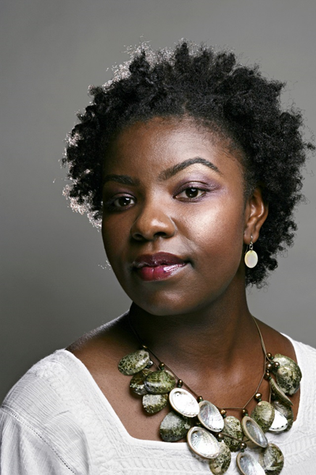
Buno buwanguzi bwamanyi obutandisobose awatali kwewayo kwa banakyewa baffe!
Biki ebyava mu kunoonyereza kwa ASPIRE?

Slide 5
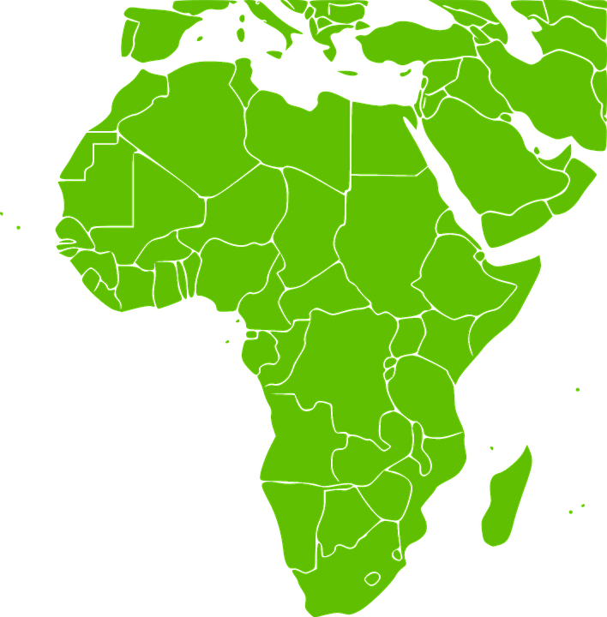
Akaweta ka Dapivirine kanafunika ddi mu bitundu byaffe gyetubeera?
IPM, ekibinja ekyakola akaweta,bakolagana ne gavumenti n’abantu abalala bebakolagana nabo n’ekigendererwa
eky’okusoboseza akaweta okufunika mu bitundu gyetubeera.
Tetumanyi oba akaweta kanafuna olukusa oba bbanga ki ddala lyekinatwaala nga akaweta tekannaba kubaawo, naye omutendeera gutera okumala emyaka egiwerako.
Notes:
Omutendera guno gulimu okufuna olukusa lungi okuva mu bitongole ebigoberera okunoonyereza ne mu ggwanga ly’enyini ate nga buli kimu kitwala obudde.

Slide 6
Lwaki okunoonyereza kwa HOPE Kukolebwa?
HOPE kwe kunoonyereza kwakaweta okamanyiddwa nti kakola, okukolebwa okuwa banakyewa akaweta akakola ngatekannaba kukoozesebwa mu bantu bomubitundu.
Notes:
Kwekunoonyereza okweyongeddeyo era kukolebwa okukungaanya amawulire amalala agakwata ku ddagala erikozesebwa nga ebikwata ku butaba nabulabe era n’okukozesa nga bw’otekeeddwa.

Slide 7
Ekigendererwa ekikulu eky’okunonyereza kwa HOPE kwekuwa banakyewa obusobozi okufuna akaweta k’omubukyala akalimu eddagala lya dapivirive, akalaze nti tekalina bulabe era n’okukeendeza omukisa gw’okufuna akawuka kamukenenya.
Lwaki okunoonyereza kwa HOPE Kukolebwa?

Slide 8
Ani alina ebisaanyizo okwetaba mu kunoonyereza kwa HOPE?
Mukiseera kino, abakyala bokka abetaba mu kunoonyereza kwa ASPIRE bebajja okulowoozebwako okuyingizibwa mu HOPE.
Abakyala bateekwa okutegeera ebisanyizo by’okunoonyereza era basalewo okukwetabamu.

Slide 9
Ani alina ebisaanyizo okwetaba mu kunoonyereza kwa HOPE?
Abakyala balina okubeera mumbeera ennungi ey’obulamu, tebalina kawuka ka mukenenya era nga tebali mbuto oba okuyonsa. Abakyala bajja kufuna okukebereebwa okwekisawo era nokwekebejjebwa okukakasa nti balina ebisanyizo okwetaba mu HOPE.

Slide 10
Okunoonyereza kunamala banga ki? Enkyala z’okunoonyereza zinabaawo buli banga ki?
Buli mukyala ayingizibwa ajja kubeera mu HOPE nga omwaka gumu (1).
Enkyala z’okunoonyereza zijja kuba zabuli mwezi mu myezi esatu egisooka eta zidde kumulundi gumu buli myezi esatu oluvanyumma lwekyo.

Slide 11
Mu HOPE akaweta k’omubukyala kali katya?
Abakyala bonna bajja kuweebwa akaweta k’omubukyala akalimu eddagala lya dapivirine okukakozesa buli mwezi.
Notes:
Obutafanana na ASPIRE,TEWALI buweta butalimu ddagala mu HOPE.

Slide 12
Abakyala abanayingizibwa mu HOPE banasabibwa kukolaki?
Abakyala bonna abalina ebisaanyizo baanirizibwa okwetaba mu HOPE era nokujjanga ku nkyala zokunoonyereza entegeke.

Slide 13
Abakyala abanayingizibwa mu HOPE banasabibwa kukolaki?
Abakyala bonna bajja kuweebwa akaweta komubukyala akalimu eddagala lya dapivirine okukakozesa buli mwezi.
Abakyala basobola okwetaba mu kunoonyereza sinsonga oba balonzewo akaweta nga enkola eyokuziyiza akawuka kamukenenya oba nedda.

Slide 14
Abakyala abanayingizibwa mu HOPE banasabibwa kukolaki?
Abakyala abalonzeko okaweta nga enkola eyokuziyiza akawuka ka mukenenya bajja kufuna okubuddabudibwa era nebiragiro ebikwata ku nkoseza y’akaweta era bajja kusabibwa okuddamu ebibuuzo ebikwata kukukozesa akaweta.

Slide 15
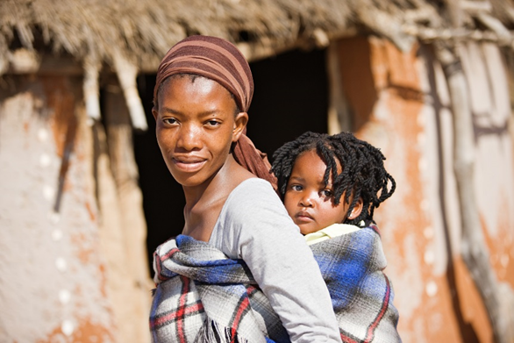
Abakyala abanayingizibwa mu HOPE banasabibwa kukolaki?
Banakyewa bayinza okukyusa endowooza yabwe ku kukozesa akaweta nebwebaba nga bamaze okuyingira mu kunoonyereza.
Jjukira, naye, nti akaweta kasobola okukuuma obutafuna akawuka kamukenenya singa kaba kakozesebwa.
Notes:
Banakyewa bonna kyebawayo kyamugaso mu kunoonyereza kasita babuliira omukozi mukunoonyereza nga tebakozesa kaweta.

Slide 16
Abakyala abanayingizibwa mu HOPE banasabibwa kukolaki?
Banakyewa bonna, abakoseza oba tebakozesa kaweta, bagya kusabibwa:
Okuddamu ebibuuzo ebikwata ku bulamu bwabwe n’eneyisa yabwe mu byokwegata
Okufuna okubudabudibwa ku kukendeza emukisa gy’okufuna akawuka ka mukenenya era n’obupiira bukalimpitawa
Okukozesa enkola eyokwegema okuzaala okuziyiza okufuna olubuto

Slide 17
Abakyala abanayingizibwa mu HOPE banasabibwa kukolaki?
Banakyewa bonna, abakozesa oba abatakozesa kaweta, bagya kusabibwa:
Ku nkyala ezimu, okufuna okeberebwa eby’obulamu
Okukeberebwa mu labu okutwaliramu okukebera endwadde eziyitira mu kwegata, olubuto era na kawuka kamukenenya
Okuwayo omusayi, enviiri z’okumutwe n’amazzi go mubukyala

Slide 18
Ate abakyala abanagaana okuyingizibwa mu HOPE?
Singa nakyewa asalawo nti tayagala kuyingira mu HOPE, ajja kubuuzibwa oba asobola okukola olukyala lumu okuwa amawulire agakwata ku lwaki aganye okuyingira mu HOPE.

Slide 19
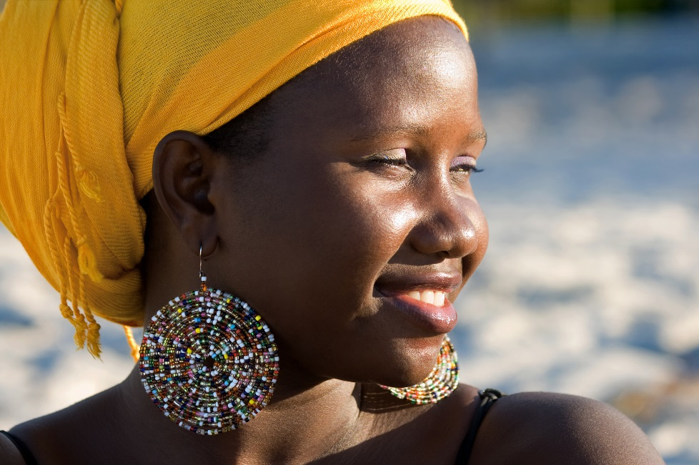
Ate abakyala abanagaana okuyingizibwa mu HOPE?
Banakyewa abagaana okuyingizibwa bayinza okukyusa endoowoza yabwe ne bayingira mu HOPE singa okunoonyereza kuba kukyagenda maaso era nga batuukiriza ebisanyizo.

Slide 20
Mulimu buzibu ki?
Obuzibu bwokwetaba mu HOPE bufanana no bwa ASPIRE:
Oyinza obutewulira bulungi oba obulumi okuva ku kukeberebwa oba okugyibwako omusayi.
Akaweta ko mubukyala kayinza obutayisa bulungi abakyala abamu era abamu bayinza okufuna okusiyibwa, obundula amazzi oba obubonero obulala

Slide 21
Mulimu buzibu ki?
Oyinza okukwatibwa ensonyi olw’ebibuuzo era n’emitendera mu kunoonyereza.
Kisoboka gwe oba muganziwo okuwulira akaweta nga muli mukikolwa eky’okwegatta

Slide 22
Mulimu buzibu ki?
Mu mbeera etatera kubaawo bwoba nga okwatidwa akawuka ka mukenenya, akawuka ka mukenenya k’olina kayiinza okumanyiira eddagala singa oba weyongedde okukozesa akaweta.
Kisoboka nti abantu abalala bayinza okukuyisa mungeri etali yabwenkanya oba okukusosola olwo kwetaba mu kunoonyereza.

Slide 23
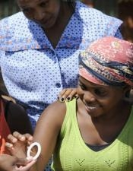
Mulimu migaso ki?
Ng’oli mu kunoonyereza, abakyala mu HOPE bagya kuweebwa akaweta k’omubukyala akasaangibwa nga tekalina bulabe era nga kakola mu kuziyiza okwattibwa akawuka kamukenenya.

Slide 24
Mulimu migaso ki?
Abakyala mu kunoonyereza era bajja kufuna okukeberebwa okwekisawo, okukeberebwa okulaba obulamu bwabwe, enkola ey’okwegema okuzaala, okubudabudibwa era n’okukeberebwa akawuka kamukenenya n’endwadde eziyitira mu kwegatta era n’obujjanjabi oba okuwerezebwa ewalala, nga bwekyetaagisa.

Slide 25
Biki abaganzi/abaami era n’abantu b’omubitundu bye basobola okukola?
Eri abakyala abalina ebisanyizo, okusalawo oba oyingira mu HOPE era oba okozesa akaweta wesalirawo wekka ggwe ng’omuntu. Abakyala bakubirizibwa okukubaganya ebirowozo kukyebasazewo ne baganzi/baami babwe era nabantu abalala ab’omugaso gyebali.
Notes:
Abakozi mu kunoonyereza bajja kukuuma abikwata kubakyala mu kunoonyereza nga byakyaama era webaali okwogera ku HOPE n’okuddamu ebibuuzo byonna abaganzi/abaami oba abantu b’omubitundu byebalina,nga bwekyetaagisa. Nga tubawaggira,abaami na bantu b’omubitundu nabo bayamba okulwanyisa akawuka/obulwadde bw’amukenenya`

Slide 26
Singa oba n’ebibuuzo oba wetaaga okumanya ebisingawo, tukusaba okyalire kilinika y’okunoonyereza.

