Slide 1

MTN-027 Clinical Management CRFs

Slide 2
CRFs for Clinical Management
Physical Exam
Pelvic Exam Diagrams
Pelvic Exam
Pelvic Exam Ring Assessment
Clinical Product Hold/Discontinuation Log
Adverse Experience Log

Slide 3
Physical Exam (PX-1)
PX-1 completed at Screening, Enrollment and Follow-up Visits
  All items require a response at Screening and Enrollment
  Items 8-16 do not need to be evaluated after Enrollment – mark ‘not done’ if not completed
Use Notes line to describe abnormal findings
    Option to use notes line to describe normal findings as well (ex. normally healed scar)
Record/update abnormal findings on PRE CRF prior to Enrollment and on the AE log CRF during follow-up
If one staff member completes vitals and a separate person does the exam assessments, ensure that both staff initials and date are indicated (use brackets as needed)

Slide 4
Pelvic Exam (PE-1)
Completed at Screening, Enrollment, and all follow-up visits
Abnormal findings columns arranged by location with a general ‘other’ column
Lists abnormalities using terms in FGGT
Record abnormal findings on PRE CRF prior to Enrollment and on the AE log CRF during follow-up
  include anatomical location
  Grade using DAIDS FGGT (Addendum 1)

Slide 5
Pelvic Exam Diagrams
(non-DataFax)
Completed whenever a pelvic exam is conducted
Used as the source document for all normal and abnormal pelvic exam findings
When completing, keep in mind that someone else may look at this form prior to the participant’s next pelvic exam. Be descriptive!
Record all abnormal findings on the Pelvic Exam CRF

Slide 6
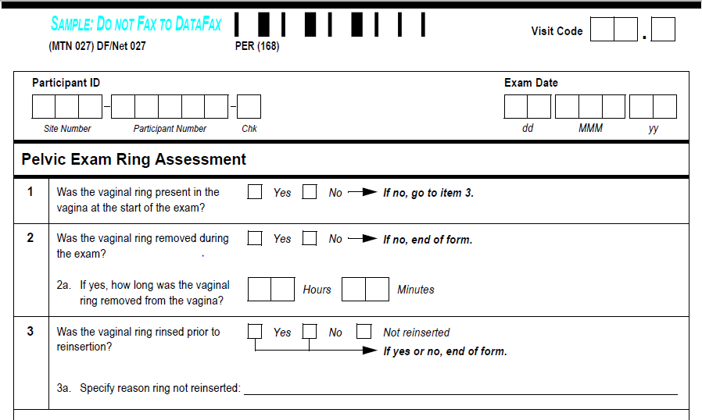
Pelvic Exam Ring Assessment (PER-1)
Complete whenever a pelvic exam is conducted during the study product period
Do not duplicate documentation of pelvic exam ring outages on the Ring Adherence CRF

Slide 7
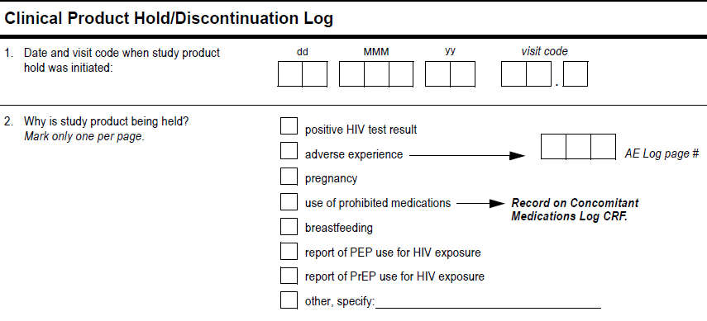
Clinical Product Hold/Discontinuation (PH) Log
Complete only for site-initiated product holds/discontinuations prior to Day 28
Complete one for each reason for hold (item 2), even if overlap in days
  Tells SCHARP # days off product due to each reason

Slide 8
Clinical Product Hold/Discontinuation (PH) Log
If hold due to AE, record AE Log Page #
  AE Date Reported to Site and item 3 visit code = PH Log item 1 hold date and visit code

Slide 9

Clinical Product Hold/Discontinuation Log
In item 3, record the date of last study product use. This date should be on or before the date that the clinical product hold was initiated

Slide 10
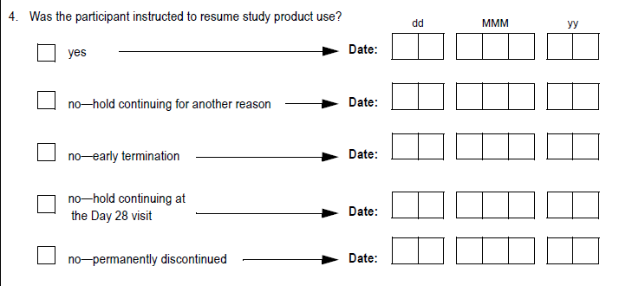
Clinical Product Hold/Discontinuation Log
If item 4 unknown at time of hold, leave blank and fax form to DF/Net
Once item 4 known, update and refax form
If “no—hold for another reason” is marked, record the date that the participant would have been
instructed to resume study product use based on resolution of the reason indicated in item 2.
Notes:
For example, if a participant is on product hold due to an AE and due to reported use of PEP. Two PH log CRFs will be completed. If the AE that precipitates the product hold resolves and the participant continues to use PEP, record the date that the participant would be been instructed to resume study product based on the resolution of the AE. In other words, record the date that the participant would have been instructed to resume study product if not for the use of PEP.

Slide 11
Clinical Product Hold/Discontinuation Log
If “no-hold continuing at the Day 28 visit” is marked, record the date the Day 28 visit was
completed. If the Day 28 visit was missed, record the target date. If the reason
for the hold later meets criteria for permanent discontinuation between the Day 28 visit and the
date of termination, update the response to “no-permanently discontinued” and record the date the
reason first met criteria for permanent discontinuation

Slide 12
Clinical Product Hold/Discontinuation Log
If “no—permanently discontinued” is marked, record the date the reason in item 2 met criteria
for permanent discontinuation.
Note: This date could fall anytime between enrollment through and including the date of
termination.
Notes:
For

Slide 13
AE CRF Reporting
All AEs in MTN-027 are reportable on an AE Log CRF.
AE reporting period = randomization through termination date

Slide 14
Page Number
For each participant, assign page numbers starting with “01” for the first AE completed for the ppt
Continue assigning page numbers in sequential ascending order (02, 03, 04, etc) until ppt is terminated
  Do not start page numbers over at each visit
Do not re-assign page numbers
Do not assign an AE page number more than once per ppt

Slide 15
Date AE Reported to Site
Is the date clinic staff became aware of the AE
This could be:
  Date of a clinic visit/assessment
  Date of a phone call in which a new AE is reported
  Date clinic staff become aware of an abnormal lab result
  Cannot be before the AE onset date (item 2)
Complete date (day, month, and year) is required

Slide 16
Onset Date
Date AE began at given severity/frequency
This could be:
  Date of a clinic visit/assessment/exam
  Date ppt-reported symptom started/worsened
  Collection date of sample that yielded an abnormal lab result
  On or prior to Date Reported to Site
Complete date (day, month, and year) is required

Slide 17
AE Text Description
Report only one diagnosis, symptom or sign per page
  Record a unifying diagnosis whenever possible
Avoid using abbreviations
  Is “BOM” burning on micturition or bilateral otitis media?
Review for correct spelling
  Variations in spelling can lead to differences in AE coding, which means similar AEs will appear in different places in AE safety reports
Do not report surgeries as AEs
  These are treatments

Slide 18
AE Text Description
Include anatomical location if not already stated
    E.g., vaginal ulcer, cervical erythema
For lab AEs, include direction of lab value (increased or decreased)
Record as much detail as possible to accurately and completely describe the AE
  E.g., “red papular rash on upper arms” rather than “rash”
Item 1 text is used for MedDRA coding

Slide 19
MedDRA Coding at SCHARP
AEs are coded once two data entry passes have occurred
Automatic coding when there is an exact match between AE text and a MedDRA LL term
Manually-coded if no exact match
A Clinical Query to the sites if they need more or better information in order to code
  AE text ambiguous, inconsistent with comments, or not descriptive enough

Slide 20
AE Text – things to note
If an STI test result is positive
  report the STI diagnosis (i.e., genitourinary gonorrhea) rather than as “X test positive”
“Genital ulcer disease” is not a codable event. Need to note a specific STI if possible; otherwise report “Ulcer” with anatomical location(s)
Reporting of assault
    Report each physical adverse event as an AE
    In AE text, add “….due to assault”

Slide 21
Documenting AEs due to ring removal/insertion
If the AE is due to the act of study ring insertion or removal, include this information in the AE Text (item 1).
    - Ex., “pelvic pain due to ring removal” or “vulvar laceration due to ring insertion” rather than just “pelvic pain” or “vulvar laceration.”
    - AEs that are due to act of IVR ring insertion or removal are assigned unique procedural coding terms within MedDRA.
However, if the AE is not due to the act of study ring insertion or removal, do not mention the vaginal ring in item 1 or in the Comments section when providing rationale for relationship to study product.
  We will know which AEs are related to ring use by Item 5 (relationship to study product)
  If Comments indicate that the AE is due to the act of ring insertion or removal, this same text needs to be in item 1. If not, this may result in a Clinical Query asking that this information be added to item 1 so that the AE is described completely.

Slide 22
Onset and Outcome Dates:
Items 2 and 7a
Onset and outcome dates can be based on
  Participant self-report
  Clinical exam dates
  Specimen collection dates (laboratory AEs)
Record a complete date whenever available,
  month and year required

Slide 23
Severity (Item 4)
AE Log - mark severity grade per
  DAIDS Toxicity Table
  FGGT Table (Addendum 1)

Slide 24
Relationship to Study Product (Item 5)
A rationale or alternative etiology of the AE is required in the Comments section regardless of the relationship of the AE to study product

Slide 25
Study Product Administration (Item 6)
“No change” if the AE does not warrant a hold or permanent discontinuation
  Mark even if the ppt is already on a hold for another reason
“Held” for each AE that meets criteria for a clinical product hold
  Mark even if ppt is already on a product hold
  Do not mark if ppt opts to refuse product because of this AE
    For each AE Log with “Held” marked, SCHARP will expect a “matching” Clinical Product Hold/Discontinuation Log with reason for hold = AE and the matching AE Log page #

Slide 26
Study Product Administration (Item 6)
“Permanently discontinued” is marked for each AE that requires permanent discontinuation
“N/A” should be marked if the AE occurred after the participant discontinued study product, if study product is held or discontinued for a different AE or reason, or if the AE is grade 5 (death)

Slide 27
Study Product Administration (con’t)
AE Log - if “Held” is initially marked, and study product use is later permanently discontinued due to the AE, you do not need to update this item on the AE Log
  We will get this data from the Clinical Product Hold/Discontinuation Log form
  Should be rare

Slide 28
Status/Outcome: Items 7 and 7a
If AE is ongoing when the CRF page is first completed, mark “continuing” and leave item 7a blank
Once a “continuing” AE’s outcome is determined:
  Line through the “Continuing” box
  Mark the appropriate box for item 7
  Record the appropriate outcome date in item 7a
  Initial, date, and refax
Use “continuing at end of study participation” if AE ongoing at time participant is terminated

Slide 29
Status/Outcome: Items 7 and 7a
If an AE increases in severity grade:
  Close out the current CRF page (lower grade) by updating item 7 to “severity/frequency increased”, record the date of increase, and Initial/date/refax.
  Complete a new AE Log page for the new (higher grade) AE. Onset Date = outcome date of previous AE. Use same AE text as lower grade, if applicable and if possible.
Improvements in AE severity do not require changes to AE Log CRF
  Do include in chart note
  Ex: a Gr. 4 AE improves to Grade 3. No changes to AE Log CRF item 7 – must wait until AE resolves (returns to baseline severity)

Slide 30
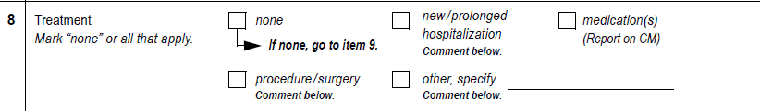
Treatment: Item 8
Mark all meds/treatments used and/or prescribed for the AE
  Participant self-report is fine
Once confirmed that meds/treatment used, record on Con Meds Log
If discovered that ppt did not use treatment/meds, change item 8 response to “other” and specify reason

Slide 31

SAE and EAE: Items 9 and 10
Item 9: mark “yes” if AE meets SAE criteria
For item 10, mark “yes” if AE has been or will be reported as an EAE
  For MTN-027, if Item 9 is marked ‘yes’, item 10 should also be marked ‘yes’.

Slide 32
For AEs Reported as EAEs
Compare AE Log form and EAE form for consistency:
Note that some cases may involve 1 EAE report but several AE Log forms (for example, a motor vehicle accident)
Discrepancies will result in a clinical query
If a previously-reported EAE is updated, update the matching AE Log form when applicable and re-fax
Fax the AE Log form to DF/Net at the same time as submitting the EAE report
Contact SCHARP PM or Clinical Affairs with any questions related to AE/EAE consistency

Slide 33
Pre-existing Condition: Item 11
Review Pre-existing Conditions form and participant’s chart to see if AE is worsening of an ongoing pre-existing condition

Slide 34
Comments Field
Include comments for all AEs reported to record rational or alternative etiology
Use to record additional notes as needed, making sure any comments are consistent with the AE text (item 1)
Avoid adding comments that refer to the vaginal ring itself.

Slide 35
Storage and Faxing
Recommendation = store all AE Log forms for a participant within one section of ppt study notebook
Consider methods to identify AE Log pages that have “continuing” AEs to help ensure these are reviewed and updated at each visit until outcome
Per MTN DM SOP, fax completed AE Log CRFs within 3 days of site awareness whenever possible

Slide 36
How to Mark AE Log Forms for Delete
Draw a diagonal line across the page, write “delete due to _____” and initial, date, and refax
Keep the AE Log form in the participant’s study notebook
Do not re-assign the AE Log page number
The deleted AE Log page remains in the database but will not be included in any reports or data analyses

