Slide 1
Follow-up Case Report Forms SCHARP

Slide 2
Follow-up Visit CRFs
Date of Visit
Follow-up Visit Summary
Ring Adherence (Y/N) prompt
Laboratory Results
Family Planning
Ring Collection/Insertion
Specimen Storage
HIV Test Results
Adverse Experience Y/N prompt
Pregnancy Test Results
Additional Study Procedures (Y/N prompt)
Monthly
Visits

Slide 3
Follow-up Visit CRFs
Date of Visit
Follow-up Visit Summary
Ring Adherence (Y/N) prompt
Laboratory Results
Family Planning
Ring Collection/Insertion
Specimen Storage
HIV Test Results
Adverse Experience Y/N prompt
Pregnancy Test Results
Additional Study Procedures (Y/N prompt)
Quarterly
Visits
Behavior Assessment (Y/N Prompt) – Month 3
ACASI Tracking – Month 3

Slide 4
Follow-up Visit CRFs
Date of Visit
Follow-up Visit Summary
Ring Adherence (Y/N) prompt
Laboratory Results
Family Planning
Ring Collection/Insertion
Specimen Storage
HIV Test Results
Adverse Experience Y/N prompt
Pregnancy Test Results
Additional Study Procedures (Y/N prompt)
Product Use End Visits
Behavior Assessment (Y/N Prompt) – Month 3
ACASI Tracking – Month 3
Pelvic Exam (+ Pelvic Exam diagrams – non Rave form)
Physical Exam
Vital Signs
STI Test Results
Vaginal Practices (Y/N Prompt)
Social Influences Assessment (Y/N Prompt)

Slide 5
Follow-up Visit CRFs
Date of Visit
Follow-up Visit Summary
Ring Adherence (Y/N) prompt
Laboratory Results
Family Planning
Ring Collection/Insertion
Specimen Storage
HIV Test Results
Adverse Experience Y/N prompt
Pregnancy Test Results
Additional Study Procedures (Y/N prompt)
Behavior Assessment (Y/N Prompt) – Month 3
ACASI Tracking – Month 3
Pelvic Exam (+ Pelvic Exam diagrams – non Rave form)
Physical Exam
Vital Signs
STI Test Results
Vaginal Practices (Y/N Prompt)
Social Influences Assessment (Y/N Prompt)
Notes:
Many of these forms were reviewed as part of the Phase I of the MTN-025 Protocol trainings and so we will concentrate on those forms that are unique to follow-up.

Slide 6
Date of Visit Form
First form completed within Medidata Rave for each required or interim follow-up visit
If participant completed the visit, the visit date is required
If participant did not complete a scheduled follow-up visit, Missed Visit CRF will populate within visit folder

Slide 7
Follow-up Visit Summary
Completed for each required or interim follow-up visit
Captures information on location of visit, prompts for ppt’s use of PEP or PrEP since last visit (to be completed during the visit)
Asks if the visit in an interim visit, and if so, the reason for the visit
Documents if this is the ppt’s PUEV, early termination, or termination visit
For split visits, complete only 1 Visit Summary CRF on the first date of that visit

Slide 8
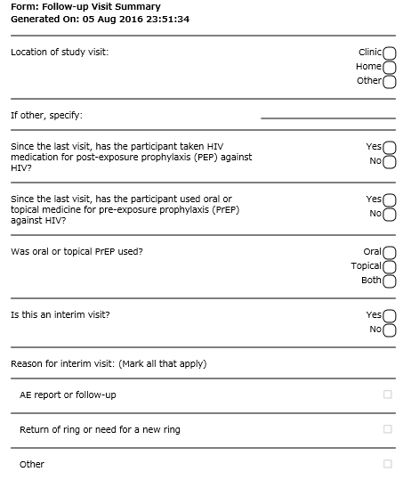
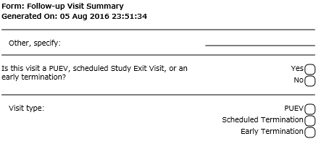
Follow-up Visit Summary CRF
Notes:
This is an example of the HOPE Follow-up Visit Summary CRF. If completing a paper CRF, space will be provided at the top of the form to designate the study visit for which the Follow-up Visit Summary CRF is completed.

Slide 9
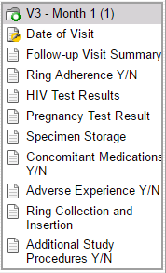
Ring Adherence Y/N Prompt
Marking ‘yes’, that a participant has used a ring since her last visit will add the Ring Adherence CRF to the visit folder
If ‘no’, the Ring Adherence CRF is not completed
Notes:
The Ring Adherence Y/N Prompt is required at each scheduled visit during follow-up. A Ring Adherence Yes No Prompt question will appear within each follow-up folder. If, since the participant’s last study visit, she has ever used a vaginal ring, mark yes. This item should be marked yes if the participant was provided a ring at her last study visit (i.e., has had access to the ring). When Yes is marked, the Ring Adherence CRF will dynamically appear. If this question is marked, “no”, the Ring Adherence CRF will not appear within the visit folder. For example, if the participant has been permanently discontinued from study product prior to this visit, this prompt would be marked ‘no’ and the Ring Adherence CRF will not be completed at this visit for this participant.

Slide 10
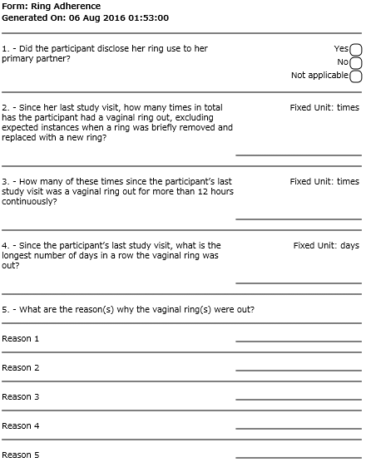
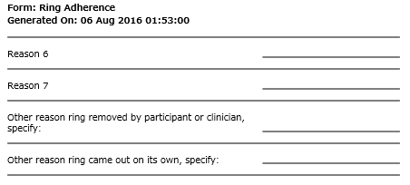
Ring Adherence CRF
Item 2 – try to include all times the ring has been out, including times removed and re-inserted by site staff at an interim visit
**Note: Do not include expected ring removals due to ring swaps between quarterly visits
Item 5 – indicate up to 7 reasons reported by the participant
Leave “other” reasons blank unless the reason is not listed
Notes:
This is an example of the Ring Adherence CRF. These items are per participant report and should be answered based on the participant’s best recollection of ring use since her last study visit.
In Item 1, “Did the participant disclose her ring use to her primary partner?”, mark “not applicable” if the participant indicates that she does not have a primary partner. For item 2, attempt to include all the times that the ring has bene out, including times that the ring was removed and re-inserted by site staff at an interim visit, if applicable. Please not the any expected removals due to ring swaps between quarterly visits by the participant should not be I
The purpose of Item 2 which asks, “Since her last study visit, how many times in total has the participant had a vaginal ring out, excluding expected instances when a ring was briefly remove and replaced with a new ring?” is to capture all instances since the participant’s last study visit when the ring was either expelled on its own or was removed by the participant or a clinician, but excluding brief ring removals when a participant is expected to replace a new ring on a monthly basis (at a scheduled visit or at home during the quarterly follow-up phase). Do not count instances when the ring was removed and momentarily out to be replaced for a new ring.
In Item 5, indicate up to 7 reasons why the vaginal ring or rings were out since the participant’s last visit. At least one reason why the ring or rings were out is required. If the reason is not listed in the table provided within the CCGs, provide the reason in the provided ‘other’ fields. Otherwise, leave these items blank.

Slide 11
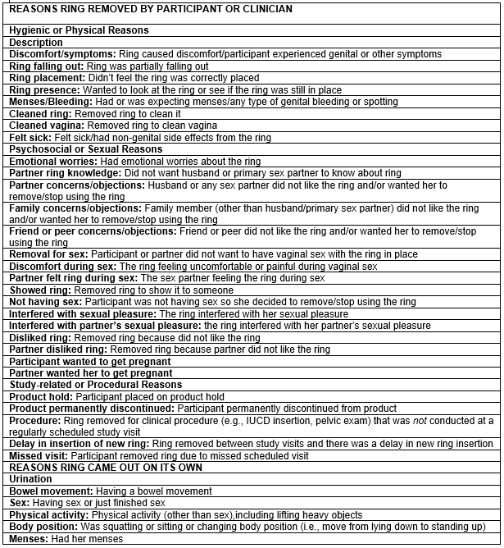
Ring Adherence CRF
Item 5: If completing a paper CRF prior to data entry into Medidata Rave, reference the list of reasons for ring removal within the CRF Completion Guidelines (CCGs)
Indicate “had her menses” if ppt removed ring due to any type of genital bleeding or spotting
Notes:
If completing this form as a paper CRF prior to completion of an eCRF within Medidata Rave, reference to the list of Reasons why the ring was removed by the participant or clinician within the CRF Completion Guidelines (CCGs) when completing Item 5 and enter in the applicable reason or reasons. If completing this form as an eCRF within Medidata Rave, a drop down menu will be provided for each reason field to select the applicable reason.

Slide 12
Ring Adherence CRF
Form is not interviewer-administered (read aloud word-for-word and translated), but is completed based on information obtained from the participant regarding her ring use
Use participant’s best estimates for number of ring outages since the last visit
Completed at all scheduled follow-up visits through PUEV for participants who have used the ring since the last study visit.
Not completed at interim visits

Slide 13
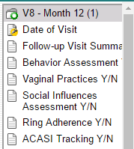
Behavior Assessment Y/N Prompt
This prompt will appear with the visit for which the Behavior Assessment is required (quarterly, PUEV)
Marking ‘yes’ on this form will dynamically add the Behavior Assessment CRF to the participant’s visit folder.
Notes:
The Behavior Assessment Y/N Prompt is required at quarterly visits and at PUEV. A Behavior Assessment Yes No Prompt question will appear within each follow-up folder. If the Behavior Assessment questionnaire as completed at the study visit, mark yes. When Yes is marked, the Behavior Assessment CRF will dynamically appear. If this question is marked, “no”, the Behavior Assessment CRF will not appear within the visit folder.

Slide 14
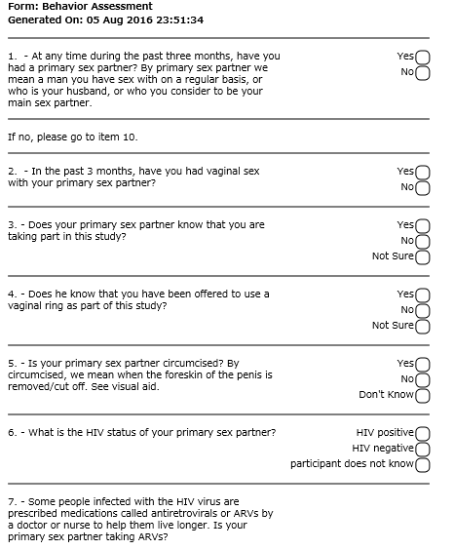
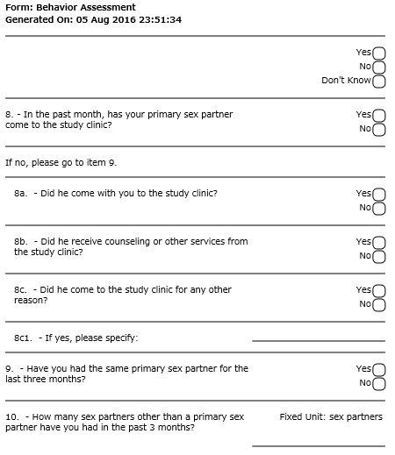
Behavior Assessment CRF

Slide 15
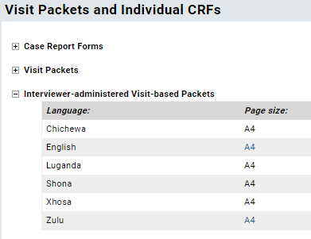
Behavior Assessment CRF
Interviewer-administered, forms available in local language on MTN-025 Atlas webpage
Items 1-17 ask about sex partners, sex frequency, condom use, intimate partner violence
Item 18 – is ppt bothered wearing the ring?

Slide 16
Behavior Assessment CRF
Item 19 – social benefit related to study participation in last 3 months; complete Social Benefits Log CRF
Item 20 – social harm related to study participation in the last 3 months’ complete Social Impact Log CRF
Items 21-26 - completed at PUEV or Early Termination Only
Items ask about ring worries, vaginal practices, ring storage issues and partner preferences, HIV prevention methods
Leave these items blank at all other visits
Notes:
Item 18 on the BA asks the participant generally if the participant is bothered to wear the ring every day. If the participant has not used the ring during HOPE, mark “not applicable”.
Item 19 asks the participant is she has experience a positive change, event, or experience in her life related to study participation. If ‘yes’ is marked, complete a Social benefits Log or check to make sure that a social benefits log form has already been completed for this event.
Item 20 asks the participant is she has experience a negative change, event, or experience in her life related to study participation. If ‘yes’ is marked, complete a Social Impact Log or check to make sure that a social Impact log form has already been completed for this event.

Slide 17
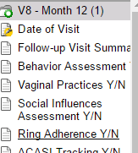
Vaginal Practices Y/N Prompt
Marking ‘yes’ on this form will dynamically add the Behavior Assessment CRF to the participant’s visit folder.
Notes:
The Vaginal Practices Y/N Prompt is required at each scheduled visit during follow-up. A Vaginal Practices Yes No Prompt question will appear within each follow-up folder. If the vaginal Practices questionnaire was completed at this visit, mark yes. When Yes is marked, the Vaginal Practices CRF will dynamically appear. If this question is marked, “no”, the Vaginal Practices CRF will not appear within the visit folder. For example, if the participant has been permanently discontinued from study product prior to this visit, this prompt would be marked ‘no’ and Vaginal Practices CRF will not be completed at this visit for this participant.

Slide 18
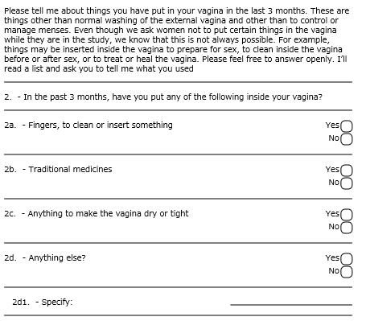
Vaginal Practices CRF
Notes:
For item 1, mark NA if the participant has not had menses or spotting in the last three months and skip to the paragraph above Item 2 on the second page.

Slide 19
Vaginal Practices CRF
Required at PUEV
Interviewer-administered in local language
Similar questions as Baseline Vaginal Practices
Item 1
In the past 3 months, what have you used to control or manage the menstrual blood or spotting?
Item 2
Sub-item 2a (whether ppt has inserted fingers to clean or insert something the past 3 months does not include Vaginal Ring insertion

Slide 20
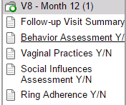
Social Influences Y/N Prompt
Marking ‘yes’ on this form will dynamically add the Study Influences Assessment CRF to the participant’s visit folder.
Notes:
The Study Influences Y/N Prompt is required at each scheduled visit during follow-up. A Study Influences Assessment Yes No Prompt question will appear within each follow-up folder. If the Study Influences Assessment questionnaire was completed at this visit, mark yes. When Yes is marked, the Study Influences Assessment CRF will dynamically appear. If this question is marked, “no”, Study Influences Assessment CRF will not appear within the visit folder. For example, if the participant has been permanently discontinued from study product prior to this visit, this prompt would be marked ‘no’ and Study Influences Assessment CRF will not be completed at this visit for this participant.

Slide 21
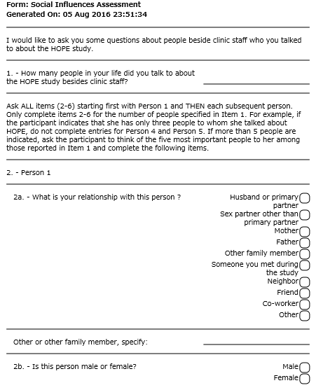
Social Influences Assessment CRF
Required at PUEV
Interviewer-administered in local language
No changes in content from MTN-020

Slide 22
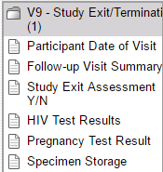
Study Exit Assessment Y/N Prompt
Marking ‘yes’ on this form will dynamically add the Study Exit Assessment CRF to the participant’s visit folder.
Notes:
The Study Exit Assessment Y/N Prompt is required at each scheduled visit during follow-up. A Study Exit Assessment Yes No Prompt question will appear within each follow-up folder. If the Study Exit Assessment questionnaire was completed at this visit, mark yes. When Yes is marked, the Study Exit Assessment CRF will dynamically appear. If this question is marked, “no”, Study Exit Assessment CRF will not appear within the visit folder. For example, if the participant has been permanently discontinued from study product prior to this visit, this prompt would be marked ‘no’ and Study Exit Assessment CRF will not be completed at this visit for this participant.

Slide 23
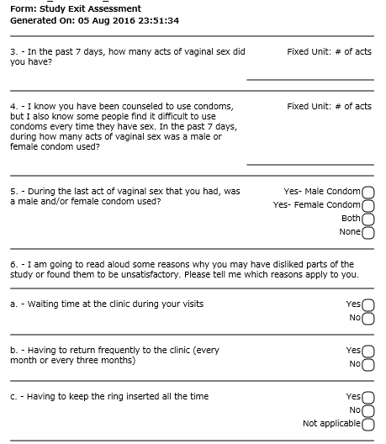
Social Exit Assessment CRF
Required at SEV
Interviewer-administered in local language
Items include sexual behavior, condom use, study participation, ring use and interest in future ring use

Slide 24
Social Benefits Log CRF
New form for HOPE
Social Benefit – positive change, event, or experience in participant’s life related to HOPE study participation
Ppts will be specifically asked about social benefits every 3 months and at PUEV (via BA CRF), but can report (and site to document) a social benefit at any time during the study

Slide 25
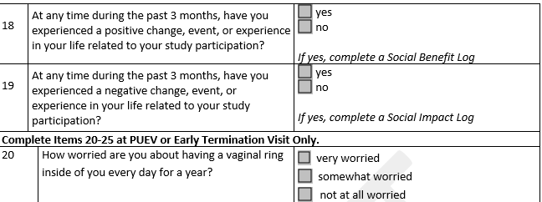
Social Benefits – BA Trigger
Item 18: Prompt for social benefits quarterly and at PUEV (if not already reported)
If a social benefit is reported in-between quarterly visits, mark “yes” at the next quarterly visit and make sure a Social Benefits Log was completed at the time of the initial report.

Slide 26
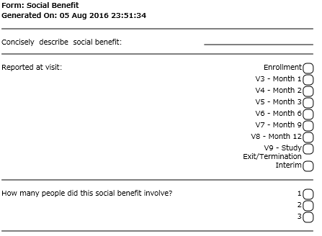
Social Benefits Log CRF

Slide 27
Other Follow-up CRFs – Notes
Physical Exam
Only General Appearance and Abdomen/Gastrointestinal required during if physical exam assessment completed during follow-up
Required at PUEV; completed if indicated at other visits
Vital Signs
Height is not required at follow-up
Required at PUEV; completed if indicated at other visits
Family Planning
Update Family Planning Log as needed during follow-up with entries for new FP/contraceptives taken and end dates for any methods stopped.
Leave baseline items blank (If FP method is the same as in ASPIRE and if not, the reason for changing/stopping)
Note: The Family Planning Log is accessed through the V2- Enrollment visit folder.
Vaginal Ring Tracking Log
Close out any open entries on the log to indicate an outcome for each ring provided to the participant
Notes:
Some notes regarding other forms where some items differs between completion of the forms at baseline and during follow-up.

Slide 28
Social Harms Reporting in HOPE

Slide 29
Social Harms
Social Harm - non-medical adverse social consequence of study participation
Ex: stigma/discrimination from members of community or family, difficulties in personal relationships with partners, family, or friends
Ppts will be specifically asked about social harms every 3 months and at PUEV (via BA CRF), but can report (and site to document) a social harm at any time during the study
Documented on Social Impact Log
Notes:
Despite efforts to protect participant’s confidentiality and privacy, participants may experience social harms as a result of participating in HOPE. Social harms are defined as non-medical social consequences that are related to study participants and some examples include discrimination/stigma from community or family members or problems in personal relationships. Participants will be explicitly asked to report any social harms at each quarterly visit and at PUEV and should be encouraged to report social harms spontaneously at any study visit.
Strategies for preparing for and responding to social harms are detailed in the SSP.
For HOPE, we will capturing social harms that directly relate to study participation on a Social Impact Log CRF.
Next we will go through a couple scenarios when a social harm would be reported and how to document this incident.

Slide 30
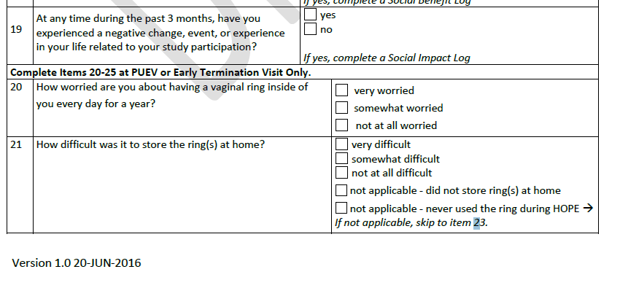
Social Harms – BA Trigger
Item 19: Prompt for social harms quarterly and at PUEV (if not already reported)
If a social harm is reported in-between quarterly visits, mark “yes” at the next quarterly visit and make sure a Social Impact Log was completed at the time of the initial report.

Slide 31
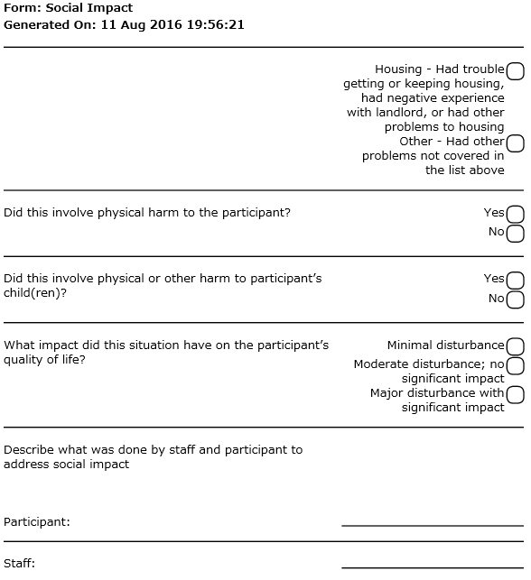
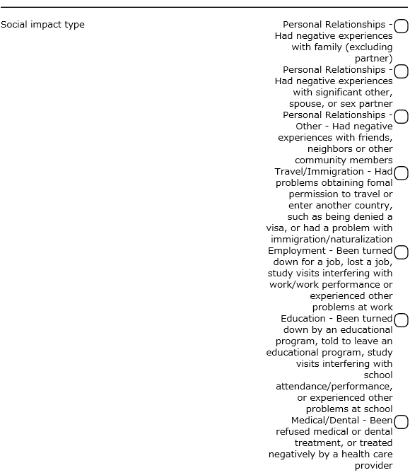
Social Impact Log CRF
Notes:
If the social impact involved physical harm to the participant, assess whether the harm is a reportable AE. If so, complete an AE log CRF, as applicable.

Slide 32
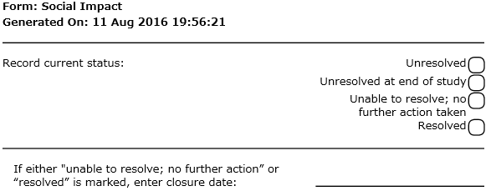
Social Impact Log CRF
If a social harm is considered unresolved when reported to the site, update this item to provide a resolution, when known.

Slide 33
Unresolved (Ongoing) Social Harms Report
Ongoing social harms are followed until resolution, it has been determined they will not be resolved, or the end of the study
SCHARP provides a site specific monthly social harms report
Includes all ‘unresolved’ social harms that have been ongoing for more than 30 days
If social harm is continuing (per ppt), no updates to CRF
If resolved, update social impact log CRF

Slide 34
Intimate Partner Violence (IPV)
Complete Social Impact Log if “yes” and event was related to study participation
Complete AE Log, if indicated (criteria defined in SSP Section 11.1) and report as EAE, if required (criteria defined in SSP Section 11.2)
Regardless of whether IPV meets criteria for reporting as a Social Harm or AE, always provide appropriate support, counseling, and referrals to the participant.

Slide 35
Adverse Event Documentation: AE Log and GAE Log CRF Completion SCHARP

Slide 36
Reportable AEs – Report on AE Log CRF
All genital, genitourinary, and reproductive system AEs except:
Fetal losses
Expected genital bleeding per clinical assessment
All Grade 2 and higher AEs
All SAEs
All AEs that results in permanent product discontinuation
All lab AEs
All EAEs
Any AE not covered above will go on a
Grade 1 AE Log CRF
Notes:
Any genital bleeding this is deemed expected by clinical assessment is not reportable as an AE. Genital bleeding this is expected includes bleeding due to contraceptive use.

Slide 37
Why both an AE and GAE CRF?
AE Log is submitted to SCHARP
used to collect reportable AE data in the database
Grade 1 AE Log (paper CRF) is not submitted to SCHARP
used to document non-reportable AEs
used in case these AEs become reportable per-protocol at some point in the future
Used together, they can be source for AE and follow-up med history documentation

Slide 38
AE and GAE: Date Reported to Site

Slide 39
Date Reported to Site
Date clinic staff became aware of the AE
This could be:
Date of a clinic visit/assessment
Date of a phone call in which a new AE is reported
Date clinic staff become aware of an abnormal lab result Recorded on AE Log only, since all lab AEs go on this form
Cannot be before the AE onset date (item 2)
Complete date (day, month, and year) is required

Slide 40
AE and GAE: Item 1 (AE Text)

Slide 41
AE Text Description
Report only one diagnosis, symptom or sign per page
Record a unifying diagnosis whenever possible
Avoid using abbreviations
Abbreviations for the following laboratory tests acceptable:
AST (SGOT), ALT (SGPT), WBC, MCV, Hgb, Hct
Review for correct spelling
Variations in spelling can lead to differences in AE coding, which means similar AEs will appear differently in AE safety reports
Do not report surgeries as AEs
These are treatments listed within an AE log form

Slide 42
AE Text Description
Include anatomical location if not already stated
For lab AEs, include direction of lab value (increased or decreased)
Record as much detail as possible to accurately and completely describe the AE
E.g., “red papular rash on upper arms” rather than “rash”
Item 1 text is used for MedDRA coding
Only AEs on AE Log are coded, since GAE CRFs are not submitted to SCHARP

Slide 43
MedDRA Coding – Brief Overview
MedDRA: standardized dictionary of medical terminology
Results from ICH initiative to standardize terms used world-wide to describe safety events in research studies
ASPIRE and IPM studies – also coded using MedDRA
- Since both studies are evaluating the same product in similar populations, the more we can do to ensure consistency of safety data across studies, the more informative the study results will be

Slide 44
MedDRA Coding – Brief Overview
MedDRA Structure – 5 levels
System Organ Class (SOC): 26
High Level Group Term (HLGT): 333
High Level Term (HLT): 1685
Preferred Term (PT): 15,149
Lower Level Term (LLT): ~65,000
LLT “maps” the AE to categories in the 4 upper levels
Coding Example:
SOC: Blood & Lymphatic System Disorders
HLGT: White Blood Cell Disorders
HLT: Neutropenias
PT: Neutropenia
LLT: Neutropenia
Notes:
Other more common option: LLT metrorrhagia → PT metrorrhagia → HLT Menstruation and uterine bleeding → HLGT Menstrual cycle and uterine bleeding disorders → SOC Reproductive and Breast Disorders

Slide 45
MedDRA Coding at SCHARP
AEs are coded once two data entry passes have occurred
Automatic coding when there is an exact match between AE text and a MedDRA LL term
Manually-coded if no exact match
SCHARP will send a Clinical Query to the sites if they need more or better information in order to code
AE text ambiguous, inconsistent with comments, or not descriptive enough

Slide 46
AE Text MedDRA Coding - Things to Consider in ASPIRE
Mention of the vaginal ring in AE text
If the AE is due to the act of study ring insertion or removal, include this information in the AE text description (Item 1)
Ex: “pelvic pain due to ring removal”
Ex: “vulvar laceration due to ring insertion”
Text about the ring will cause AEs to be coded to device MedDRA terms rather than a term that describes the AE
If the AE is NOT due to the act of study ring insertion/removal, do not include mention of the ring in AE text description
Ex: “pelvic pain while ring is in place”
Notes:
When completing the AE text description, do not include information on relatedness to study product or timing of study product use in the AE term/description. Limit the AE text to the medical description and anatomical location, when needed. Including text such as “after ring insertion” or “at site of ring placement” affects the way the AE is MedDRA-coded, and thus, how it will appear in safety reports.
However, when reporting AEs which are due to the act of ring removal or insertion, specifically, please follow the guidance below:
• If the AE is due to the act of study ring insertion or removal, include this information in the AE text. For example, use AE text of “pelvic pain due to ring removal” or “vulvar laceration due to ring insertion” rather than just “pelvic pain” or “vulvar laceration.”
It is important to clearly identify AEs that are due to the act of study ring insertion or removal because these AEs are assigned unique coding terms within the standardized MedDRA coding system.
If the AE is not due to the act of study ring insertion or removal, do not include mention of the ring in the AE text.
• If text is present in the “Comments” field that the AE is due to the act of ring insertion or removal, this same text needs to be in item 1. If not, this may result in a Clinical Query asking that this information be added to item 1 in order to accurately and completely describe this AE.

Slide 47
AE Text MedDRA Coding - Things to Consider in ASPIRE
Reproductive/Genital Pain AE severity grading
Use the pain row on the FGGT rather than the grading provided on the general tox table.
Note: Per the pain row of the FGGT, if any type of non-narcotic medication is taken for the pelvic/reproductive pain AE, the AE must be at least a severity grade of 2

Slide 48
AE Text – Lessons from ASPIRE
If a ppt reports pain in the abdominal region, probe to determine if it is truly abdominal pain or if the source is some other area/organ
Specify exact anatomical location of the pain
Examples: uterine pain, pelvic pain, urethral pain, ovarian pain, bladder pain, vulvovaginal pain, perineal pain
Do not use ‘suprapubic pain’ as it does not provide a precise enough anatomical location
If an STI test result is positive
report the STI diagnosis (i.e., genitourinary gonorrhea) rather than as“X test positive”

Slide 49
AE Text – Lessons from ASPIRE
Pregnancy outcomes should not be reported as AEs (i.e., spontaneous abortions) – only the resulting maternal complications (if any)
“Genital ulcer disease” is not a codeable event. Need to note a specific STI OR they should just report “Ulcer” with the anatomical location(s)
Example: “vaginal ulcer”

Slide 50
A Bit More on Clinical Queries
Applied within Medidata Rave by SCHARP Clinical Affairs
AE clinical coding clarification or a safety query
AE clarification; product hold clarification
Are resolved by making additions or corrections on applicable eCRF to the data in question and submitting updates
Any corrections to eCRFs should also be made to paper CRFs completed, if applicable.
Notes:
AE clinical coding clarification or a safety or clinical query (i.e., lab value(s), product hold clarification, AE reporting)
Emailed to designated clinical site staff as a pdf
Are resolved by making additions or corrections on applicable CRF to the data in question

Slide 51
Onset and Outcome Dates
Onset and outcome dates can be based on
Participant self-report
Physical and/or pelvic exam dates
Specimen collection dates (laboratory AEs)
Record a complete date whenever available
month and year required

Slide 52
Severity (Toxicity) Grade
AE Log - mark severity grade per FGGT or General Tox Table
If condition appears on both tox tables, use FGGT to assess for severity
GAE Log has ‘Grade 1’ box marked for you – no need to complete this item
If you start a GAE for a Grade 2 or higher AE:
Stop the form at item 1
Draw a diagonal line across page, add note “Recorded on AE Log page XYZ”, initial and date
Keep this GAE page in binder; do not delete!

Slide 53
Relationship to Study Product
If “not related”, record rationale or known cause of AE in the Comments section of the form
May use “not biologically plausible”
For example: earache
Notes:
\

Slide 54
Study Product Administration
“No change” if the AE does not warrant any change to the ppt’s use or non-use of study product
Ppt is using product and will continue to use product
Ppt is on a product hold (for a reason other than this AE) and will continue to remain on a hold
“Held” for each AE that requires a clinical product hold
Mark even if ppt is already on a product hold or if the ppt did not accept the ring previously
Do not mark if ppt refuses product based on this AE
Note: For each AE Log with “Held” marked, SCHARP will expect a “matching” Product Hold/Discontinuation Log with reason for hold = AE and the matching AE Log page #

Slide 55
Study Product Administration
“Permanently discontinued” for each AE that requires permanent discontinuation
Mark even if the ppt did not accept the ring previously
“N/A” should be marked if the AE is reported
on or after the PUEV
on or after the visit where ppt is permanently discontinued from study product

Slide 56
Status/Outcome:
If AE is ongoing when the CRF page is first completed, mark “continuing” and leave outcome date
Will need to update status at some point; SCHARP will provide listings to help
Note instructions for “resolved” status – if a med is used to control the AE, keep the AE as “continuing” as long as the medications is indicated
Once a “continuing” AE’s outcome is determined:
Line through (on a paper CRF) and/or update (in Rave) the “Continuing” box
Mark the appropriate box for item 6
Record the appropriate outcome date
Initial and date any paper CRFs, resave eCRFs within Rave
Use “continuing at end of study participation” if AE ongoing at time participant is terminated

Slide 57
Status/Outcome
If an AE on an AE Log or GAE Log increases in severity grade:
Close out the current CRF page (lower grade) by updating item 6 to “severity/frequency increased”, record the date of increase, and resubmit the form.
Complete a new AE Log page for the new (higher grade) AE. Onset Date = outcome date of previous AE. Use same AE text as lower grade, if applicable.

Slide 58
Status/Outcome
Improvements in AE severity do not require changes to AE Log CRF
Document in chart notes
For example, a Grade 4 AE improves to Grade 3. No changes to AE Log CRF item 6 – must wait until AE resolves or returns to baseline status

Slide 59
Treatment
Mark all treatments the ppt reports using for the AE
Ppt self-report is fine
Only mark treatments/meds that have used (not ones indicated but not yet used); use “other” for meds/actions indicated but not yet used
Once med or procedure has taken place, update this item and resubmit the form.
All meds taken should also go on the Con Meds Log
Specify the concomitant medication log line associated with the AE
Hospitalization – GAE form contains a note to stop and report AE on AE Log
Document AE on AE Log per previous guidance on reportable AEs

Slide 60
SAE and EAE
SAE item: mark “yes” if AE meets SAE criteria
On GAE, the SAE question is already pre-marked as “no”
EAE item: mark “yes” if AE has been or will be reported as an EAE
Enter in the EAE number in the space provided in the AE log CRF
On GAE this item has been pre-marked as “no”; if yes, stop GAE,
Document on AE Log per previous guidance

Slide 61
For AEs Reported as EAEs
Compare AE Log form and EAE form for consistency:
Protocol and PTID
AE term
Onset date
Severity
Relationship to study product
Note that some cases may involve 1 EAE report but several AE Log forms (for example, a motor vehicle accident)
Discrepancies will result in a clinical query
If a previously-reported EAE is updated, update the matching AE Log form when applicable and re-fax
Fax the AE Log form to SCHARP at the same time as submitting the EAE report
Contact SCHARP CDM or Clinical Affairs with any questions related to AE/EAE consistency

Slide 62
Baseline Medical Condition
Will need to review completed Baseline Medical History Log forms to see if the AE is a worsening of an ongoing baseline medical condition.
If the AE is a worsening of a baseline condition, complete end date for this condition within the applicable log line.

Slide 63
Comments Field
Comments field is a required field to capture rationale for relatedness of AE to study product
Tell the “story” for why the AE is considered related
Use Comments to record additional notes as needed, making sure any comments are consistent with the AE text
If the AE is not due to the act of study ring insertion/removal, do not include mention of ring in the comments
If there is text that the AE is related to act of ring insertion/removal, ensure the same text is also in Item 1

Slide 64
Log Form Storage
Recommendation = store all AE Log forms for a participant within one section of her study notebook; same for GAE Log
Consider methods to identify AE/GAE Log pages that have “continuing” AEs to help ensure these are reviewed and updated at each visit until outcome
Each month, SCHARP will provide an “Unresolved AE” listing that lists AEs that have been continuing for 90 or more days
Submit AE Log CRFs within 3 days of site awareness, whenever possible

Slide 65
Clinical Product Hold/Discontinuation Log
All clinical product holds and permanent discontinuations initiated by study staff should be documented
Form not completed in cases of ppt decline
Complete a separate log CRF for each reason a hold or perm d/c is required
1 PH Log CRF per reason, even if multiple reasons for hold at a given visit
Complete even if ppt is already on hold (e.g., a pregnant ppt has a genital finding requiring a hold)
CRF updated once product hold outcome is determined
Should also be completed for participants who are not currently using study product/have never used product
1 Document any clinical reasons that would have required a product hold had the participant been using the ring

Slide 66
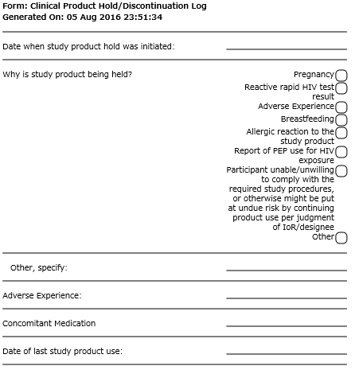
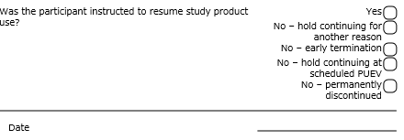
Clinical Product Hold/Discontinuation Log
Date hold initiated – date at which clinic staff initiated the hold
Item 2 – reason for the hold
Mark only one reason per CRF page
If study product is held due to a reason associated with an AE, specify the applicable AE on this form

Slide 67
Product Hold/Discontinuation Log CRF, cont’d
Date Vaginal Ring Was Last in Place
Can be per participant report
Use best estimate if exact day is not known
Unless it is known that this is a permanent discontinuation, leave the remaining items blank and save the page, if completing an eCRF.
Once staff have determined if product use will be resumed or not, complete item 4 and resubmit the form to SCHARP

Slide 68
Product Hold/Discontinuation Log CRF, cont’d
Was the Participant Instructed to Resume Product?
“yes” if ppt will resume product use
Record date ring inserted or date product would have been resumed for participant who did not accept the ring previously
“no – hold continuing for another reason” if ppt would have resumed product use based on the reason marked on this form, but is continuing on product hold for another reason (documented on a separate PH Log CRF)
Record date use would have resumed
“no – early termination” if ppt terminates early and the hold was ongoing at time of early termination
Record date of early termination

Slide 69
Product Hold/Discontinuation Log CRF, con’t
Was the Participant Instructed to Resume Product?
– continued
“no – hold continuing at scheduled PUEV” if hold ongoing when ppt completes her scheduled PUEV
Record PUEV date
“no – permanently discontinued” if ppt was permanently discontinued prior to PUEV/early termination
Record date it was determined by study staff the ppt would be permanently discontinued from study product

Slide 70
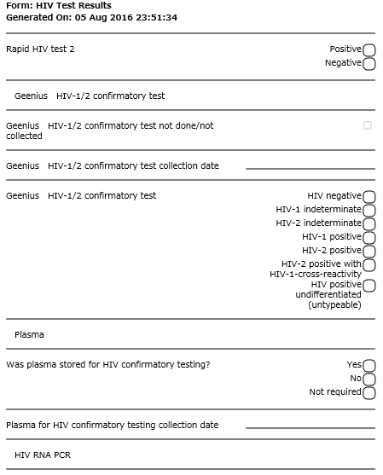
HIV Test Results
Required at each follow-up visit
Documents:
HIV Rapid test results
Geenius confirmatory test results
Confirmatory plasma storage
HIV RNA PCR
CD4+

Slide 71
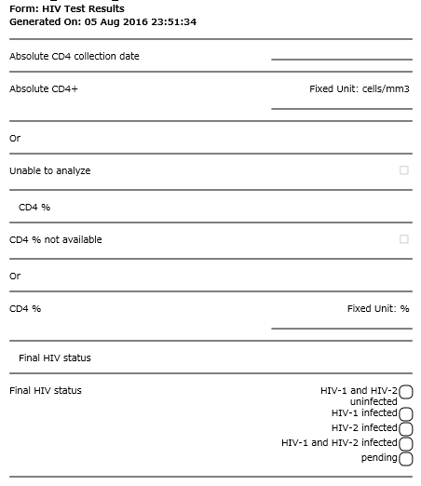
HIV Test Results
If at least one HIV rapid test is reactive and confirmatory testing is indicated, the ‘Final HIV status’ is required
If marked ‘pending’, update this item when final outcome known
Notes:
If at least one of the HIV rapid tests is reactive, additional confirmatory testing is required to determine the final HIV status. If the final HIV status is pending further confirmatory testing, mark pending for the last item on this form. Remember to revisit this form and provide a final HIV status when know.

Slide 72
Seroconverter Test Results Y/N Prompt
Seroconverter Laboratory Results Y/N prompts asks whether participant is enrolled in MTN-015.
If “no”, collect HIV RNA PCR, T Cell subsets, CD4 results and plasma storage on the Seroconverter Lab Results CRF
If “yes”, the Seroconverter Laboratory Results CRF not required

Slide 73
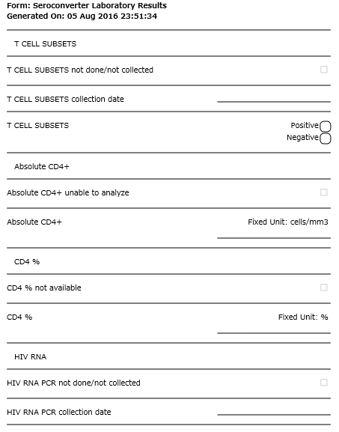
Seroconverter Test Results
This form is required at every visit after seroconversion (unless participant is enrolled in MTN-015)
Documents T Cell Subsets, CD4+, HIV RNA PCR, seroconverter plasma storage

Slide 74
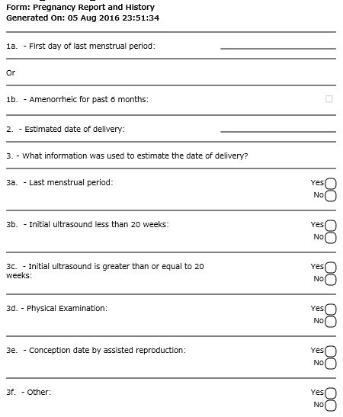
Pregnancy Report and History
If hCG test results is positive at any visit, Pregnancy Report and History CRF required
No changes from MTN-020 CRF

Slide 75
Pregnancy Outcome Y/N Prompt
Pregnancy Outcome Y/N prompts asks whether each pregnancy reported during the study has an obtainable outcome
If “yes”, Pregnancy Outcome CRF will be dynamically added to visit folder
If “no”, site to confirm with SCHARP at the end of the visit that no outcome could be obtained by the site

Slide 76
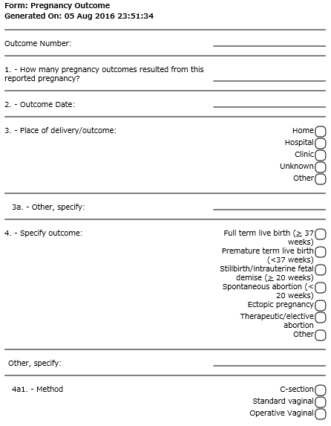
Pregnancy Outcome
For every Pregnancy Report and History CRF, a Pregnancy Outcome CRF is required
No content changes from MTN-020 CRF

Slide 77
Questions?

