Slide 1
Dapivirine Vaginal Ring
The Licensure Program
Annaléne Nel, CMO
ASPIRE Protocol Team Meeting
10 Feb 2013, Bethesda, USA

Slide 2
Dapivirine Ring Program Timelines
2012
2013
2014
2015
2016
DPV Ring Regulatory Consultations
Regulatory submissions for product approval
The Ring Study
ASPIRE
Drug-drug interaction
Women > 45 safety
Male condom compatibility
Adolescent safety
Female condom compatibility
Open-label / post-marketing studies

Slide 3
Dapivirine Ring Licensure Program
IPM 027
The Ring Study
Long-term safety and efficacy study
MTN-020
ASPIRE
Safety and effectiveness study
Additional planned safety studies
Drug-Drug interactions
Condom compatibility: Male and Female
Safety in Adolescents and Post-menopausal women
1650 participants, ongoing (2012-2015) in Africa
3476 participants, planned (2012-2014) in Africa
1100 participants on Ring-004
~1738 participants on Ring-004

Slide 4
Dapivirine Ring Phase III Program
 | IPM 027 The Ring Study | MTN-020 ASPIRE
Study Objectives | Safety and efficacy | Safety and effectiveness
Study design | Double-blind, randomized (2:1), placebo-controlled | Double-blind, randomized (1:1), placebo-controlled
Endpoints | Approx 80 endpoints; 2 year on IP | Endpoint driven: 120 endpoints
Power | 83.2% power to detect 50% treatment effect | 90% power to detect 60% treatment effect with a lower bound of 25% treatment effect
Targeted enrollment | 1650 women, ages 18-45 1100 on Ring-004 | 3476 women, ages 18-45 Approx 1737 on Ring-004
Sites in Africa | 5-6 IPM research center partners in South Africa (n=4) and Uganda (n=1) | 13-16 MTN clinical research centers in 5 countries (NIH CTUs)
Participant follow-up | 2 years + 6 weeks following ring discontinuation | Approx 1-2 years + 4 weeks following ring discontinuation
Initiation | Q1-2012 | Q2 2012

Slide 5
IPM 027 The Ring Study
Annaléne Nel, CMO
On behalf of the IPM 027 Team
Co-Chair: Saidi Kapiga
SA National PI: Linda-Gail Bekker
IPM Director Clinical Operations: Val Kidd

Slide 6
The Ring Study
IPM 027
Protocol Version 1.0 Amendment 1.0 Dated 23 January 2012
A MULTI-CENTRE, RANDOMISED, DOUBLE-BLIND, PLACEBO-CONTROLLED SAFETY AND EFFICACY TRIAL OF A DAPIVIRINE VAGINAL MATRIX RING IN HEALTHY HIV-NEGATIVE WOMEN
Study design | Double-blind, Randomized (2:1), Placebo-controlled
IP | Vaginal rings inserted every 4 weeks ± 7 days
Endpoints | Approx 80 endpoints; 2 year on IP
Power | 83.2% power to detect 50% treatment effect
Targeted enrollment | 1650 women, ages 18-45 1100 on Ring-004
Sites in Africa | 5-6 IPM research center partners in 2-3 countries
Participant follow-up | 2 years + 6 weeks following ring discontinuation

Slide 7
The Ring Study (IPM 027)
Study objectives:
Primary: Long-term safety and efficacy of dapivirine ring when inserted once every 4 weeks over a period of 24 months
Secondary: Incidence of HIV-2; incidence of STIs; pregnancy; adherence and acceptability; frequency of drug resistance

Slide 8
IPM 027 : Clinical Research Center Partners
Madibeng Center for Research (MCR)
Brits, South Africa
Maternal, Adolescent and Child Health (MatCH)
Edendale South Africa
Qhakaza Mbokodo (QM)
Ladysmith, South Africa
Prevention of HIV/AIDS Project (PHIVA)
Pinetown, South Africa
Medical Research Council (MRC)
Masaka, Uganda
8

Slide 9
Key Risks : “The Big Five”
Recruitment
“Safety”
Retention Adherence
“Safety”
Data Quality
“Safety”
Community Engagement
Rumours
“Safety”
Research Centre Operations
“Safety”

Slide 10
Recruitment
Retention Adherence
Data Quality
Community Engagement
Rumours
Research Centre Operations

Slide 11
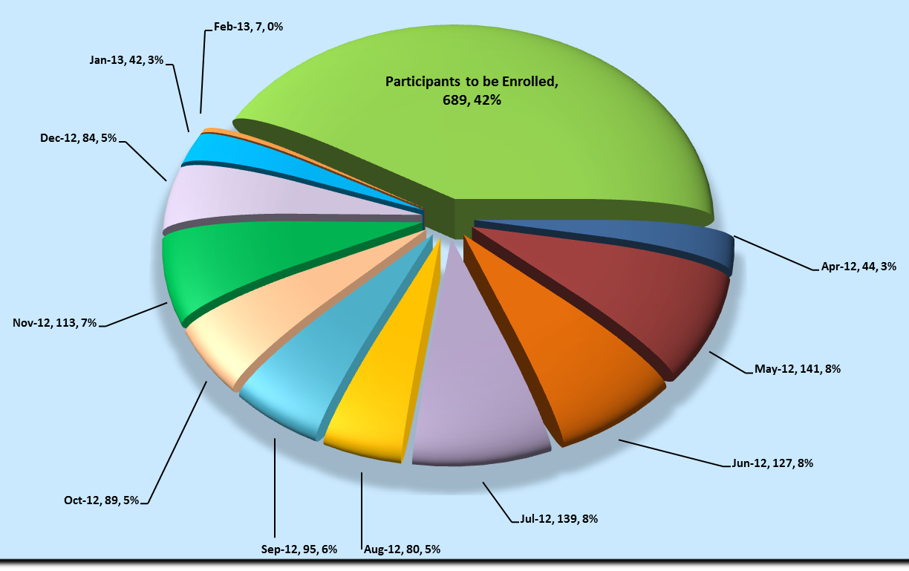
IPM 027: Monthly Enrollment
Snapshot: 7 February 2013
7 Feb ‘13 | Screened 1834 | Enrolled 961

Slide 12
IPM 027: Screening & Enrolment
 | Screened | Enrolled
MCR | 483 | 273
MatCH | 452 | 260
QM | 486 | 203
PHIVA | 413 | 225
MRC, Uganda | Expected FPI May ‘13
Total | 1834 | 961
Snapshot: 7 February 2013
Screening : Enrolment 2:1

Slide 13
Screen Failures
HIV positive at Screening
Cervical Cytology Abnormalities
Symptomatic for Genital Infections
Unstable form of Contraception
Grade 2 or higher abnormal lab values
Pregnant or Breastfeeding
Non-stable chronic diseases
Investigator Opinion

Slide 14
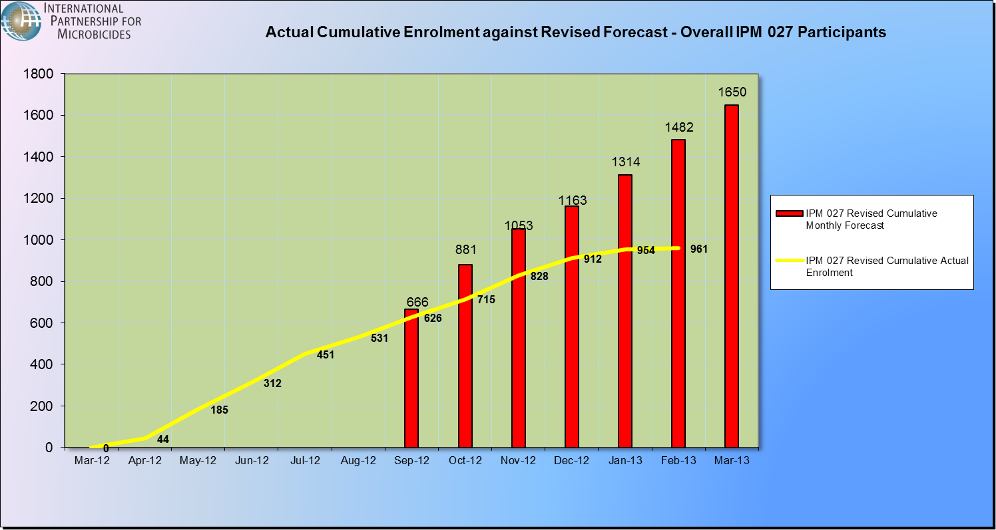
Accumulative Participant Enrolment/Month
Snapshot: 7 February 2013

Slide 15
Recruitment
Retention Adherence
Data Quality
Community Engagement
Rumours
Research Centre Operations

Slide 16
IPM 027: Protocol Visit Adherence
91% | 94% | 94% | 93% | 92% | 92% | 91% | 92% | 99% | 100%
Snapshot: 7 February 2013
Average Monthly Visit Retention 91%

Slide 17
IPM 027: Visit Adherence per Month
100% | 99% | 99% | 98% | 95% | 93% | 92% | 88% | 91%
Snapshot: 7 February 2013
Average Monthly Visit Retention 91%

Slide 18
Early Discontinuations
HIV-1 infections
Relocation out of district
Partner pressure
Withdrawal of informed consent
Other medical reasons

Slide 19
Recruitment
Retention Adherence
Data Quality
Community Engagement Rumours
Research Centre Operations

Slide 20
Data Quality Metrics
97.2% of records currently in database are clean
40.6% of records clean on arrival
10% QC rate per 100 records currently in database

Slide 21
Monitoring
CRF backlog to be monitored
Current focus to monitor data for May DSMB meeting
Quintiles has implemented a plan to meet the target for the DSMB meeting
All participant visits up to 31 Dec 2012 to be monitored by end Feb 2013
Collaboration between CRAs, site staff and IPM
Ongoing discussions regarding quality of monitoring and monitoring reports

Slide 22
CRF Faxing
IPM 027 Screening Totals: IXRS 1813 DF Net 1621
IPM 027 Enrolment Totals: IXRS 954 DF Net 817
IPM 027 Follow-up Visit Totals: IXRS 4409 DF Net 3505
*IXRS: Interactive Voice and Web Response Systems

Slide 23
Frequent Monitoring Report Findings
Snapshot 31 January 2013
23
Notes:
23

Slide 24
Recruitment
Retention Adherence
Data Quality
Community Engagement
Rumours
Research Centre Operations

Slide 25
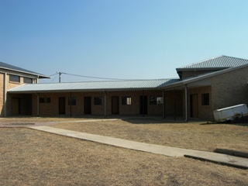
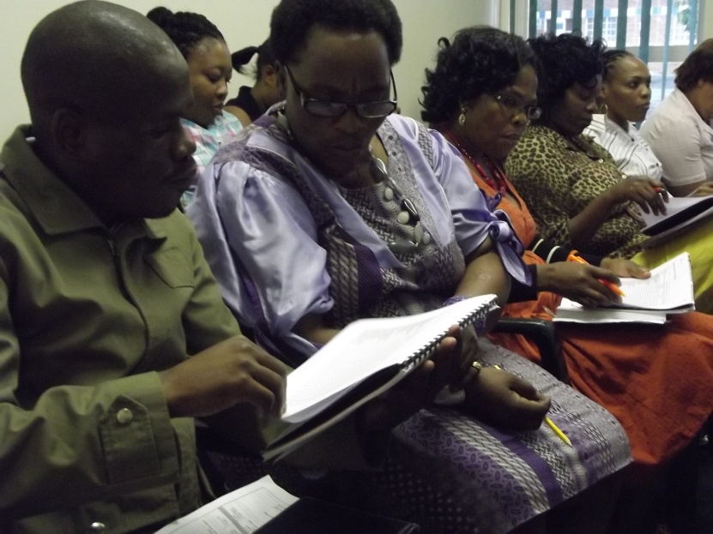
Operations….
Infrastructure for growth
Resource allocation with retention focus
Critical Staff contingency planning
Training needs management
Community rumours mitigation
Community events
Retention officer engagement
Message standardisation

Slide 26
The Ring Study 2013… Plan for Success
Retention: Protocol adherence & Ring use
Recruitment: Getting to 1650
Data: Quality Management
Participant Care: Safety, Pharmacy, Laboratory
Community Engagement: Outreach activities that continue to keep communities, participants and our teams motivated and engaged
Collaborative team efforts

