Slide 1
MTN-028 Laboratory Related CRFs

Slide 2
Laboratory Related CRFs
Pharmacokinetics Specimens (PKS-1) - Enrollment, Day 28
Pharmacokinetics Specimens (PKD-1) - Days 1, 2, 3, 7, 14, 21, 29, 30, 31, 35)
Specimen Storage
HIV Results
HIV Confirmatory Results
Ring Collection and Insertion
Safety Laboratory Results
STI Test Results

Slide 3
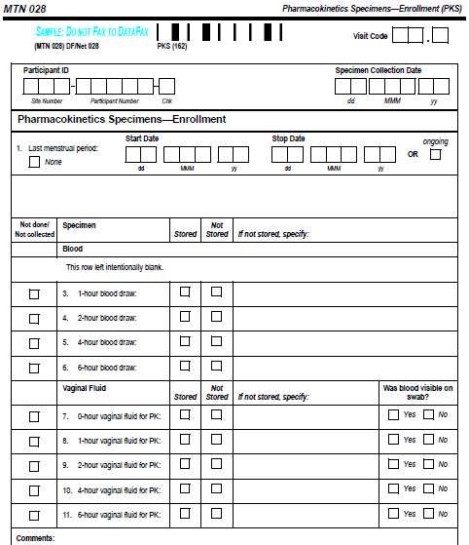
Pharmacokinetics – Enrollment CRF
Record start and stop date for last menstrual period during the last 30 days
Select if blood and vaginal fluid samples for PK were stored, not stored or not collected
If not stored, specify why
There is no item 2 on the Enrollment form because there is no 0-hour blood draw at enrollment
Collection times are documented on the LDMS tracking form

Slide 4
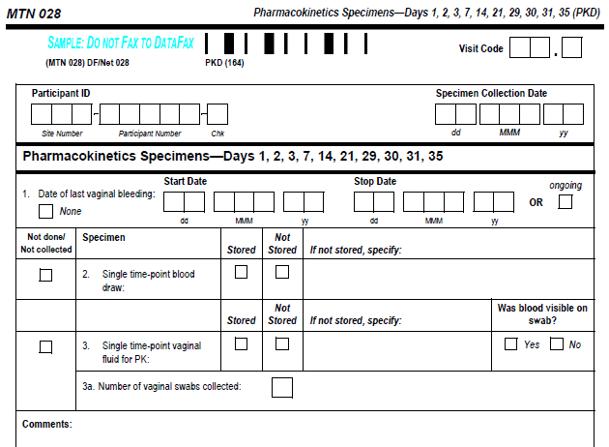
Pharmacokinetics – Days 1-21, 29-35 CRF
Record the start and stop date for occurrence of last vaginal bleeding in the last 30 days
Select if the single-time blood and vaginal fluid for PK were stored, not stored or not collected
If not stored, specify why

Slide 5
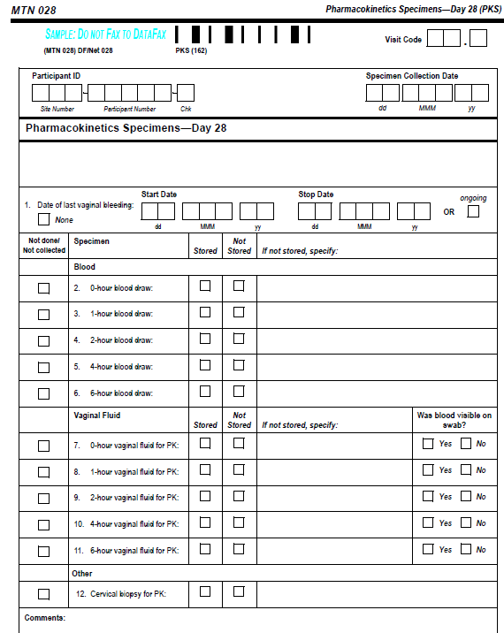
Pharmacokinetics – Day 28 CRF
Similar to the Enrollment PK form, except the Day 28 form includes the 0-hour blood draw and last date of vaginal bleeding question
If silver nitrate/monsels solution is used to stop bleeding during the collection of cervical biopsies, this should be noted in the comments section to better inform PK analyses

Slide 6
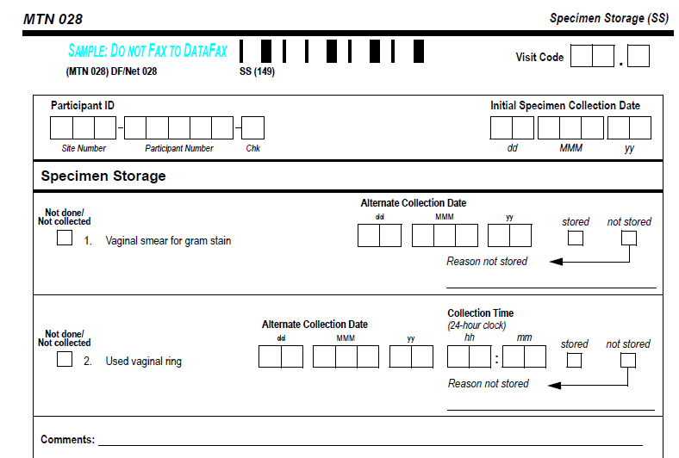
Specimen Storage (SS-1) CRF
Specimen Storage form:
Completed at Enrollment, Day 3, Day 28 and Day 35
Documentation for:
Vaginal smear for gram stain
Collection of the used vaginal ring and collection time

Slide 7
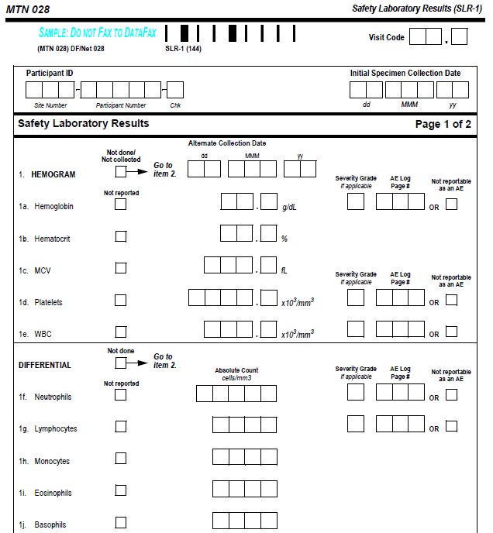
Safety Laboratory Results (SLR-1) CRF
Safety Laboratory Results CRF: Complete at Enrollment and at Day 28 and 35 Visits
Page 1 documents Hemogram and Differential
If Severity is Grade 1 or higher, it should be entered, if below Grade 1 leave the “Severity Grade” box blank
Record any AE Log Page #’s associated with the lab result

Slide 8
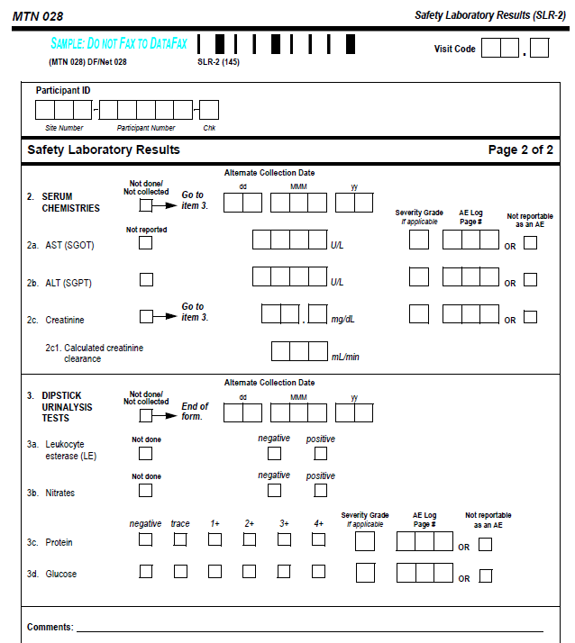
Safety Laboratory Results (SLR-2) CRF
Safety Laboratory Results CRF page 2: Documentation for chemistries and Dipstick UA results
Grade the severity of the urine glucose value according to the “Proteinuria, random collection” row of the DAIDS Table V1.0

Slide 9
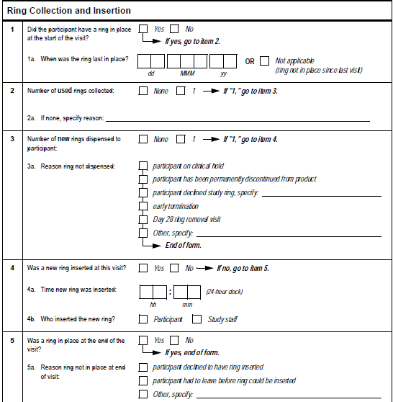
Ring Collection and Insertion (RCI-1) CRF
Required on Day 28 to document ring collection
Complete as needed if an additional ring is dispensed or a ring is returned during the study- not expected

Slide 10
Ring Collection and Insertion (RCI-1) CRF
Item 1a: If the ring was removed prior to Day 28, indicate the date that the ring was last in place
Item 4: If a ring was inserted at this visit, indicate the time that the ring was inserted in item 4a.

Slide 11
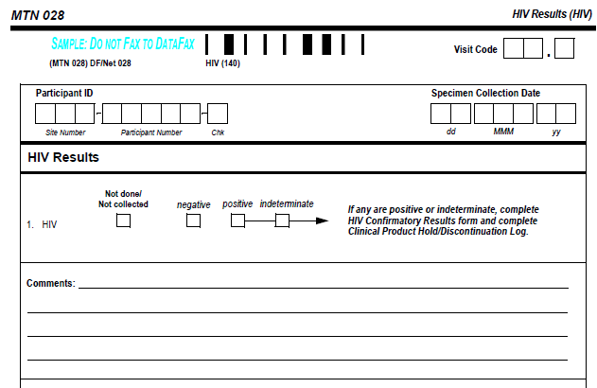
HIV Results CRF
Complete this form at Day 35/Final Clinic Visit and if indicated during follow-up
If test is positive or indeterminate, complete the HIV Confirmatory Results CRF and document product hold on PH-1
Notes:
format

Slide 12
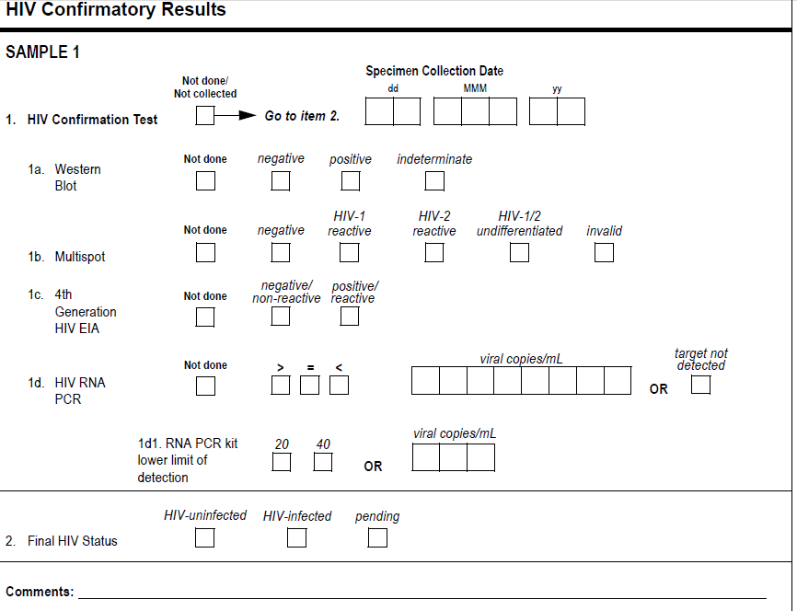
HIV Confirmatory Results CRF
Complete this form for each visit where the participant has a positive or indeterminate EIA test
In Item 2, mark ‘pending’ if the participant’s final HIV status is not clearly known and update once final status is determined
Notes:
format

Slide 13
STI Results CRF
Complete this form, if indicated, to document Vaginal Wet Prep, rapid Trich, GC/CT and syphilis testing during follow up
If a test result(s) indicates that the participant has a new (or increased severity) laboratory-confirmed infection or diagnosis, this must be recorded as an adverse experience on an Adverse Experience (AE) Log

Slide 14
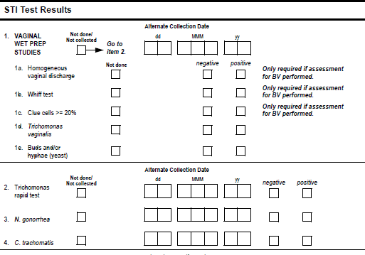
STI Results CRF
If vaginal wet prep was performed but not all assays were completed, mark “Not done/Not collected” for each uncompleted wet prep assay

