Slide 1
Genital Bleeding
ASPIRE SSP Section 10.6.1 Updates
31 January 2014

Slide 2
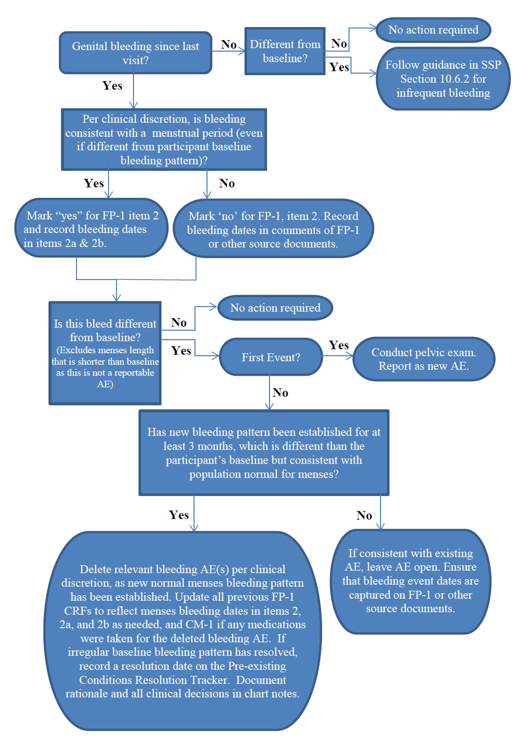
A Genital Bleeding Decision Tree has been developed to help guide documentation of genital bleeding.
Above all, clinical discretion should be used to determine if the participant is experiencing normal menstrual bleeding.
Notes:
It is recommended for this training that staff have this available for reference.

Slide 3
Assessment of genital bleeding
At each scheduled follow-up visit, study staff will actively ascertain whether any genital bleeding (menstrual or non-menstrual) was experienced since her last visit.
Remember that if bleeding was ongoing at last visit to ask about a stop date. Document in current visit source documents (but don’t update stop date on FP-1 from previous visit).

Slide 4
No bleeding since last visit?
Ask: Is this lack of bleeding different than her reported baseline (described on SMH-1)?
If no, no further action is required.
If yes, follow guidance in section 10.6.2 to determine if an AE for infrequent bleeding has occurred.

Slide 5
Infrequent Bleeding
Reporting infrequent bleeding as an AE is dependent on whether it is expected due to contraceptive use, pregnancy, or post-partum status (not an AE), or unexplained (AE)
If infrequent bleeding is expected, important to note this in the comments of the FP-1 CRF (or chart notes) as rationale for not reporting as an AE
X
Missed menses expected due to contraception

Slide 6
Infrequent Bleeding (Cont)
New events of infrequent bleeding during follow-up or delay of menses for more than one month (when NOT explained by hormonal contraception or pregnancy/postpartum):
Document as an AE on an AE Log CRF using appropriate term: below:
Missed menses duration | Term to use
1-3 months | missed menses
4-5 months | oligomenorrhea
6 or more months | amenorrhea
Grade the missed menses event per the below “Unexplained infrequent bleeding” row of the FGGT.

Slide 7
Infrequent Bleeding (Cont)
Note that the FGGT should be interpreted as a delay in menses of one month or more from the time when next menses is expected (but does not come):
For example, if a participant’s last menstrual period was in August, 2013 and she had not had her menses by October 2013, she experienced a delay in menses for more than one month, so a ‘missed menses’ AE should be reported.
The start date for her missed menses is September 2013 (the next time that she typically would have expected menses if it had not been missed).
‘Missed menses’ should not be used for instances when menses was delayed for any amount of time less than one month (i.e. it came 2 weeks late).
While this situation may be different from the participant’s baseline pattern, it is not a gradable AE per the FGGT.

Slide 8
What if she has had bleeding since the last visit?
First, make a determination about whether bleeding is consistent with a menstrual period (clinical discretion)
The answer to this question will determine where this information should be documented (see next slide )

Slide 9
Documenting Bleeding on the FP-1
Any menstrual-like bleeding should be documented in items 2, 2a, 2b of the FP-1 CRF.
Recording LMP should be based on clinical impression and does not need to be consistent with AE reporting terms used to describe the bleeding.
That is, bleeding that is captured as an AE can still be considered menstrual-like for the purposes of completing the FP-1 CRF.
Note that genital bleeding that is not considered to be menses should not be documented on the FP-1 CRF in items 2, 2a, and 2b.
Instead, document it in other source documents as applicable (such as the comments section of the FP-1 CRF, a bleeding log, or chart notes), as well as an AE Log CRF, if it meets AE reporting requirements.

Slide 10
Next step: AE Determination
Ask: Is this bleeding different than her reported baseline (described on SMH-1)?
If no, no further action is required.
If yes, determine whether this is the first event of its kind for this participant.
If yes, conduct pelvic exam, and report as new AE
Note that a shorter than baseline menses (e.g. 2 days, when baseline is 3-5 days) is not considered an AE per the FGGT.

Slide 11
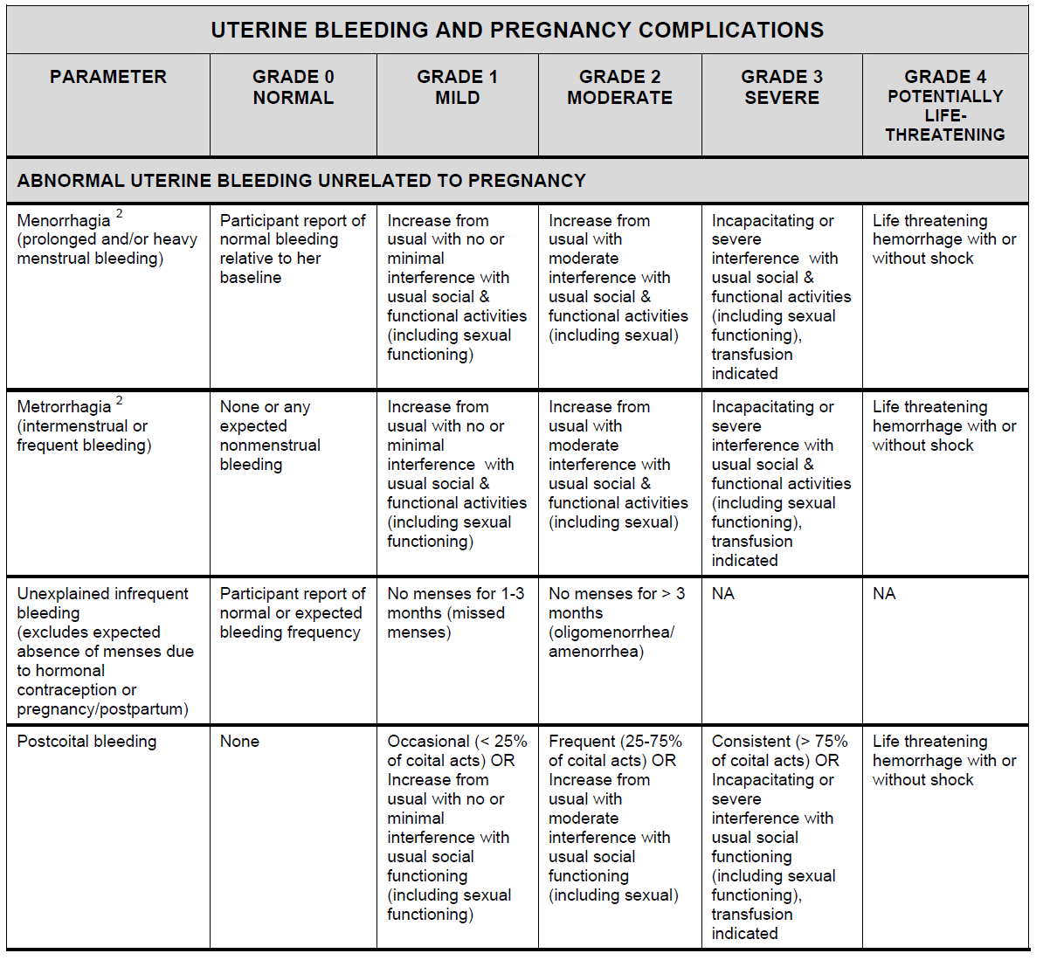
Bleeding AE terms and Grading

Slide 12
What if this isn’t the first event? (Recurrent bleeding AEs in follow-up)
Determine if this bleeding pattern has been established for at least 3 months (more on this soon).
Let’s say it hasn’t (see next slide)

Slide 13
What if this isn’t the first event? (Recurrent bleeding AEs in follow-up)
If a participant has an ongoing (recurrent) bleeding adverse event, a pelvic exam is not required each time the participant reports the same ongoing bleeding, provided that the clinician assesses the bleeding to be consistent with the bleeding captured by the ongoing adverse event.
As per SSP Section 11.4, if the AE increases in severity, a new AE Log CRF should be completed to document this change in severity.
As needed, update the AE Log CRF to be ‘continuing’.
Note: The dates of each irregular bleeding episode do not need to be recorded on the AE Log CRF, but should be captured in source documentation.
If reviewing files in retrospect, mark for deletion any AE Log CRFs completed for bleeding episodes that can be subsumed under the AE that was initially reported for the event.
When/if any AEs are deleted, clearly document the rationale in the relevant source documents.
If applicable, review the CM-1 CRF “Taken for a reported AE?” and “AE Log page” to ensure that no deleted AEs are reflected on the form.

Slide 14
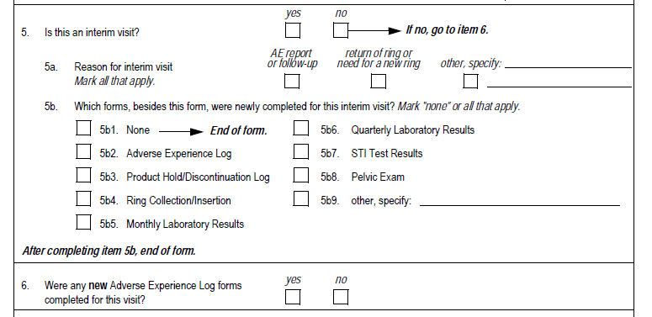
Updates to items 5b2 or 6 on the Visit Summary and items 2-2a on the Pelvic Exam CRFs are not needed.
From Visit Summary CRF:
From Pelvic Exam CRF:

Slide 15
What if this isn’t the first event? (Recurrent bleeding AEs in follow-up)
But what if this same pattern has been going on for at least 3 months, and it seems like a new normal menses pattern has established (even though it’s different than baseline)?
(See next slide.)

Slide 16
What if this isn’t the first event? (New normal menses pattern established during follow-up)
If during follow-up a new recurrent bleeding pattern is considered to be consistent with a normal menstrual cycle, (even if different from the participant’s baseline pattern), any previously reported AEs related to this bleeding should be deleted.
Clinical judgment should be used and based on a population definition of normal menses (i.e., regularly timed bleeding approximately 4 weeks apart), regardless of whether it is consistent with the participant’s baseline bleeding pattern.
It is recommended that the new pattern be established for at least 3 cycles before making this determination.
When/if any AEs are deleted, ensure the rationale is clearly documented in source documents.

Slide 17
What if this isn’t the first event? (cont) (New normal menses pattern established during follow-up)
If an irregular baseline bleeding pattern has resolved, record a resolution date for an irregular bleeding pattern on the Pre-existing Conditions Resolution Tracker.
As needed, update the FP-1 CRF (items 2, 2a and 2b) from previous visits to document the new normal menstrual pattern as menses.
If concomitant medications were provided to treat the bleeding episode, update the CM-1 CRF to reflect that these medications were not taken for a reported AE.
Updates to items 5b2 or 6 on the Visit Summary and items 2-2a on the Pelvic Exam CRFs are not needed.
If a new normal menses pattern develops for a participant, subsequent bleeding events should be reported as new AEs if, per clinical discretion, the event is generally not consistent with this new pattern.

Slide 18
Tracking bleeding during follow-up:
To assist in the recognition of a new menstrual bleeding pattern or changes to bleeding throughout follow-up, it is recommended that sites implement a genital bleeding tracking log so that changes to bleeding patterns can easily be assessed over time.

Slide 19
What about blood on swabs?
If there is blood on the self-collected swab, clinical discretion should be used to determine if an unscheduled pelvic exam is necessary (e.g., Is the blood fresh or dried? Is she currently having, or has she recently finished her menses? Does she have a history of metrorrhagia?).
In other words, blood on the swab does not automatically require a pelvic, but does require that a clinician make a determination about the need for an exam.
Clinical decision-making should be documented in chart notes or other applicable source documents (i.e., document rationale for further investigation of the blood stained swab, or why this was deemed unnecessary).

Slide 20
Scenario # 1
At baseline, a participant reports 1-3 days of bleeding every 2-3 months. She is on DMPA.
In follow up she changes her contraception to IUCD.
At the month 7 visit she reports 3 days of bleeding one month after her last episode of bleeding

Slide 21
Scenario #1 cont’d
Do you need to do a pelvic exam?
Yes, it is bleeding different from baseline. This is a new AE unless and until you determine that a new pattern of normal menses has been established.
Do you file an AE?
Yes, bleeding different from baseline….and not yet clear that it is a new monthly bleeding pattern
What do you call it?
Metrorrhagia
Do you close it or leave it open?
Use clinical discretion

Slide 22
Scenario #1 cont’d
The participant returns over the next two months and reports 2 more episodes of bleeding lasting 3 days and occurring 4 weeks apart.
What is your clinical assessment?
She is having regularly timed menses now that she has three months of regularly monthly bleeding
Is this an AE?
Now that you have determined this to be a new normal menstrual pattern, this is not an AE.
How do you document?
Delete the AE (s) for metrorraghia that you filed since Month 7.
Document your reasoning for deleting the AE in a chart note.

Slide 23
Questions??
Please direct any questions to the 020 Management Team and safety MDs
We also encourage case discussions on the clinician listserve!

