Slide 1
MTN-020 Common QCs and Form Completion Questions
May 23, 2013

Slide 2
What are most common
QCs and data queries
in ASPIRE so far?
Let’s see some examples...

Slide 3
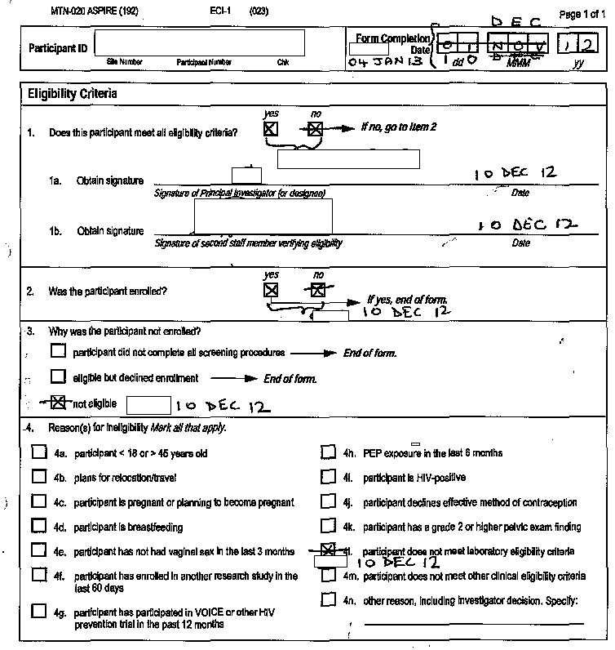
Eligibility Criteria (ECI-1) CRF
Form Completion Date
If a participants rescreens for ASPIRE, update the original ECI-1 from the initial screening attempt for that participant with her eligibility information, initial and date all items updated and fax to SCHARP
Remember to also update the Form Completion Date to the date of the reassessment

Slide 4
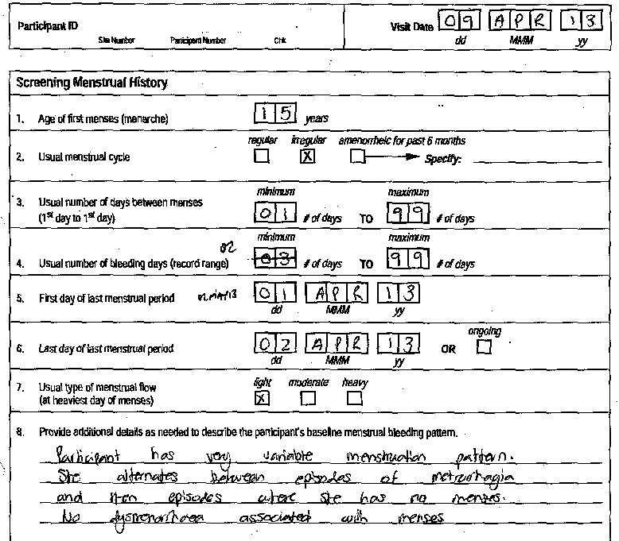
Screening Menstrual History (SMH-1) CRF
Item 4: Usual Number of bleeding days (record range)
If the participant’s usual maximum number of bleeding days is greater than 99 days, record ‘99’ in Item 4 and provide details in Item 8 as needed

Slide 5
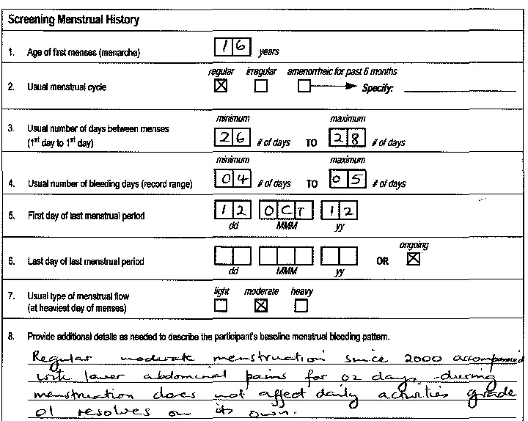
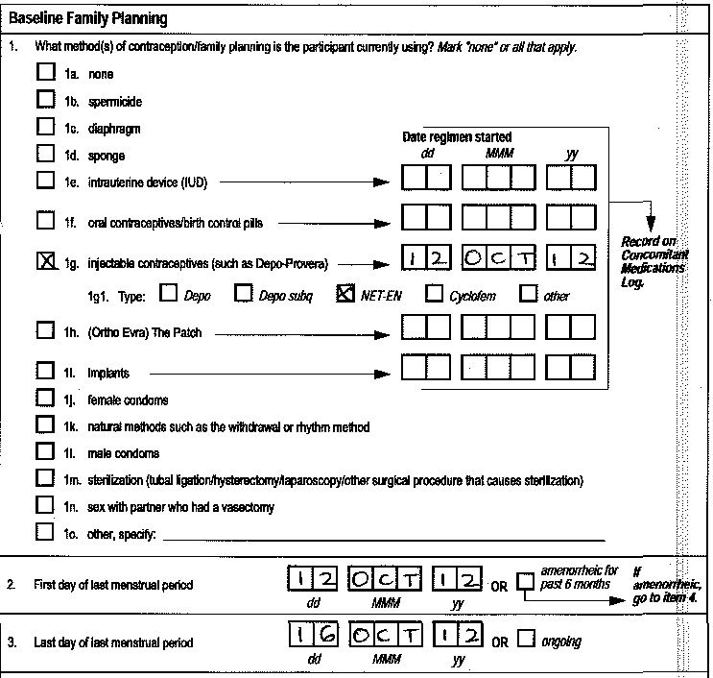
Screening Menstrual History (SMH-1) CRF
Item 6:
If the participant’s menses is ongoing at her Screening Visit, mark ‘ongoing’ in Item 6 and do not revise this CRF at a later date when known.
This date will be collected on the Baseline Family Planning CRF at Enrollment.

Slide 6
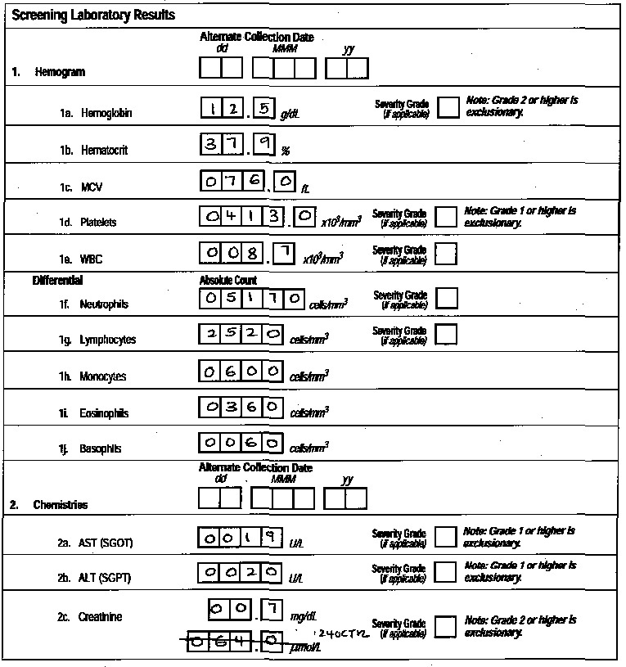
Screening/Quarterly Laboratory Results (SLR-1, QLR-1) CRF
Item 2c. Creatinine
Only one value should be completed for creatinine
Space is provided to record the value reported on the site’s lab results form
This QC can be resolved by lining through one of the options, initial/date and refax to SCHARP

Slide 7
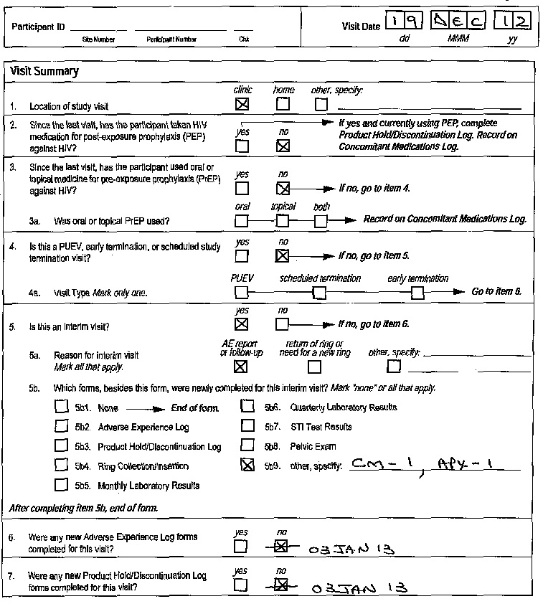
Visit Summary (VS-1) CRF
Items 6 & 7
If a Visit Summary is completed at an interim visit, per the skip instruction highlighted, items 6 & 7 should be skipped as any new AE-1 or PH- log pages will be documented in Item 5.

Slide 8
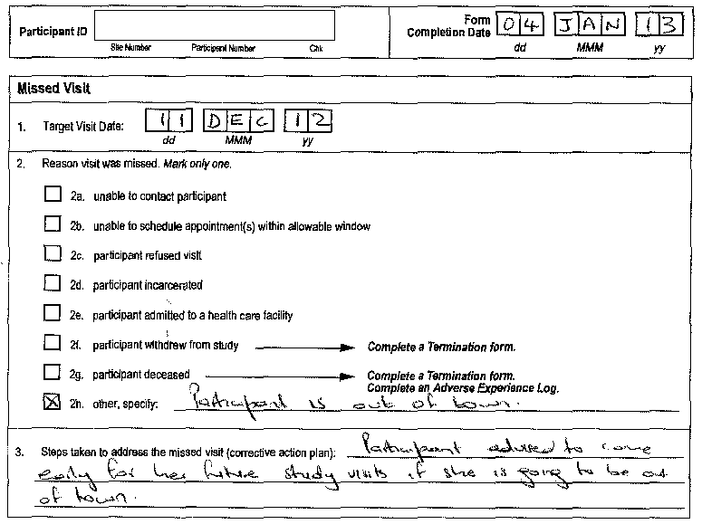
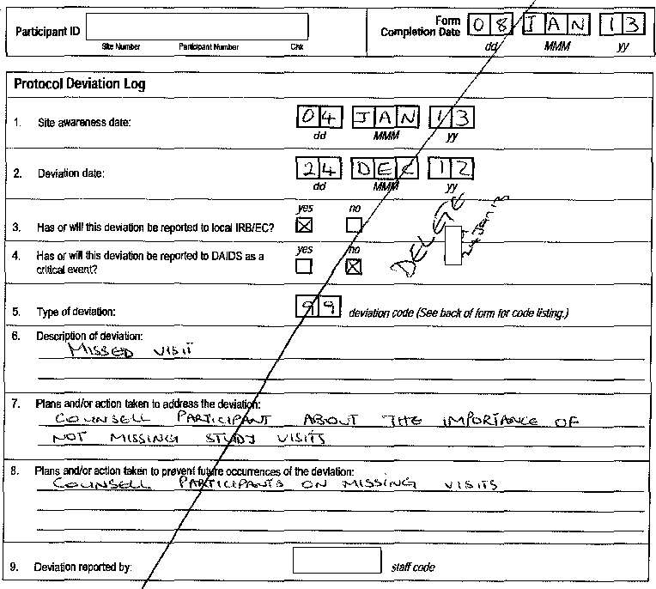
Documentation of Missed Visits on MV-1
A missed scheduled visit should be documented on the Missed Visit (MV-1) CRF. While this is a protocol deviation, a PDL-1 does not need to be completed. Item 3 on MV-1 (corrective action plan) is sufficient documentation to address the deviation.

Slide 9
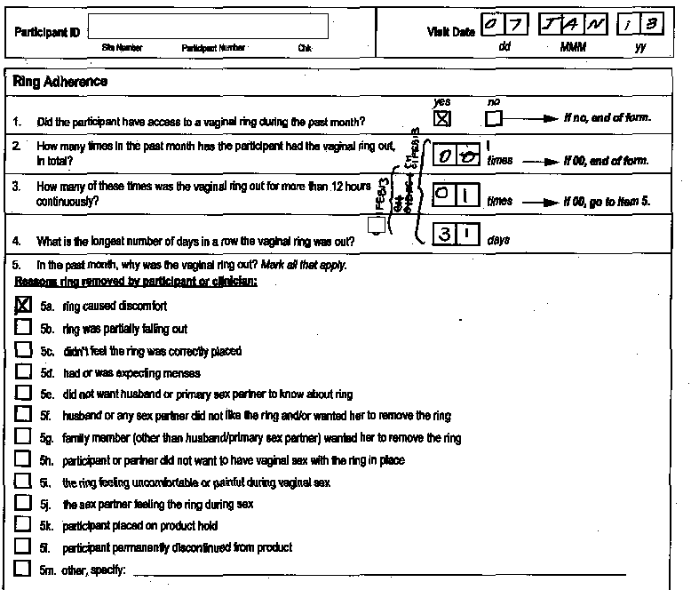
Ring Adherence (RA-1) CRF
Item 1:
If a participant missed the last scheduled monthly visit previous, and was dispensed a ring at her last visit, item 1 should be marked ‘yes’.
The remaining items pertain to the previous month only.

Slide 10
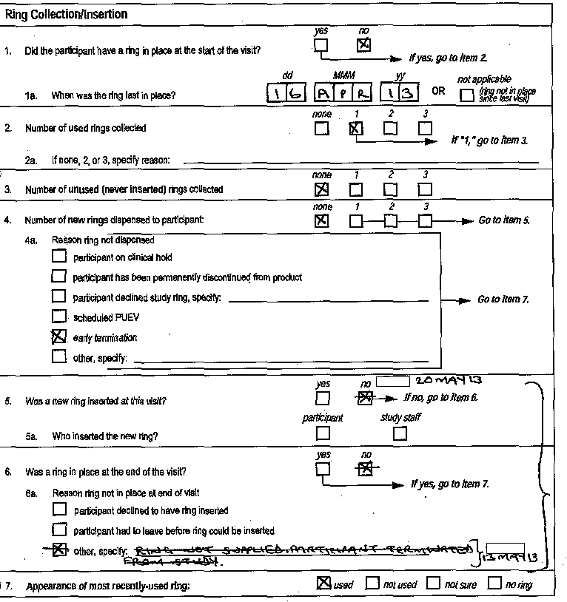
Ring Collection/Insertion (RCI-1) CRF
Pay particular attention to the skip patterns on this form!
Ex: If Item 2 ‘number of used rings collected’ is ‘none’, ‘2’, or ‘3’, a reason is required in Item 2a. If ‘1’, go to Item 3.
Ex: If a new ring is not dispensed and item 4a is completed, skip items 5 and 6 and complete Item 7, ‘Appearance of the ring’

Slide 11
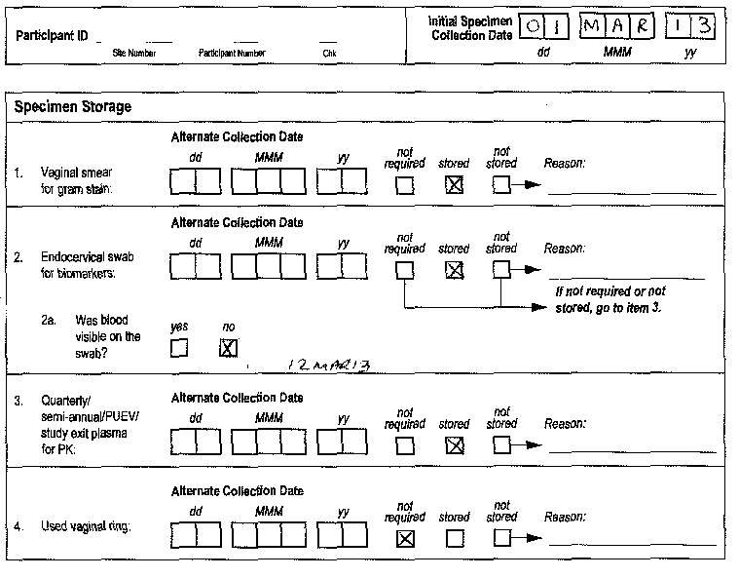
Specimen Storage (SS-1) CRF
Item 2a
If Item 2 (endocervical swab for biomarkers) is marked as ‘stored’, item 2a, “Was blood visible on the swab?” must be completed.

Slide 12
Questions?
Please contact Jen Berthiaume and Karen Patterson with any questions you have about this slide presentation.
Email us at:
jberthia@scharp.org
karenp@scharp.org

