Slide 1

ASPIRE Common QCs - PUEV and SEV
April 30, 2015

Slide 2

What are most common
QCs at the PUEV and SEVs?

Slide 3
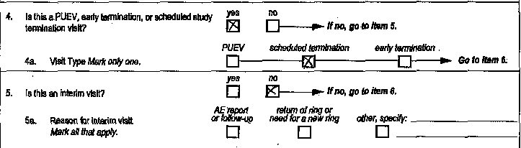
Visit Summary (VS-1) CRF
Item 4a:
If the PUEV or SEV visit is not an interim visit, remember to follow the skip pattern in Item 4a. If the study visit is not an interim visit and item 5 is completed, a QC will be applied.
To correct this QC, line through the response in item 5, initial, date, and refax to SCHARP.
JMB 4/30/15

Slide 4
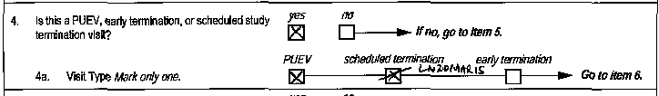
Visit Summary (VS-1) CRF
Item 4a:
Please mark item 4a as “PUEV” for participants who are exiting from ASPIRE at the PUEV.
The “scheduled termination” box in item 4a should only be marked if the participant is completing her scheduled SEV approximately four weeks after her PUEV.

Slide 5
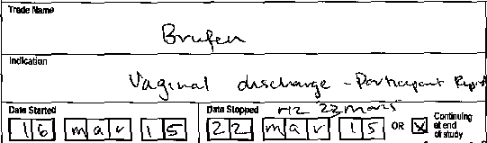
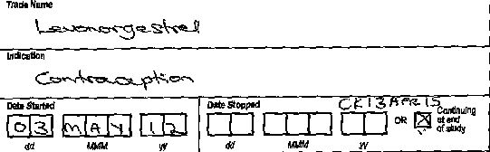
Concomitant Medications log CRF
Date Stopped:
If a medication is ongoing at end of study, mark “Continuing at end of study”. If this checkbox is marked, a date stopped should not be provided.
√

Slide 6
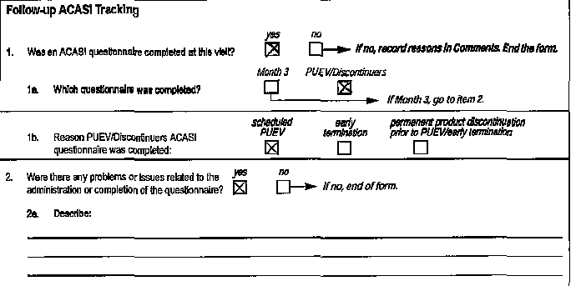
Follow-up ACASI Tracking
(FAT-1) CRF
Items 2 and 2a:
If Item 2 is marked ‘yes’ to indicate that there was an issue in administering the PUEV/Discontinuers ACASI questionnaire, describe the issue in as much detail as possible in item 2a.
The Month 3 questionnaire was completed in error at this participant’s PUEV instead of the required PUEV/Discontinuers questionnaire.

Slide 7
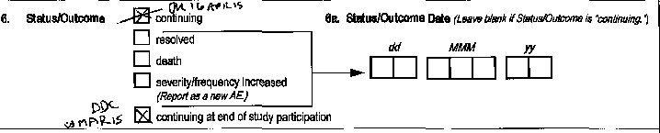
AE log CRF
Status/Outcome:
If an AE is continuing at the end of a participant’s study participation, update Item 6 by lining through the ‘continuing’ box, marking ‘continuing at end of study participation’ and initial, date, and refax to SCHARP.

Slide 8
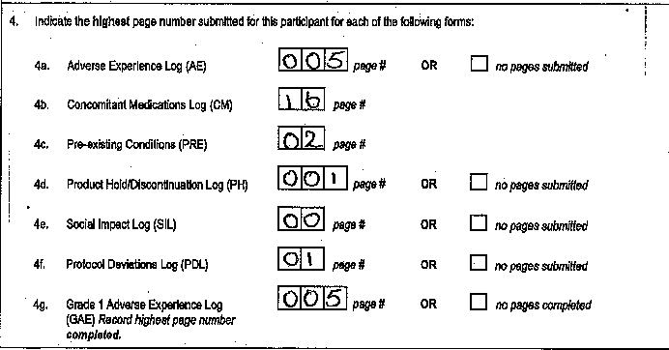
End of Study Inventory
(ESI-1) CRF
Item 4:
If no pages were submitted for any of the forms listed in items 4a-4g, mark ‘no pages submitted’ for that log form
If ‘00’ is indicated as the highest page number, a QC will be applied.
JMB 30apr15
JMB 30apr15

Slide 9
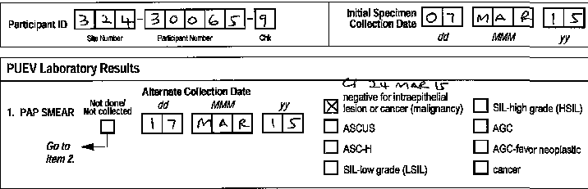
PUEV Laboratory Results
(PLR-1) CRF
Item 1:
If a Pap Smear is performed on the second day of a split PUEV, indicate the date that the assessment was performed using the “alternate collection date” field.

Slide 10
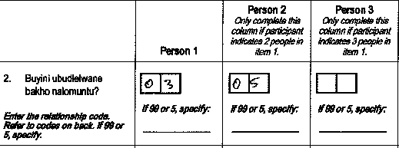
Social Influences Assessment
(SOC-1) CRF
Item 2:
If ‘99’ or ‘05’ is indicated as the relationship for persons 1-5, specify this relationship to the study participant in English on the line provided.
Sister
JMB 30apr15

Slide 11
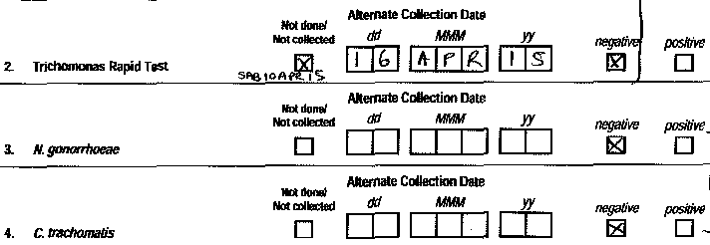
STI Test Results
(STI-1) CRF
If an item is initially marked ‘not done/not collected’ and later completed with the visit window for the visit, complete the alternate collection date for that item and remember to line through the original response of ‘not done/not collected’ and initial and date this update.
Jmb 30apr15

Slide 12
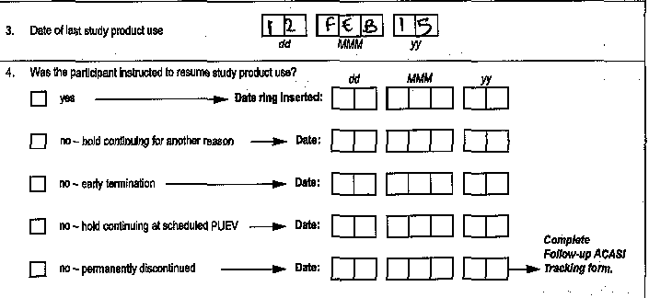
Product Hold/
Discontinuation Log CRF
Item 4:
Remember to update Item 4 on a PH log CRF for any clinical product holds that are ongoing at a participant’s scheduled PUEV.

Slide 13

Questions?
Please contact Jen Berthiaume (jberthia@scharp.org) with any questions you have about this slide presentation.

