Slide 1
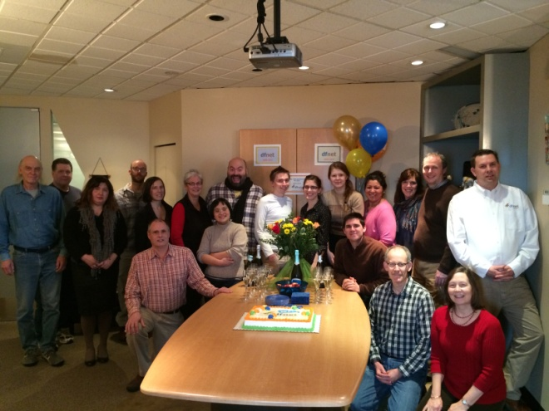
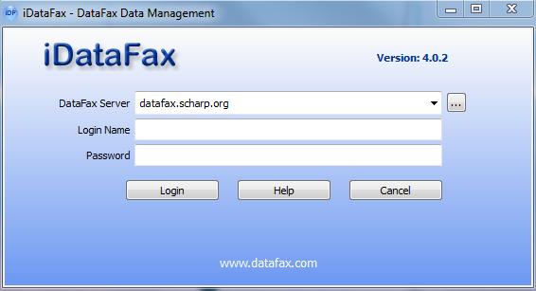


Introduction to iDataFax
Melissa Peda
MTN-023 SCHARP Project Manager

Slide 2

What is iDataFax?
    Data management system used to receive, enter, review, and modify participant data collected at study sites.
Notes:
iDataFax is the same data management software that SCHARP has used for MTN since inception. Essentially you will be able to view the electronic copy of each CRF that you fax in for MTN-023.

Slide 3
What is iDataFax?
    For MTN-023
Sites to fax in paper copies of case report forms to SCHARP
Sites can view their own faxed CRF images and data using iDataFax
Sites can view their QCs, clinical queries, and identify missing CRF pages or study visits at any time
Monthly QC Reports will be sent by DF/Net
  DF/Net is a DataFax data management group who works with SCHARP in developing the clinical data pipeline (DataFax database) where study information is collected and stored.
Notes:
Being able to view participant data and QCs will allow sites to review and resolve QCs even before they are included on a QC Report. Being able to see the actual CRF image in the database can also help you to understand what needs to be modified or reported on the paper CRF to resolve the query.
All QCs that are generated within iDataFax will count in Data Management Quality Report (DMQ Report). In other words, if a QC is resolve before the next scheduled QC Report is issued, it will not appear on the report. However, the QC will be counted as part of the total number of QCs that were created in the past month. (In other words, the number of QCs on the QC Report and on the DMQ will not be the same).

Slide 4
Features of iDataFax
Sites will have view-only access
You can:
  View faxed images
  View data
  View queries
  Confirm queries are resolved after paper CRF refax
  Identify missing pages or study visits
  You cannot:
  Add new data
  Change data
  Respond to or resolve queries within iDataFax

Slide 5
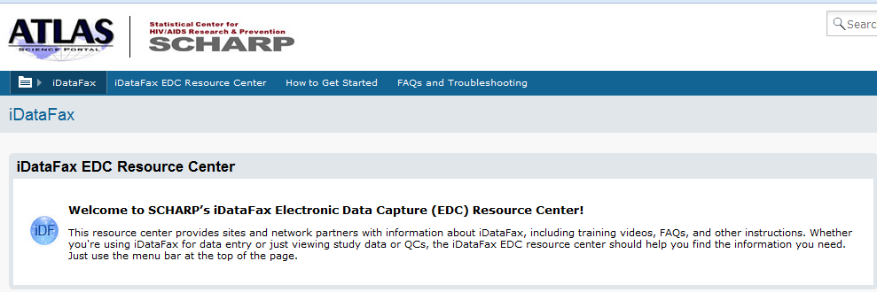
iDataFax Set up
First, each site must download the iDataFax software from the Atlas site: https://atlas.scharp.org/cpas/project/iDataFax/How%20to%20Get%20Started/Getting%20Started/begin.view?

Slide 6
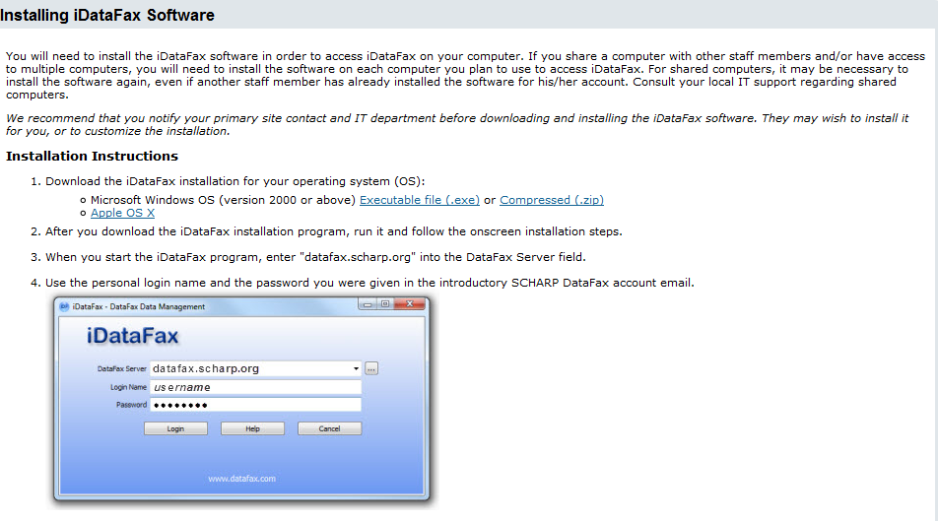
iDataFax Set up
Once logged into Atlas, the iDataFax software can be downloaded.

Slide 7
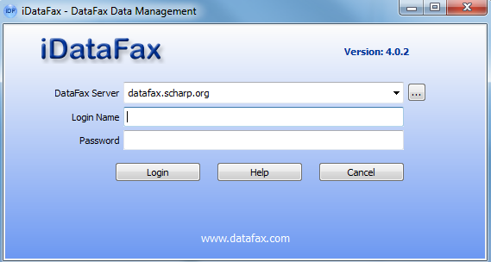

DataFax Access
    Once installed and accounts have been set up, click on the icon on your desktop to log into iDataFax.

Slide 8
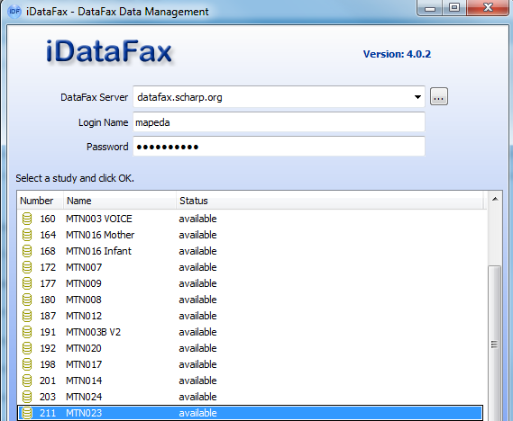
Study Access
    All studies to which you have access will be displayed.

Slide 9
Features of iDataFax
The View Menu
      Data: View faxed CRFs.
      Queries: Look up existing queries
      Status: Shows the status of the study at any given moment
      List: Shows all data associated for a selected CRF

Slide 10
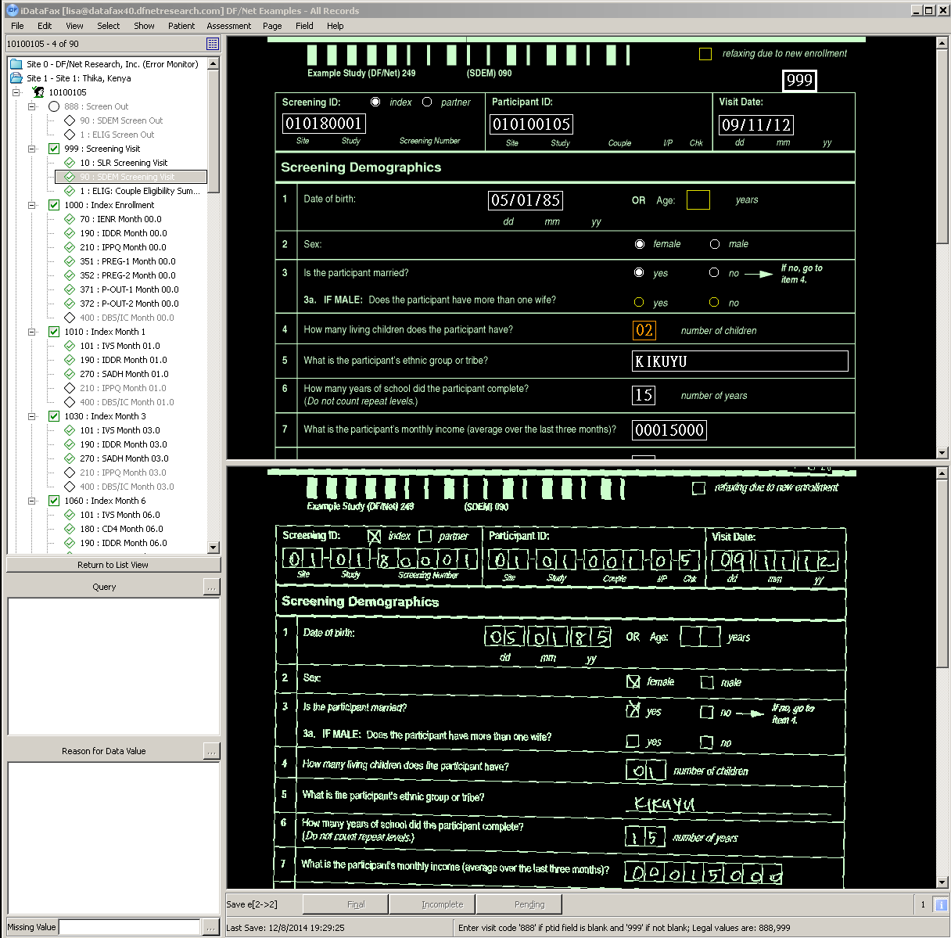
Data View
CRF Data Screen
Participant Binder
CRF Scanned Image

Slide 11
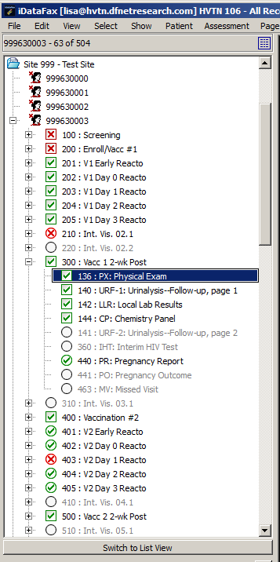
Participant Binders
Site Folder
Participant Binders
Visits
CRF Pages

Slide 12
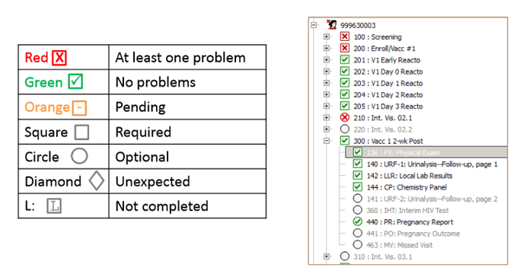
Colors and Symbols

Slide 13
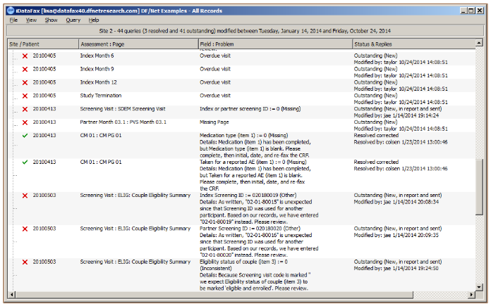
Queries View
From main menu, go to View → Queries
Used to review queries and questions from DF/Net.
Double-click on field to jump to that CRF.

Slide 14
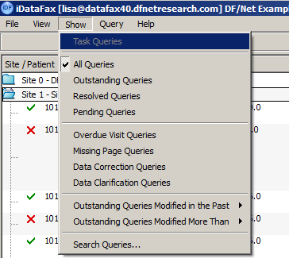
Filtering Queries in iDataFax
Filter to show only:
  Outstanding queries
  Pending queries
  Missing page queries
  Overdue visit queries
  Oldest outstanding queries
Notes:
To resolve QC, update and fax paper CRF with corrections, initial, and date as necessary.

Slide 15
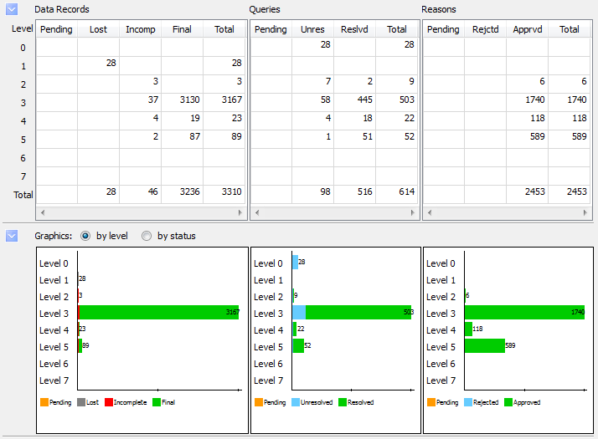
Status View

Slide 16
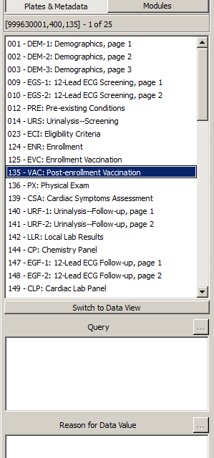
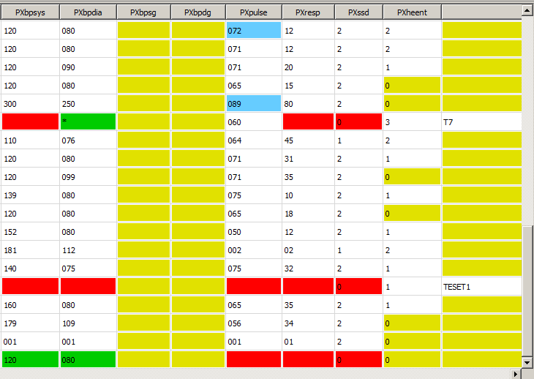
List View
Shows all data for a selected CRF in spreadsheet form
Cells are color coded
Easily view problem or outlier values
Export the data to Excel for further review
    Red: Illegal values
    Blue: Outstanding queries
    Green: resolved queries and missing values
    Orange: Pending queries and reasons
    Yellow: Blank optional fields

Slide 17
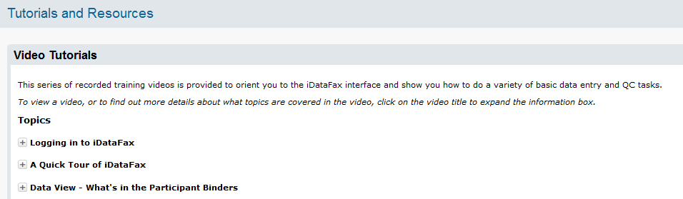
iDataFax Resources
Atlas has an iDataFax EDC Resource Center with video tutorials that may be useful
  Logging into iDataFax
  A Quick Tour of iDataFax
  Data View – What’s in the Participant Binders
MTN-023 Data Collection SSP
Notes:
The data collection section of the SSP provides this guidance on Atlas and iDatafax log in and data management, QC processes

Slide 18
Questions?
SCHARP Project Manager: Melissa Peda
  mapeda@scharp.org
DF/Net Data Manager: Sue Tracy-Waisanen
  sue@dfnetresearch.com
  For technical assistance related to iDataFax, contact support@scharp.org

