Slide 1


Requirement for Investigators and Sub-Investigators to File Financial Disclosure Forms

Slide 2

Investigator of Record – Definition
“The individual at the CRS responsible for ensuring that a clinical trial is conducted in accordance with the protocol, applicable U.S. federal regulations, in-country regulations and any provisions imposed by the reviewing IRB/EC/other regulatory entity. This person is the signatory for the Form FDA 1572 for studies conducted under an IND or the DAIDS Investigator of Record Form for non-IND studies.” (from DAIDS Protocol Registration Manual, p.8)

Slide 3
Reporting Financial Interests
Goal: Preserve objectivity of clinical research and the protection of human subjects
Regulations: 21 CFR 54 and 21 CFR 312.53
Requirement: Each clinical investigator must disclose any financial interests that may be affected by the outcome of the research or attest to the absence of relevant significant financial interests

Slide 4
Specific Requirement
Per 21 CFR 54, each clinical research Investigator and Sub-Investigator (anyone listed on the FDA Form 1572 for the study) is required to disclose the aggregated financial interests of themselves, their spouse and dependent children, as they relate to the study sponsor and/or study product(s).
Per 21 CFR 312.53, financial disclosures must be completed prior to study involvement

Slide 5

When to Report: 4 Time Points
Before an Investigator or Sub-Investigator begins study activities, i.e., before final sign-off by the IoR of the 1572 form

Slide 6
When to Report: 4 Time Points
2. Within thirty (30) days of discovering that relevant changes to their significant financial interests have occurred (during their study involvement and for one year following the end of their study involvement)

Slide 7
When to Report: 4 Time Points
    When an Investigator or Sub-Investigator is removed from the FDA Form 1572 prior to study completion

Slide 8
When to Report: 4 Time Points
    4. At the completion of all study-specific activities, that is, the date of the last participant follow-up visit at the study site. Investigators and Sub-Investigators listed on the current FDA Form 1572 must disclose.

Slide 9
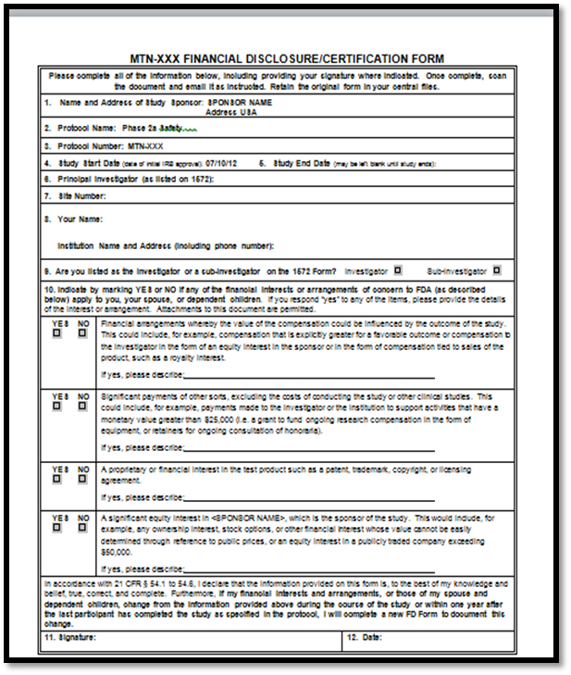
How to Report Financial Disclosure
Blank study-specific Financial Disclosure Forms and instruction page available on MTN website (www.mtnstopshiv.org )
  Under “Studies”, click on relevant study, then click on “Study Implementation Materials”, and look under “Financial Disclosure”.
  All items can be entered electronically except signature and date
Definition of reportable financial interests (as per 21 CFR 54) and instructions for completion of the form will appear on the form itself.

Slide 10
Steps to Report Financial Disclosure
Print the study-specific, Financial Disclosure Form.
Complete the form in its entirety (Items #1-12).
  Remember to check all boxes, sign and (hand) date the form.
  ‘Study start date’ = date on the cover of Version 1.0 of the protocol
  ‘Study end date’ = last follow-up date at site.

Slide 11
Steps to Report Financial Disclosure (continued)
Upload a scanned copy of the completed, signed and dated Financial Disclosure Forms to the DAIDS Protocol Registration System.
  Submit ALL scanned FD forms under “Other” submission category.
  Identify the submitted FD forms as “Financial Disclosure Forms”.
  Note: Updates to personnel listed on the FDA Form 1572 (additions and deletions) should always prompt the completion of FD form(s) and a subsequent DPRS upload. Ideally updated FDA Form 1572s and FD Forms are uploaded to DPRS simultaneously.
File the original, completed, signed and dated FD forms in the study binder along with the associated FDA Form 1572.

Slide 12
What To Do if an FD Form was Not Obtained When Leaving?
In the event an Investigator/Sub-Investigator leaves the site before you are able to obtain a completed FD Form, documentation of due diligence to obtain the form is required.
MTN provides the following guidelines for documenting the due diligence (see next slide)

Slide 13
MTN Guidance Regarding Missed FD Forms
In the event an FD form has not been obtained:
  Over a minimum of two-weeks, at least three (3) attempts should be made by 2 different contact methods (e.g., phone, text, mail, email) to obtain the completed FD form. Documentation of contact attempts is required (copies of emails, phone log, etc.)
  If, after site contact attempts the Investigator(s) or Sub-Investigator(s) is unresponsive to the request, site must complete a Note to File. The NTF should include:
    The date Investigator(s) or Sub-Investigator(s) was removed from the 1572
    Employment end date (as applicable)
    Reason(s) FD form was not obtained
    Details regarding contact attempts (dates, method, etc.)

Slide 14
Resources
  21 CFR § 54 Financial Disclosure by Clinical Investigators
  42 CFR § 50, Subpart F Responsibility of Applicants for Promoting Objectivity for Research for Which Public Health Service Funding Is Sought
  45 CFR § 94 Responsible Prospective Contractors
  21 CFR § 312.53 Investigational New Drug Application
  21 CFR § 812.43Investigational Device Exemptions
  21 CFR § 314.50 Applications for FDA Approval to Market a New Drug
  21 CFR § 814.20 Premarket Approval Application (PMA)
  NIH HIV/AIDS Clinical Trials Networks Financial Disclosure Policy and Procedure
  DAIDS Financial Disclosure Guidance Process for Collection of Financial Disclosure by Clinical Investigators per 21 CFR 54.4
  OPCRO, DAIDS, Protocol Registration Manual
  DAIDS Policy #DWD-POL-CL-03.03 Human Subjects Protection (HSP) and Good Clinical Practice (GCP) Training Requirements
  FDA Guidance Financial Disclosure by Clinical Investigators
  FDA Form 3454 Certification: Financial Interests and Arrangements of Clinical Investigators
  FDA Form 3455 Disclosure: Financial Interests and Arrangements of Clinical Investigators

Slide 15
Reporting Financial Disclosure via HANC Online System
The Office of HIV/AIDS Network Coordination (HANC) online FD is a separate requirement for some network members that ensures compliance with 42 CRF 54. If your disclosure is necessary you will be notified. Details regarding HANC online FD have not been covered in this presentation, but should you have any questions regarding the HANC disclosure you can contact MTN Regulatory at mtnregulatory@mtnstopshiv.org.

