Slide 1
MTN-026 Study Product Considerations
Cindy Jacobson/Lindsay Kramzer
Microbicide Trials Network
Pittsburgh, PA
USA

Slide 2
Presentation Overview
Study Gel Prescription Completion
Study Gel Supply and Labeling
Chain of Custody, Accountability, Unused Gel Retrieval/Returns
Study Gel Request Slip & Management Slip Completion
Study Gel Complaints

Slide 3
Reference Materials
MTN-026 Protocol, Version 2.0
Section 6
MTN-026 SSP Manual
Section 6

Slide 4
Study Visit Schedule & Regimen
Visit 2/Enrollment Visit – Randomization; No Study Product.
Visit 3/Single Dose Administration Visit.
Visits 7*-13/Study Product Administration Visits - DOD.
*One dose of gel for as-needed at home use will be provided to the participant at Visit 7.

Slide 5
Visit 2/Enrollment Visit
The study database (via the Medidata Balance module) will assign the participant to a treatment arm and the Randomization Date and Time will appear automatically on the Randomization eCRF.
A participant is considered enrolled in the study once this step takes place

Slide 6
Visit 3/ Single Dose Administration Visit
Completion of Prescription by clinic staff/authorized prescriber will occur at the Visit 3
Prescription is a 2 part no carbon required (NCR) paper document. The top white is the original (pharmacy) and the bottom is yellow (clinic).
A supply of 25 prescriptions is provided to the clinic staff

Slide 7
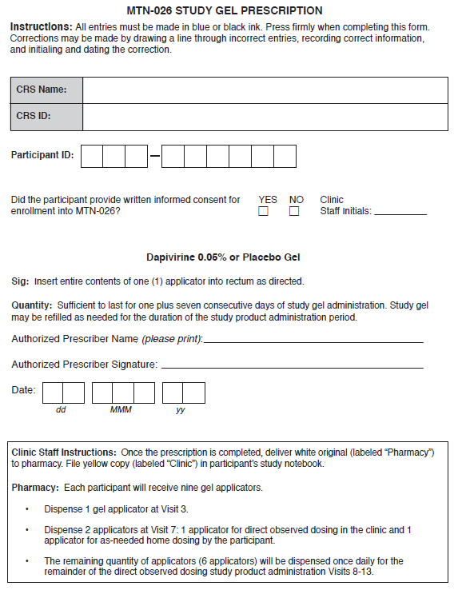

Slide 8
MTN-026 Prescription
When completing the prescription, place the cardboard flap under the copy (clinic prescription)
Double check the accuracy of all entries
Errors may be corrected in blue or black ink by putting a line through and initialing
Retain the yellow copy for the participant study notebook in the clinic
Deliver white copy to pharmacy

Slide 9
MTN-026 Prescription
The pharmacist will review the prescription.
If an error is noted, the white and yellow copies must be individually corrected by an authorized prescriber with identical information on both copies (correction, initials, date).
If no problems are noted, the pharmacist will dispense the study gel.

Slide 10
Study Product Supply – Study Gel
One pre-filled applicator contains either:
2.5 grams (2.5 mL) of Dapivirine 0.05% gel (1.25 mg of dapivirine)
2.5 grams (2.5 mL) of Universal HEC placebo gel
Store at controlled room temperature, 77°F (25°C). Excursion between 59-86°F (15°C to 30°C) are permitted.*
*Participants should be counseled on proper storage of the take home dose.
Notes:
Can do this one quickly sites are familiar

Slide 11
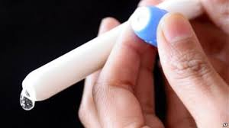
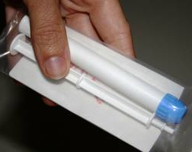
Study Product Supply – Study Gel

Slide 12
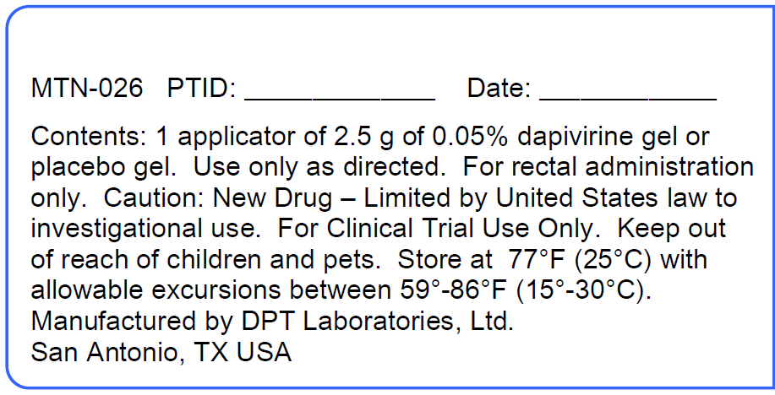
MTN-026 Study Gel Label
PoR will indicate

Slide 13
Chain Of Custody
The study product must be tracked with documentation, from the pharmacy to the participant, all steps in between and the return documented in the clinic.
Study product may be prepared by the pharmacist based on either original documents or faxed copies, but will not be released to the clinic staff until the original prescription is received.
Upon receipt of a completed and signed prescription, the PoR will dispense study gel per the Study Visit Schedule.

Slide 14
Chain Of Custody
Study Product is dispensed by pharmacy staff to:
Clinic staff who will:
Insert the gel into the participant’s rectum or
Provide the gel to another clinic staff member for him/her to insert it into the participant’s rectum
Provide the gel to the participant for self insertion (DOD or as-needed home use).
Runner who delivers the gel to clinic staff
Depends on pharmacy site-specific Chain of Custody SOP
Chain of Custody from pharmacy staff to clinic staff/runner is documented on the Record of Receipt of Site-Specific Study Gel at time of dispensation
This record is stored in the pharmacy

Slide 15
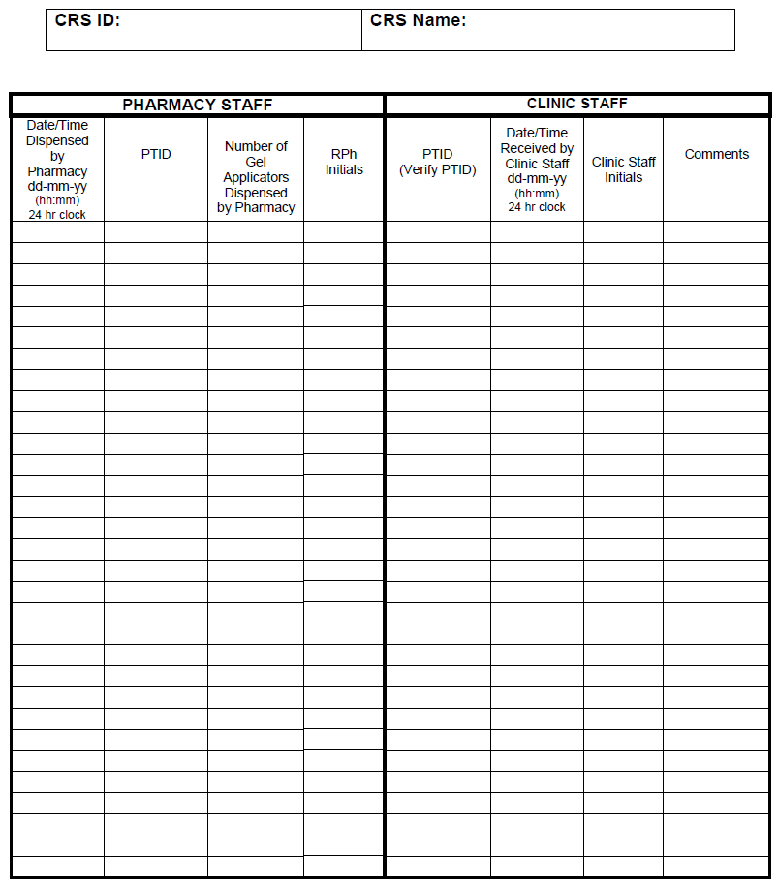
Record of Receipt of Site-Specific Study Gel

Slide 16
Chain of Custody
Clinic Staff Responsibilities
Control access to the study product in their custody.
Clinic staff must document delivery of the study product to designated participants in the participants’ study charts (chart notes, visit checklists, or on other source documents designated for this purpose by clinic staff).

Slide 17
Chain of Custody
Clinic Staff Responsibilities
If study product dispensed for a participant is not provided to the participant, clinic staff must document this in the participant's study chart and return remaining product (unused) to the pharmacy.

Slide 18
Chain Of Custody – Weekend Dispensing
PITT
Study gel chain of custody remains the same as during weekday visits

Slide 19
Chain Of Custody – Weekend Dispensing
UAB
Study gel will be dispensed from the pharmacy to the clinic on Friday
MTN Study Gel Request Slip and Site-Specific Prescription for both Saturday and Sunday.
Weekend Binder provided by pharmacy to clinic on Friday
Study Gel Applicator(s)
Record of Clinic Storage of Participant Specific Study Product
USB Temperature Monitor
Pharmacy staff will retrieve the Weekend Binder on Monday or the first business day of the week following the weekend.
This procedure will be documented by the Study Nurse in a chart note and/or visit checklist in the participant’s study notebook.

Slide 20
Study Gel Request Slip
A supply of 150 Study Gel Request Slips is provided to the clinic staff.
A Request Slip is a 2 part no carbon required (NCR) paper document. The top white is the original (pharmacy) and the bottom is yellow (clinic).

Slide 21
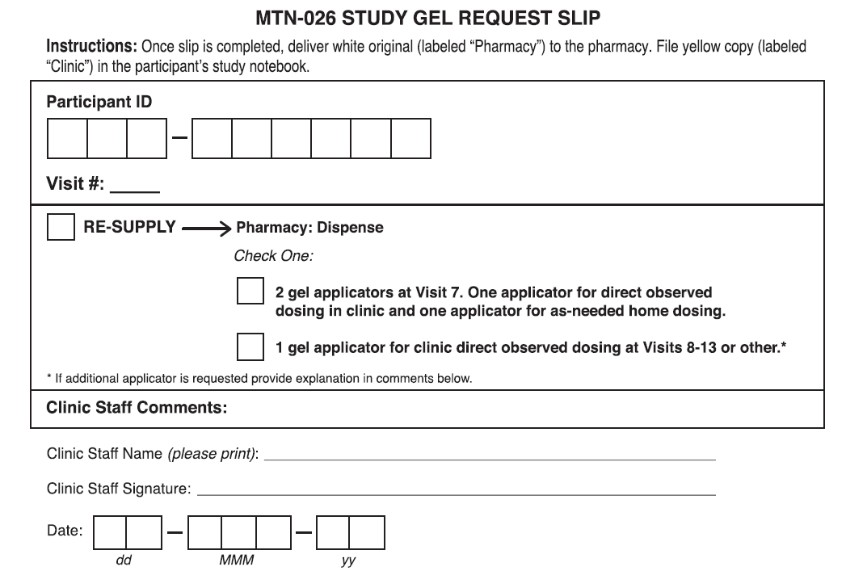

Slide 22
Study Gel Request Slip – RE-SUPPLY
Visit 7
2 pre-filled applicators – one for DOD at that clinic visit and one for as-needed at home use.
Visits 8-13
1 pre-filled applicator for DOD at specified clinic visit.
1 pre-filled applicator for ‘other’ reason
As-needed home dose was lost, stolen, damaged, etc
Study product complaint for as-needed home dose or clinic dose (product remained unused).
Use IoR discretion and document.
NOTE – if the participant uses the one as-needed home dose of gel, another dose will not be provided if this action is requested by the participant.

Slide 23
Study Gel Request Slip Completion
This slip can be completed by any authorized clinic staff
Insert cardboard flap behind the clinic copy
Double check the accuracy of all entries
Errors may be corrected in blue or black ink by putting a line through and initialing
Retain the yellow copy for the participant study notebook in the clinic
Deliver white copy to pharmacy
Once the white and yellow copies are separated errors must be corrected on each sheet separately

Slide 24
Study Gel Management Slip
Other actions related to study product
Permanent discontinuation
Participant decline
Product use period completed
A supply of 25 Study Gel Management Slips is provided to the clinic staff.
A Management Slip is a 2 part no carbon required (NCR) paper document. The top white is the original (pharmacy) and the bottom is yellow (clinic).

Slide 25
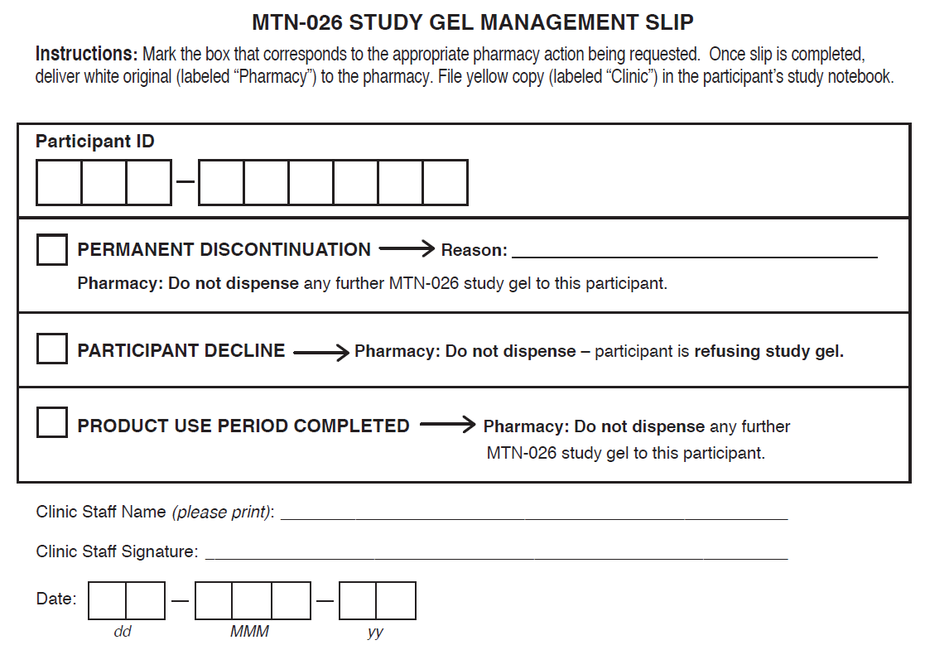

Slide 26
Study Gel Management Slip
PERMANENT DISCONTINUATION
If study clinician determines that a participant should permanently stop gel use, then the box for “PERMANENT DISCONTINUATION” is marked
Indicate reason for permanent discontinuation
Future management and request slips will no longer be completed at the participant’s remaining study visits

Slide 27
Study Gel Management Slip
PARTICIPANT DECLINE
If a participant decides that she does not want to use the gel, then the box for “PARTICIPANT DECLINE” is marked
In the event that a participants declines gel use, then the PSRT should be notified.

Slide 28
Study Gel Management Slip
PRODUCT USE PERIOD COMPLETED
Used by clinic staff to communicate to the pharmacy when the participant has completed or withdrawn from the study

Slide 29
Study Gel Management Slip
At minimum, the Management Slip should be used for:
One scheduled Product Use Period Completed
After completing Visit 13/Last Study Product Administration Visit

Slide 30
Retrieval of Unused Study Gel
Protocol Section 6.7
SSP Section 6.9
Document all efforts to retrieve study gel
Study gel retrieval may occur by the participant returning the gel to study staff or attempts should be made by study staff to contact the participant to retrieve gel
The need for retrieval is expected to be rare
Only one gel applicator for as-need at home use.

Slide 31
Retrieval of Unused Study Gel
Study gel must be retrieved within 24 hours when it is permanently discontinued.
If not retrieved within 24 hours, then the MTN-026 PSRT must be notified.
If not previously returned (at or by Visit 14: 24 hours PK Visit), it is expected that participants will returned unused gel at Visit 16/Final Clinic Visit.
If not returned by Visit 16/Final Clinic Visit, site staff will make efforts to have the unused study gel returned within 7 days.
If not returned within 7 days, then the MTN-026 PSRT must be notified.
All attempts to retrieve study product should be documented.

Slide 32
Unused Study Gel Return
ONLY unused study gel should be returned to the pharmacy
Any unused dose including the take home dose
NO USED GEL APPLICATORS should be returned to the pharmacy
Unused gel is returned to the pharmacy by:
Clinic staff member or runner
Depends on pharmacy site-specific Chain of Custody SOP
Documented on Record of Return of Site-Specific Study Gel
This record is stored in the pharmacy
Notes:
In response to last bullet point, damaged unused study product should be counted as returned.

Slide 33
Chain Of Custody
If returning unused gel because damaged or contaminated, record the details on the record
The pharmacy will document and quarantine any returned unused gel

Slide 34
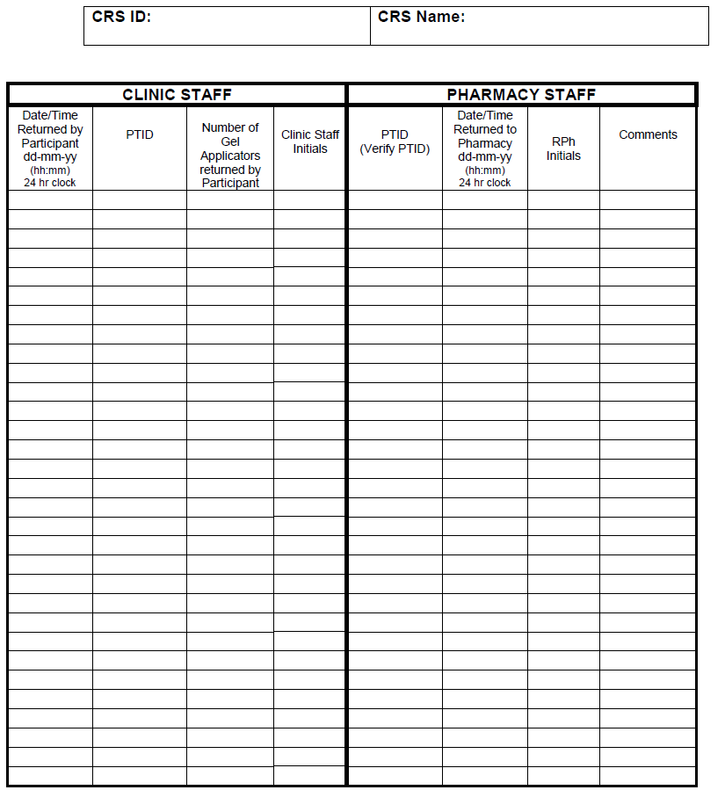
Record of Return of Site-Specific Study Gel

Slide 35
Study Gel Complaints
Study product problem may be noted by pharmacy, clinic, and/or participant.
May concern dosage form (gel), applicator (barrel, piston, cap, plunger), packaging (overwrap), or other aspect.
Clinic staff will make thorough record of clinic staff or participant complaint.
Clinic staff member will email complaint to site PoR
PTID, Date of observed issue, date issue was reported, date gel was dispensed, did adverse event occur, nature of issue, picture (if possible and applicable), any other necessary details

Slide 36
Study Gel Complaints
Pharmacy staff will email all study product complaints to MTN LOC Pharmacy.
If the complaint is concerning an unused gel applicator, then the unused gel applicator should be held in quarantine in the pharmacy
If the complaint is concerning a used gel applicator, then the clinic staff should process the used study product per standard operating procedures for used study products (if applicable)

Slide 37
Other Items Supplied to Clinic
200 male condoms (for Visit 6)
200 – 4mL sachets of lubricant for applicator insertion
6 – 4oz tubes of lubricant for procedures
An order does not need to be submitted

Slide 38
Contact Information
If you have any questions, please do not hesitate to contact us:
Cindy Jacobson
(412) 641-8913
cjacobson@upmc.edu
Lindsay Kramzer
(412) 641-3865
fergusonlm@upmc.edu
Questions? Thank you!

