Slide 1
MTN-041 (MAMMA)
Study Specific Training
Julia Ryan & Ariana Katz
Women’s Global Health Imperative (WGHI)
RTI International
Notes:
Put WGHI logo too

Slide 2
Morning Agenda
Welcome and Introductions
Overview of 041
  Objectives, Eligibility Criteria, Sample
Study Procedures
  Recruitment/prescreening, IC Process, Data Collection
Data Management Process & Timeline
Analysis Plan Overview
Questions

Slide 3
Overview of MTN-041
Julia Ryan
Women’s Global Health Imperative (WGHI)
RTI International

Slide 4
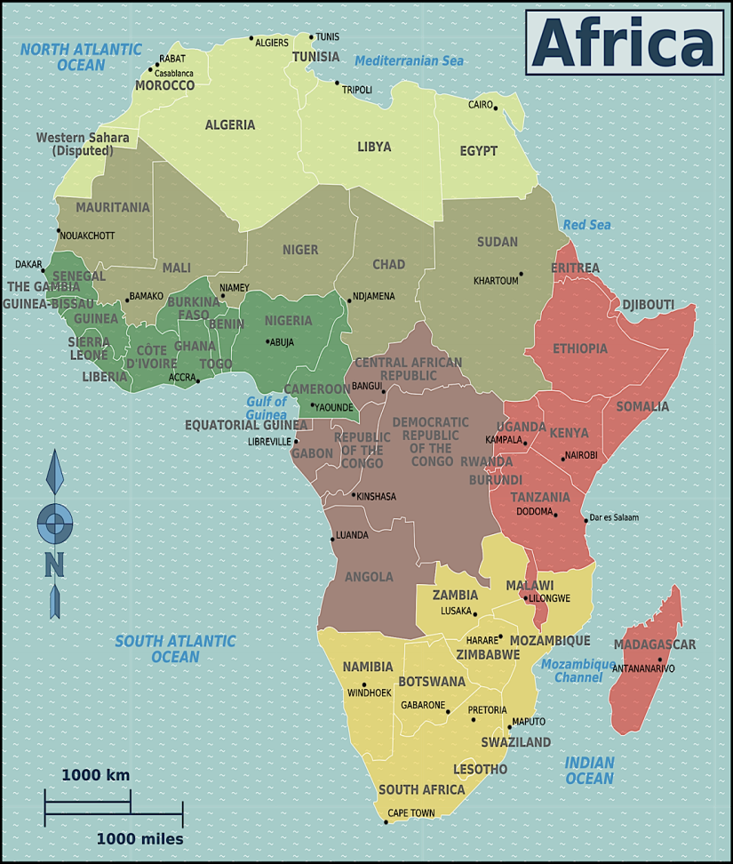
Study Sites
Uganda
Kampala (MU-JHU)
Malawi
Blantyre (JHU-CTU)
Zimbabwe
Zengeza (UZCHS-CTRC)
South Africa
Johannesburg (Wits RHI)
Notes:
Check location of stars in countries to map to correct city

Slide 5
Study Objectives: Primary
To explore attitudes about use of a vaginal ring (VR) during pregnancy and breastfeeding, including participants’ willingness to use or recommend/support use of a VR during pregnancy and breastfeeding
To explore attitudes about use of oral PrEP during pregnancy and breastfeeding, including participants’ willingness to use or recommend/support use of oral PrEP during pregnancy and breastfeeding
Notes:
Exploratory – all to inform development of 042 and 043 which will be clinical trials involving product use in these populations

Slide 6
Study Objectives: Secondary
To explore potential preference for a VR or oral PrEP during pregnancy and breastfeeding
To explore participants’ attitudes about and perceptions of sexual activity during pregnancy and breastfeeding, including how a VR or oral PrEP might affect sexual activity
To explore participants’ perceptions of HIV risk during pregnancy and breastfeeding
To explore community beliefs and practices considered taboo (or encouraged) during pregnancy and breastfeeding that might affect VR and PrEP uptake and use during these periods, including use of oral medications and intravaginal products

Slide 7
Study Timeline
January 2018:
- IRB Submissions
-Engagement
February/March 2018:
- Approvals
- Staffing
- Training
- Activation
- Data Collection
March/April 2018:
- Activation
- Data Collection
April 9-10 2018:
- 042 Protocol Development Meeting

Slide 8

Inclusion Criteria: All Participants
Able and willing to provide written informed consent in one of the study languages
Able and willing to complete the required study procedures

Slide 9
Inclusion Criteria: P & BF Women FGDs
P & BF Women: HIV-uninfected women aged 18-40 who are currently pregnant (P) or breastfeeding (BF), or who were P or BF within the previous two years

Slide 10
Inclusion Criteria: Male Partner FGDs
Male Partners: Men aged 18 or older whose partners are currently P or BF, or whose partners were P or BF within the previous two years

Slide 11
Inclusion Criteria: Grandmother FGDs
Grandmothers: Maternal and paternal grandmothers whose daughters or daughters-in-law are currently P or BF, or were P or BF within the previous two years
Notes:
Mothers and mothers-in-law of the pregnant/breastfeeding women, not REALLY grandmothers
NOT the mothers and mothers in law of the women in the study

Slide 12
Inclusion Criteria: Key Informant IDIs
Individuals who:
  Currently work as:
    A clinician (e.g., obstetrician, nurse, pharmacist, etc.)
    Traditional care provider (e.g., TBA, healer, midwife, etc.)
    Social service provider (e.g., social worker, family planning counselor, etc.)
    Community health worker in one of the study countries, verified per site SOPs
  Currently acts in a community leadership role (e.g., local chief, religious leader, etc.)

Slide 13
Exclusion Criteria
Has any condition that, in the opinion of the IoR/designee, would preclude informed consent, make study participation unsafe, complicate interpretation of study outcome data, or otherwise interfere with achieving the study objectives
For currently or recently pregnant or breastfeeding women: known HIV-positive status, verified per recent health record or by self-report if health record(s) not available

Slide 14
Total Accrual Targets
Total sample size across all sites should not exceed 200 FGD participants and 40 KI IDIs
Per site: ~50 male and female community members for focus group discussions (FGDs) and ~10 key informants (KI) for IDIs
  Sites should be mindful of sample size and not exceed these targets, unless approved by the MTN-041 Management Team

Slide 15
Accrual Targets by Study Group
Participant Group | ~No. of participants/ per site for KI IDI | ~No. of participants/ per FGD | Number of FGDs/per site
P/BF Women FGD | N/A | 6-10 | 2
Male Partner FGD | N/A | 6-10 | 1-2
Grandmother FGD | N/A | 6-10 | 1-2
Key Informant IDIs | 10 | N/A | N/A

Slide 16
Accrual Considerations
Sites should aim to enroll a diverse study sample
  Sites should not intentionally enroll participants who are related (i.e. P/BF women, their partners, their mothers)
  However, it is not prohibited for related individuals to enroll
FGDs with P and BF women will focus on the recruitment of product-naïve women (who do not have previous microbicide/PrEP experience)
  Note: it is not prohibited for women with prior experience with microbicides/PrEP to enroll
Key Informant IDIs should be approved by the MTN-041 Management Team prior to interviewing*
  Email mtn041mgmt@mtnstopshiv.org with short description of participant’s background, print/file approval email
Notes:
(*) until no longer necessary
For those who are part of qual team for HOPE, similar to what you do for interesting cases

Slide 17
Accrual Considerations cont.
All potentially eligible non-KI participants will be asked to complete a single FGD
  If sites think a single IDI should occur instead of an FGD for a certain participant, consult with the MTN-041 Management Team for approval
  Email mtn041mgmt@mtnstopshiv.org with a brief description of the participant’s circumstances, including a rationale for wanting to interview him/her and the circumstances preventing FGD participation; print/file approval email
  Expected to be rare
Notes:
Not encouraged but consult management

Slide 18

Accrual Timelines
Accrual is targeted to be completed within approximately 3 months from initiation of enrollment at each site

Slide 19

Questions?

Slide 20
Study Procedures:
Recruitment/Prescreening, IC Process & Data Collection
Petina Musara
Protocol Co-chair, MTN-041
UZCHS-CTRC

Slide 21
Recruitment/Prescreening - Definitions
“Prescreening/recruitment” for this study refers to any procedures taking place before informed consent
  Should not include any ‘on study’ procedures (for example, formal evaluation of eligibility, assignment of PTIDs, collection of identifiable participant information, etc.)

Slide 22
Community Sensitization Plans
Any Community Sensitization Plans should be described in site accrual/eligibility SOPs:
  For example, will any meetings with CAB members be held?
  If so, what will be the goal of this/these meetings (e.g. to generate list of stakeholders, to seek input on recruitment locations and/or strategies for engaging target study population for community (FGD participants and key informant (IDI) participants)?

Slide 23

Recruitment/Prescreening - Materials
Note that use of printed materials and/or formal prescreening checklists may only be implemented with appropriate approvals from site IRBs
Fine to do generalized education about the study (verbal), followed by scheduling of MTN-041 screening and enrollment visits to formally evaluate eligibility

Slide 24

Recruitment - Discussion
Who will be responsible for conducting recruitment activities?
What recruitment venues will you target for different study groups?
What are your site-specific plans to educate participants about MTN-041?
What educational materials/prescreening tools will you utilize, if any?
Notes:
Recruitment plans relevant to each study group (P/BF Women, Male Partners, Grandmothers, KIs) should be described in site SOPs and include:
What are the recruitment locations and venues
Plans for education about the study
Description of prescreening activities (as applicable)
Plans for referral to screening visits (and how ineligible participants will be handled)
What are the recruitment materials (as applicable)

Slide 25
Discussion - Strategies for Scheduling FGDs
What strategies will your team use to schedule FGDs, considering:
  How to get ideal number of participants to present to clinic for FGD participation (ideal: 6-10, no less than 4, no more than 12)?
  How to complete all visit procedures efficiently?
    Note that MTN-041 Screening and Enrollment Visit procedures include IC, determination of eligibility, CRF administration, and conduct of the FGD/IDI
    Participants may complete MTN-041 visit procedures over multiple visits, as needed
  How to balance visit length (if all procedures done in same day) with potential loss of participants (if visits are split)?

Slide 26
Recruitment Logs/Tracking
Recruitment activities should be tracked on site-specific logs to monitor progress towards accrual goals
These logs should include only summary level, non-identifiable information such as:
  Recruitment venue
  Study Group (P/BF FGD, Male Partner FGD, Grandmother FGD, KI IDI)
  Total # of potential participants contacted
  # of potential participants booked for S&E visits
  Date of scheduled visit/interview
Notes:
No identifiable information about potential participants should be collected prior to signing of an informed consent form during the screening and enrollment visit. If sites chooses to assign prescreening IDs this process should be outlined in site SOPs and these IDs should not be linked to any identifiable participant information.

Slide 27
Informed Consent & Eligibility Determination
Julia Ryan
Women’s Global Health Imperative (WGHI)
RTI International

Slide 28
Informed Consent Overview
Each study participant will provide written informed consent prior to completing any study procedures.
The IC process will cover these topics:
  Purpose of the study
  Potential risks & benefits
  Participant rights
  Compensation
Notes:
The informed consent process will cover all elements of informed consent required by research regulations. In addition, the process will specifically address the following topics of importance to this study:
Purpose of the study
Potential risks & benefits
Participant rights
Compensation

Slide 29
Informed Consent Considerations
There are two main ICFs for MTN-041:
Key Informant ICF
  Used for KIs participating in an IDI
FGD (Community) ICF
  Used for P&BF Women, Male Partners and Grandmothers participating in an FGD
  Note:
  During IC review, only P&BF women are asked to provide access to medical records to confirm their eligibility. However, self-report is acceptable if not provided.
Notes:
If required by local IRBs, there may be an additional ICF for (potential) Community IDIs

Slide 30
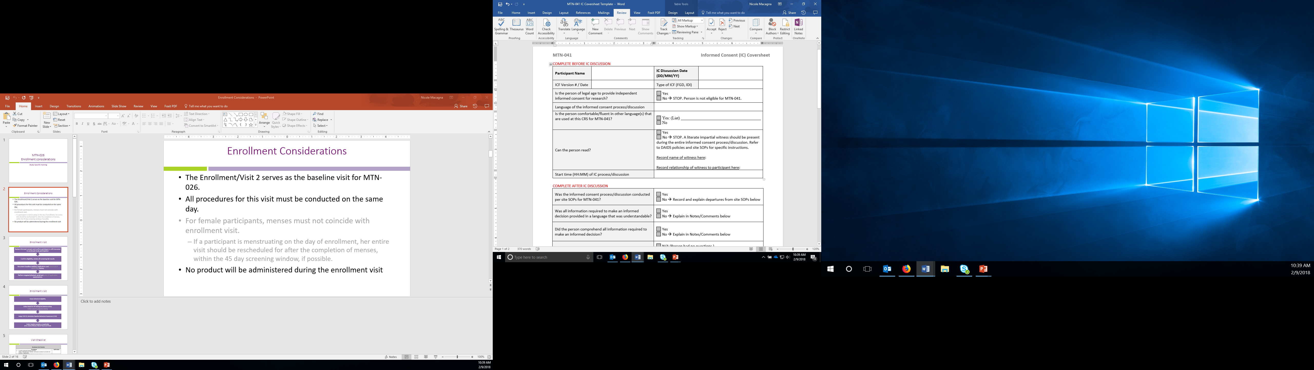

Documentation of IC Process
Informed Consent Coversheet
IC Comprehension Assessment
Complete 1st part of coversheet
Review ICF
Assess Comprehension
Complete 2nd part of Coversheet
Notes:
DAIDS policy details requirements and suggestions for documenting the informed consent process. Site staff are strongly encouraged to use an Informed Consent Coversheet to facilitate documentation of the informed consent process, in addition to the signed/dated informed consent form.
If coversheet is not used, IC review must be documented in ppt file or the IC process must be described, in detail, in site SOP, with a ppt file note stating that informed consent was obtained, per site SOP.
We have developed a study-specific template for sites that captures all required elements of IC documentation.
Here is a look at the sample coversheet. The first half of the coversheet should be completed at the start of the IC session and the remainder should be completed at the end of the IC session.
Question: will sites adopt the sample coversheet?
The participant must not be asked to agree to take part in the study, or to sign the ICF, until s/he fully understands the information contained in the informed consent, including visit procedures.
We have provided an IC Comprehension Assessment tool to assist staff in assessing participant comprehension and ensuring participant understanding prior to providing consent for study participation.
This assessment should occur after the participant has completed the IC discussion described above and before s/he is asked to sign the ICF.
Failure to document comprehension of all required points will be considered an IC process protocol deviation.
Q: Do sites plan to use this tool?

Slide 31
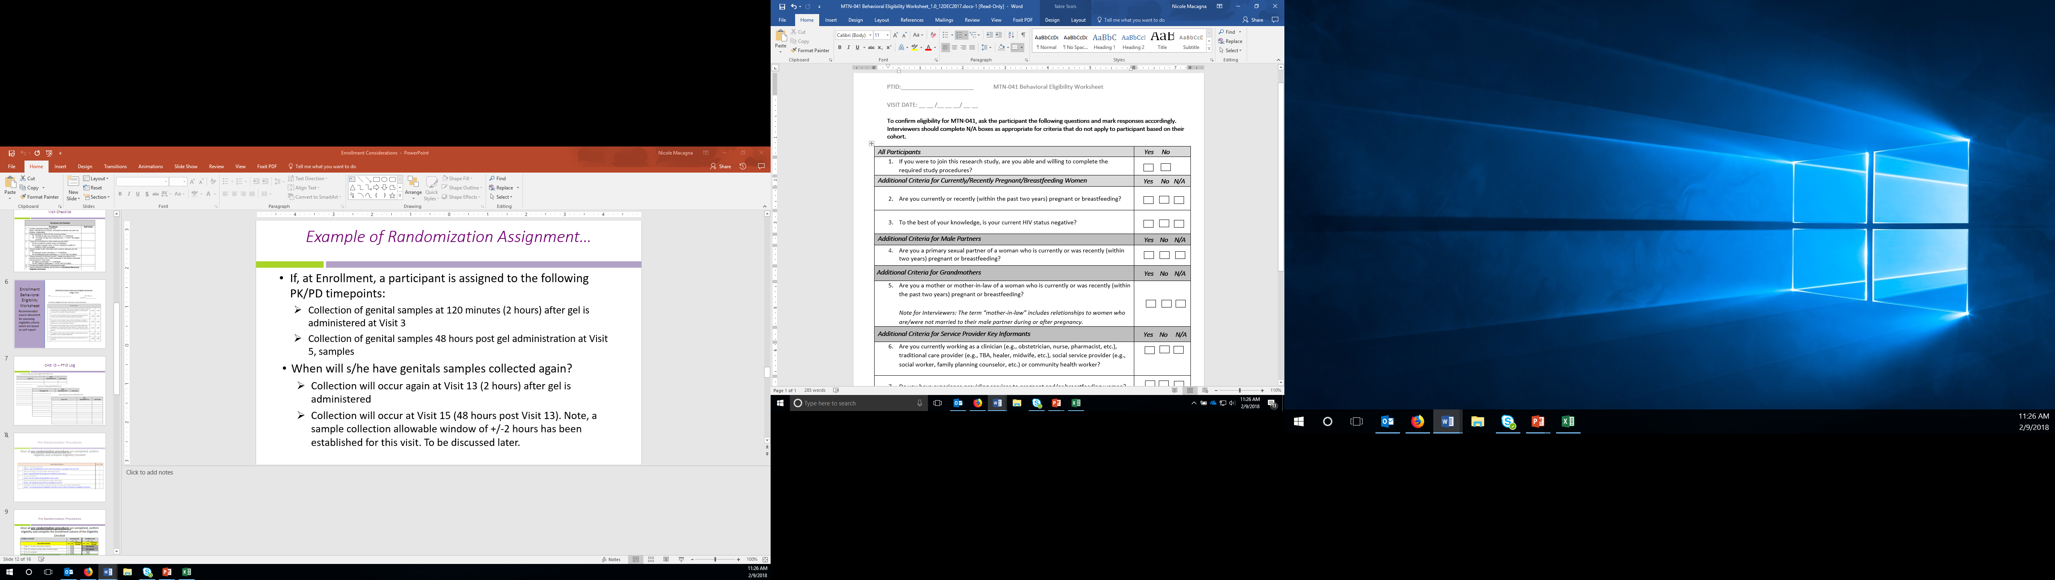
Eligibility Assessment Worksheet
Used for assessing eligibility criteria
Completed after IC is obtained
Note additional criteria for each cohort
To be eligible, participant responses (as applicable) must be ‘YES’ at his/her Screening / Enrollment Visit
Notes:
Sites can record participant-reported responses to behavioral eligibility requirements on the behavioral eligibility worksheet.
Considered source and therefore questions must be ask verbatim and responses recorded on the worksheets
If a participant is determined ineligible at any point during the assessment, the visit can stop.
Sites may modify worksheet as needed.

Slide 32

Eligibility Confirmation Checklist
Used to confirm and document eligibility prior to enrolling participant in study
Guide for inclusion/exclusion criteria and source documentation
As soon as the participant is deemed ineligible at Screening / Enrollment, no need to ask remaining questions
Notes:
It is the responsibility of the site IoR and other designated staff to ensure that only participants who meet the study eligibility criteria be enrolled in the study.
To be completed on day of enrollment.
Prior to enrollment, eligibility for study participation must be confirmed and documented on the Eligibility Checklist by designated staff.
The site IoR (or designee) and a second staff member should sign and date the Eligibility Checklist to confirm eligibility status prior to being enrolled.
If the participant is deemed ineligible at Screening or at Enrollment, the checklist does not have to be completed – document the criteria where the ppt failed and mark N/A or leave blank for rest.

Slide 33
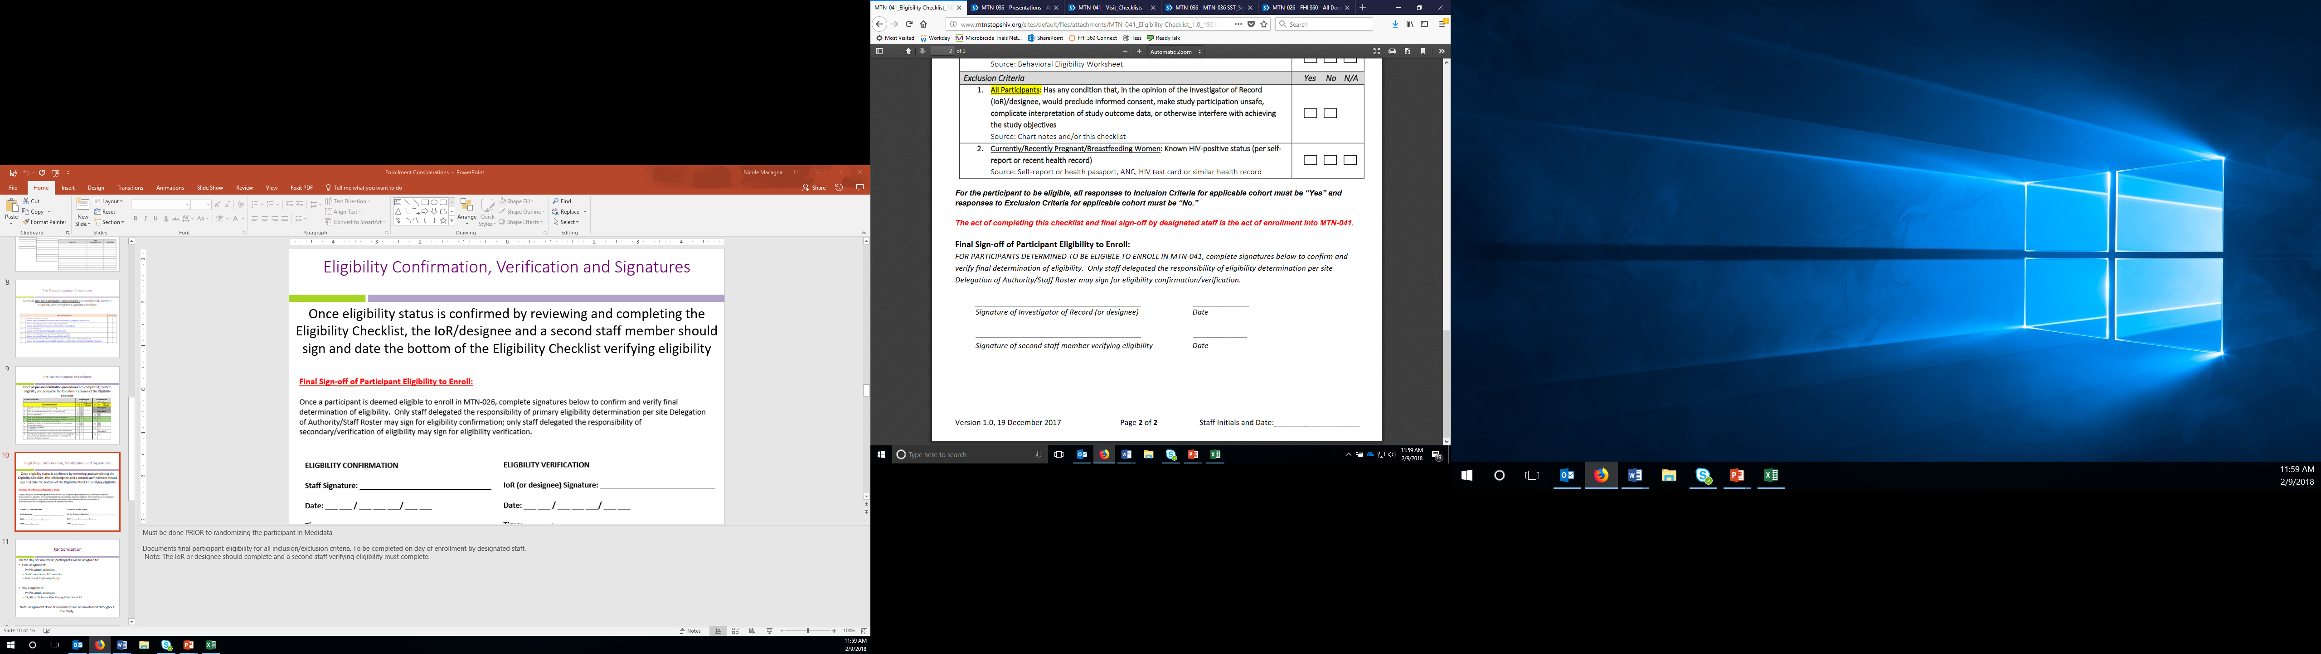
Eligibility Confirmation Checklist Cont.
Once eligibility status is confirmed by reviewing and completing the Eligibility Checklist, the IoR/designee and a second staff member should sign and date the bottom of the checklist, verifying eligibility:
Notes:
The site IoR (or designee) and a second staff member should sign and date the Eligibility Checklist to confirm eligibility status prior to being enrolled.
Must be done PRIOR to enrolling the ppt and assigning a PTID

Slide 34
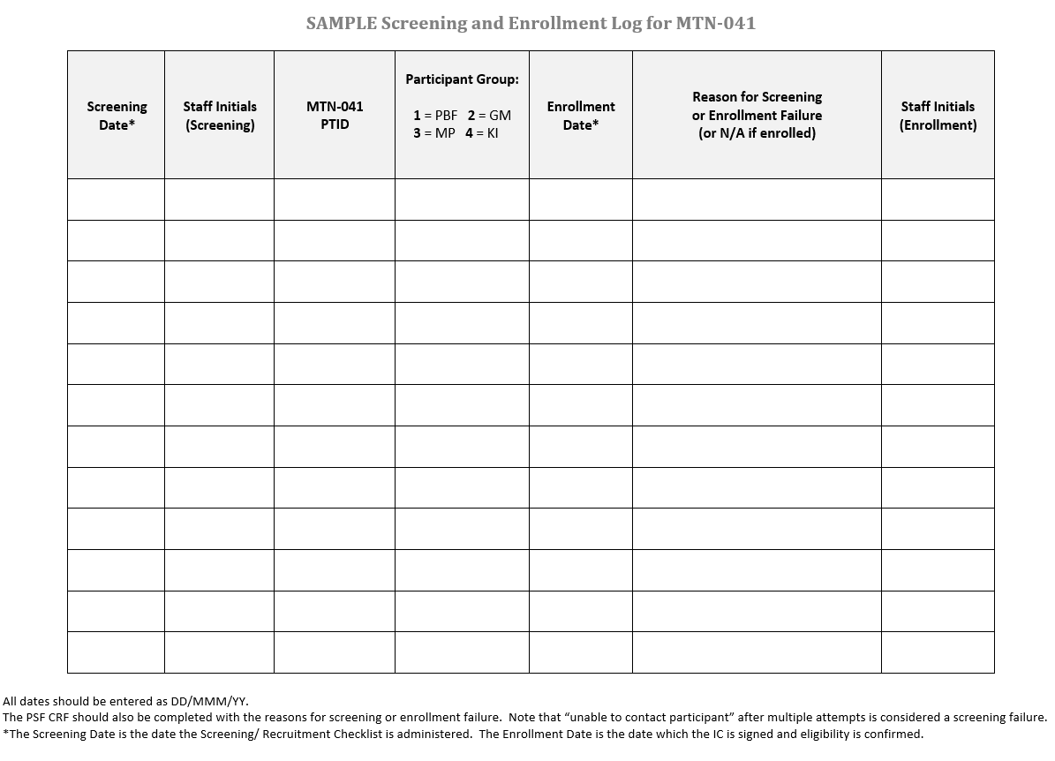
Screening and Enrollment Log
Use one log for all four participant groups:
Only complete if participant provides IC
Completed immediately after IC completion and eligibility determination
One entry for each screening attempt
Notes:
The log needs to be used in real time and completed as soon as a potential participant completes screening and signs the IC form. If the participant does not provide written IC (also meaning s/he does not have a PTID assigned), s/he should NOT be listed on this log.
If a participant re-screens, a new row on the log must be completed for that occurrence, using the SAME PTID previously assigned in the first screening attempt.

Slide 35
Required Documentation - Screen Failures
Completed ICF
All source documentation complete up until the time that ineligibility was determined indicating screen failure reason(s) and date of ineligibility determination
Visit Checklist
Eligibility Checklist
Participant file notes
Completed Screening and Enrollment Log
Participant Status Form (PSF)

Slide 36
Site Discussion
Where will the IC process take place?
  How will you ensure confidentiality?
Who at your site is responsible for obtaining IC?
How will the process be documented?
How will you handle group consent (minimize need for split visit and extra time)?

Slide 37

What are your questions about recruitment and the informed consent process?

Slide 38
PTID Assignment
One PTID will be assigned to each potential participant after informed consent for the study has been obtained
  Staff should ensure each PTID is assigned only once and should track this using the Name/Link Log
  Once assigned, a participant’s PTID should be used for all subsequent MTN-041 documentation

Slide 39
PTID Assignment cont.
PTIDs will be assigned in sequential order:
  First two digits are 41 for all sites
  Remaining digits are sequential for individual identification (or ‘F’ for focus group)
Site | PTID Range | FGD # Range
WRHI | 41-2001 to 41-2099 | 41-F21 to 41-F29
Zengeza | 41-4001 to 41-4099 | 41-F41 to 41-F49
MUJHU | 41-6001 to 41-6099 | 41-F61 to 41-F69
Blantyre | 41-8001 to 41-8099 | 41-F81 to 41-F89
Notes:
Recorded on name/link log
41 first two digits for all sites, then either the site digit or “F” for focus group; then sequential digits

Slide 40
Visit Checklists
Visit checklists outline required study visit procedures, guides procedure flow/order, and documents completion of all procedures
3 types of visit checklists for MTN-041:
  IDI Visit Checklist
  Group FGD Visit Checklist
  Individual FGD Visit Checklist

Slide 41
Visit Checklists: General Instructions
Complete staff initials next to items completed
  Do not initial for other staff members
  If other staff members are not available to initial checklist items themselves, initial and date a note on the checklist documenting who completed the item, e.g., “done by {name}” or “done by interviewer.”
If an item listed on the checklist is not performed, enter “ND” for “Not Done” or “NA” for “Not Applicable” beside the item and record the reason why (if not self-explanatory)
If any items are not completed on the date recorded at the top of the checklist, ensure that the procedure date is included in the comments section
  Do NOT complete second visit checklist if visit is split

Slide 42
Visit Checklist: General Sections
Preparation
  Complete prior to participant(s) arrival
  Includes items such as confirming all necessary study materials/supplies are available, confirming availability of appropriate staff and venue/space
Participant Arrival, IC and Data Collection
  Includes all study procedures involving participants, such as IC, eligibility determination, PTID Assignment, CRF administration, conduct of IDI or FGD, reimbursement, etc.
Post-IDI or FGD
  Includes all procedures to be done after participant(s) has/have left, such as completion of debrief report, data backup, QC of file

Slide 43
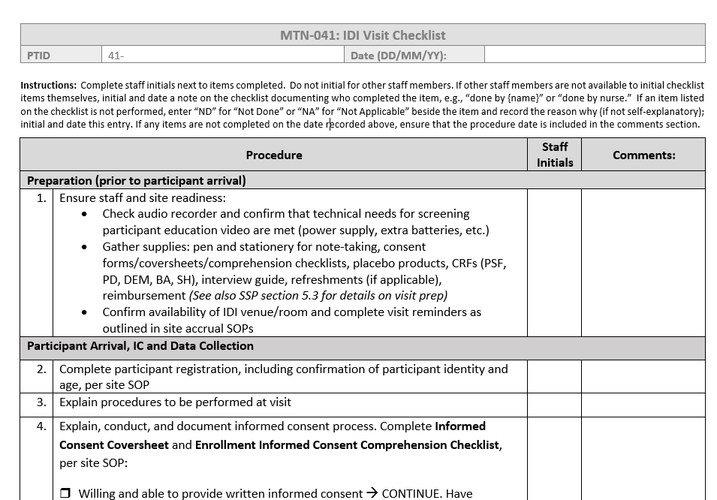
IDI Visit Checklist
Completed for all IDIs, including:
  Service provider key informants
  Community leader key informants
  IDIs of community members originally recruited for FGDs (rare)

Slide 44
FGD Individual Visit Checklist
Used for participants of all FGD types (P/BF women, male partners, and grandmothers)
One individual FGD visit checklist is completed per FGD participant
Documents procedures that must be completed on an individual level
  For example, IC, Eligibility Determination, PTID Assignment, CRF completion, reimbursement, etc.

Slide 45
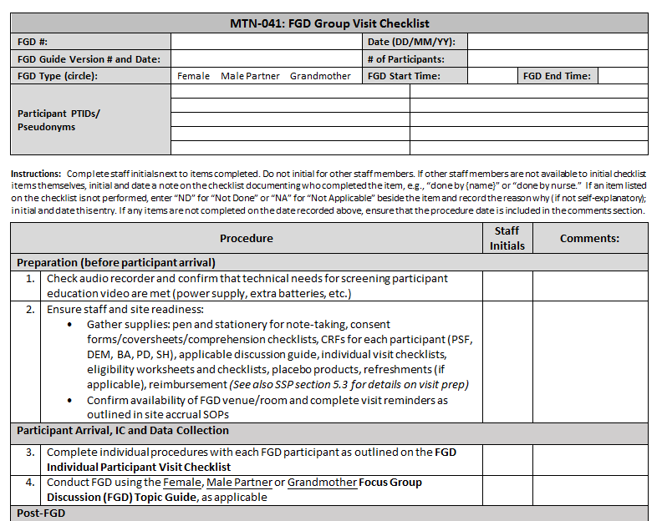
FGD Group Visit Checklist
Used for all FGD types
One group FGD visit checklist is completed per FGD
Documents summary-level information about FGD (type, date, start/stop time, PTIDs, pseudonyms), preparatory activities, and post-FGD activities

Slide 46
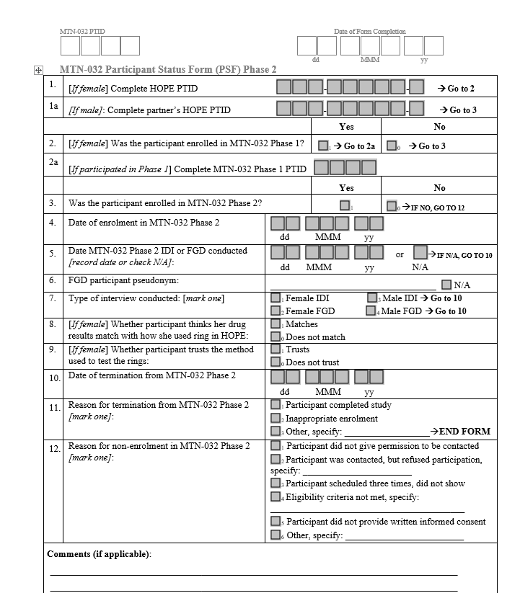
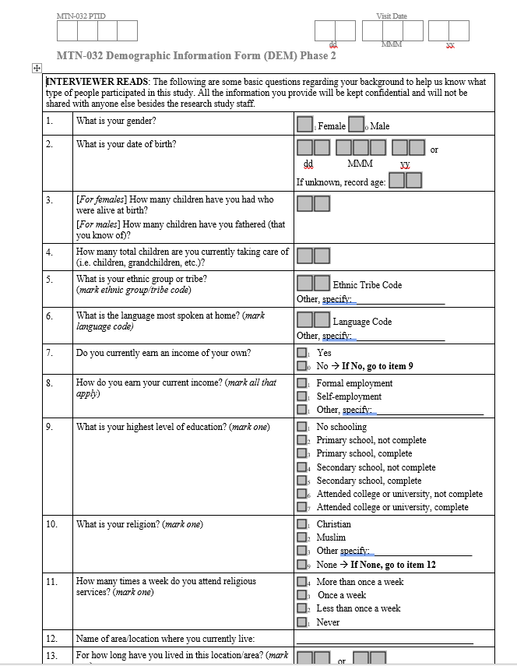
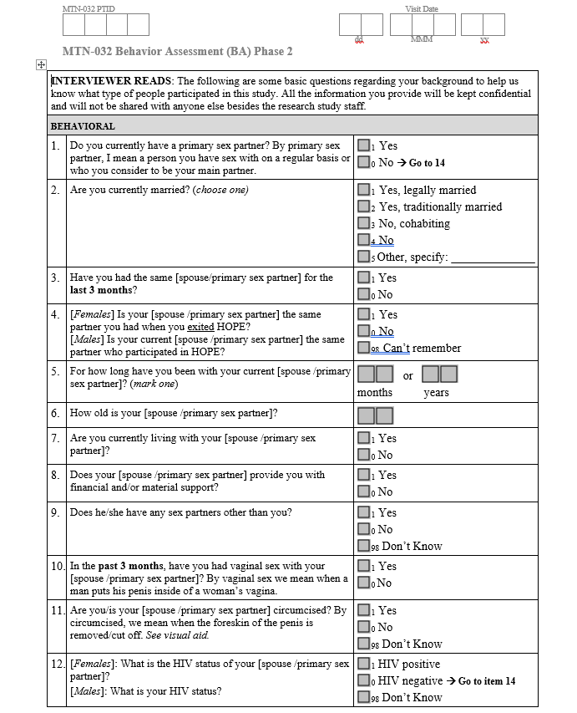
Data Collection Tools I: CRFs
CRFs:
  Required:
  Behavior Assessment (BA) – Male and Female
  Demographic Information Form (DEM)
  Participant Status Form (PSF)
  If needed:
  Protocol Deviation Report (PD)
  Social Harms Report (SH)
Notes:
Two types of data collection tools: CRFs and Guides

Slide 47
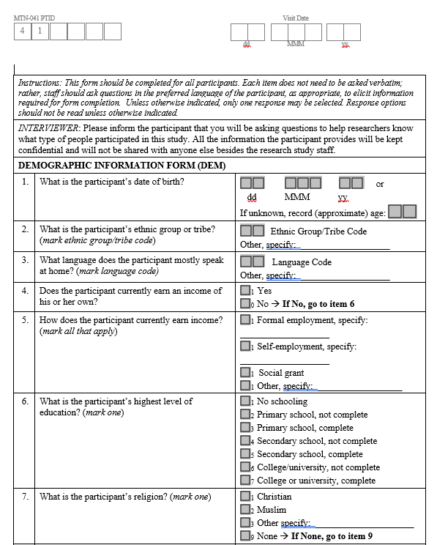
DEMOGRAPHIC INFORMATION FORM
Collected prior to IDI/FGD:
Collect relevant demographic information on participants
Key Topic Areas:
DOB
Ethnic group/tribe
Language
Income
Education
Religion/religiosity
Marital status
# children
Household stats
Food insecurity
Water source
HIV prevention products knowledge and use
Notes:
Designed in such a way that you are not asking participant the questions directly but rather collecting the information necessary to fill out the form

Slide 48
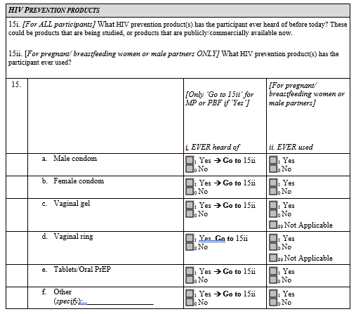
DEMOGRAPHIC INFORMATION FORM cont.
NEW in 041:
HIV prevention products
  ALL participants ask about what they have HEARD about (15i)
  P/BF and MP ONLY ask what they have ever used (15ii)
Notes:
Designed in such a way that you are not asking participant the questions directly but rather collecting the information necessary to fill out the form

Slide 49
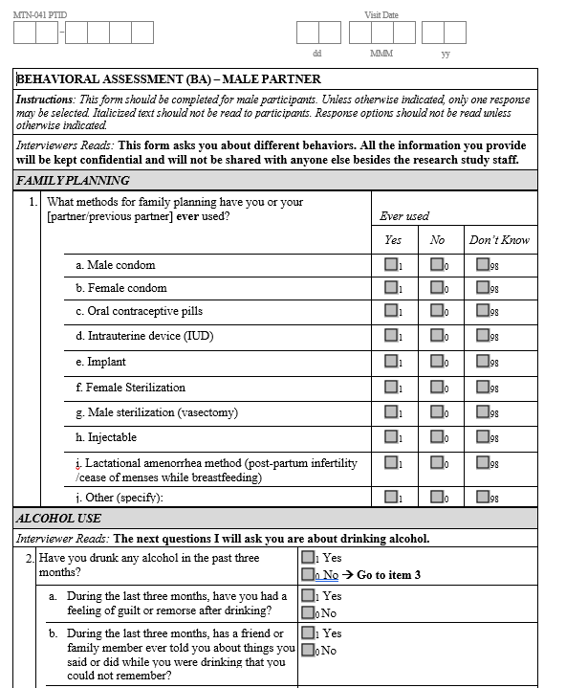
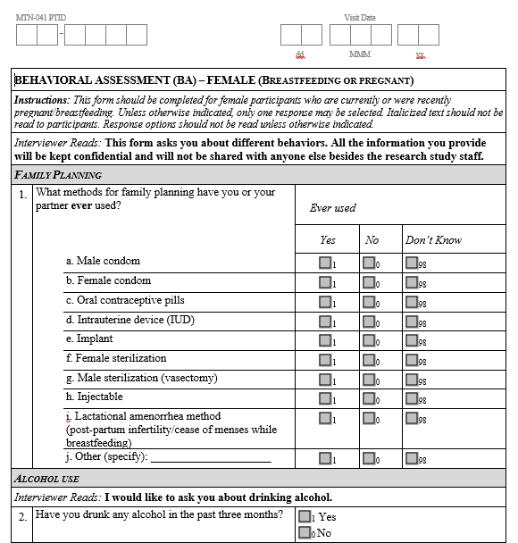
BEHAVIOUR ASSESSMENT:
Male Form & Female Form
Interviewer-administered prior to IDI/FGD:
Helps to inform different aspects of data collected during the IDls and FGDs
Key Topic Areas:
Family planning
Alcohol use
Sexual behavior & relationship dynamics
Pregnancy/Breastfeeding history
P/BF practices and decision making

Slide 50
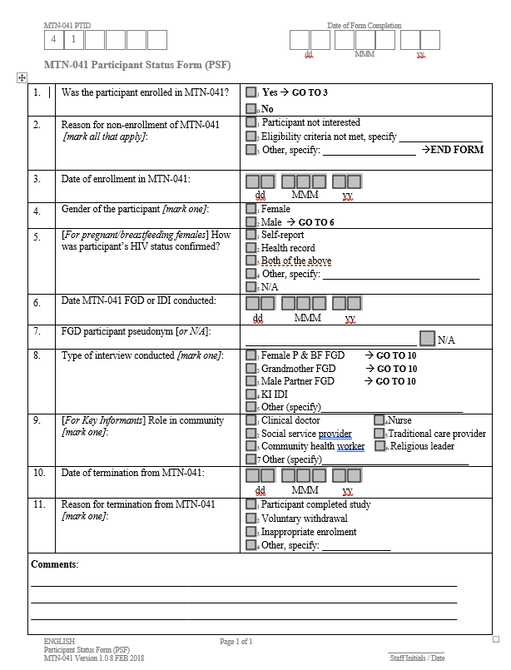
PARTICIPANT STATUS FORM
Captures:
MTN-041 PTID
Enrollment, interview and termination dates
Reason for termination
Reason for non-enrollment
Notes:
Not for everyone contacted like 032 – just participants who sign IC

Slide 51
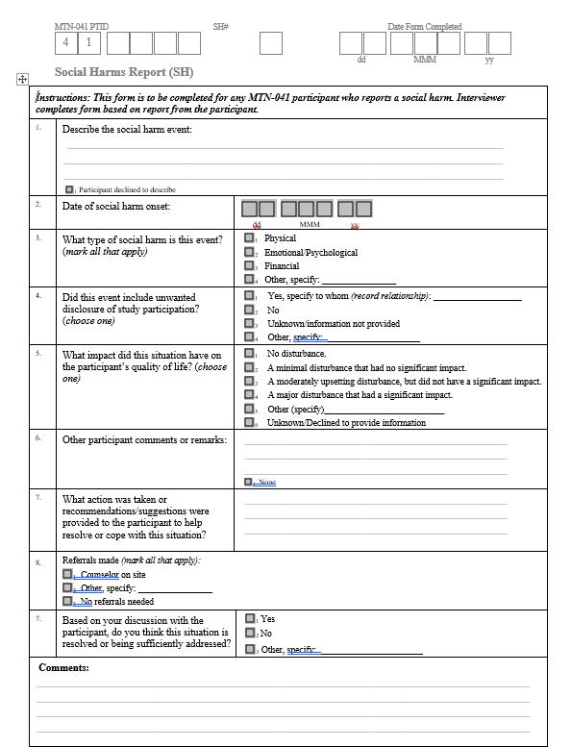
SOCIAL HARMS REPORT
Captures:
Details of any social harms event (date and type)
Impact of social harm
Actions taken/needed
Referrals made

Slide 52
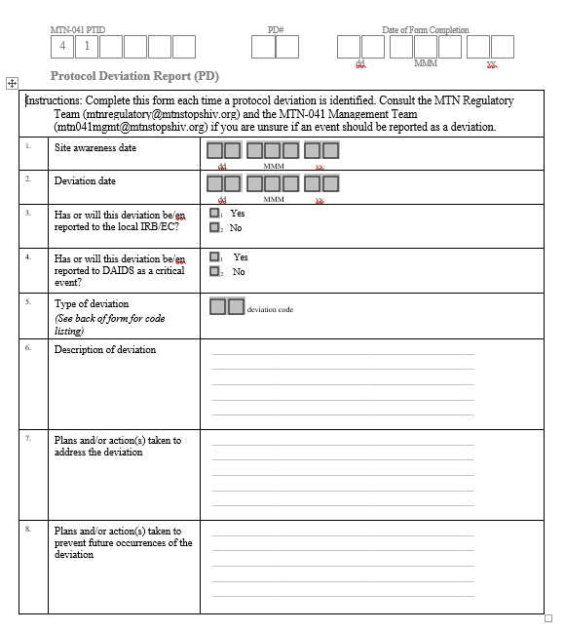
PROTOCOL DEVIATION
Captures:
Details of any protocol deviation event (date, type and reporting)
Actions taken/needed
Plans/actions to prevent future occurrences

Slide 53

Data Collection Tools II: Guides
FGD Guides:
  P & BF Women
  Male Partner
  Grandmother
Key Informant IDI Guide
Notes:
Focus on similarities and differences between guides

Slide 54
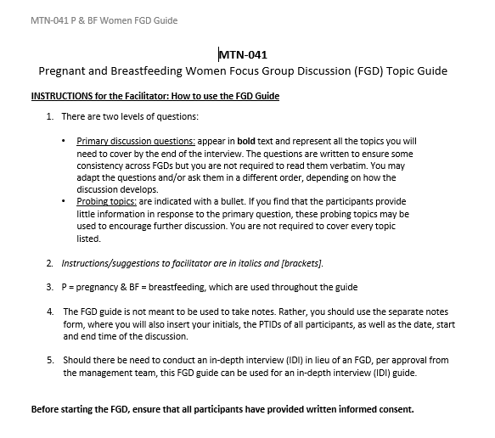
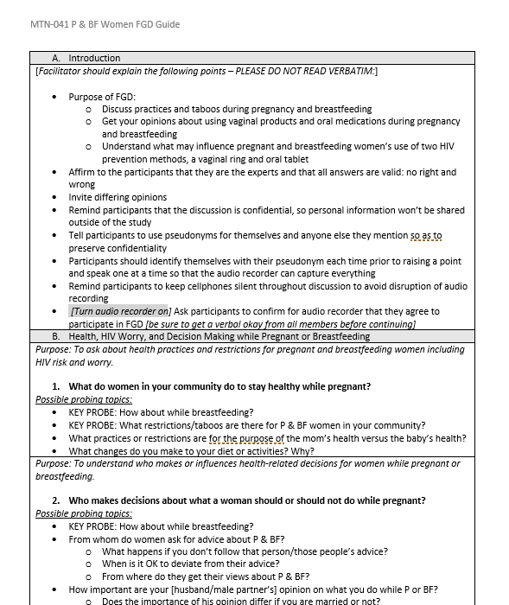
FGD GUIDES:
P and BF women; Male Partner; Grandmothers
Topic Areas:
Health, HIV worry, and decision making while P/BF
Sexual activity and vaginal practices while P/BF
Oral PrEP and VR acceptability
Suggestions to encourage product use in P/BF populations
Wrap-up

Slide 55
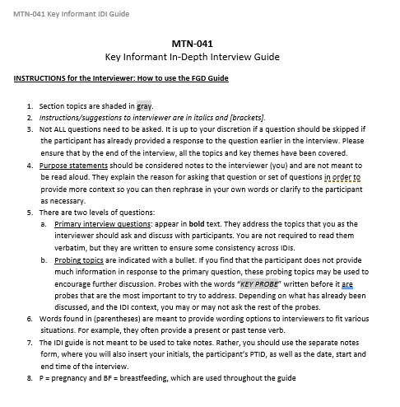
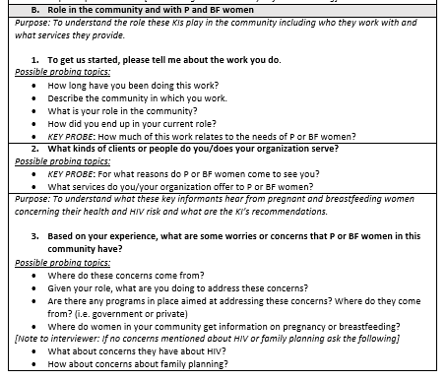
KEY INFORMANT IDI GUIDE
Topic Areas
Role in the community and with P/BF women
Sexual activity community practices while P/BF
Perception of P/BF women’s risk of HIV
Ring and PrEP discussion
Recommendations to explain and encourage product use in P/BF populations
Wrap-up

Slide 56
Educational Video/Storyboard
Designed to be shown during FGD
Ideally sites will have all necessary IRB approvals for the video at the time of activation
  If approval is delayed, staff should instead present the storyboard to participants (showing each picture and reading the text provided)

Slide 57
Data Management
Ariana Katz
Women’s Global Health Imperative (WGHI)
RTI International

Slide 58
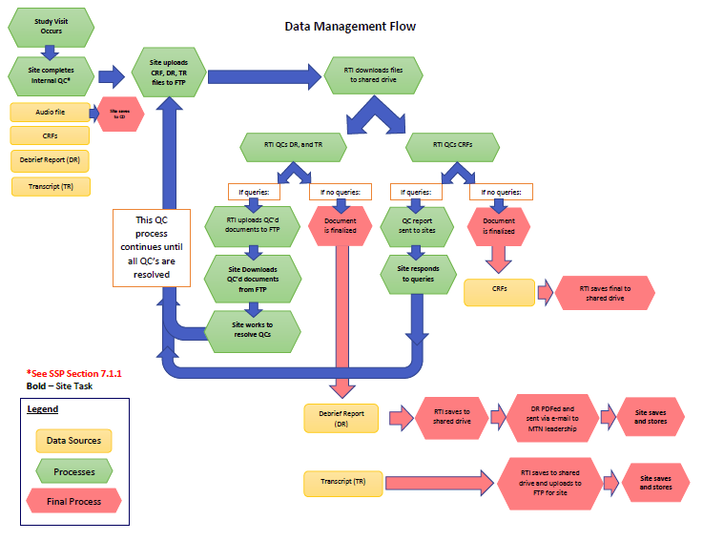
Data Management Flow
Notes:
Details in SSP Section 7 and your site Data Management SOP, which you should all now be working on.
Focus slide on SITE LEVEL data management activities: NOTE we are not asking you to send audio files to RTI. They are source document and we want to minimize number of copies.

Slide 59
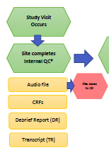

Slide 60
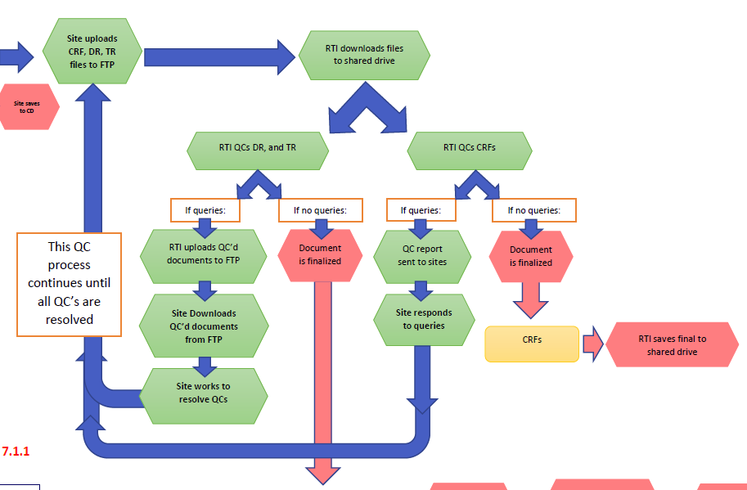

Slide 61
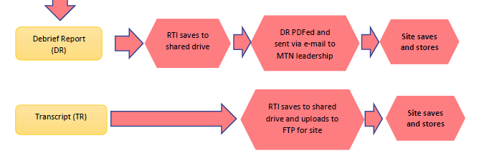

Slide 62
Data Management Timeline
Timing after interview | Overview of Tasks (See SSP Section 7)
Same day (before ppt leaves) | Site QC Review #1 of all checklists and forms
Same day (ASAP after IDI/FGD) | Verify audio recording; copy onto password protected hard drive Begin entering notes into DR
Within one week | Save audio file to CD as source; store in ppt or FGD file Site QC Review #2 of all forms, DRs, etc. Upload CRFs and DRs to RTI
Within one month | Transcribe/translate IDI/FGD → English transcript Site transcript QC & upload to FTP for RTI

Slide 63
RTI-Site CRF QC Process
Task | Timeline
Site upload CRFs to RTI via FTP | Within one week of interview
RTI completes double data entry into RTI’s database | As received
RTI sends Quality Control (QC) Report to site via e-mail | Weekly
Site corrects or clarifies CRF(s); updated CRFs re-uploaded to RTI via FTP | Within one week of receiving QC report
RTI will review corrected pages If resolved → no further action If not resolved → more detailed query sent to site with next QC report | Weekly
Notes:
Send back full pdf of CRFs after corrects

Slide 64
CRF Query Report
Query report will include:
  A list of PTIDs for which there are discrepancies or other issues
  Relevant details for each issue (to which question and form it pertains)
Notes:
Will be a list by PTID, will detail what the issue is on which question on which form

Slide 65
RTI-Site Debriefing Report
QC Process
Task | Timeline
Site uploads DR to FTP | Within one week of interview
RTI reviews DR and re-uploads to FTP with queries to site | Within one week of initial receipt
Site responds to RTI queries and re-uploads to FTP | Within one week of query receipt

Slide 66
Transcript Timeline
Task | Timeline
Site creates English language transcript and uploads to FTP (after internal QC) | Within one month of the interview
RTI reviews transcript and re-uploads to FTP | Within two weeks of initial transcript receipt
Site responds to RTI queries and re-uploads to FTP site | Within two weeks of query receipt

Slide 67
Debrief Reports
Purpose:
To provide a summary of the participants’ attitudes towards the key themes, the mood of the discussion, whether it was dominated by certain participants (FGD), unique comments, and any other important information in REAL TIME
Report to be completed immediately after IDI or FGD
Will be discussed on study team calls and shared across sites

Slide 68
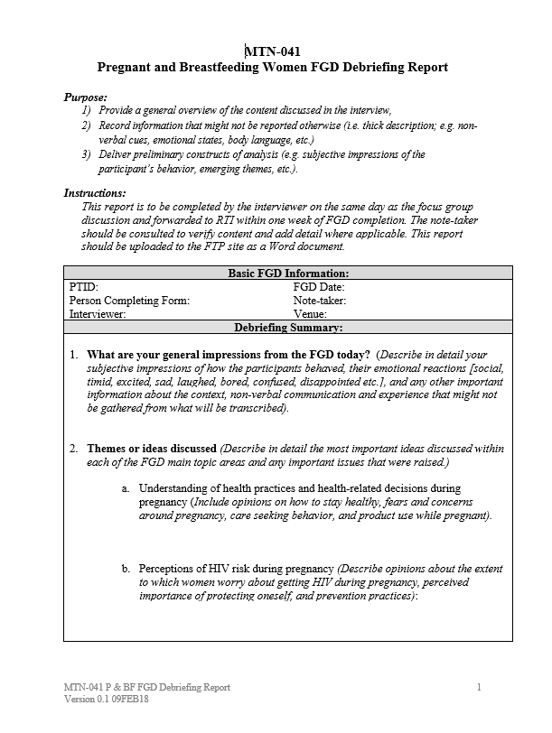
P & BF WOMEN FGD DEBRIEF REPORT

Slide 69
File Naming Conventions
Initial format:
  IDI_[PTID]_[Data Type]_[Date of IDI]
Query format:
  IDI_[PTID]_[Data Type]_[Date of IDI]_[Initials]
Final format:
  IDI_[PTID]_[Data Type]_[Date of IDI]_FINAL
IDI_1001_AF_22MAR16
IDI_1001_DR_22MAR16_CN_AK
IDI_1001_TR_22MAR16_FINAL
Filename acronyms:
Audio File = AF
Debrief Report = DR
Transcript = TR

Slide 70
Transcript Formatting Expectations
Consistent font across transcripts
  Times New Roman, 11 or 12 point font, 1.15 spacing
Header Includes: Interview Type, Participant ID, Drug Detection Level, Interview Date, Clinical Site, Audio File Name, Audio Recording Length, Interviewer Name, Transcriber/Translator Name, Interview Language
After header, label next section “Interview Text,” insert a hard return and begin transcribing the content of the audio file verbatim (in English)
Use “I:” before Interviewer remarks and “R:” before respondent remarks
Italicize all respondent remarks
Notes:
These formatting expectations are the same as they have been – new expectation is transcript certification, which I will discuss in a minute

Slide 71
Transcript Formatting Expectations cont.
Auto-number the transcript by paragraph
  Each time the Interviewer or Respondent begins a new response, this should be indicated by a new number
Replace all references to individual names or other identifying data with pseudonyms
Any mumbling, laughing or silences recorded in transcript can be noted by [brackets] not parentheses
Long pauses can be represented by use of an ellipsis “…”
Insert a footer with page X of X on right-hand side
Spell check the transcript for any spelling and grammar errors
Filename should follow instructions described in section 7-7 SSP
Be consistent with all formatting!

Slide 72
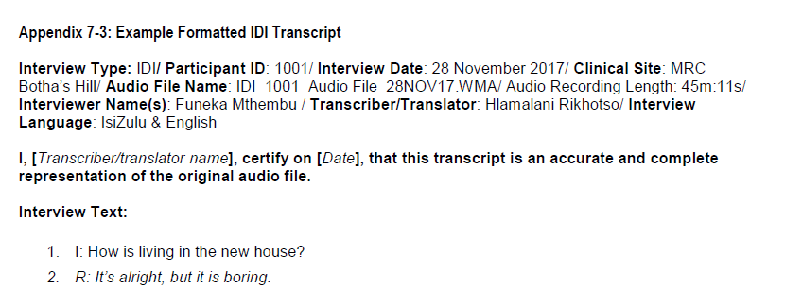
Transcript Certification
Notes:
NEW (those working on HOPE will be familiar): Once a transcript is deemed ready for RTI review, the transcriber should certify that the transcript is an authentic representation of the audio recording by adding their name and date to the top portion of the transcript.

Slide 73
Analysis Plan Overview
Rapid analysis plan
  Debrief reports as primary analytic document
    -> focus on pregnancy finding to prepare for MTN-042
  Focus on key themes outlined in DR template
    Importance of “emerging themes” and field “what stands out/surprise”
  Results to inform MTN-042 protocol development in April
Longer-term analysis plan
  Full transcription and translation
  Transcripts as primary analytic document
  Use of a codebook and code report/memo-ing

Slide 74

Questions?

