Slide 1
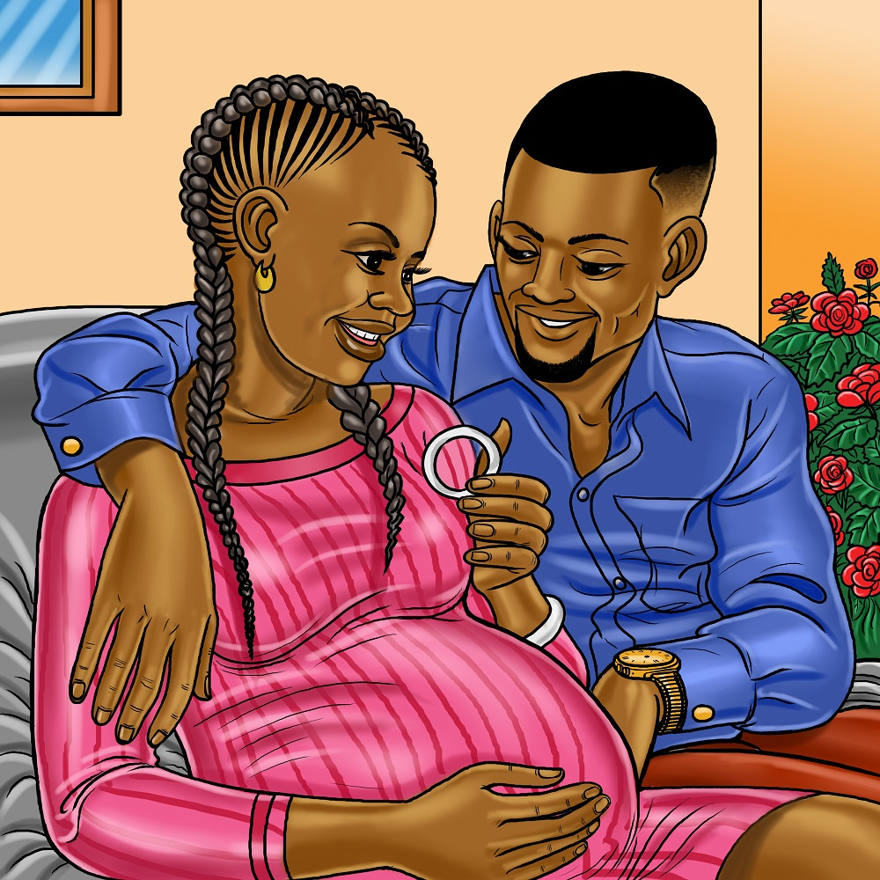
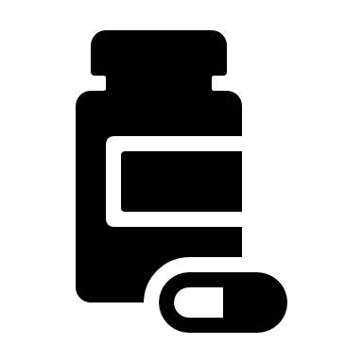
Male Partner Support
Social support is essential to the success of HIV prevention research. Support from male partners can be especially important.
How can male partners help?
“Medical research is a good thing, and it is one of the things that have helped us to get drugs that have managed to kill some deadly diseases in the world.” (Kampala, Uganda)
You can help your partner by:
Supporting her adherence to the study products
Reminding her about study visits
Assisting with ring insertion or removal, as needed
Helping her with transportation
Become an HIV Prevention Champion: You can be an advocate for HIV prevention by talking to your male friends or dispelling rumors and myths that may be circulating in the community.
Knowledge is power
By becoming engaged in the study as a supportive partner, you will:
learn more about pregnancy and breastfeeding
become more familiar with study procedures
feel more confident with your partner’s study product use
You will also learn about cutting edge HIV research and be part of a global movement to expand options for HIV prevention.
“He actually encouraged me… So, I kept the ring inserted.”
(Chitungwiza, Zimbabwe)
What is the MTN-042/DELIVER study all about?
The study intends to learn whether two safe and effective HIV prevention methods, the dapivirine vaginal ring (“the ring”) and oral Truvada (also known as “oral PrEP”), are also safe to use during pregnancy for mom and baby. More details about the study design and the study products are available from study staff.
MTN-042 Male Partner Support Factsheet, v1.0 29JUL2021

Slide 2
Are these products safe to use during pregnancy?
Oral PreP: A daily pill taken by mouth.
Most people report no side effects, but some do.
Common side effects are mild and go away shortly after starting use (for example, headaches, stomach pain).
Some side effects are more serious, but these are very rare.
No safety concerns have been identified with use of oral PrEP during pregnancy or breastfeeding. The World Health Organization (WHO) recommends oral PrEP for pregnant and breastfeeding women who are at high risk of HIV.
Dapivirine ring: A vaginal ring inserted and replaced monthly
Most women experience few to no side effects
Less is known about the use of the ring during pregnancy. However, information from brief use of the ring early and late in pregnancy from other studies is very encouraging.
Data from the first group enrolled in DELIVER, which included women 8 to 9 months pregnant and their infants also did not indicate any safety concerns.
What about safety for men?
“When she inserts it properly, I would even forget that she uses a ring.” (Lilongwe, Malawi)
The safety of oral PrEP for men is well established. You will not be exposed to the medication in oral PrEP by your partner taking it.
Previous studies show that the ring and the drug dapivirine does not harm the male partner
A women’s use of oral PrEP or the ring will NOT provide HIV protection for the male partner.
Does the ring impact sex?
In past studies, most male partners reported that they did not feel the ring during sex.
For those who did, most said that the ring did not reduce their sexual pleasure or cause them to change sexual positions or practices.
Some reported increased sexual pleasure by feeling the ring, knowing that the ring was in place, or feeling increased vaginal wetness while using the ring.
“I would feel big pleasure on the side only to find out it is the ring”
(Durban, South Africa)
For more information about DELIVER, go to: http://www.mtnstopshiv.org/news/studies/mtn042
Contact study staff <site name contact information>
MTN-042 Male Partner Support Factsheet, v1.0 29JUL2021

