Slide 1
MTN-042 (DELIVER)
MTN-043 (B-PROTECTED) Study Education Slides
MTN-042/MTN-043 Study Education Slides, English, V2.0, 27AUG2021 (Slides 1-78)

Slide 2
Overview and
Study Rationale

Slide 3

Women need and deserve options for HIV prevention during all phases of life.
Notes:
In Africa, more than half of people living with HIV are women.
Women need and deserve options for HIV prevention.
Options they can use during all phases of their lives—including pregnancy and breastfeeding.

Slide 4


Notes:
The purpose of the DELIVER and B-PROTECTED studies is to learn whether two HIV prevention methods are safe to use during pregnancy and breastfeeding.
This information is critical for supporting future recommendations and approvals of these HIV prevention methods for use during pregnancy and breastfeeding.
By studying two different HIV prevention options, these studies will help women have choices.

Slide 5
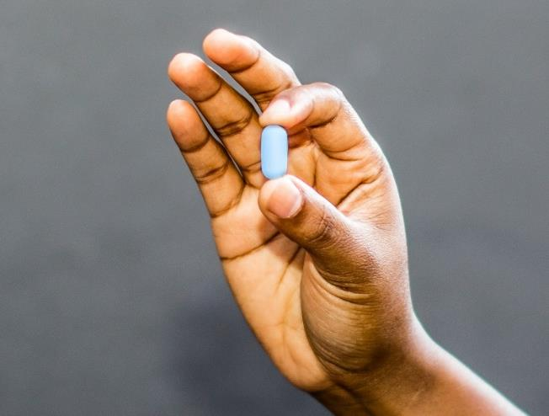
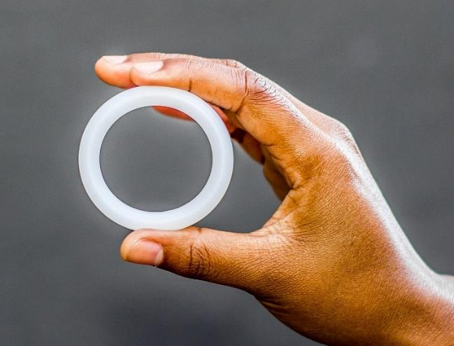
The Study Products
Daily oral Truvada pill
Monthly dapivirine vaginal ring
Notes:
What are the study products?
• The two HIV prevention products in DELIVER and B-PROTECTED are a daily oral pill called Truvada (taken as pre-exposure prophylaxis, or PrEP) and the monthly dapivirine vaginal ring.
•The ring and Truvada have both been studied in women who are not pregnant or breastfeeding and have been shown to be safe and effective at reducing HIV risk.

Slide 6
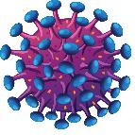
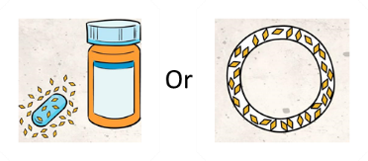
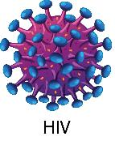
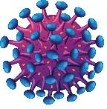

How do they work?
Without Pills or Ring
With Pills or Ring
X
X
X
Virus can make copies
Virus cannot copy
Notes:
How do they work?
•Drugs (ARVs) in the ring and pills release into the body.
•This prevents the HIV from making copies of itself and infecting the body.
•Both must be used correctly and consistently to reduce HIV vulnerability from exposure through vaginal sex.
•Neither protects against other sexually transmitted infections (STIs) or pregnancy.

Slide 7
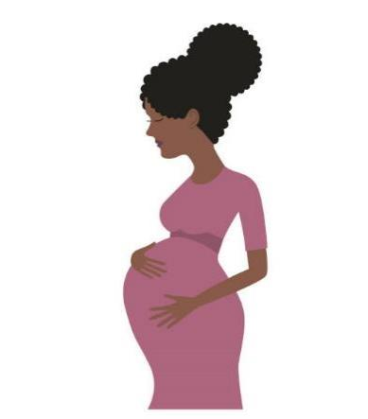
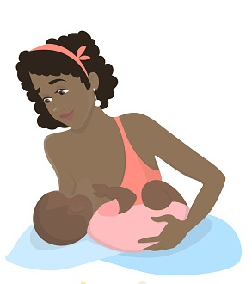
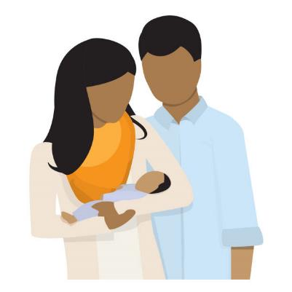
Why Study HIV Prevention Options for Pregnant and Breastfeeding Women?
Preventing HIV in mothers also protects babies and families.
Pregnancy and breastfeeding are periods of increased HIV risk.
Notes:
Why study HIV prevention options for pregnant and breastfeeding women?
• Women may be pregnant or breastfeeding for a significant portion of their life.
• Pregnancy and breastfeeding are periods of increased HIV risk, for various biological, social, and behavioral reasons.
• Preventing HIV in mothers also protects their babies and their families.
• While well implemented prevention programs have helped with the reduction in transmission of HIV from mother to child, preventing mothers from getting HIV in the first place has been more challenging to accomplish.

Slide 8

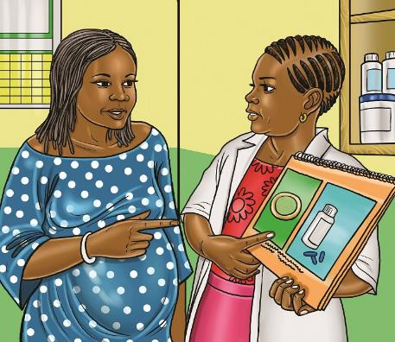
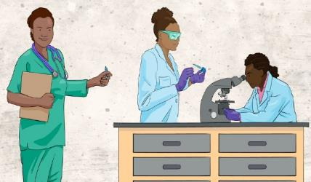
How Are Medicines Studied in Pregnant and Breastfeeding Women?
Research is done in stages
Minimizes potential unknown risks
to mothers and their babies
Notes:
How are medicines studied in pregnant and breastfeeding women?
• First, small studies are done in laboratories and on animals, and then with small groups of healthy people (who are not pregnant or breastfeeding), to test if the products are safe to use.
• Next, larger studies are done with more people to test if the products work and if people will use them as intended.
• Typically, only after products are proven safe and effective is research expanded to include pregnant and breastfeeding women. This is where research is now with the dapivirine ring and oral Truvada for HIV prevention.
This approach minimizes potential unknown risks to mothers and their babies.

Slide 9
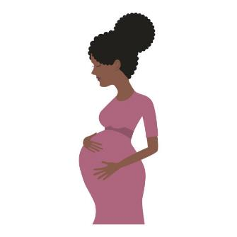
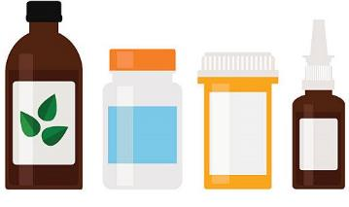
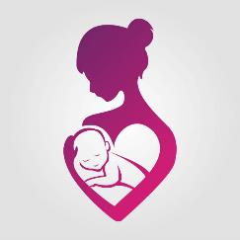
Why Do Research in Pregnant Women?
The body changes during pregnancy.
Medicines may work differently
during pregnancy.
This may affect the mother or her developing baby.
Notes:
Why is research in pregnant women needed?
• The body undergoes many changes during pregnancy
• Medicines may work differently in pregnant women
• Medicines may pass to the developing baby and cause potential harm to the baby or put the pregnancy at risk

Slide 10
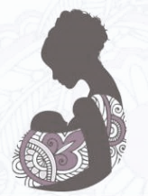
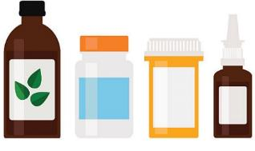

Why Do Research in Breastfeeding Women?
The body changes during breastfeeding.
Although rare, medicines may affect the milk supply or pass into breastmilk.
If the risks are unknown, mothers may stop breastfeeding.
Notes:
Why is research in breastfeeding women needed?
• The body undergoes many changes during breastfeeding
• Although rare, certain medicines may affect milk supply and/or pass into breastmilk and cause potential harm to the baby
• If the risks of medicines are unknown, some mothers may choose or be instructed to stop breastfeeding, depriving both them and their babies of many health benefits . Other mothers may stop taking their medication or have to switch to a different kind of medication that is known to be safe during breastfeeding.

Slide 11
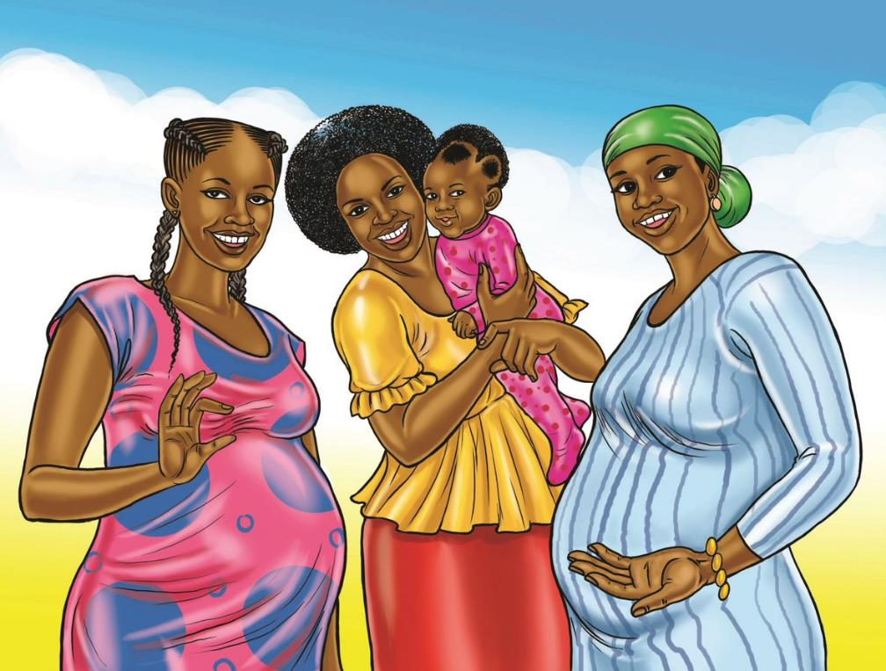
Women deserve HIV prevention options they know are safe—for themselves, their pregnancies, and their babies
Notes:
Ultimately, pregnant and breastfeeding women may not have access to needed medicines or may be concerned about the safety of medicines they could benefit from, if they have not been studied in these populations.
Women need options for HIV prevention that they can use during all phases of life.
DELIVER and B-PROTECTED aim to ensure that women can be protected against HIV with options suited to their own preferences and that they know are safe – for themselves, their pregnancies and their babies.

Slide 12
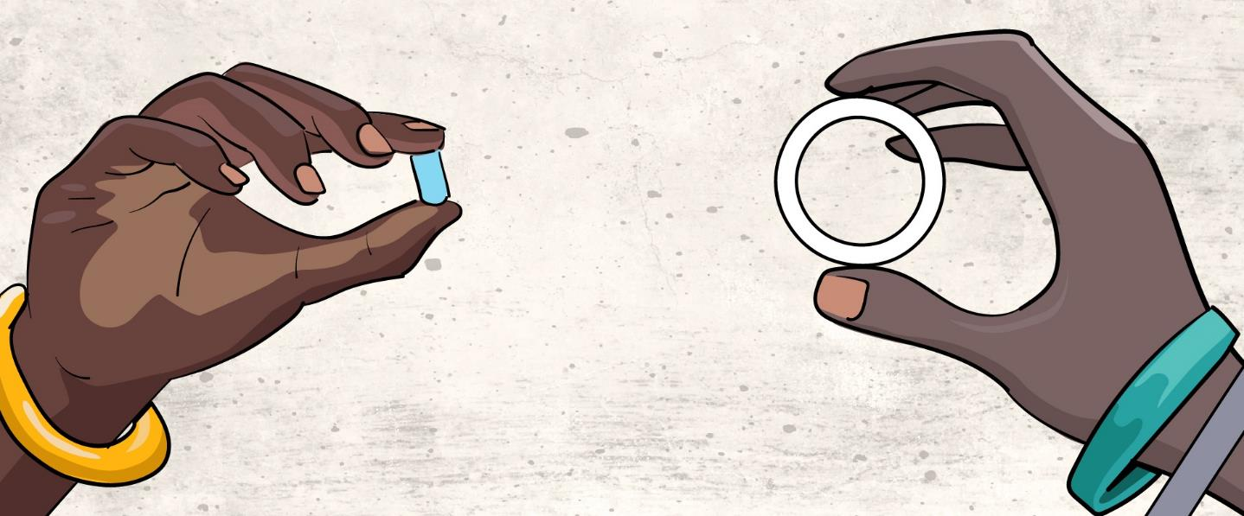
Study Products

Slide 13
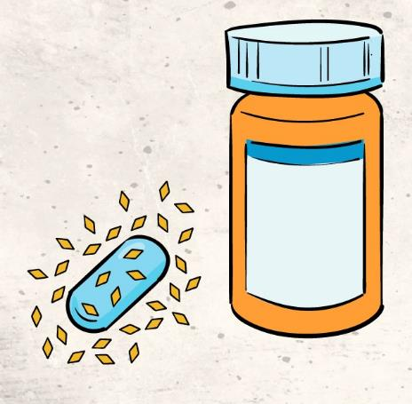

Daily oral Truvada pill
Monthly dapivirine vaginal ring
Notes:
The two HIV prevention products in DELIVER and B-PROTECTED are a daily oral pill called Truvada and the monthly Dapivirine vaginal ring.

Slide 14
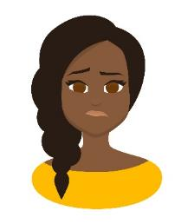


More about the dapivirine ring…
The ring contains an ARV drug called dapivirine.
Found safe and effective when used continuously each month
Did not work as well for younger women
WHO recommended as an HIV prevention option for women. Remains under review by multiple regulatory authorities.
Notes:
More about the dapivirine vaginal ring…
• The ring contains an antiretroviral (ARV) drug called dapivirine. In previous studies, the ring was found to be safe and effective for women who used it continuously.
• The ring didn’t work as well in younger women, and researchers think this might be because they had trouble using the ring the whole month. More research about the ring is currently ongoing in younger women.
• Study staff can keep you informed on progress being made towards approvals

Slide 15
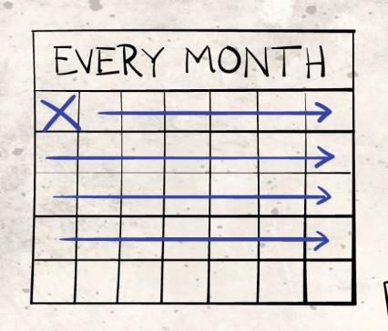
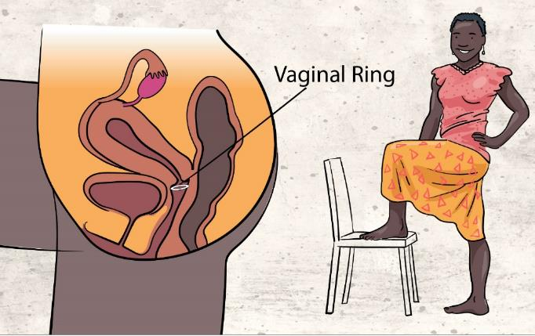
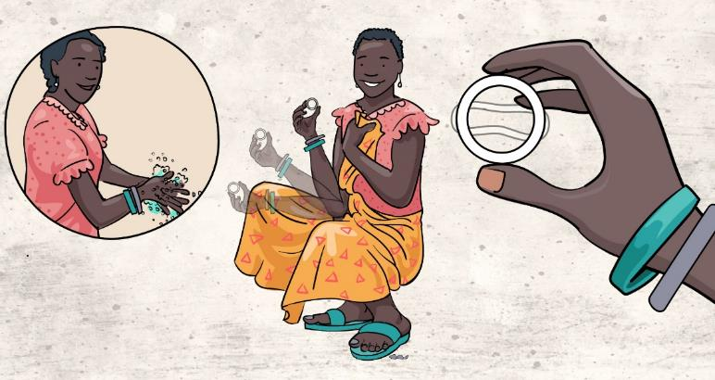
How is the ring used?
Left in place the whole month, then replaced
Staff will teach how to insert and remove
Soft and flexible;
Inserted with your finger.
Notes:
How is the ring used?
The ring is soft and flexible. Women can insert the ring into their vagina using their finger
The ring is left in place continuously for a whole month, then removed and replaced with a new ring.
Study participants will be taught how to insert and remove the ring. Study staff can help them as needed.

Slide 16
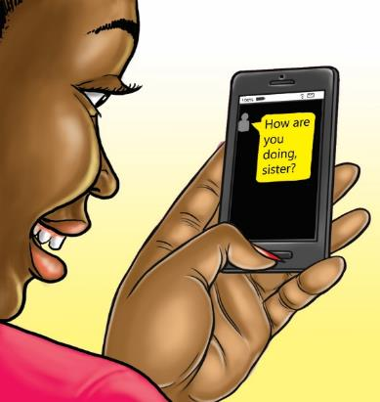
What are the side effects of the ring?
Some
Mild side effects such as vaginal discomfort or discharge
Most
Few to no side effects
Very Rare
Allergic reaction, Toxic Shock Syndrome
May be different during pregnancy or breastfeeding.
Staff will counsel on issues or concerns!
Notes:
What are the side effects of the ring?
• Most women experience few to no side effects from the ring.
• Some women may feel discomfort when the ring is inserted or have vaginal discharge, pelvic pain, burning, itchiness, or urinary tract infections.
• Although very rare, the ring may cause an allergic reaction, or a condition called “toxic shock syndrome.”
• Side effects may differ in pregnant or breastfeeding women, or they may resemble normal symptoms of pregnancy or breastfeeding.
Study staff will counsel participants on potential side effects, common symptoms during pregnancy and breastfeeding, and any concerns they have.

Slide 17
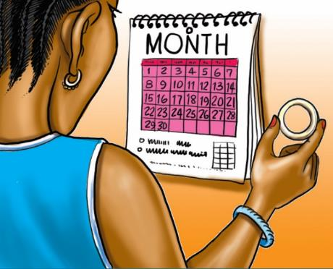

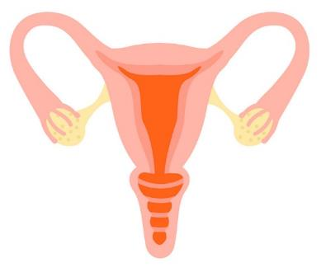
What does research show so far?
No increased risk of vaginal infections, cervical cancer
Comfort with the ring increases with experience
Notes:
What does research show so far?
Comfort with the ring increases with experience.
The ring does not lead to increased risk of vaginal infections, such as bacterial vaginitis or yeast
The ring does not increase the risk of cervical cancer

Slide 18
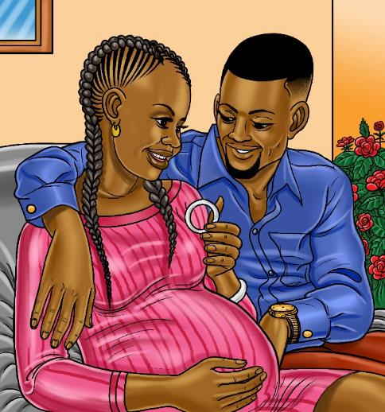


What is already known about the safety?
Women in previous ring studies stopped using the ring once their pregnancy became known.
No increase in negative pregnancy outcomes
No increase in birth defects
DELIVER will provide needed information on women who use the ring at different stages of pregnancy.
The first group of women enrolled in DELIVER have completed follow-up and no safety concerns were identified.
Notes:
What is already known about the safety of ring use in pregnant women?
• In studies with pregnant animals, dapivirine did not cause side effects in the animals or their offspring.
• In previous studies, women who became pregnant while using the ring stopped using the ring, but were followed throughout their pregnancies to monitor any negative effects.
• Women who used the dapivirine ring before they knew they were pregnant did not experience more negative pregnancy outcomes (like miscarriages, preterm births, or low birthweight babies).
• Additionally, babies born to women who used the dapivirine ring did not experience more birth defects than babies born to mothers who were not exposed to dapivirine.
• Since women in previous studies stopped using the ring soon after becoming pregnant, more safety information is needed about the ring when it is used for longer periods and at different stages during pregnancy.
This is why DELIVER is being done—to learn more about the safety of ring use during pregnancy. Follow-up of mother from the first group enrolled when they were late in their pregnancy is complete. Data from the first group enrolled in DELIVER, which included women 8 to 9 months pregnant and their infants also did not indicate any safety concerns.

Slide 19

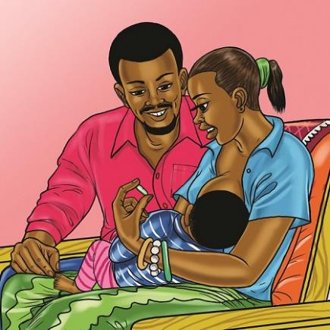

What is already known about the safety?
B-Protected is the first study of the ring in breastfeeding women
In a previous ring study, women who had already weaned their babies but were still making breastmilk enrolled.
The study showed:
          No safety concerns
          Only very small amounts of dapivirine in breastmilk
B-PROTECTED is being done to learn more
Notes:
What is already known about the safety of ring use by breastfeeding women?
• This is the first study to look at ring use in breastfeeding women. who are still breastfeeding infants.. However, there was a small study in the United States that enrolled women who had already weaned their infants but were still able to produce breastmilk. There were no safety concerns and the study found that only very small amounts of dapivirine got into breastmilk.
B-PROTECTED is being done to learn more about the safety of ring use during breastfeeding.

Slide 20
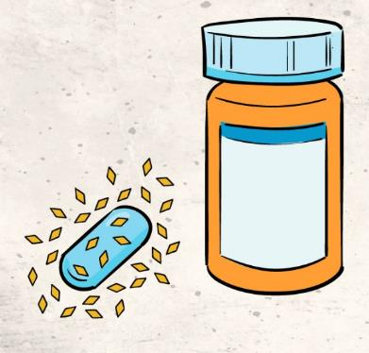
More about oral Truvada…
Truvada is a pill that contains two ARV drugs.
You may know it as oral PrEP
Approved for preventing HIV
Approved for HIV treatment
May be available in your community
Notes:
More about oral Truvada…
Oral Truvada is a pill that contains two ARV medications. Truvada may also be known in the community as oral PrEP (pre-exposure prophylaxis). It is approved for preventing HIV in adults and adolescents >35 kg. It is also approved for treating HIV in people 12 years and older, in combination with other drugs.
Oral Truvada may be available in the community outside of this study. Study staff can provide more information about potential access to Oral Truvada to anyone who is interested.

Slide 21
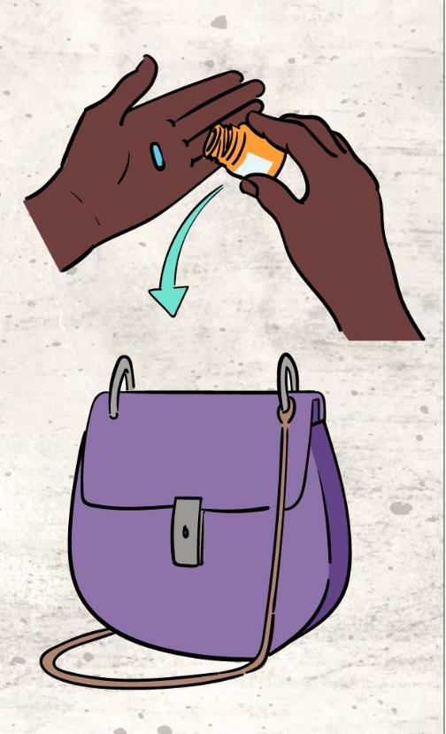
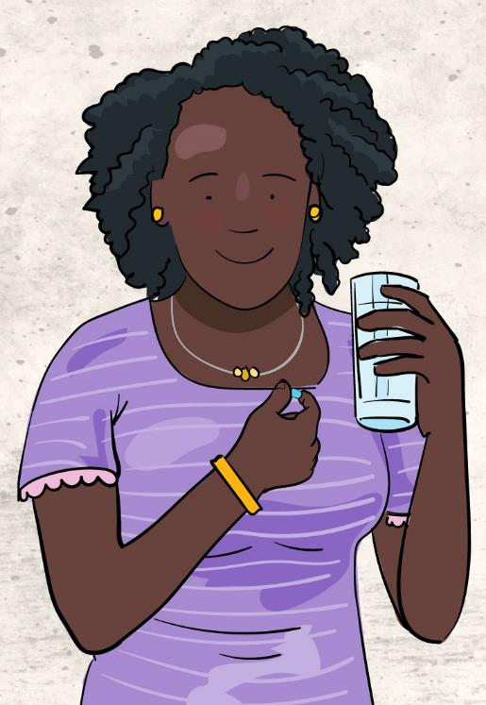

How is Truvada used?
Pill taken by mouth
Taken around the same time every day
Staff will share pill taking tips
Notes:
How is Truvada used?
Oral Truvada is a pill taken once daily by mouth, around the same time each day.
Participants will be provided information on how to swallow pills and strategies to assist with taking Truvada every day.

Slide 22
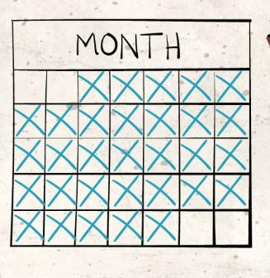
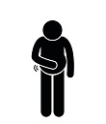



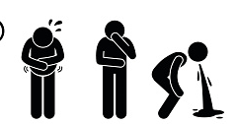
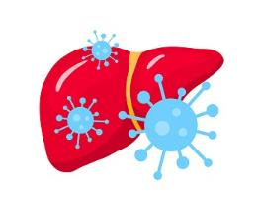
What are the side effects of oral Truvada?
Most
Side effects are mild and go away shortly after starting use
Rare
Serious side effects include rash, kidney damage, bone pain, allergic reaction
Hepatitis B
People with Hepatitis B who suddenly stop using Truvada may get worse
Staff will monitor your health and counsel on issues or concerns!
Notes:
What are the side effects of Oral Truvada?
Use of oral Truvada may cause mild side effects including abdominal pain, diarrhea, headache, dizziness, tiredness, passing gas, nausea, vomiting, or inability to sleep. These typically go away shortly after starting use.
Rare but more serious side effects include rash, kidney damage, bone pain or changes, allergic reaction, or lactic acidosis (a condition that can cause shortness of breath, nausea, and liver failure).
Individuals with Hepatitis B who suddenly stop taking oral Truvada may get a “flare” or worsening of hepatitis symptoms.

Slide 23


What is already known about the safety?
Truvada is used for HIV treatment when pregnant or breastfeeding
Studies in breastfeeding women with Truvada used as PrEP
No safety issues identified to date
Babies exposed to very low levels through breastmilk
Notes:
What is already known about the safety of oral Truvada use during pregnancy and breastfeeding?
In clinical studies on oral Truvada and pregnancy, the medicine did not cause birth defects or miscarriages when it was given to pregnant animals.
No adverse effects have been found among babies exposed to oral Truvada when the medicines were taken as treatment by HIV-infected women during pregnancy or during breastfeeding.
Several small studies have looked at Truvada as PrEP during breastfeeding. So far, the studies have shown that the use of Truvada during breastfeeding is safe and that babies are exposed to only very low levels of the drug through breastmilk.

Slide 24




What is already known about the safety?
WHO recommends Truvada for pregnant and breastfeeding women who are at high risk of HIV
DELIVER and B-PROTECTED will provide needed information on women who use Truvada while pregnant and breastfeeding.
Notes:
What is already known about the safety of Truvada use during pregnancy and breastfeeding?
Based on the available safety data, the World Health Organization (WHO) considers that oral Truvada should be continued during pregnancy and breastfeeding for women who continue to be at substantial risk of HIV infection. More safety data is needed, which is why DELIVER and B-PROTECTED are being done.
Some countries are already prescribing oral Truvada to breastfeeding women
Countries which permit PrEP during breastfeeding:
Kenya
Eswatini
Uganda
United States
UK
France
Australia
New Zealand
Canada

Slide 25
Other HIV Prevention Options

Slide 26

Options for HIV Prevention
There are many things you can do to reduce your and your partner’s risk of HIV .

Slide 27
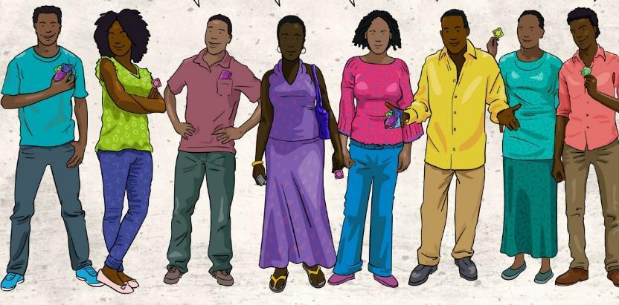
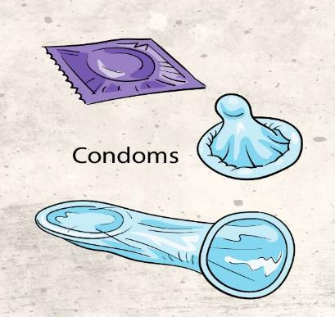

Condoms: Internal (Female) and External (Male)
Use a condom correctly every time you have sex.
Notes:
Male or female condoms if used correctly and consistently protect against STI and HIV infection during vaginal, anal sex, oral sex, and unintended pregnancy.

Slide 28













Limit Number of Sexual Partners
Notes:
The more sexual partners a person has, the more likely it is that one of them has HIV.
More than one partner means many routes for HIV to travel.
Your sexual network may be bigger than you think.
Therefore, one way to reduce HIV risk is to reduce the number of partners you have and for your partners to reduce the number of partners they have.

Slide 29
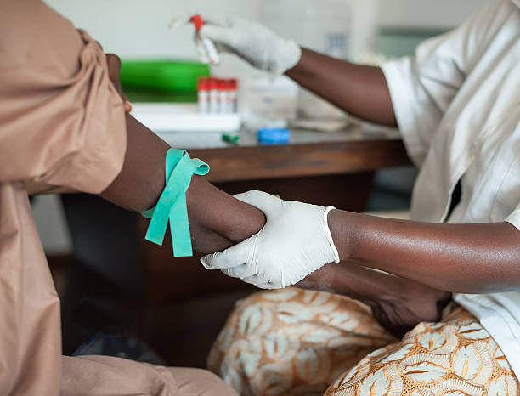
HIV and STI Testing
Talk to your partner about HIV and STI testing and get tested regularly.
Notes:
Knowing if your partner is HIV positive can help you decide which prevention methods might be most effective for you.
If you have a sexually transmitted infection (STI), get treatment.
Having an STI can increase your risk of getting HIV or spreading it to others. Encourage your partner/s to get tested and treated as well.

Slide 30
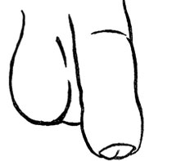
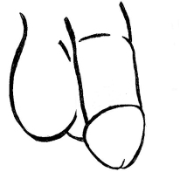

Voluntary Male Circumcision
Circumcised men are less likely to get HIV than uncircumcised men.
Notes:
Male circumcision does not protect women from getting HIV.
Circumcised men are about half as likely to get HIV as uncircumcised men.

Slide 31

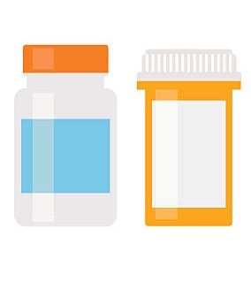
Treatment as Prevention
HIV medicine can reduce the amount of HIV in the blood (viral suppression)
When a person with HIV is virally suppressed, transmission to other people is highly unlikely.
Notes:
HIV medicine can reduce the amount of HIV in the blood (also called viral load).
HIV medicine can make the viral load so low that a test can’t detect it. This is called undetectable viral load.
Having an undetectable viral load (or staying virally suppressed) is the best thing people with HIV can do to stay healthy.
If their viral load stays undetectable, they have effectively no risk of transmitting HIV to an HIV-negative partner through sex.

Slide 32
HIV and Pregnancy/Breastfeeding

Slide 33

What are the risks of pregnancy?
Women should continue routine antenatal care and notify staff of any concerns.
While most pregnancies do not have major complications, all pregnancies have risks. Some are serious.
Notes:
The health and safety of participants and their pregnancies is what is most important.

Slide 34
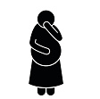



What are some common issues during pregnancy?
Some symptoms of pregnancy may be similar to side effects from the ring. Talk to study staff about any concerns you have.
Notes:
Many women experience various issues during pregnancy, such as:
Nausea and morning sickness
Constipation
Backache
Cramping and/or swelling in legs or feet
Feeling faint and/or hot
Heart palpitations
Tiredness, Difficulty sleeping
Headaches
Incontinence and/or having to pass urine frequently
Indigestion/Heartburn
Pelvic join pain
Hemorrhoids
Bleeding gums, nose bleeds
Stretch marks
Vaginal discharge
Varicose veins
Leaking nipples
Itchy skin
Some common issues that pregnant women experience may be similar to mild side effects associated with starting product use.
Participants are encouraged to talk with staff/providers about any concerns or issues they have.

Slide 35
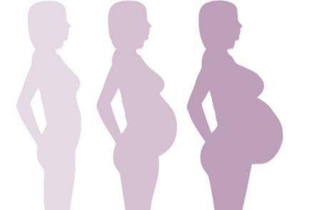

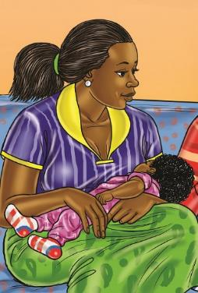
Why should women be tested for STIs and HIV during pregnancy?
Having an STI can complicate pregnancy.
Having an STI can make it easier to get HIV.
Acute or recent HIV infection during pregnancy and breastfeeding is associated with a high risk of vertical transmission of HIV.
Notes:
It is important for women to be as healthy as possible during pregnancy so that they have the best chance of having a healthy baby.
If a woman is pregnant or planning to get pregnant, she should get tested for STIs and HIV as soon as possible.
STIs can complicate your pregnancy and may have serious effects on both you and your developing baby. Some of these problems may be seen at birth; others may not be discovered until months or years later.
Having an STI can make it easier to get HIV. For example, an STI can cause a sore or a break in the skin, which can make it easier for HIV to enter the body. Having HIV and another STI may increase the risk of HIV transmission.
The high rate of transmission associated with acute infection is likely related to the combination of the high viral loads in plasma, breast milk, and the genital tract associated with acute infection and the fact that the diagnosis is easy to miss, which results in lost opportunities for implementing prevention interventions.
Because of these risks, all women should get tested for HIV during pregnancy.
The decision to take the HIV test and then wait for the results can be very stressful. If test results are positive, women will have many decisions to make.
Even though it is stressful, women need to know their HIV status to decide what is best for them and their family. There is support available for women who find out during their pregnancy that they have HIV.

Slide 36
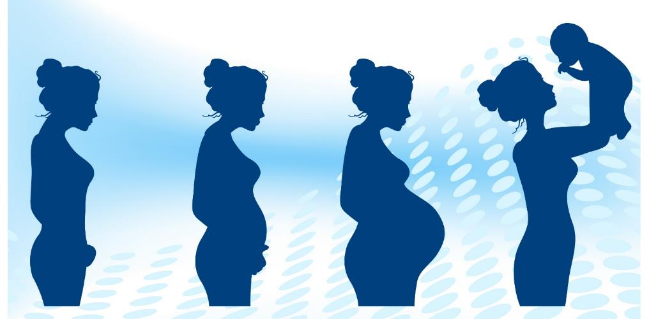
What is vertical transmission?
Vertical transmission is when HIV is passed from a mother to her baby.
Notes:
Vertical HIV transmission (also known as mother-to-child transmission) can happen at any time during pregnancy, childbirth, and breastfeeding.
In the absence of any intervention, HIV transmission from mom to baby rates range from 15% to 45%.

Slide 37
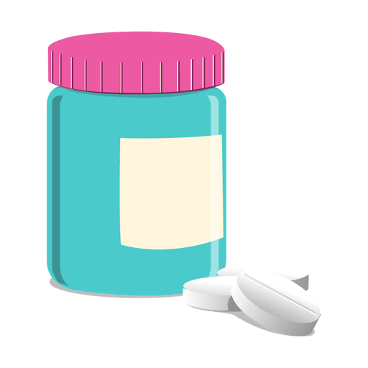
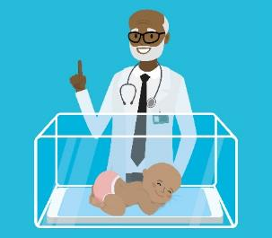
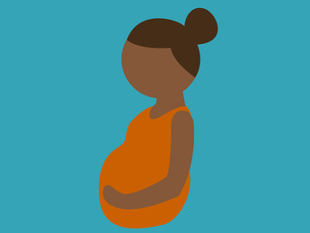
What if a woman acquires HIV during her pregnancy?
The risk of passing HIV to the baby is higher if a woman gets HIV during pregnancy.
Starting ART as soon as possible can help prevent transmission to the baby.
HIV medicine provided to the baby immediately after birth can also prevent transmission.
Notes:
Acute or recent HIV infection during pregnancy and breastfeeding is associated with a high risk of vertical transmission of HIV.
All pregnant women with acute or recent HIV infection should start ART as soon as possible, with the goal of preventing vertical transmission.
Babies born to women who received a diagnosis of acute HIV during pregnancy or breastfeeding are at high risk of vertical HIV transmission and should receive appropriate HIV treatment.

Slide 38
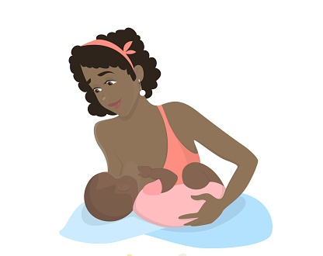
Can a mother living with HIV still breastfeed?
Breastfeeding is recommended for mothers that are living with HIV.
Mothers should be given ART.
Notes:
The World Health Organization (WHO) recommends that mothers who have HIV breastfeed exclusively for the first 6 months of life and continue breastfeeding for at least 12 months, with the addition of complementary foods. These mothers should be given ART to reduce the risk of transmission to their baby through breastfeeding.

Slide 39
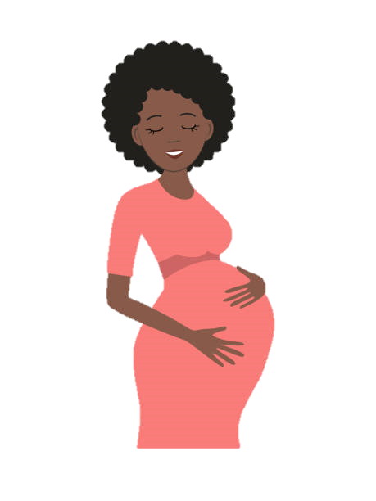
What should a woman do if she is pregnant to prevent HIV?
Use condoms
Get tested for HIV
Encourage partner testing
If available, start PrEP
If already HIV+, take ART
Notes:
All women who are pregnant or trying to get pregnant should encourage their partners to also get tested for HIV.
HIV-negative women who have a partner living with HIV should talk to their doctor about taking HIV medicine daily, called pre-exposure prophylaxis (PrEP), to protect themselves while trying to get pregnant and to protect themselves and their baby during pregnancy and while breastfeeding.
If either partner has HIV, partner with HIV should take HIV medicine daily as prescribed to stay healthy and prevent transmission.

Slide 40
MTN-042/DELIVER
Study Overview

Slide 41



The DELIVER study aims to learn whether two safe and effective HIV prevention methods are also safe to use during pregnancy.
Notes:
The purpose of the DELIVER study is to learn whether two safe and effective HIV prevention methods, the Dapivirine vaginal ring and oral Truvada, are also safe to use during pregnancy.

Slide 42

Who will join the DELIVER study?
550 pregnant women and their babies from Malawi, South Africa, Uganda, Zimbabwe
Notes:
Who will join the DELIVER study?
About 550 pregnant women and their babies will take part in the study. These women will come from 4 different countries – Malawi, South Africa, Uganda, and Zimbabwe.

Slide 43

What is the Study Design?
Notes:
What is the Study Design?
Women will be enrolled in groups, one group at a time, starting with women late in pregnancy and progressing to early stages of pregnancy:
Group 1 – 9+ months (36+ weeks) pregnant
Group 2 – 7-9 months (30-35 weeks) pregnant
Group 3 – 3-7 months (13-29 weeks) pregnant
Women will use either Truvada or the ring for the remainder of their pregnancy and safety reviews of product use during each stage of pregnancy will be conducted before deciding to enroll the next earlier group of women.
Study staff can provide more information about what group is currently enrolling and what information is available from previously enrolled groups.

Slide 44



Who can participate?
Plans to deliver at hospital
Willing to enroll baby
Healthy pregnant women
HIV-free
18-40 years
Willing to be assigned by chance to pills or ring
Notes:
Who can participate?
Healthy women who do not have HIV, are 18-40 years old with a normal pregnancy carrying one baby and who meet other eligibility criteria
Women must be willing to be assigned by chance to use either daily oral Truvada or the monthly Dapivirine vaginal ring during the remainder of their pregnancy
Women must be planning to deliver at a health center or hospital, and enroll their baby in the study

Slide 45








How are study groups assigned?
Groups assigned by chance.
Groups 1 & 2
2 ring: 1 pill
Group 3
4 ring: 1 pill
Notes:
How are study groups assigned?
Participants will be assigned to use either the dapivirine ring or oral Truvada pills by chance (randomization). Neither participants nor study staff can decide which product participants receive.
More participants will be assigned to the dapivirine ring than oral Truvada.
In Cohorts 1 & 2, for every two women who receive the ring, one woman will receive oral Truvada.
In cohort 3, for every four women who receive the ring, one woman will receive oral Truvada.

Slide 46

Why are more women assigned to ring?
Less research has been done with the ring than with Truvada. Having more women use the ring will help fill this information gap.
Notes:
Why are more women assigned to ring?
While some clinical research has been done with oral Truvada to show it is safe for the mother and baby when used during pregnancy, there is less known about the dapivirine ring and pregnancy. Therefore, more women will be assigned to use the ring in effort to fill in this gap in information.

Slide 47




What is the visit schedule?
Duration of Pregnancy
6 weeks
1 Year
or
Product Use Period
Notes:
What is the visit schedule?
Participants will have regular study visits and phone contacts for the remainder of their pregnancy and until 6 weeks after delivery.
One of the study visits will occur as soon as possible after delivery (no later than 2 weeks after).
Women should continue all ANC visits
Babies will complete up to 4 study visits over about 12 months. The first baby visit will be scheduled as soon as possible after delivery.

Slide 48



How long will participants be in the study?
 | 11 Visits | 10 weeks
 | Up to 16 Visits | Up to 18 weeks
 | Up to 20 Visits | Up to 36 weeks
Group 1
9+ months pregnant
5 Visits
1 Year
Group 2
7-9 months pregnant
Group 3
3-7 months pregnant
Notes:
How long will participants be in the study?
Group 1: Up to 11 TOTAL visits (including phone/clinic) for a total duration of about 10 weeks
Group 2: Up to 16 TOTAL visits (including phone/clinic) for a total duration of about 18 weeks
Group 3: Up to 20 TOTAL visits (including phone/clinic) for a total duration of about 36 weeks
All infants will be in the study for up to 5 visits over the course of 1 year

Slide 49


What will women be asked to do at their study visits?
OR
Receive Study Product
During Pregnancy
Notes:
What will women be asked to do at their study visits?
Participants will receive either one new ring or a month’s supply of Truvada pills each month for the duration of their pregnancy.

Slide 50

Where the ring is placed in the body
Placenta
Umbilical Cord
Uterus
Fetus
Cervix
Ring
Rectum
Bladder
Urethra
Vagina
Notes:
Key Anatomy of a Pregnant Women
Fetus: the growing baby inside the mother.
Uterus (womb): pear-shaped organ located in the middle of the pelvis. where a fetus grows during pregnancy.
Vagina: tube that connects the external opening at the base of your pelvis with your cervix and provides and opening for menstrual blood or babies to pass through. Some people put penises, fingers, sex toys, medications, and/or tampons in the vagina as well.
Cervix: located between the vagina and uterus, your cervix separates your vagina from the rest of your body, so things like tampons or the vaginal ring can’t get “lost” inside of you. The cervix helps hold the baby inside of you during pregnancy and opens during labor to let the baby pass through.
Placenta: organ that forms in the uterus during pregnancy that helps provides oxygen and nutrients to the growing baby.
Umbilical cord: cord that delivers the nutrients and oxygen to the baby by connecting the placenta to the fetus. The cord is cut after the baby is born (forms the baby’s belly button).
The ring sits at the top of the vagina, right below the opening to the cervix. The ring does not enter the uterus or touch the baby. The ring should be removed before delivering the baby.

Slide 51




What will women be asked to do at their study visits?
Pelvic Exams
Permission to access medical records
Provide samples
Physical Exams
Notes:
What will women be asked to do at their study visits?
Participants will be asked to have physical and pelvic exams, provide vaginal fluid, blood and urine samples for testing and allow study staff access to medical records.
If participants have an illness, they will be treated or referred to another facility for care. Participants might stop using the study products until they are better, if that is what is best for their health.

Slide 52



What will women be asked to do at their study visits?
Counseling and Referrals
Answer questions about product use, sexual behaviors
Some may be asked to have longer, recorded interviews
Notes:
What will women be asked to do at their study visits?
Participants will be counseled about how to protect themselves from HIV and other sexually transmitted infections (risk reduction counseling). Study staff will offer / provide participants condoms.
Participants will receive counseling and any necessary referrals
Women may be asked questions about use of their assigned study product and their sexual behaviors. Participants don’t have to answer any of these questions if they don’t want to.
Some participants will be invited to have a longer interview, which may be audio-recorded.

Slide 53

What procedures will be done with babies in the study?
Physical Exams
Blood Draws
Medical History
Notes:
What procedures will be done with babies in the study?
Babies will have physical exams, blood draws, testing for HIV if needed, and routine lab tests. With their mother’s permission, photos may be taken of them to assess potential medical issues.
Mothers will be asked questions about their baby’s health and any medicines their baby is taking.

Slide 54


The pill and the ring reduce the risk of HIV when used regularly.
will provide more information about the safety of these products in pregnant women.
Notes:
Key things to remember
Women who participate in the study will be randomized to either the dapivirine ring or oral Truvada, but cannot choose which product they receive.
Women will use the assigned product for the remainder of their pregnancy and have study visits until 6 weeks after delivery. Babies will be in the study from birth until 12 months.
Oral Truvada and the dapivirine vaginal ring reduce the risk of HIV when used regularly. DELIVER will provide more information about the safety of these products in pregnant women.

Slide 55
MTN-043/B-PROTECTED
Study Overview

Slide 56

The B-PROTECTED study aims to learn whether two safe and effective HIV prevention methods are also safe to use during breastfeeding.
Notes:
The purpose of the B-PROTECTED study is to learn whether two safe and effective HIV prevention methods, the dapivirine vaginal ring and oral Truvada, are also safe to use during breastfeeding.

Slide 57
Who will join the B-PROTECTED study?
200 pairs of breastfeeding women and their babies from Malawi, South Africa, Uganda, Zimbabwe
Notes:
Who will join the B-PROTECTED study?
About 200 pairs of breastfeeding women and their babies will take part in the study. These women will come from four different countries – Malawi, South Africa, Uganda, and Zimbabwe.

Slide 58






What is the study design?
Moms and babies enter the study
Moms use ring or Truvada for three months while breastfeeding
Measure study drug in blood and breastmilk and assess safety
or
Notes:
What is the study design?
HIV-uninfected, women breastfeeding women and their babies will enroll in the study when the babies are 6-12 weeks old.
The mothers will be assigned to use the ring or Truvada pills for about three months.
Researchers will measure the amount of the study drug that gets into blood and breastmilk and collect safety information for the mothers and babies.

Slide 59









Who is eligible?
Willing to be assigned by chance to pills or ring
Using an effective contraceptive method
Healthy women
  HIV-free
  Exclusively breastfeeding
Infants
  6-12 weeks old
Willing to continue exclusive breastfeeding
Notes:
Who is eligible?
Healthy HIV-negative women and their exclusively breastfed babies, aged 6-12 weeks. “Exclusively breastfed” means that the baby does not receive any food or drink other than breast milk.
To enroll, women must agree for their babies to also participate.
Women must be willing and able to continue exclusive breastfeeding while in the study (about three and a half months).
At the time of enrollment, participants must be using an effective method of contraception, and be willing to be assigned by chance to use either daily oral Truvada or the monthly dapivirine vaginal ring.

Slide 60



How many visits are there?
There will be 8 study visits over a period of about three and a half months.
Notes:
How long will participants be in the study? What is the visit schedule?
Each mother-baby pair will be in the study for about three and a half months.
There will be a total of 8 clinic visits during this time. Visits are more frequent during the first month of study participation and become less frequent after that.

Slide 61
How are study groups assigned?
Groups are assigned by chance. For every three women assigned the ring, one will be assigned Truvada.
Notes:
How are study groups assigned?
Participants will be assigned to use either the dapivirine ring or oral Truvada by chance (randomization). Neither participants nor study staff can decide which product participants receive.
More participants will be assigned to the dapivirine ring than oral Truvada. For every three women who receive the ring, one woman will receive oral Truvada.

Slide 62
Why are more women assigned to ring?
Less research has been done with the ring than with Truvada. Having more women use the ring will help fill this information gap.
Notes:
Why are more women assigned to ring?
While some clinical research has been done with oral Truvada to show it is safe for the mother and baby when used during pregnancy, there is less known about the dapivirine ring and pregnancy. Therefore, more women will be assigned to use the ring in effort to fill in this gap in information.

Slide 63


What will women be asked to do at their study visits?
OR
Receive Study Product
Notes:
What will women be asked to do at their study visits?
Once a month, participants will receive a new ring or a month’s supply of pills.

Slide 64



What will women be asked to do at their study visits?
Pelvic Exams
Permission to access medical records
Provide samples
Physical Exams
Notes:
What will women be asked to do at their study visits?
Participants will be asked to have physical and pelvic exams, provide vaginal fluid, blood and urine samples for testing and allow study staff access to medical records.
If participants have an illness, they will be provided with medicine or referred to another facility for care. Participants might stop using the study products until they are better, if that is what is best for their health.

Slide 65
What will women be asked to do at their study visits?
Counseling and Referrals
Answer questions about product use, sexual behaviors
Some may be asked to have longer, recorded interviews
Notes:
What will women be asked to do at their study visits?
Participants will be counseled about how to protect themselves from HIV and other sexually transmitted infections. Study staff will offer participants condoms.
Participants will receive counseling and answer questions about use of their assigned study product and their sexual behaviors. Participants don’t have to answer any of these questions if they don’t want to.
Some participants may be asked to have one or more longer interviews, which may be audio-recorded.

Slide 66
What procedures will be done with babies in the study?
Physical Exams
Blood Draws
Medical History
Notes:
What procedures will be done with babies in the study?
Babies will have physical exams, blood draws, testing for HIV if needed, and routine lab tests.
Mothers will be asked questions about their baby’s health and any medicines their baby is taking.

Slide 67


The pill and the ring reduce the risk of HIV when used regularly.
will provide more information about the safety of these products in breastfeeding women and their babies.
Notes:
Key things to remember
Women who participate in the study will be randomized to either the dapivirine ring or oral Truvada, but cannot choose which product they receive.
Women who join the study must agree for their babies to participate as well and should continue exclusive breastfeeding for the duration of their study participation.
Women will use the assigned product for about three months. Babies will be in the study for the same amount of time. The only exposure to study product for babies will be through breastmilk. Based on information from previous studies, we know that the amount of drug that passes into breast milk is low.
Oral Truvada and the dapivirine vaginal ring reduce the risk of HIV when used regularly.
B-PROTECTED will provide more information about the safety of these products in breastfeeding women and their babies.

Slide 68
General Information about Participation in Research

Slide 69

How will participant samples be used?
Monitor health
Answer research questions
With permission, stored for future research
Notes:
How will participant samples be used?
Samples taken at study visits will be tested to monitor the participant’s health and evaluate the study research questions. Participants will be provided results of any tests when they are available.
Samples are stored in special laboratories and only study staff have permission to access them
After the study, there may be some samples left over. At some study sites, researchers will ask permission to use these samples for future research, but each participant can make her own decision about this and it will not impact whether she or her baby can join the study.

Slide 70

How long are study visits?
Depends on visit type, usually a few hours
Notify staff of any concerns
Notes:
How long are study visits?
Study visit length depends on what type of visit it is. Most visits will last a few hours, but some may be shorter or longer. Participants are encouraged to talk to study staff if they have any concerns or questions about study visit length.

Slide 71


Does being in the study cost anything?
No cost
Reimbursed for transport and time
Notes:
Does being in the study cost anything?
Being in the study will not cost participants anything. The study staff will reimburse participants for their time and effort to come to the clinic and the cost of trips to and from the clinic.

Slide 72




What if participants get HIV during the study?
Rare, but possible
Study products and condoms reduce HIV risk
Will continue visits, receive health monitoring, referrals for HIV treatment, testing for baby
Notes:
What if participants get HIV during the study?
It is possible for anyone to get HIV or other STIs from sex or other risky activities.
Using condoms correctly and the study products consistently can help reduce this risk.
If participants test positive for HIV during the study, the study staff will help them get treatment and other services for HIV. Participants will stop using the study products, but they and their baby can still come for study visits. The study staff will do more blood tests to find out which medicines are best for treating the participant.

Slide 73

Is it possible that babies will get HIV during this study?
Rare, but possible
Women who are diagnosed referred for immediate care and treatment to prevent transmission
Notes:
Is it possible that babies will get HIV during this study?
If a mother gets HIV, it is rare but possible that her baby may get HIV during pregnancy or breastfeeding. With appropriate care and treatment, the risk of transmission is very low. Women who are diagnosed with HIV during pregnancy or breastfeeding will be immediately linked to services to prevent transmission of HIV to her baby.

Slide 74

What are the risks of joining the study?
Potential side effects from study products
Notes:
What are the risks of joining the study for women and their babies?
Women or their babies might experience side effects from exposure to the study products. The study staff will help with any health problems or side effects that happen during the study.

Slide 75

What are the risks of joining the study?
Embarrassed by personal questions
Discomfort from exams or blood draws
Worry about test results
Unfair treatment by others
Notes:
What are the risks of joining the study for women and their babies?
Most procedures done in this study are routine medical procedures and pose little risk to women and their babies. Participants may feel discomfort from blood draws.
Women might feel uncomfortable answering questions about their personal life, or having blood tests or physical exams done.
Women might feel worried about getting their or their baby’s test results, but study counselors will be available to talk to them about how they are feeling.
Others may find out about and treat women or their babies poorly or unfairly for being in the study (social harms). The study staff will do their best to stop this from happening and keep all participant information private.

Slide 76

What are the benefits of joining the study?
Information from this study may help expand HIV prevention options for pregnant and breastfeeding women
Access to care, testing, counseling, and referrals
Access to effective HIV prevention method
Notes:
What are the benefits of joining the study?
Women and their babies will have access to counseling, medical exams, tests, clinical care, and care referrals. Study visits do not replace regular antenatal, postnatal, or well-baby care.
Women will have access to the dapivirine ring or oral Truvada as an HIV prevention method. If used consistently, these products can help reduce a woman’s risk of HIV, and in turn, her baby’s risk.
Information learned from this study may help expand available HIV prevention options for pregnant and breastfeeding women.

Slide 77


Protecting choices and privacy
Information kept private and locked
Free to make own choice about joining.
May withdraw at anytime.
Involvement of partners or other family encouraged
Notes:
Protecting choices and privacy
Women are free to make their own choice about joining the study. They may voluntarily withdraw their participation, or the participation of their baby, at any time.
Participants are encouraged to ask questions and involve their partner or other individuals who are important to them in their decision-making. Staff can help participants by providing study information to share with loved ones, or inviting them to the clinic to learn more about the study.
All personal information about study participants will be kept private and locked away. Only approved study staff will have access to participant information.

Slide 78


Thanks!
Any questions?
You can find me at:
@username
user@mail.me

