Slide 1
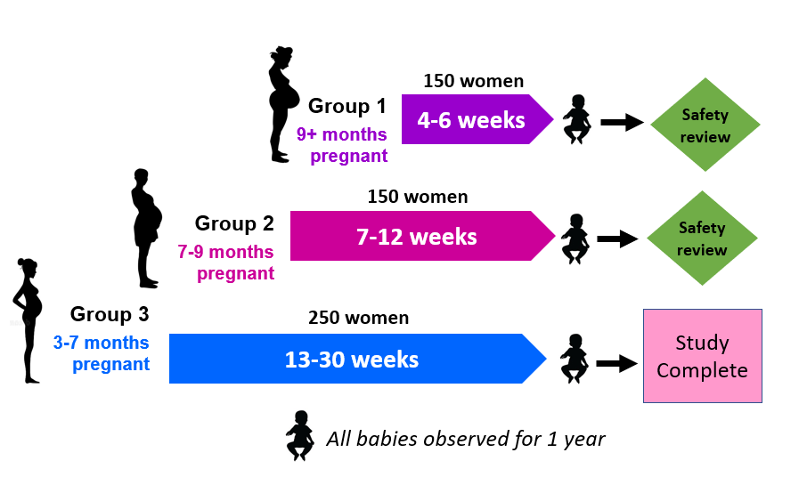
This patient is a participant in the MTN-042/DELIVER study CARE PROVIDERS SHOULD READ THIS SHEET CAREFULLY AS IT CONTAINS IMPORTANT INFORMATION RELATED TO THE PATIENT’S MEDICATIONS AND THE STUDY THEY ARE PARTICIPATING IN.
STUDY INFORMATION
The DELIVER study is assessing if two HIV prevention products - the Dapivirine Vaginal Ring and Oral Pre-Exposure Prophylaxis (PrEP) (TRUVADA®) - are safe and well-tolerated for pregnant women and their babies.
Both products were shown in previous studies to be very safe and reduce the risk of HIV acquisition for adult women who were not pregnant when used consistently.
In DELIVER, study participants are enrolled during pregnancy and randomly assigned to use either the vaginal ring or oral PrEP until the end of their pregnancy.
The participant's baby, once born, will be followed for one year to identify any impact of drug exposure.
Participation in this study does not replace routine antenatal care. Study participants should continue regularly scheduled visits with their obstetric care providers.
This patient is a participant at the <SITE NAME>Please contact <NUMBER> if you have any questions about the study, if the patient requires urgent care, or to notify the study team of the patient’s delivery.
The DELIVER study has several safeguards in place to monitor participant safety.
Only healthy, HIV negative women with a singleton pregnancy are eligible to join the study.
Women will be enrolled in 3 groups, starting with women who are full term and progressing to earlier stages of pregnancy if supported by review of safety data. Group 1 mothers have completed follow-up.
Participants will be seen at the study clinic for regular visits including side effects monitoring and HIV testing through 6 weeks after their pregnancy outcome.
Group 1 safety results: Adverse pregnancy outcomes and complications were uncommon when the study products were used in late pregnancy and were generally similar to rates observed in the communities where the study is being conducted.
The DELIVER study hopes to provide the safety data necessary to ensure that both products be made available to pregnant women, a group at increased risk of HIV acquisition. HIV prevention during pregnancy protects not only the mother, but her baby as well.
The DELIVER study is conducted by the Microbicide Trials Network (MTN) with funding from the US National Institutes of Health. Additional information about the study can be found at https://mtnstopshiv.org and www.clinicaltrials.gov, search MTN-042.
MTN-042 Provider Guide – <SITE NAME>, V2.0, 27AUG2021

Slide 2
This patient was assigned to use the Dapivirine Vaginal Ring.
Important information
The vaginal ring (VR) contains 25 mg of dapivirine (DPV), a non-nucleoside reverse transcriptase inhibitor which prevents HIV from making copies of itself to establish an infection.
The VR is inserted in the vagina and worn continuously for approximately one month, to be replaced every month.
Two studies of the DPV VR, MTN-020 (ASPIRE) and IPM 027 (The Ring Study) enrolled 4588 women total in Africa. Both showed minimal absorption of dapivirine, no safety concerns, and that the DPV VR can reduce HIV risk if used consistently.
The DPV VR received a positive opinion from the European Medicines Agency to reduce the risk of HIV infection in adult women and is now recommended by the World Health Organization as a prevention option. It remains under review by multiple regulatory authorities.
Potential Risks
Some women in previous studies of the ring reported experiencing vaginal discharge, vulvovaginal pain, burning, itchiness, or urinary tract infections.
It is rare but possible that a participant may have an allergic reaction.
As with any vaginal product, the possibility of toxic shock syndrome, although rare, exists.
The VR should remain in the vagina as directed by the research clinic. Should the VR need to be removed, this is done by inserting a clean finger into the vagina, hooking it through the middle of the VR and carefully pulling out the VR.
Limited information is available about DPV VR use during pregnancy, and therefore there may be some risk to pregnant women that are not yet known. However, all information in non-pregnant women suggests that it is very safe. Additionally, the benefit of HIV prevention from using the VR during pregnancy is expected to be much greater than the potential risks since women participating in this study live in communities with high HIV incidence.
If disruptive or uncomfortable during a pelvic examination, the VR can be removed temporarily and replaced after the exam. Place the VR on a clean surface or store in the study-provided bag until reinserted.
If the patient starts contractions, her water breaks, or she arrives at your facility already in labor, remove the VR and store it in the study-provided bag or other clean container. Please give her the VR for her to return to the study clinic.
If care providers observe or the patient reports any of the above symptoms, please contact the study clinic.
MTN-042 Provider Guide – <SITENAME>, V2.0, 27AUG2021

Slide 3
This patient was assigned to use oral PrEP (Truvada).
Important information
Oral PrEP, Truvada, is approved for use as HIV prevention and contains two drugs – 200 mg of emtricitabine (FTC) and 300 mg of tenofovir disoproxil fumarate (TDF) – combined into 1 pill taken daily by mouth.
The patient is provided a bottle of 30 pills every month.
The patient has been instructed to stop taking Truvada if she starts contractions or her water breaks. Please ensure she keeps any unused pills for her return to the study clinic.
Potential Risks
Common mild side effects of using Truvada (observed in < 10% of users) may include: Gastrointestinal intolerance (such as nausea, abdominal pain, diarrhea, or vomiting), flatulence (gas), headache, dizziness, tiredness, or inability to sleep. Symptoms typically resolve after the first or second month of use.
Other side effects are rare, but may include rash, worsening or new kidney damage, bone pain and bone changes such as thinning and softening, allergic reaction, lactic acidosis.
Individuals with hepatitis B virus (HBV) who suddenly stop taking Truvada may get a “flare” or worsening of hepatitis symptoms. In order to enroll in the study, participants must be negative for HBV.
There is limited information available about Truvada use during pregnancy by HIV-negative women, but Truvada is recommended for treatment of HIV infection during pregnancy and is generally considered safe.
If care providers observe or the patient reports any of the above symptoms, please contact the study clinic.
MTN-042 Provider Guide <SITENAME>, V2.0, 27AUG2021

