Slide 1

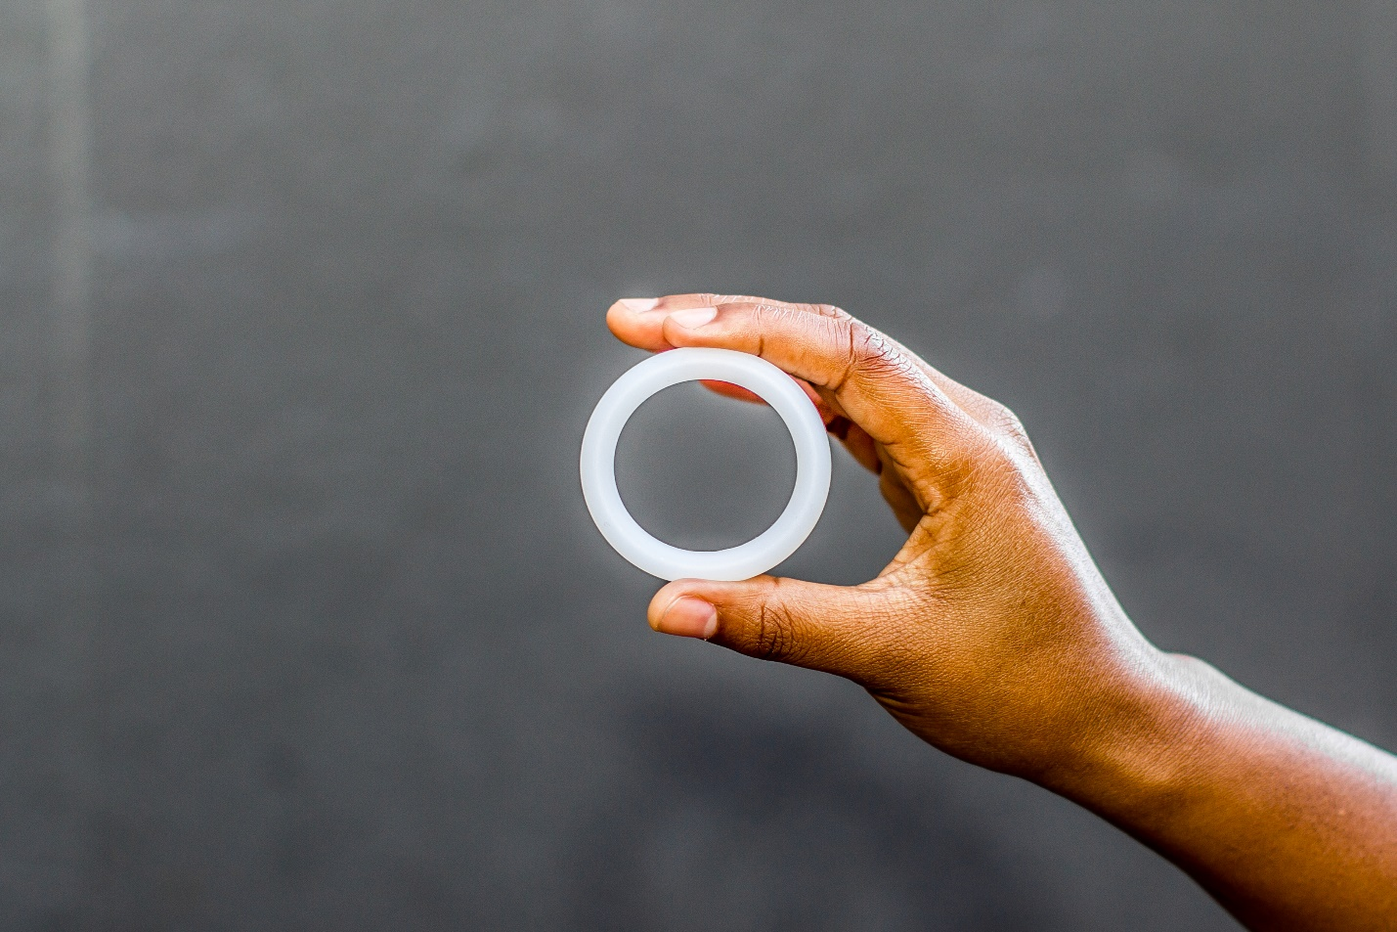
This patient is using the Dapivirine Vaginal Ring as part of the MTN-042/DELIVER study
STUDY INFORMATION
The DELIVER study is assessing if two HIV prevention products - the Dapivirine Vaginal Ring (DVR) and Oral Pre-Exposure Prophylaxis (PrEP) (TRUVADA®) - are safe for use during pregnancy.
Previous studies in women who are not pregnant have shown minimal dapivirine absorption, no safety concerns, and that the DVR can reduce HIV risk if used consistently. Less is known about DVR use during pregnancy, which is why this study is being done.
INSTRUCTIONS FOR RING REMOVAL
If the patient starts contractions, her water breaks, or she arrives at your facility already in labor, please assist the patient with removal of the DVR, as needed, and store it in the study-provided bag or other clean container.
The ring is removed by inserting a clean finger into the vagina, hooking it through the middle of the DVR and carefully pulling it out.
Please give the patient her DVR to return to the study clinic.
Please contact the study team at {CRS Name, phone number} if you have any questions about the study, if the patient requires urgent care, or to notify the study team of the patient’s delivery.
MTN-042 Ring Removal Card, v1.0, 17JUN2021

Slide 2
This patient is using the Dapivirine Vaginal Ring as part of the MTN-042/DELIVER study
This patient is using the Dapivirine Vaginal Ring as part of the MTN-042/DELIVER study
STUDY INFORMATION
The DELIVER study is assessing if two HIV prevention products - the Dapivirine Vaginal Ring (DVR) and Oral Pre-Exposure Prophylaxis (PrEP) (TRUVADA®) - are safe for use during pregnancy.
STUDY INFORMATION
The DELIVER study is assessing if two HIV prevention products - the Dapivirine Vaginal Ring (DVR) and Oral Pre-Exposure Prophylaxis (PrEP) (TRUVADA®) - are safe for use during pregnancy.
Previous studies in women who are not pregnant have shown minimal dapivirine absorption, no safety concerns, and that the DVR can reduce HIV risk if used consistently. Less is known about DVR use during pregnancy, which is why this study is being done.
Previous studies in women who are not pregnant have shown minimal dapivirine absorption, no safety concerns, and that the DVR can reduce HIV risk if used consistently. Less is known about DVR use during pregnancy, which is why this study is being done.
INSTRUCTIONS FOR RING REMOVAL
If the patient starts contractions, her water breaks, or she arrives at your facility already in labor, please assist the patient with removal of the DVR, as needed, and store it in the study-provided bag or other clean container.
The ring is removed by inserting a clean finger into the vagina, hooking it through the middle of the DVR and carefully pulling it out.
Please give the patient her DVR to return to the study clinic.
INSTRUCTIONS FOR RING REMOVAL
If the patient starts contractions, her water breaks, or she arrives at your facility already in labor, please assist the patient with removal of the DVR, as needed, and store it in the study-provided bag or other clean container.
The ring is removed by inserting a clean finger into the vagina, hooking it through the middle of the DVR and carefully pulling it out.
Please give the patient her DVR to return to the study clinic.
Please contact the study team at {CRS Name, phone number} if you have any questions about the study, if the patient requires urgent care, or to notify the study team of the patient’s delivery.
Please contact the study team at {CRS Name, phone number} if you have any questions about the study, if the patient requires urgent care, or to notify the study team of the patient’s delivery.
MTN-042 Ring Removal Card, v1.0, 17JUN2021
MTN-042 Ring Removal Card, v1.0, 17JUN2021
This patient is using the Dapivirine Vaginal Ring as part of the MTN-042/DELIVER study
This patient is using the Dapivirine Vaginal Ring as part of the MTN-042/DELIVER study
STUDY INFORMATION
The DELIVER study is assessing if two HIV prevention products - the Dapivirine Vaginal Ring (DVR) and Oral Pre-Exposure Prophylaxis (PrEP) (TRUVADA®) - are safe for use during pregnancy.
STUDY INFORMATION
The DELIVER study is assessing if two HIV prevention products - the Dapivirine Vaginal Ring (DVR) and Oral Pre-Exposure Prophylaxis (PrEP) (TRUVADA®) - are safe for use during pregnancy.
Previous studies in women who are not pregnant have shown minimal dapivirine absorption, no safety concerns, and that the DVR can reduce HIV risk if used consistently. Less is known about DVR use during pregnancy, which is why this study is being done.
Previous studies in women who are not pregnant have shown minimal dapivirine absorption, no safety concerns, and that the DVR can reduce HIV risk if used consistently. Less is known about DVR use during pregnancy, which is why this study is being done.
INSTRUCTIONS FOR RING REMOVAL
If the patient starts contractions, her water breaks, or she arrives at your facility already in labor, please assist the patient with removal of the DVR, as needed, and store it in the study-provided bag or other clean container.
The ring is removed by inserting a clean finger into the vagina, hooking it through the middle of the DVR and carefully pulling it out.
Please give the patient her DVR to return to the study clinic.
INSTRUCTIONS FOR RING REMOVAL
If the patient starts contractions, her water breaks, or she arrives at your facility already in labor, please assist the patient with removal of the DVR, as needed, and store it in the study-provided bag or other clean container.
The ring is removed by inserting a clean finger into the vagina, hooking it through the middle of the DVR and carefully pulling it out.
Please give the patient her DVR to return to the study clinic.
Please contact the study team at {CRS Name, phone number} if you have any questions about the study, if the patient requires urgent care, or to notify the study team of the patient’s delivery.
Please contact the study team at {CRS Name, phone number} if you have any questions about the study, if the patient requires urgent care, or to notify the study team of the patient’s delivery.
MTN-042 Ring Removal Card, v1.0, 17JUN2021
MTN-042 Ring Removal Card, v1.0, 17JUN2021

