Slide 1
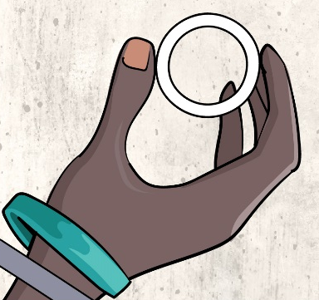
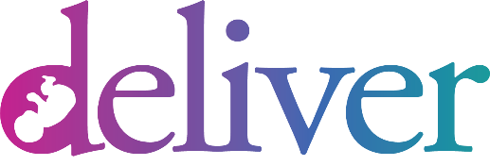
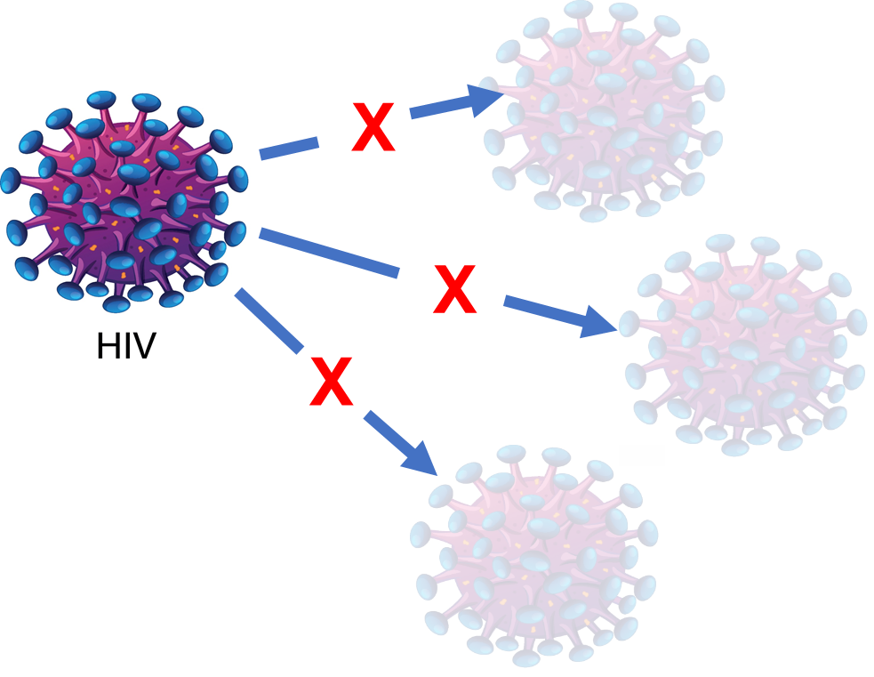
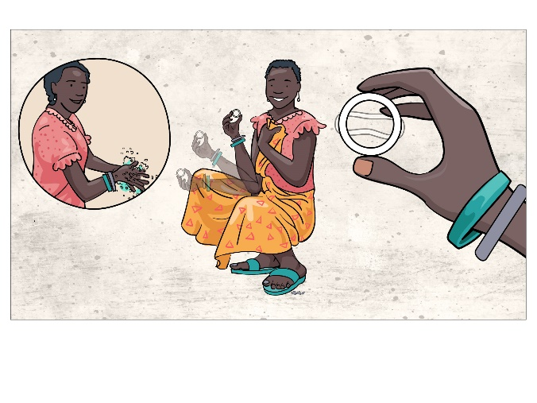
About the Dapivirine Vaginal Ring
The dapivirine ring is worn in the vagina and replaced monthly. It contains an ARV drug, dapivirine, that can prevent the woman from getting HIV if exposed during vaginal sex.
How does the ring work?
When the ring is in the vagina, the drug dapivirine is slowly released over the course of one month. Dapivirine works by preventing HIV from making copies of itself and infecting the body.
Studies have shown the ring can reduce HIV vulnerability from exposure through vaginal sex. The ring is most effective when kept in place continuously and replaced each month with a new ring.
How do you use the ring?
The ring is soft and flexible. It is easy for women to insert and remove from their vagina using their fingers. The ring sits high up in the vagina where it cannot be felt.
The ring is left in place continuously for a whole month, then removed and replaced with a new ring.
The ring can slip out but this is not common. If this happens, women can rinse the ring in water and reinsert it.
Pregnant women will be instructed to remove the ring as soon as they go into labor.
Will the ring impact daily life?
The ring should remain in during daily activities, including bathing, sex, and antenatal care visits.
Most women do not feel the ring if inserted properly nor do their partners feel it during sex.
Women may feel reassured knowing that use of the ring may protect her and her baby from getting HIV.
Study participants will be taught how to insert and remove the ring. Study staff can help them as needed.
Is the ring safe for women?
The ring has been studied in women who are not pregnant or breastfeeding and shown to be safe and effective for those who wear it continuously.
The ring has been recommended by the World Health Organization as an HIV prevention option for women. It remains under review by multiple regulatory authorities.
Most women experience few to no side effects from the ring. The ring does NOT: change the size or shape of the vagina, cause cervical cancer, impact fertility, or cause other significant health problems.
What about for pregnant women?
Side effects may differ in pregnant women, or they may resemble normal symptoms of pregnancy.
Women in previous ring studies were asked to stop using the ring once their pregnancy became known. These women did not have more problems in their pregnancy nor did their babies have more birth defects than women not using rings.
Since women in previous studies stopped using the ring soon after becoming pregnant, more safety information is needed about the ring when it is used for longer periods and at different stages during pregnancy.
MTN-042 Study Product Factsheet, V2.0, 27AUG2021

Slide 2
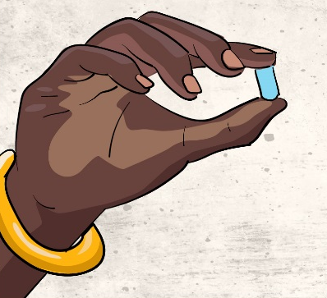
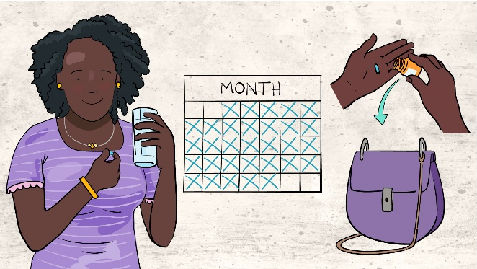
About Oral Truvada
Oral Truvada, also called PrEP, is a pill taken daily that contains ARV drugs to prevent the man or woman taking it from getting HIV if exposed.
What is PrEP?
PrEP stands for pre-exposure prophylaxis. It is a strategy for HIV-negative people to prevent HIV. Oral Truvada is a type of PrEP and is a pill that contains two anti-retroviral (ARV) drugs inside each tablet. Oral Truvada may be available in the community outside of this study. Study staff can provide more information about potential access.
How does oral Truvada work?
When oral Truvada is taken daily, the ARV drugs are released from the pill and circulate in the body. The drugs works by preventing HIV from making copies of itself and infecting the body. Truvada can reduce the risk of HIV infection up to 90% if taken everyday.
How do you use oral Truvada?
Oral Truvada is a pill taken once daily by mouth
The pills should be taken with water or another non-alcoholic beverage, they do not need to be taken with food.
Pregnant women will be instructed to stop taking the pills as soon as they go into labor.
Study participants will be counseled on how to swallow pills and strategies to take oral Truvada every day.
Is oral Truvada safe?
Oral Truvada is approved for preventing HIV in adults and adolescents. It is also approved for treating HIV in people 12 years and older, in combination with other drugs. Most side effects are mild and go away shortly after starting use (for example, headaches, stomach pain)
Serious side effects, although rare, include rash, kidney damage, bone pain, allergic reaction. People with Hepatitis B who suddenly stop using Truvada may get a flare.
What about for pregnant women?
Side effects may differ in pregnant women, or they may resemble normal symptoms of pregnancy.
No adverse effects have been found among babies exposed to oral Truvada when the drugs were taken as treatment by HIV-infected women during pregnancy or during breastfeeding.
The World Health Organization (WHO) recommends that oral Truvada be continued during pregnancy for women who are at substantial risk of HIV infection. More safety data are needed, that is why DELIVER being done.
For more information about DELIVER, go to: http://www.mtnstopshiv.org/news/studies/mtn042
Contact study staff at <clinic name> < staff name, phone number>
MTN-042 Study Product Factsheet, V2.0, 27AUG2021

