Slide 1
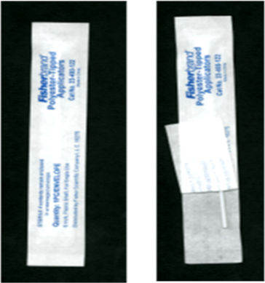
Swab Collection Order
PARTICIPANT GUIDE
Weeks 2 and 4, Bi weekly after 36th week
Collect swabs one at a time in this order per the color stickers on the swab packaging
1
1
Dacron
2 swabs
(Microbiota)
2
Dacron
(Gram stain)
3
Dacron (Biomarker)
Place each swab in the vial of the same color sticker
MTN-042 Sample Swab Order Guide, v1.1, 17SEP2020

Slide 2
Swab Collection Order
PARTICIPANT GUIDE
6 week PPO/SEV/Early SEV
Collect swabs one at a time in this order per the color stickers on the swab packaging
1
Cepheid (GC/CT/TRICH)
2
2
Dacron
2 swabs (Microbiota)
3
Dacron
(pH)
4
Dacron
(Gram stain)
Place each swab in the vial of the same color sticker
5
Dacron (Biomarker)
MTN-042 Sample Swab Order Guide, v1.1, 17SEP2020

