Slide 1


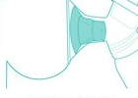
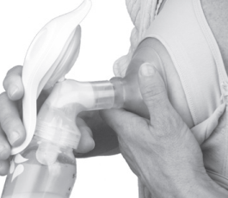
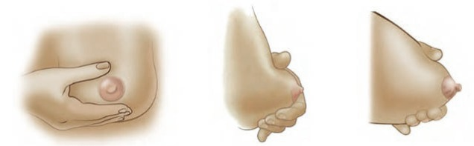


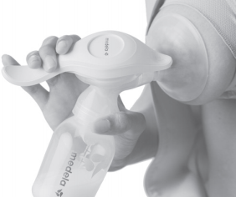

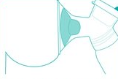
Breast Milk Expression Guide for
MTN-043/B-PROTECTED
Fully express all the milk from one breast into the provided container using one of the techniques below
Hand Expression
Manual Breast Pump
Push back toward chest wall
Squeeze/Compress
Release
Assemble pump according to instructions
Squeeze and release handle to create suction
Ensure proper shield fit
MTN-043 Breastmilk Expression Guide, English, Version 1.0, 18NOV2019 Page 1 of 1

