Slide 1

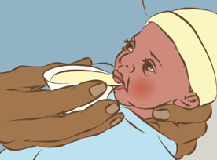
Feeding Expressed Breast Milk
in MTN-043/B-PROTECTED
When you express breast milk for the B-PROTECTED study, you may have milk left over that can either be discarded (poured down the drain) or returned to you for feeding to your baby. If you choose to have the milk returned to you, follow the instructions below for the safe storage and feeding of expressed milk.
Storing Expressed Milk
Expressed milk should be stored in a clean glass, plastic, or metal container and covered, if not being fed to the baby right away. Expressed milk should be fed to the baby within the specified time periods or discarded.
Room temperature (25° or colder) | Up to 4 hours
Refrigerator (4° or colder) | Up to 4 days
If milk is leftover after a feeding, it can be offered again to the baby any time within the next two hours.
Feeding Expressed Milk
Cup Feeding Technique
The easiest way to provide expressed milk to your baby is by cup feeding. Cup feeding does not require any special equipment and should not impact your ability to continue breastfeeding. Direct feeding at the breast should continue whenever possible.
Feed according to your baby’s cues. The baby should be awake and alert. When done properly, the baby should not cough or choke when feeding and should be able to stop when full.
Place a small amount of milk in a clean cup or spoon
Position baby semi-upright.
Rest cup lightly on baby’s lower lip, touching the outer, upper lip.
Tip the cup so milk reaches the baby’s lips.
Allow the baby to lick the milk (do not pour milk into the mouth).
Allow the baby to take small amounts until the baby closes mouth and no longer appears interested. This may take up to 30 minutes.
Burp the baby after feeding.
Questions or Concerns
The study staff is here to help and support you. If you have any questions about storing or feeding expressed breast milk, contact [INSERT SITE SPECIFIC CONTACT INFO]
MTN-043 Feeding Expressed Breast Milk, English, Version 1.0, 18NOV2019 Page 1 of 1

