Slide 1

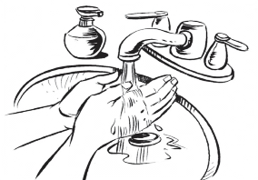
Oral Truvada
Use Instructions
1
Wash your hands with soap and dry them on a clean cloth.
2
Open the bottle by pressing down on the cap while turning to the left.
3
The first time the bottle is opened, there will be a seal covering the bottle. If the seal is broken or missing, do not use the pills and contact study staff for a replacement.
Remove and discard this seal.
4
There is a small sealed bag (SORB-IT® CAN) inside the bottle that helps keep the pills dry.
Do not open, swallow, or remove this bag from the bottle.
5
Remove one pill from the bottle when taking one pill each day.
6
After removing the pill, close the bottle tightly by replacing the cap and turning it to the right.
7
Put one pill in your mouth and swallow it with water or other non-alcoholic beverage.
See “Tips for Taking Oral Truvada” for easy methods to swallow pills.
MTN-043 Oral Truvada Use Instructions, English, Version 1.0, 30SEP2019 Page 1 of 3

Slide 2

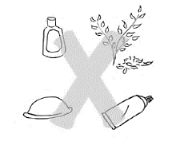

Oral Truvada
Important Information
TRUVADA pill IMPORTANT INFORMATION
If the ring falls or is taken out:
Take One pill Each Day. Every Day
To make it easier to remember to take the pill once a day, try taking it around the same time each day (for example, when you go to sleep at night or brush your teeth).
If you forget and your next pill is not due in the next 6 hours, take the missed pill as soon as you remember and the next dose at its regular time. If you forget and your next pill is due within 6 hours, skip the missed pill.
Do Not Share
Take Whole
Pill by Mouth
Only take the pills provided to you and do not share them with anyone else.
The pill should not be chewed or split in half.
Take pill with water or other non-alcoholic drink. It can be taken with or without a meal.
Do not use vaginal products (spermicides, lubricants, douches, or medications).
Do not take non-study PrEP during the study.
What to Avoid
24 hours before study visit, do not:
Insert vaginal objects (tampons, female condoms, sex toys, etc.)
Engage in receptive sex (vaginal or anal), receptive oral sex or finger stimulation.
These practices may impact testing of samples collected during your visit.
Talk to study staff before using any medications.
How to Store
Do not remove labels from bottle.
Keep pills in a safe place and out of reach of children.
Store at room temperature.
Keep pills in tightly closed container. Talk to study staff about how to properly store and carry pills.
Questions or Concerns
The study staff is here to help and support you. If you think you are experiencing side effects or have questions or concerns, please contact us between visits. {INSERT SITE SPECIFIC CONTACT INFO]
MTN-043 Oral Truvada Use Instructions, English, Version 1.0, 30SEP2019 Page 2 of 3

Slide 3
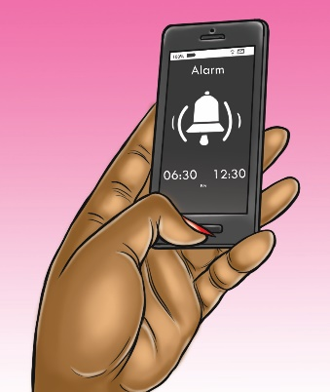
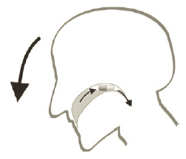
Tips for Taking
Oral Truvada
TIPS FR TAKING pillS
If the ring falls or is taken out:
Ways to Remember To Take pills
Set a recurring reminder or alarm. For example on your mobile phone, calendar or alarm clock.
Tie the time you take your pill with a daily activity such as breakfast, brushing your teeth, or going to sleep at night.
Have a responsible, trusted family member or friend remind you.
Keep your pill bottle in an easy to spot place such as your bed stand or bathroom (be sure to consider safety and discretion if necessary).
Easy Methods for Taking Large pills
Lean-Forward Method:
Put the pill on your tongue.
Take a medium sip of water, but do not swallow yet.
Bend your head forward by tilting your chin slightly toward your chest
Swallow the pill and the water with your head bent forward
Pop-Bottle Method:
Fill a plastic water bottle with water.
Put pill on your tongue and close your lips tightly around the opening of the bottle.
Take a drink from the bottle, by keeping your lips on the bottle and using a sucking motion. Swallow the water and the pill together, right away.
Don’t let air get into the bottle as you swallow. You should feel the bottle squeeze in on itself as you swallow.
Schiele JT, Schneider H, Quinzler R, Reich G, Haefeli WE. Two Techniques to Make Swallowing Pills Easier. Annals of Family Medicine. 2014;12(6):550-552.
MTN-043 Oral Truvada Use Instructions, English, Version 1.0, 30SEP2019 Page 3 of 3

