Slide 1
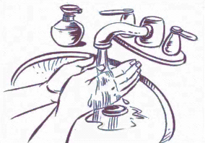
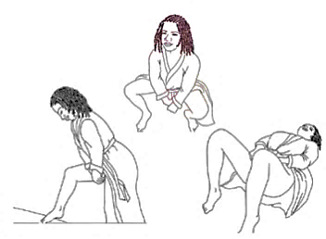
Vaginal Ring
Insertion Instructions
1
Wash your hands with soap and dry them on a clean cloth.
2
Get in the position that is most comfortable for you to insert the ring, for example lying down, squatting or standing with one leg raised on a surface.
3
Hold and press the sides of the ring together. You may find it easier to insert the ring if you twist it into the shape of the number ‘8’.
4
Use your other hand to hold open the folds of skin around your vagina.
5
Place the tip of the ring in the vaginal opening and then use your finger to push the folded ring gently into your vagina.
6
Push it up towards your lower back as far as you can. If the ring feels uncomfortable, it is probably not inserted far enough into your vagina. Use your finger to push the ring as far up into your vagina as comfortable.
7
The ring should now be in your upper vagina. Wash your hands when you are done. If you have trouble, contact the clinic or come in for assistance.
MTN-043 Vaginal Ring Use Instructions, English, Version 1.0, 30SEP2019 Page 1 of 3

Slide 2
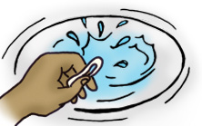
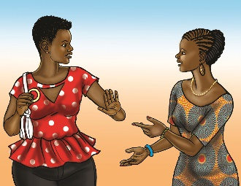
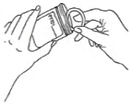
Vaginal Ring
Important Information
Leave Inserted All The Time
When to Replace
The ring should be kept inserted at all times including during menses, bathing and sex, unless instructed otherwise by a care provider or study staff.
The ring should be replaced every 4 weeks for the duration of your study participation.
If the Ring Falls or is Taken Out
Somewhere clean: Try reinserting the ring as soon as possible. Rinse the ring in clean water and follow the insertion instructions on the other side of this document. If you cannot reinsert it right away, place the ring in the bag provided to you.
Somewhere dirty (such as the toilet or the ground): Do NOT reinsert the ring. Instead, place it in the bag provided to you and contact the clinic as soon as possible.
Do Not Share
What to Avoid
Insert only the ring provided to you and do not share your ring with anyone else.
Other than the ring, using any vaginal products is not allowed. (spermicides, lubricants, douches, or medications).
Do not take other PrEP medications during study.
24 hours before study visits, do not:
Insert vaginal objects (tampons, female condoms, sex toys, etc.)
Engage in receptive sex (vaginal or anal), receptive oral sex or finger stimulation.
These practices may impact testing of samples collected during your visit.
Talk to study staff before using any medications.
Returning Your Ring
You should return to the clinic with the ring still inserted.
Bring back to the clinic any ring your are no longer using by storing it in the bag provided to you and keeping it with you at all times to avoid loss.
Questions or Concerns
The study staff is here to help and support you If you think you are experiencing side effects or have questions or concerns, please contact us between visits [INSERT SITE SPECIFIC CONTACT INFO]
MTN-043 Vaginal Ring Use Instructions, English, Version 1.0, 30SEP2019 Page 2 of 3

Slide 3
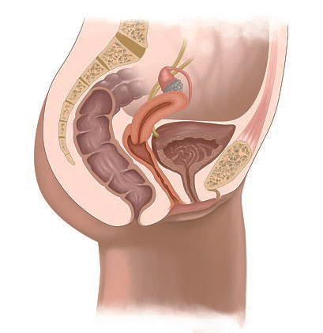
Female Anatomy
BACK
Ovary
FRONT
Uterus
Cervix
Ring
Bladder
Urethra
Vagina
Anus
Key Anatomy of a Women
Uterus (womb): pear-shaped organ located in the middle of the pelvis. Where a fetus grows during pregnancy.
Vagina: tube that connects the external opening at the base of your pelvis with your cervix and provides and opening for menstrual blood or babies to pass through. Some people put penises, fingers, sex toys, medications, and/or tampons in the vagina as well.
Cervix: located between the vagina and uterus, your cervix separates your vagina from the rest of your body, so things like tampons or the vaginal ring can’t get “lost” inside of you. The cervix helps hold the baby inside of you during pregnancy and opens during labor to let the baby pass through.
Ovaries: about the size of a walnut. You have two of them, which are attached to the uterus and store your eggs. Every female is born with thousands of eggs in her ovaries.
Bladder: about the size of a pear when empty. Where urine is stored before urination.
Urethra: the tube through which urine passes to exit the body. Your urethra is close to your vaginal opening.
Anus: The opening behind the vaginal opening where feces/waste exits the body. Also where a penis goes during receptive anal sex. The ring does not protect against HIV if you are exposed during anal sex.
Where the Ring Sits Inside of a Woman
The ring sits at the top of the vagina, right below the opening to the cervix. The ring does not enter the uterus and cannot get lost inside the body.
MTN-043 Vaginal Ring Use Instructions, English, Version 1.0, 30SEP2019 Page 3 of 3

