Slide 1
Female Anatomy, Reproduction, and Hygiene
MTN-34 (REACH), V1.0, 21 Feb 2018
Notes:
Females are born with a complex system of organs and body parts located in the pelvic area of their body. Each part serves an important purpose when involved in a women’s reproductive functions including vaginal sex, menstruation, and pregnancy.
A healthy understanding of one’s own anatomy will go a long way in improving your life. The next few slides will help to deepen your knowledge of the female reproductive system.
A young women's reproductive system is complex but important to understand. It is important to take steps to protect it from infections and injury, and prevent problems. Taking care of yourself and making healthy choices can help protect you and your loved ones. Protecting your reproductive system also means having control of your health!
Good genital hygiene should be part of a daily routine of respecting and caring for your body so that it can continue helping you feel your best.

Slide 2
Outline:
Staying healthy
Anatomy
Identifying problems
Menstrual cycle
Ring use 101
Notes:
During this presentation, we will review the basics of how the female anatomy is structured (where the vagina and cervix are, the purpose of these organs,)
We will then talk about some common problems that females may experience in their genital area and ways to maintain good health and hygiene. Then we will explain the mysterious, not so fun time of the month for women – the menstrual cycle. Lastly, we will discuss how the ring and your body interact.

Slide 3
Anatomy Overview:
Internal and External
Notes:
In the next two slides we take an inside look at the internal and external anatomy of what the female reproductive system and understand how each organ works together.
Site staff are recommended to review these slides along with visually displaying the pelvic model.

Slide 4
Getting to know your body
Internal
Notes:
The vagina is a tube that connects your vulva (external opening at the base of your pelvis) with your cervix and uterus. It’s what babies and menstrual blood leave the body through. It’s also where some people put penises, fingers, sex toys, menstrual cups, and/or tampons. This is also were the Ring sits.
The uterus is a pear-shaped organ located in the middle of the pelvis, behind the bladder, and in front of the rectum. It’s sometimes called the womb because it’s where a fetus grows during pregnancy.
The cervix separates your vagina and uterus, located right between the two. It can be seen during a pelvic examination. It looks like a donut with a tiny hole in the middle. You can usually feel your cervix at the end of your vagina if you insert your fingers into your vagina. Your cervix separates your vagina from the rest of your body, so things like tampons or the vaginal ring can’t get “lost” inside of you.
Sperm can enter and menstrual blood can exit the uterus through the cervix (cervical canal). Although the cervix is usually a good barrier, bacteria that cause sexually transmitted diseases can also potentially enter the uterus through the cervix during sex.
Ovaries are pearl-colored, oblong, and about the size of a walnut. You have two of them, which are attached to the uterus and store your eggs. Every female is born with thousands of eggs in her ovaries; she will not produce any more during life. The eggs are so small that they cannot be seen by the naked eye. Beginning in puberty, your ovaries start to release an egg each month. They do so until much later in your life when you start menopause.
Fallopian tubes extend from the upper edges of the uterus to connect each ovary. They carry eggs from your ovaries to your uterus. Sperm travels through them from the uterus to try to fertilize your egg. A fertilized egg will travel out of the fallopian tube to the uterus to develop into a fetus.

Slide 5
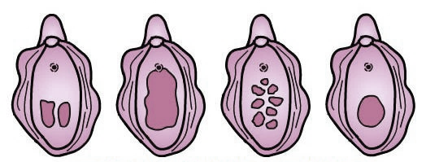
Getting to know your Body
Mons Pubis
Vulva
Hymen
External
(Vulva)
Vulvas with various hymens shapes
Notes:
The vagina is the canal that forms the passageway from the uterus to the outside of the body. Menstrual fluid flows out of the body through the vagina, and it is also where a woman inserts the dapivirine ring.
The female external genital organs include the mons pubis, labia majora, labia minora, and clitoris. The area containing these organs is called the vulva. It is important to remember that everyone’s external genitalia is unique. The size and shape of each organ varies from person to person, and all of the differences are normal!
The external genital organs have three main functions:
Enabling sperm to enter the body
Protecting the internal genital organs from infectious organisms
Providing sexual pleasure
The mons pubis is a rounded mound of fatty tissue that covers the pubic bone. During puberty, it becomes covered with hair.
The labia (lips) are folds of skin around your vaginal opening. The labia majora (outer lips) are usually fleshy and covered with pubic hair. The labia minora (inner lips) are inside your outer lips.
The opening to the vagina is called the introitus. The vaginal opening is the entryway for the penis during sexual intercourse and the exit for blood during menstruation
The opening to the urethra, which carries urine from the bladder to the outside, is located above and in front of the vaginal opening.
The clitoris is a small protrusion that corresponds to the penis in the male. The tip of the clitoris (clitoris glans) is located at the top of your vulva, where your labia minora (inner lips) meet. The tip is just the beginning of the clitoris though. The rest of your clitoris is inside your body. It extends back and down on both sides of the vagina. Your clitoris is made of spongy tissue that becomes swollen when you're aroused (turned on). It has thousands of nerve endings and its only purpose is to make you feel good. ☺
The hymen is located just inside the opening of the vagina. The hymen helps protect the genital tract. The hymen usually encircles the opening like a tight ring, but it may completely cover the opening. It may tear during the early attempts at sexual intercourse, or it may be so soft and pliable that no tearing occurs. The hymen may also be torn during exercise or insertion of a tampon or diaphragm. Tearing usually causes slight bleeding. Once the hymen is torn, it may be unnoticeable or may form small tags of tissue around the vaginal opening.
The anus is the opening of the rectum through which stool passes out of your body.

Slide 6
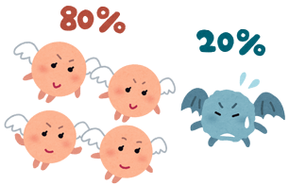
.
BACTERIA
Not all are bad!
More good bacteria
…and less bad bacteria
Notes:
Bacteria! There are lots of different bacteria in the vagina. These are "friendly" bacteria that normally live in our digestive, urinary, and genital systems without causing disease, and they even help keep bad or harmful bacteria from growing in our systems.
When the bacteria are in balance, the vagina is in a healthy state, but this can quickly change if the bacteria gets out of balance. Balanced bacteria inside the body can help to prevent infection from outside bacteria, yeast and viruses.

Slide 7
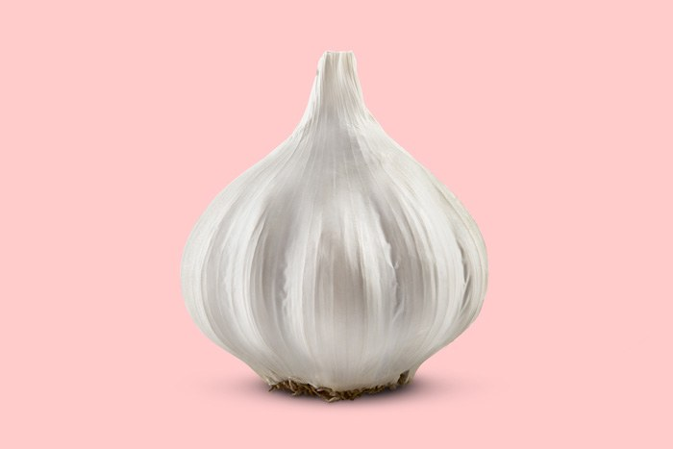
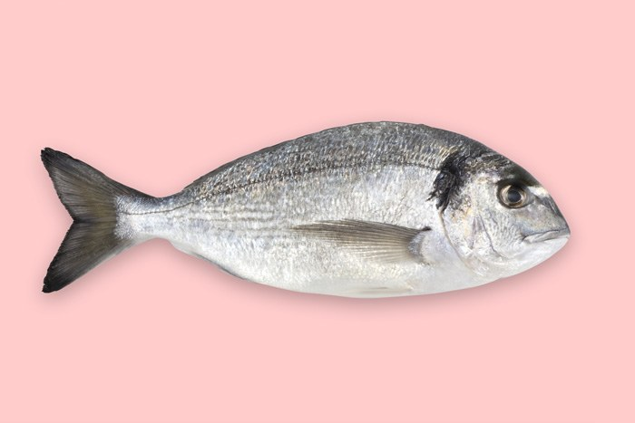
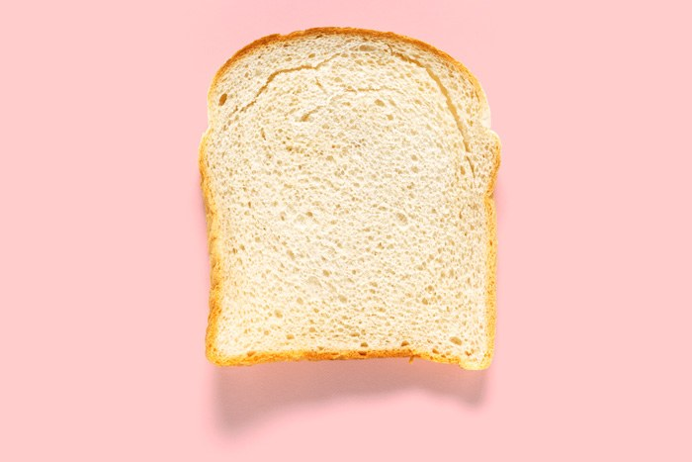
Warning signs that your vagina is unhealthy
Spotting
Itching, Burning
Odors
Notes:
When your vaginal is unhealthy, there are usually signs…
A constant itch or a burning sensation could by signs that a vaginal infection is beginning.
If you notice a strong odor (maybe a fishy smell), it could be a sign of an active infection.
If you experience bleeding between your menstrual period that is unexplained, it may be cause for concern. However, spotting can be normal for the first few months after staring a new type of hormonal contraceptive.
A period that lasts an unusually long time or if your menstrual bleeding is much lighter or heavier than normal may be signs that there is a problem.

Slide 8
Your Menstrual Period
Notes:
The amount of time between a girl's periods is called her menstrual cycle (the cycle is counted from the start of one period to the start of the next). Some girls will find that their menstrual cycle lasts 28 days, others might have a 24-day cycle, a 30-day cycle, or even longer.

Slide 9
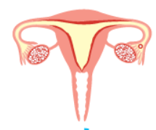
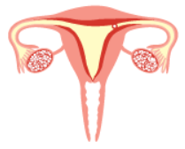
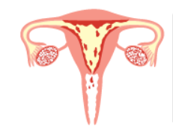
The Menstrual Cycle
Egg releasing (ovulation)
Egg traveling
Uterine lining shedding
Notes:
Menstruation (a period) can be confusing. A girl’s first menstruation is one of the many physical signs of puberty - that she is turning into a woman. Many girls don't have a complete understanding of a woman's reproductive system or what actually happens during the menstrual cycle.
About once a month, a tiny egg leaves one of the ovaries, a process called ovulation, and travels down one of the fallopian tubes toward the uterus. In the days before ovulation, the hormone estrogen stimulates the uterus to build up its lining with extra blood and tissue, making the walls of the uterus thick and cushioned. This happens to prepare the uterus for pregnancy: If the egg is fertilized by a sperm cell, it travels to the uterus and attaches to the cushiony wall of the uterus, where it slowly develops into a baby. Each egg has about a 24 hour time-window to be fertilized by a sperm, and sperm can survive up to six days in the fallopian tube waiting for an egg to fertilize.
If the egg isn't fertilized within two weeks— which is the case during most of a woman's monthly periods — it doesn't attach to the wall of the uterus. When this happens, the uterus sheds the extra tissue lining. The blood, tissue, and unfertilized egg leave the uterus, going through the vagina on the way out of the body. This is a menstrual period.

Slide 10
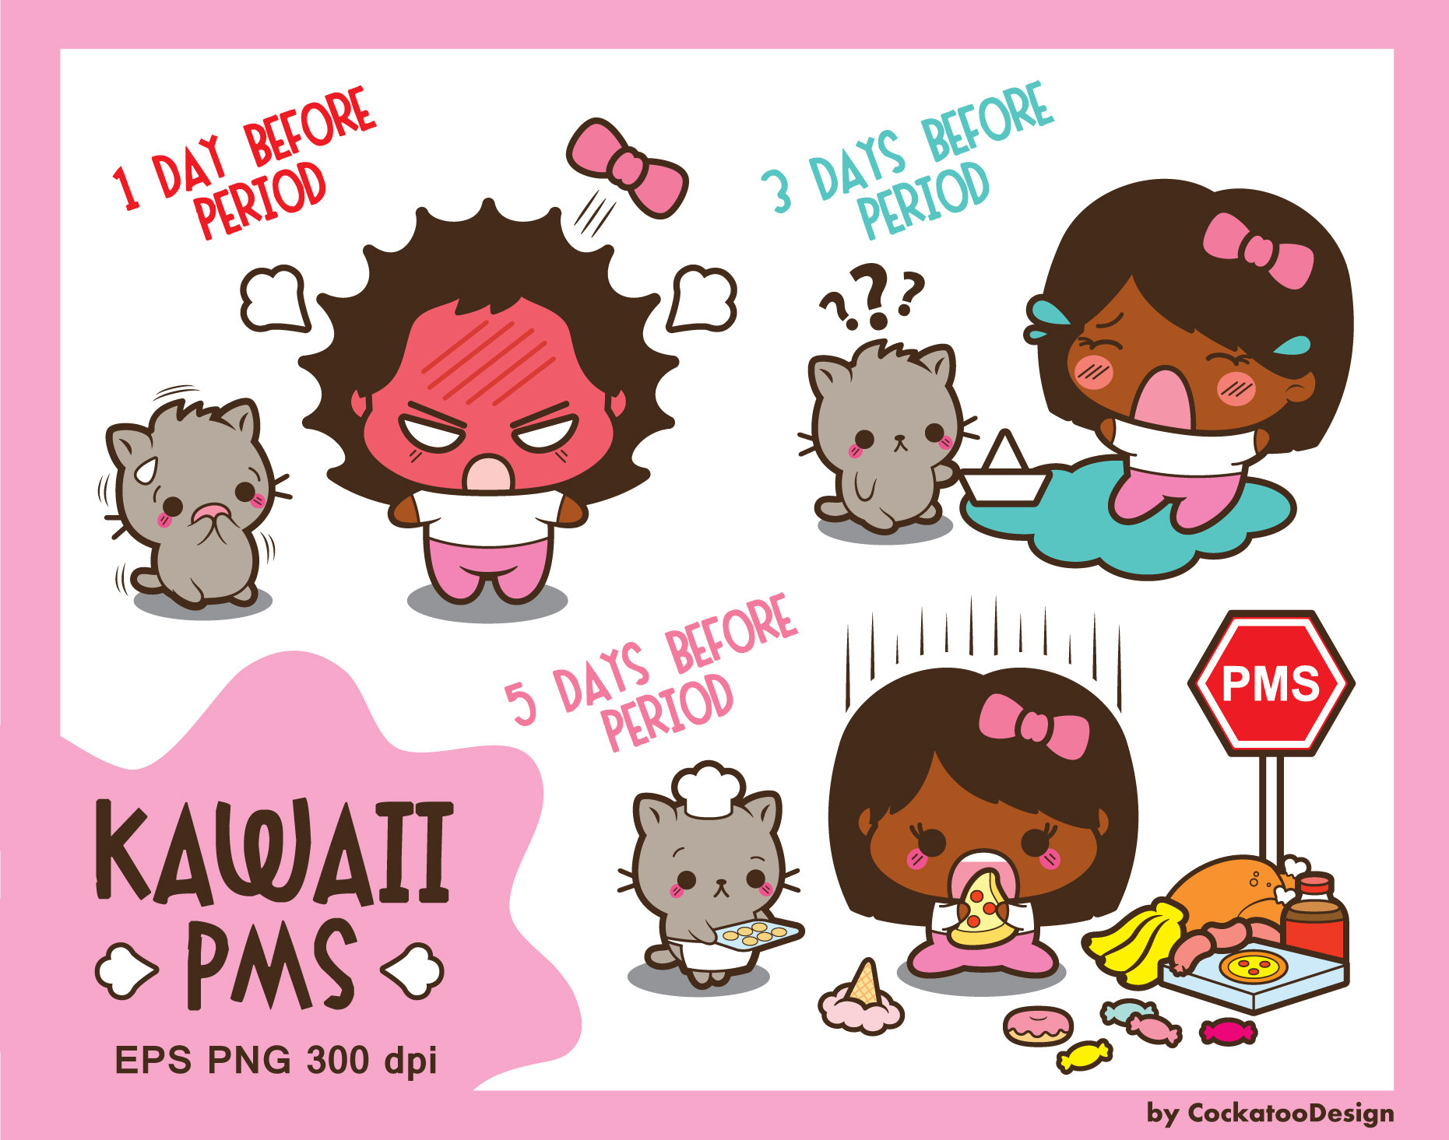
Those Crazy Hormones
Hormones changing =
PMS!
Notes:
Your body produces chemicals called hormones. They travel in your bloodstream to tissues or organs to help them do their jobs. They work slowly, over time, and affect many different processes, including growth, metabolism (how your body gets energy from food), mood, sexual function and reproduction. One of the many types of hormones your body produces are reproductive hormones. For example, the ovaries release two types of hormones – estrogen and progesterone. These hormones work together to signal your body to make physical changes that happen during puberty such as breast size, body hair, and the beginning of the menstrual cycle, and then continue to signal changes to your reproductive system during your menstrual cycle and pregnancy.
During your menstrual cycle, reproductive hormone levels rise and fall, which can affect your mood, energy, love life, sleep quality, food cravings and health. These hormone changes also cause many of the uncomfortable symptoms you have before or during your period such as cramps, mood swings, bloating in your stomach, acne, aching breasts, and headaches. Menstrual side-effects like these are usually normal. However, if they start to interfere with your regular life or you have symptoms like this at other times (unexplained), your hormones may be imbalanced which could be a signal that your body has a problem.
Many contraceptive methods, such as the pill, patch, implant, hormonal IUDs, and Depo, work by changing hormone levels in the body. These methods release alternative forms of reproductive hormones to change your body’s regular hormone levels throughout the menstrual cycle. Hormonal contraceptive methods can work in different ways. Some methods, like the pill, ring, or patch, prevent the ovaries from releasing eggs (ovulation) – whereas some, the hormonal IUD, implant, and depo, allow ovulation but make the uterine environment unfavorable for an egg to be fertilized. Changing your hormones with these contraceptive methods may seem unnatural, but they have all been well studied and proven safe and effective!

Slide 11
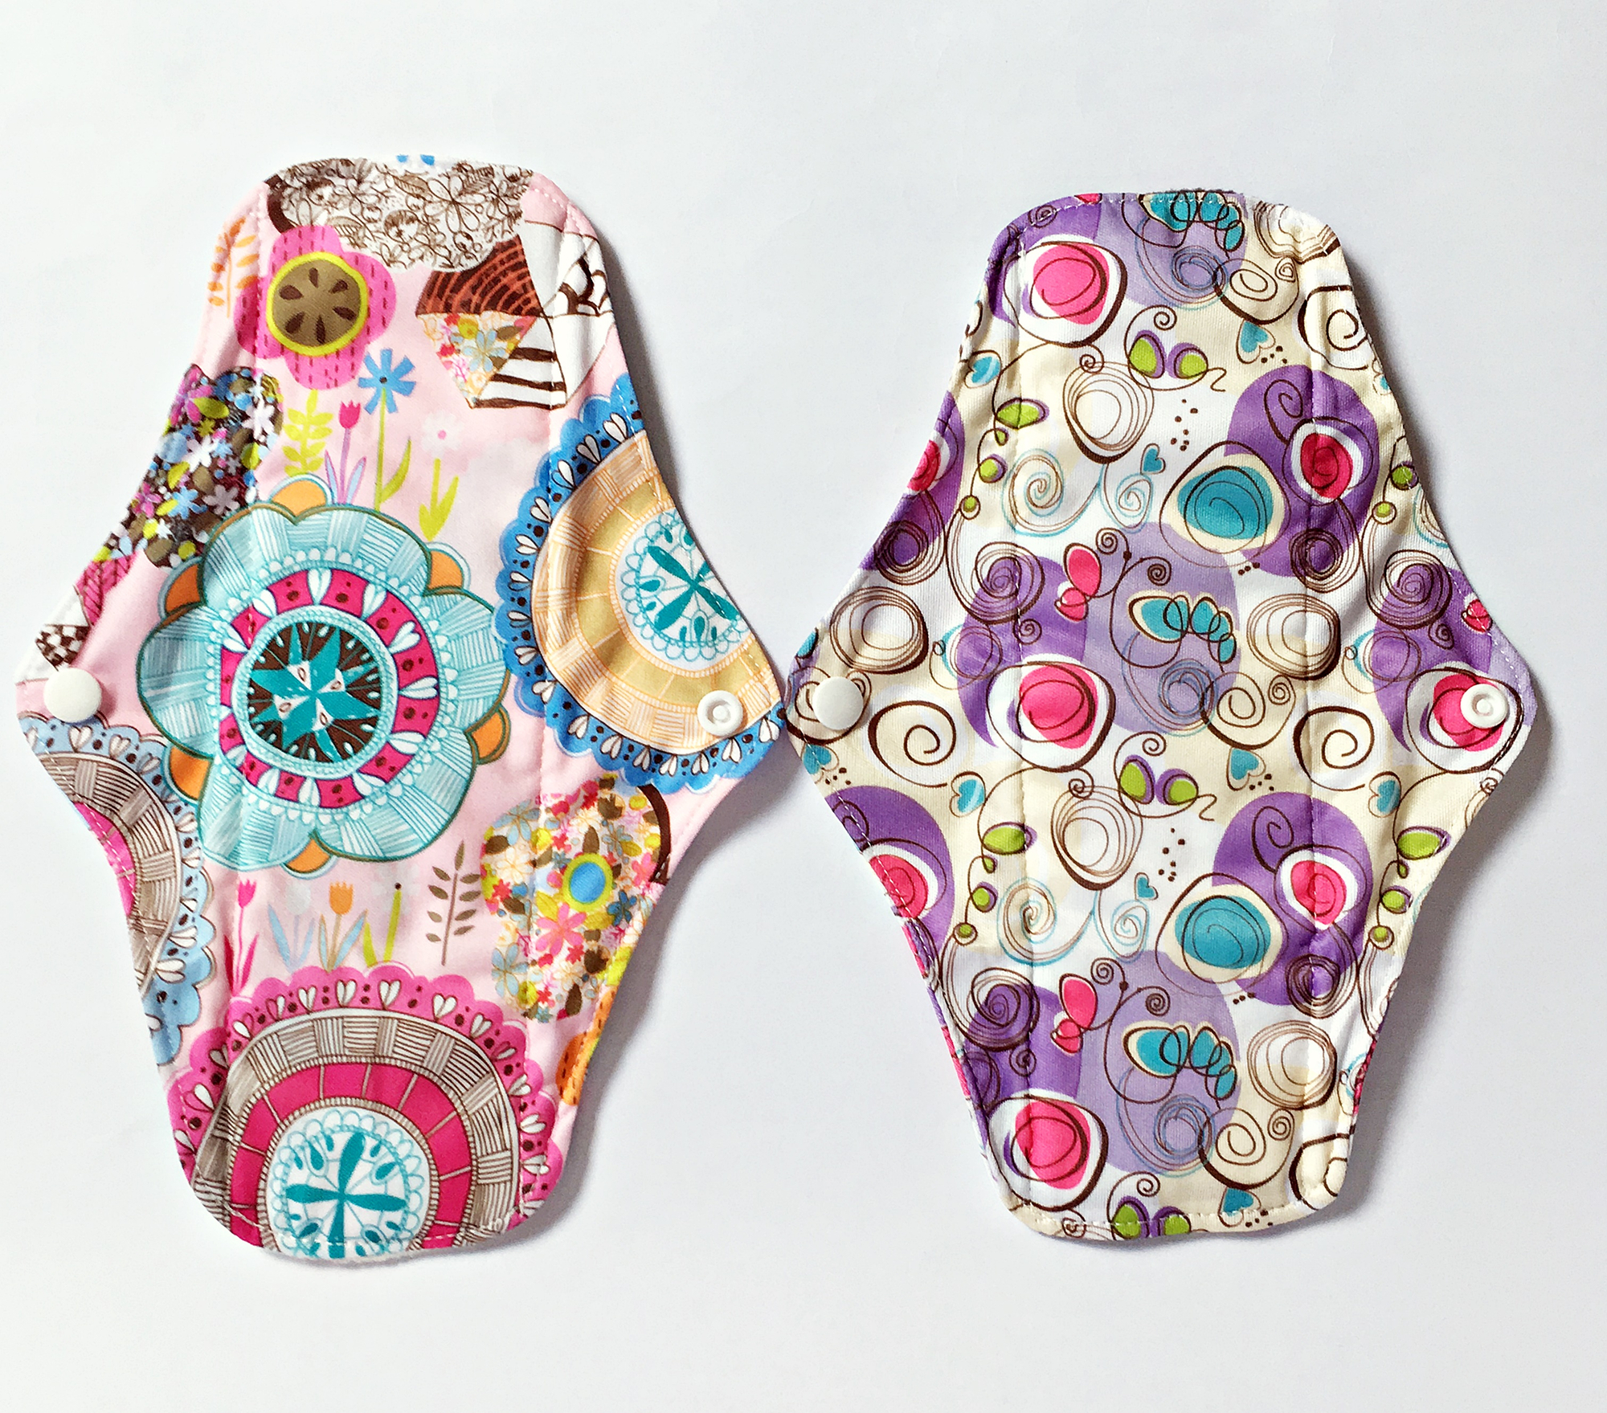
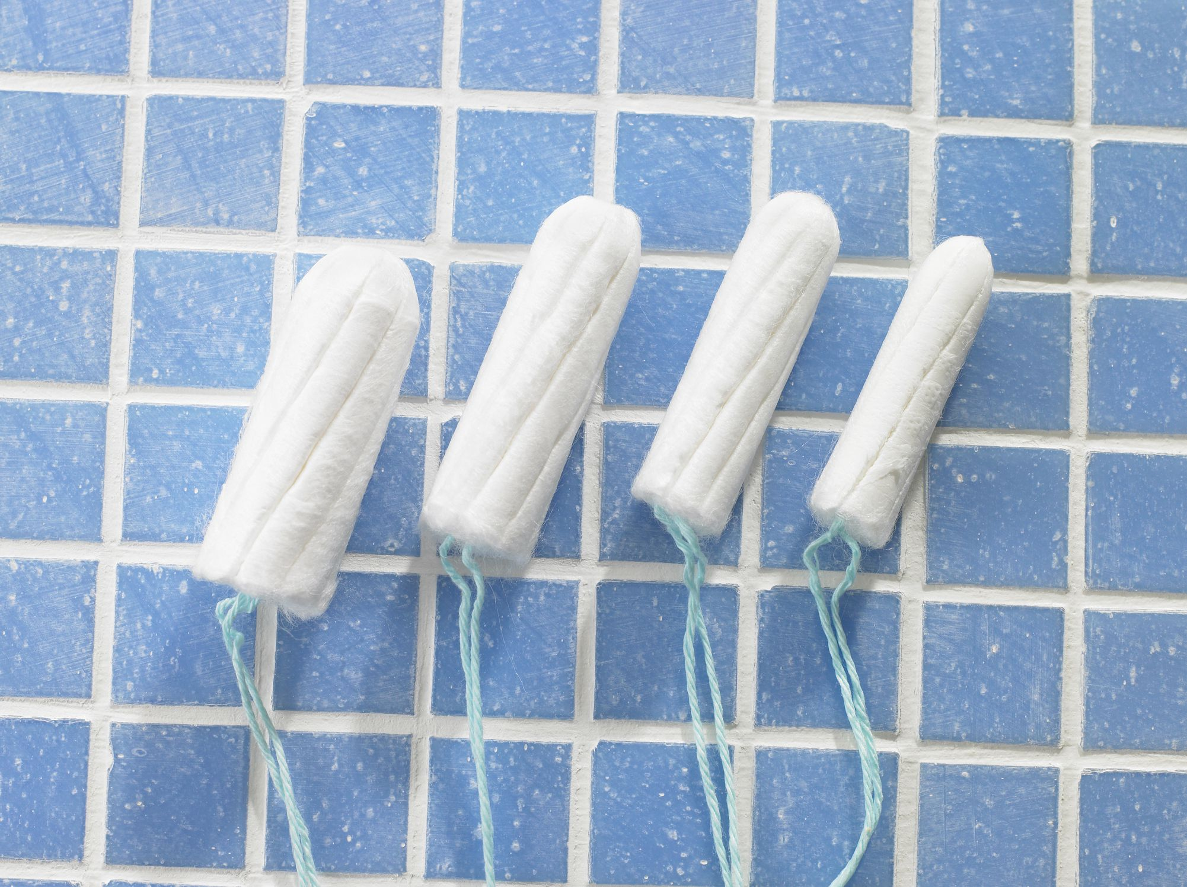
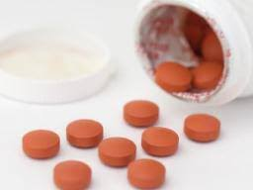
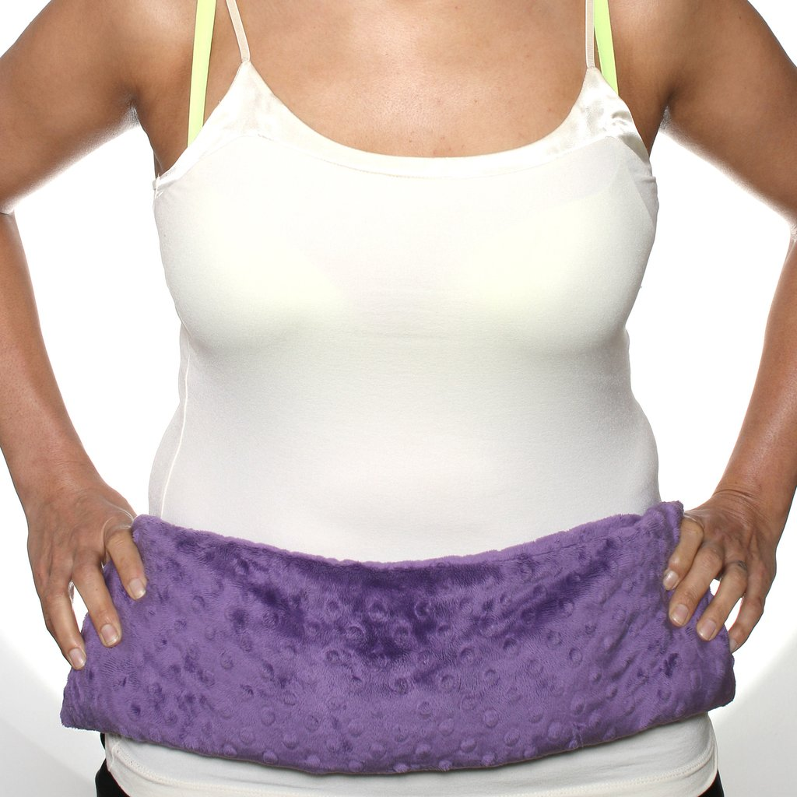
Absorbing menstrual fluid
Tools for Dealing with your Period
calming cramps
Notes:
Lots of girls notice body or mood changes around the time of their periods. Cramps are pretty common and can be dull or intense. Sometimes you can feel cramps in your back or belly area. Many women find that over-the-counter pain medicine (like acetaminophen or ibuprofen) can help cramps. So can taking a warm bath or putting a warm heating pad on the lower abdomen. Exercising regularly throughout the monthly cycle may help lessen cramps, too. Some women find that they feel easily irritated during the few days or week before their periods. Others may get angry more quickly than normal or cry more than usual. Some girls crave certain foods. These changes are called pre-menstrual syndrome (PMS).
Once you begin menstruating, you'll need to use something to absorb the blood. Many girls use a pad or a tampon; menstrual cups are another option. Which method you choose should be what works best for you!

Slide 12
Staying Healthy:
Tips on how to have a
Happy and Healthy vagina
Notes:
As we’ve just learned, the female reproductive system is very complex! It is important for your overall health to take good care of this delicate system.

Slide 13
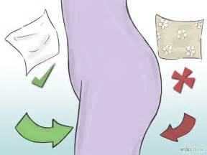
#1 Wipe from FRONT to BACK
Notes:
Usually, germs get into your system through your urethra, the tube that carries urine from your bladder to the outside of your body. The germs that usually cause these infections live in your large intestine and are found in your stool. Women have short urethras so it's easy for this bacteria (once inside) to make its way to the bladder, where it can multiply, damage tissue, and cause inflammation. If these germs get inside your urethra, they can travel up into your bladder and kidneys and cause an infection. This is a urinary tract infection (UTI), which can be painful and require antibiotics.
Wiping from front to back reduces the chance that the bad bacteria from your stool will get inside your urethra and cause a urinary tract infection.

Slide 14
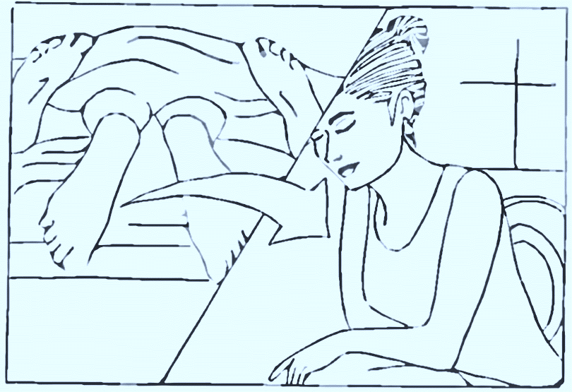
#2 Urinate AFTER sex
Notes:
When you have intercourse, that penetration allows some bacteria from your stool to get closer to the urethra. Peeing right after sex can help prevent the spread of bacteria into the urethra and from the urethra to the bladder.

Slide 15
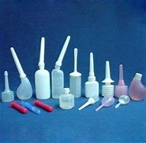
#3 Do not Douche and AVOID Feminine Sprays!
Notes:
The vagina is designed to take care of itself. This means that interfering with the natural cleansing process is likely to cause a problem.
There are many reasons a girl or young woman may decide to douche. Common reasons people give for using douches include:
to clean the vagina
to rinse away blood after monthly periods
to get rid of odors from the vagina
In reality, douching may do more harm than good. Douching removes the healthy bacteria in the vagina that you need to help prevent an infection. Feminine sprays can also lead to irritation and potentially an allergic reaction. Douching may kill smelly bacteria, but it kills the “friendly” bacteria too!

Slide 16
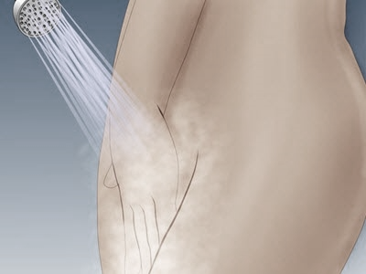
#4 Use WATER and/or a mild cleanser to clean Externally
Notes:
Always bathe regularly, especially when you are on your period.
Use water or gentle soaps to clean the outside of your pelvic area only. Do not try to clean internally!

Slide 17
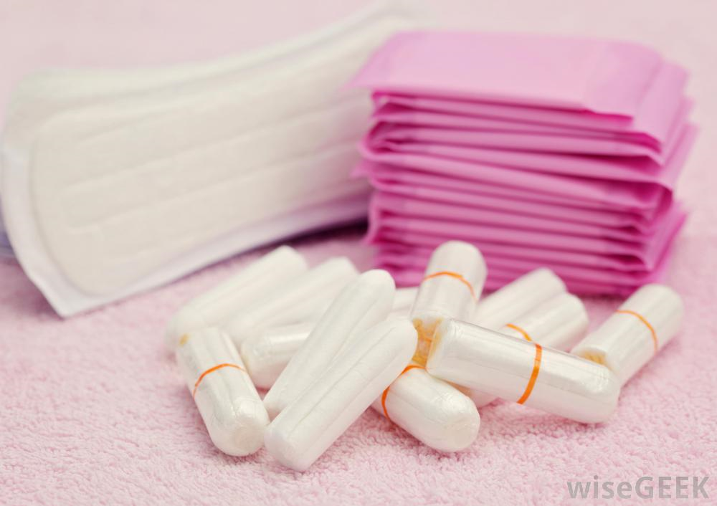
#5 Keep your genital area DRY and CLEAN
Notes:
Your vagina should stay clean and dry — and what you wear can affect that. Certain types of clothing/fabrics can create warm, moist places where bad bacteria like to grow.
Wear loose fitting clothes and underwear that is breathable, preferably underwear made from cotton.
Sanitary pads and tampons should be changed regularly during your period. Avoid wearing tampons or sanitary pads for extended periods of time. Using these too long can lead to a build up of bacteria which can cause irritation and infection. Be sure to change them every few hours to keep your genital area clean.

Slide 18
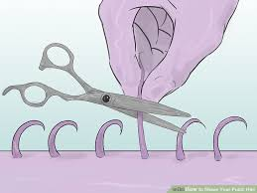
#6 Be WARY of shaving
Notes:
Bacteria lives ON the skin. Your pubic hair provides a cushion against friction that can cause skin abrasion. Pubic hair also prevents dirt and floating germs from entering the vagina.
Shaving causes tiny breaks in the skin, allowing the bacteria to enter BELOW the skin and cause an infection.
It is better to trim pubic hair, rather than shave, if it seems bothersome.

Slide 19
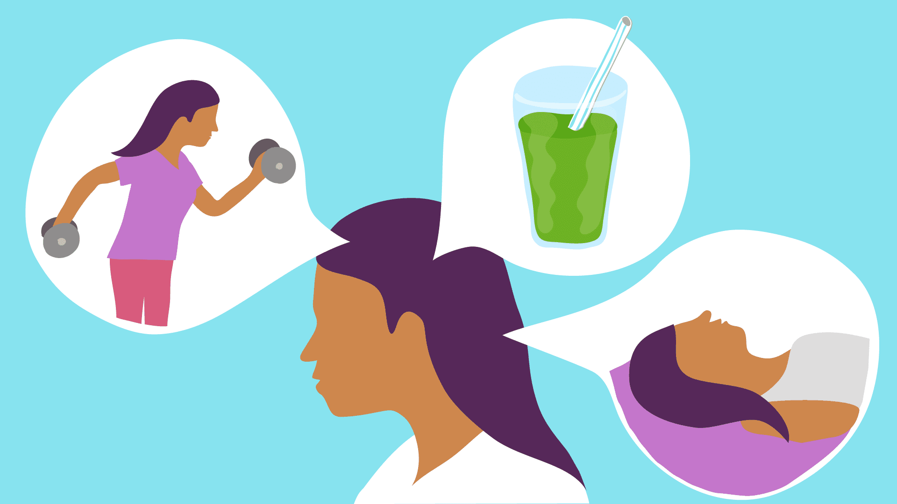
#7 Practice good overall health
Sleep
Excercise
Diet
Lifestyle
Notes:
Reproductive health is directly linked to your overall health, meaning it is affected by your diet, lifestyle, medical conditions, environmental exposures and many more. Good reproductive health will keep you fertile, regulate your periods, and fight off STIs and diseases.
Try the best you can to
Eat right, Exercise , Maintain a healthy weight, Get enough sleep – under/over weight and stress can impact your hormone balance and menstrual cycle
Avoid smoking and alcohol, and recreational drugs – these can also impact your hormones and alter organ function

Slide 20
Ring Use
101
Notes:
In the next few slides, we discuss some common questions and concerns, young women may have when it comes to using a vaginal ring and how it may or may not affect their everyday lives and activities.

Slide 21
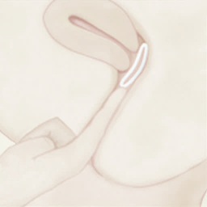
Inserting the Ring
Inserting the ring does not require lubrication
The lubrication may interfere with the medication on the ring so it is not advised
If needed, wetting the ring with water is safe

Slide 22
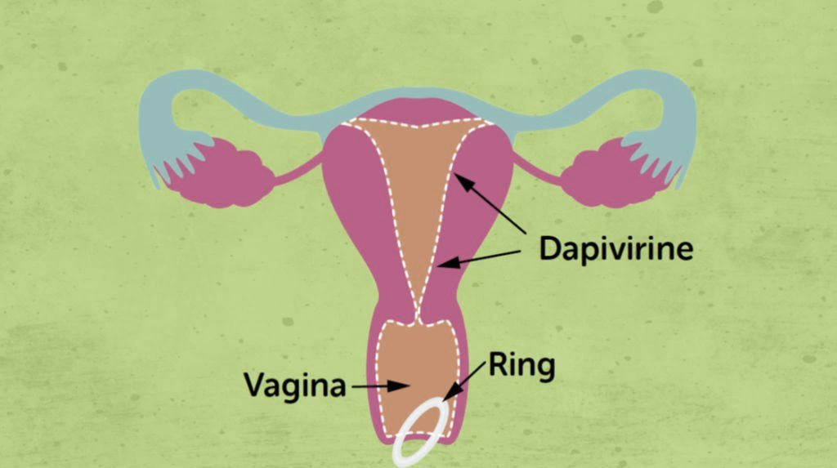
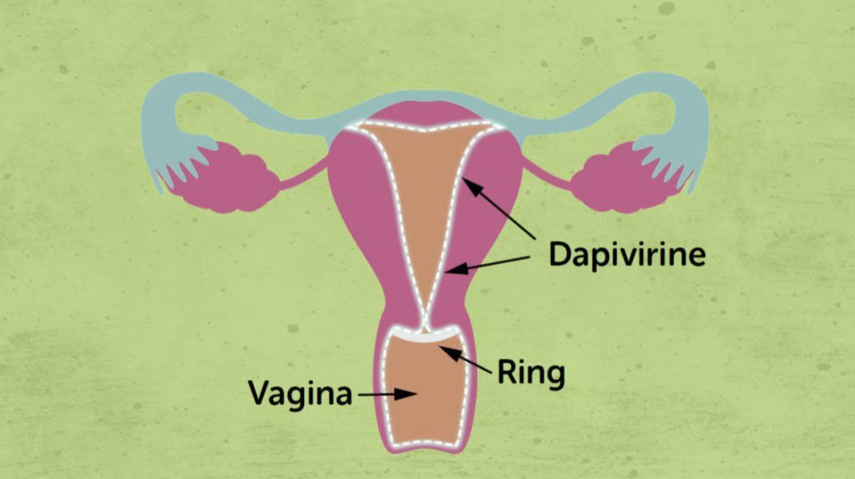
Location of the RING
Will my partner feel the ring?
Will the ring fall out the vagina?
Notes:
The ring sits along the vaginal wall.
The front part of the ring sits under a bone and the back part rests behind the cervix
Some young women want to know if their partner will feel the ring. Some partners are aware of the ring, but sex should not be painful for either the man or the woman.
Studies have found that the ring DOES NOT CAUSE a problem for the male partner
Another question young women ask is: will the ring fall out the vagina? The vagina is normally not open. The vaginal wall and muscles at the opening of the vagina keep the ring in place. In some ways, the vagina is like a sock – it is closed when it’s at rest and not being used, but can open to allow something to go in it – like the ring. In very rare instances, the ring can slip out. This is not common, but may happen during exercise or a bowel movement. If women are worried that the ring has slipped out, they can always use their finger to check that it is still inserted. If the ring falls out in a clean place, it should be rinsed in clean water and may be reinserted. If the ring falls out into a dirty place, like a latrine, it should be replaced with a new ring.

Slide 23
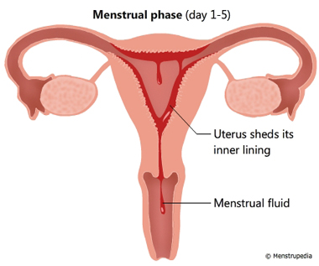
The RING and MENSES
Ring
The ring does not effect your menses
Notes:
The ring does not contain hormones and will not interfere with the timing or the heaviness of your menstrual cycle.
The ring does not block blood from coming out of the vagina
The vagina is like a tube, and blood comes down the vagina around and though the ring

Slide 24
The RING and your HEALTH
The Ring…
Is safe for the partners of women who use it
Does not cause cancer or increase your risk for cancer
Has been proven safe for your health
Does not cause infertility or impact your ability to have children

Slide 25
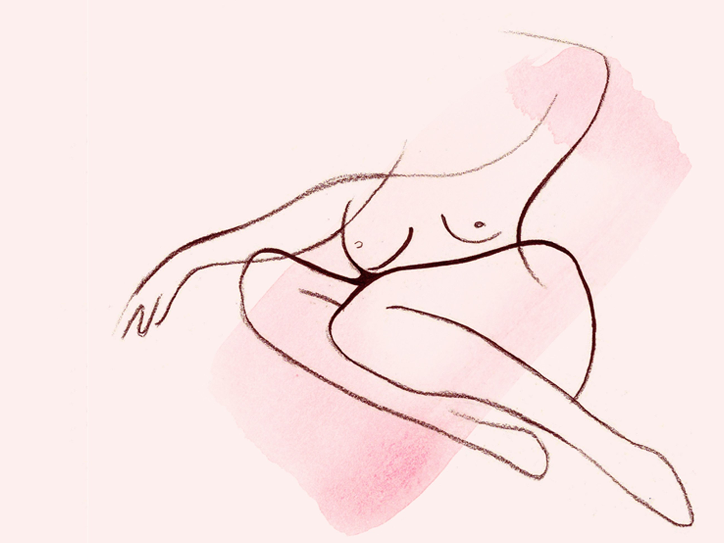
Love your Body
Questions?
Notes:
Remember, a young women's reproductive system is complex but important to understand. It is important to take steps to protect it from infections and injury, and prevent problems. Taking care of yourself and making healthy choices can help protect you and your loved ones. Protecting your reproductive system also means having control of your health!
Good genital hygiene should be part of a daily routine of respecting and caring for your body so that it can continue helping you feel your best.
Any questions?

